Slide 1
Our first lecture on Attitude

Slide 2
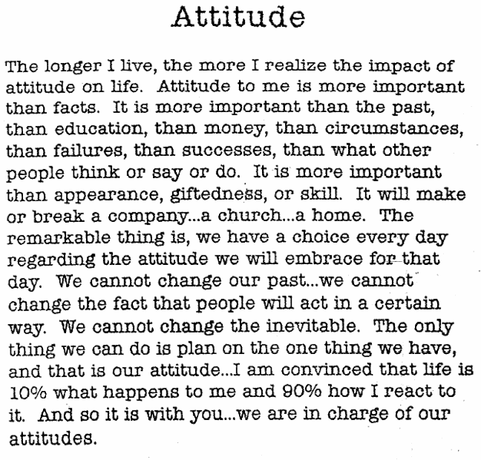
… Lou Tice of the Pacific Institute

Slide 3
Why do we choose the jobs that we do?
This might be a great essay question

Slide 4
Technical ability is not enough
Teamwork
Coping / Burnout / Self worth
Modeling the problem space: perceptions, experience, prejudices, loyalties, preconceptions, optimism

Slide 5
Personality Traits and Attitude
Are these good or bad?
Humility vs. Self Assurance
Independence vs. Team-centric
Creative vs. Disciplined
Pessimistic vs. Optimistic
These are good:
Moderation in all things (especially those above)
Honesty combined with diplomacy
Responsibility
Personal Hygiene

Slide 6
So let’s look at some personality traits & attitudes:
Eclecticism vs. Dogma
Flexibility
Being Comfortable with Uncertainty & Errors

Slide 7
Eclecticism
Pronunciation: e-'klek-tik
1 : selecting what appears to be best in various doctrines, methods, or styles
2 : composed of elements drawn from various sources;

Slide 8
Dogma
Pronunciation: 'dog-m&, 'däg- 1 : something held as an established opinion; especially : a definite authoritative tenet
2 : a code of such tenets <pedagogical dogma>
3 : a point of view or tenet put forth as authoritative without adequate grounds

Slide 9
get a sense of perspective
Go-to’s, pointers, and issues of clarity
Go-tos are not to be “avoided at all costs”. It is, instead, serpentine code that needs to be avoided.
Simplicity and clarity should override most other design decisions.
A go-to, in particular, is a powerful tool when used as a direct, no-nonsense jump under well-stated conditions, and can very closely follow problem-space behavior if used with some planning and forethought. Most languages include a go-to keyword.
... published coding standards

Slide 10
Emotional Wars
Coding Standards
Bracket Placement
Variable Names / Naming Conventions
Indentation
OO vs. non-OO (you can, but should you?)
Differences between what you can do and what you should do (multi-platform? configurability? mobile site vs. app?)
Design Patterns vs. Design
Documentation Standards

Slide 11
Coding Standards
https://users.ece.cmu.edu/~eno/coding/CppCodingStandard.html

Slide 12
A Real Coding Standards Defense
The Emotional Topic of Coding Standards
Please be patient with these coding standards until they become natural... it is only then that an honest opinion as to correctness or utility can be formed. They need not impede the feeling of craftsmanship that comes with writing software. Consider the common good. Embrace the decisions of the group.
A Limited Lifetime Warranty
The spirit of this document, not it’s rules, should dictate the place of standards and consistency within and across projects.
I Never Learned This in School… Is This a Joke?
You have to use some style, why not be consistent across the project?
Individual styles are not best just because they’re individual.
Individual styles are learned in a non-business environment (school?).
Any style becomes natural after 100,000 lines.
Syntax-based editors can be configured to do the mundane tasks

Slide 13
OO, Java, Design Patterns, XP
Object Oriented Java supplemented by Design Patterns in an Extreme Programming methodology is currently thought to be the quickest way to develop high quality code, on a large scale, in a team and business environment. It represents the greatest advances in computer language use since high level languages were invented. However:

Slide 14
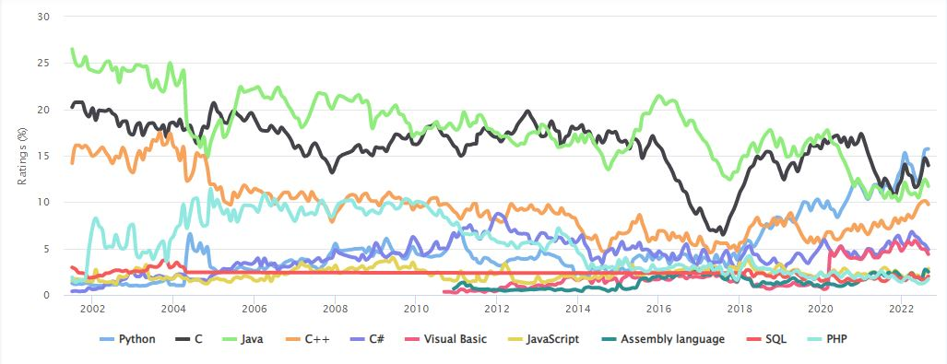
Sometimes you can’t:

Slide 15
Applications where you have to be flexible and adapt
Legacy Systems – 80%-90% of all SW work
Digital Signal Processing
Mobile Devices – phones, mp3, etc
Vendor-native (Windows Mobile, PalmOS, VxWorks)
Games
Databases - SQL
Industrial Control – PLCs -
Embedded Devices – auto computers, etc.

Slide 16
Learn…
Visual Basic / Delphi / LabView
"visual" languages
C
ASP.Net
SQL
Python, PHP, Ruby, anything....
the ability to learn new languages and environments

Slide 17
Be Comfortable With Uncertainty
We were reminded that software engineering was not about right and wrong but only better and worse, solutions that solved some problems while ignoring or exacerbating others. That the machine that all the world seems to see as possessing some supreme power and intelligence was indeed intelligent, but only as we humans are: full of hedge and error, brilliance and backtrack and compromise.
Ellen Ullman

Slide 18
your resume
Skills: software development, requirements specification, incremental methods, software project management, testing.
Programming experience: Java, C++, Visual Basic, many more. Most structured, object oriented, and visual languages. Event- and error-driven programming. Embedded systems.

Slide 19
Quotes
Writing the first 90 percent of a computer program takes 90 percent of the time. The remaining ten percent also takes 90 percent of the time and the final touches also take 90 percent of the time. ~N.J. Rubenking

Slide 20
The problem with the Dream Curve
Historically, we have relied mostly on the waterfall method: building large systems in a single large effort, throwing the switch, and hoping that all of the interactions, data boundaries, time slices, and pointers to memory work as planned. This "big bang" approach to design and implementation depends on knowing and building everything up front.
Even with careful analysis and documentation, this is rarely how complex systems evolve... a design team's understanding of the problem naturally gets better through fielding and evaluation of better and better attempts. Otherwise, the concept of software versions might never be needed.

Slide 21
Schedule
Dream Curve:
Integration Thread:

Slide 22
The reading list
Reading assignment for my travel weeks October 10, 12, 17, 19.
Of course my sincere apologies for being away.
Essay on Objects and Modeling Essay on Levels of Thought The Integration Thread Idea The Tao of Pooh Alogorithms Are Great But They Ruin Lives: WIRED Drop And Code Me Twenty The Critical Thinking Institute You're Not Going To Need It Big Design Up Front The Future Of Interactive Design Managing Feature Creep

