Slide 1

Prof. Michael Buckley SW Engineering Socially Relevant Computing

Slide 2
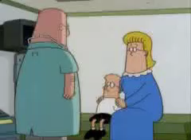

Slide 3
This week, and next
Create teams – by Sept. 5, after which I will assign
Pick a project
Invent one
Use this website: https://invenst.cse.buffalo.edu/viewideabank.php
The project must be SOCIALLY RELEVANT
Here’s some from my lab: https://cse.buffalo.edu/~mikeb/Projects.html
Socially Relevant Computing: an enabling technology that improves the quality-of-life of a disadvantaged person or group.
Something you would be proud to put on your resume.

Slide 4
Prof. Michael Buckley
mikeb@buffalo.edu
www.cse.buffalo.edu/~mikeb
Personal contact is far better than email
Davis 327

Slide 5
Meeting – you are expected to produce team documents fully half of your participation time.
Lectures on Monday and Wednesday
Friday is a dependable time when your team (and I) can meet – no lecture
Friday is available for meetings with me via Zoom, just let me know
We don’t use recitations in this course

Slide 6
Objectives
Step through a “real” project
Criticize Bad Design / Recognize Good
Understand the Complexity of Building Systems
Chart a Logical Path Through the Complexity
Appreciate Simple Elegance
Connect Left and Right Brains
Apply CRITICAL THINKING skills

Slide 7
This course
This is a software engineering, project management, and philosophy of work course

Slide 8
Grading
Project Grade 70% -
Requirements Specification - Requirements from the customer perspective (Phase 1) - 15%
Design (Phase 2) - 20% (this includes 5% for the architectural diagram)
Project Plan (Phase 3) – 15%
Implementation/testing/Demo (Phase 4) - 15%
Peer Review – 5%
Individual Grade 30% -
Essay/Research Question #1 10%
Essay/Research Question #2 10%
Class participation & professionalism (individual) 10% - attendance is taken randomly throughout the semester, usually when the class looks empty. The professional component includes not just the attendance, but emphasizes more pointedly the productive value of input a student offers to class discussion. It could also include professional behaviors such as not texting during class, looking at laptops when they are not needed for the class, and not talking with fellow students during class. It includes other aspects of professional behavior such as properly written emails, preparedness when attending office hours, and advanced notification for classes that are missed.

Slide 9


books
useful in your career
but NOT required
Required (free pdf)

Slide 10




Slide 11


Slide 12
Topics
Software Errors
Design Methodologies & Lifecycle Models
SADCITM
Customers
Users
Requirements
Documentation
Coding
People and Personality
Attitude
Case Histories
SW Project Management
Project Planning
Scheduling
Estimation
Legal Issues
Ethics
Risk
Metrics
Human Factors
Configuration and Version Control

Slide 13
http://c2.com/cgi/wiki?BigDesignUpFront
% of time spent
The Dream Curve
Spec Analysis Design Code Integration Test Maintenance

Slide 14
The Class Team-based Project
These should be for real customers and users – Improve someone’s quality of life, needed in our community
4 Phases - requirements, design, planning, coding – via SLACK
You can work on teams of 6-8 people.

Slide 15
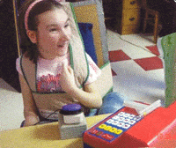

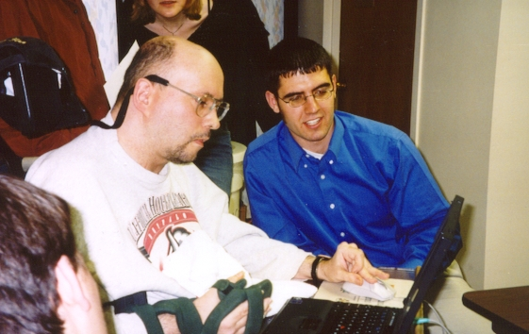
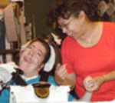
Our Clients & Customers

Slide 16
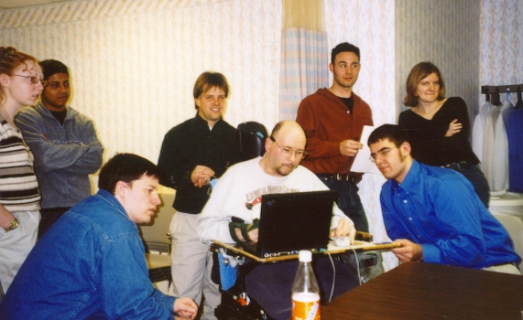
UB Talker

Slide 17
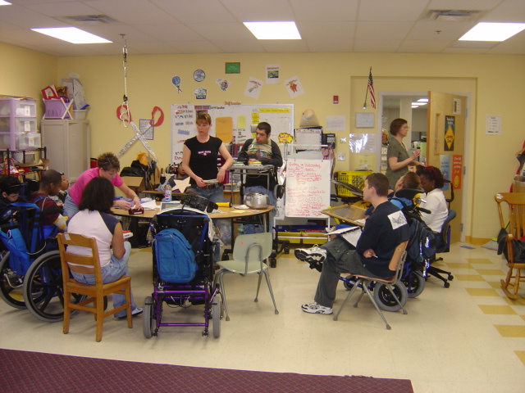

Slide 18
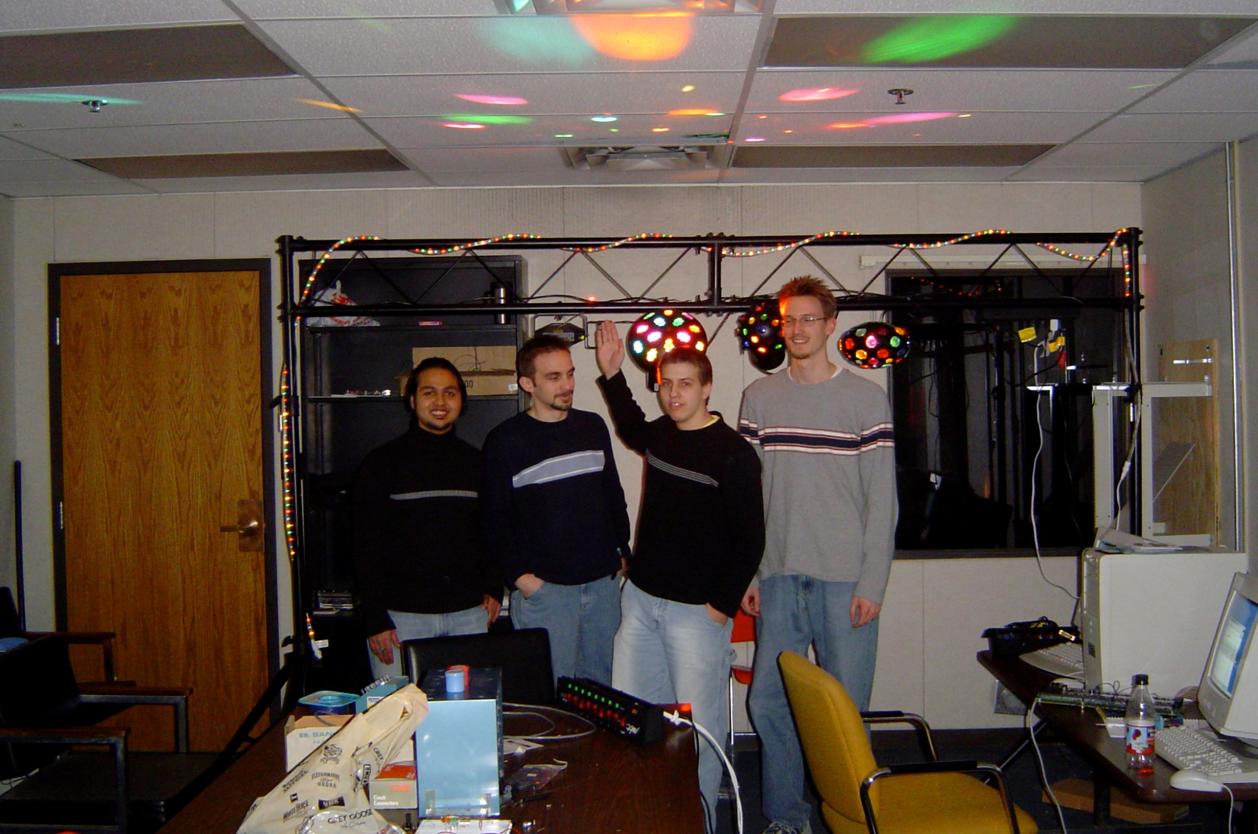
DISCO

Slide 19
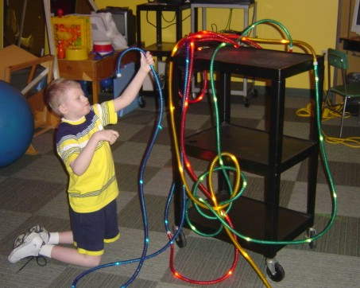

Slide 20
