Slide 1
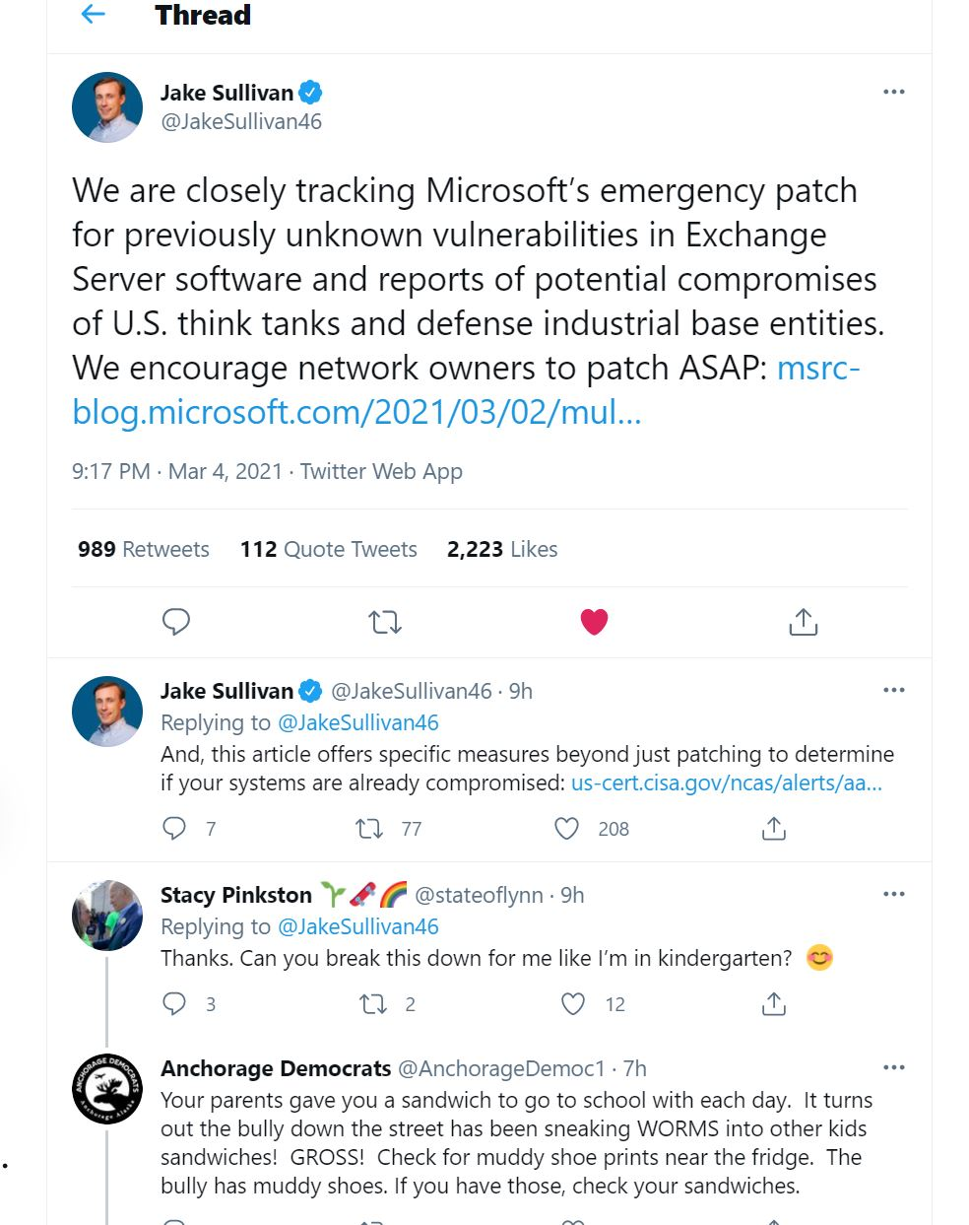

Slide 2
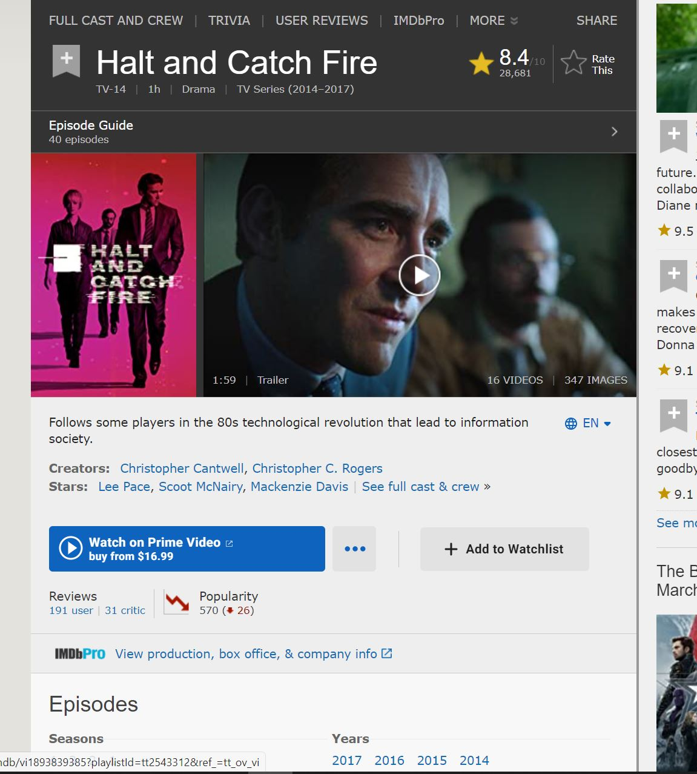

Slide 3
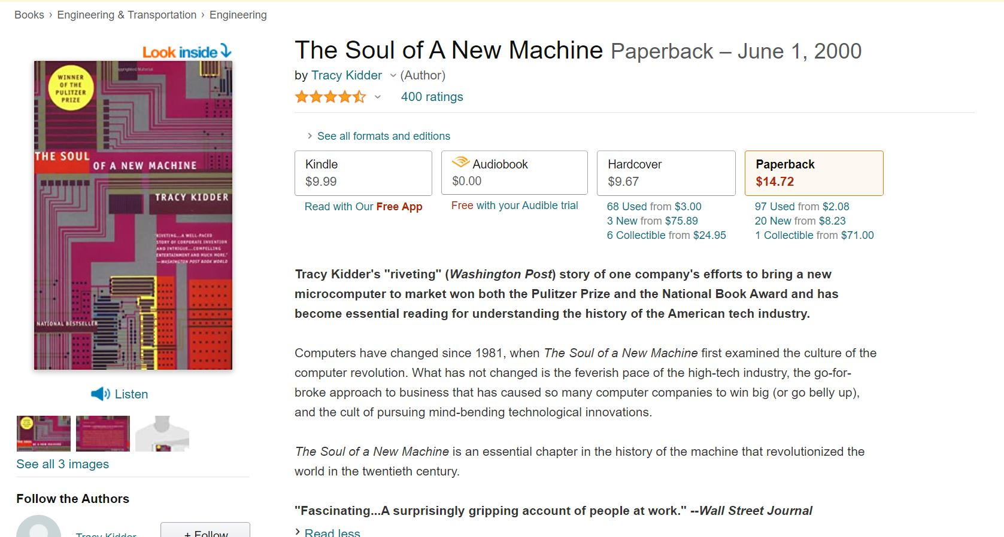

Slide 4
1978 – 1982 The golden age of personal computers
IBM mainframes (research and universities)
The rise of mini-computers (small businesses)
The rise of Personal Computers (hobbyists)

Slide 5
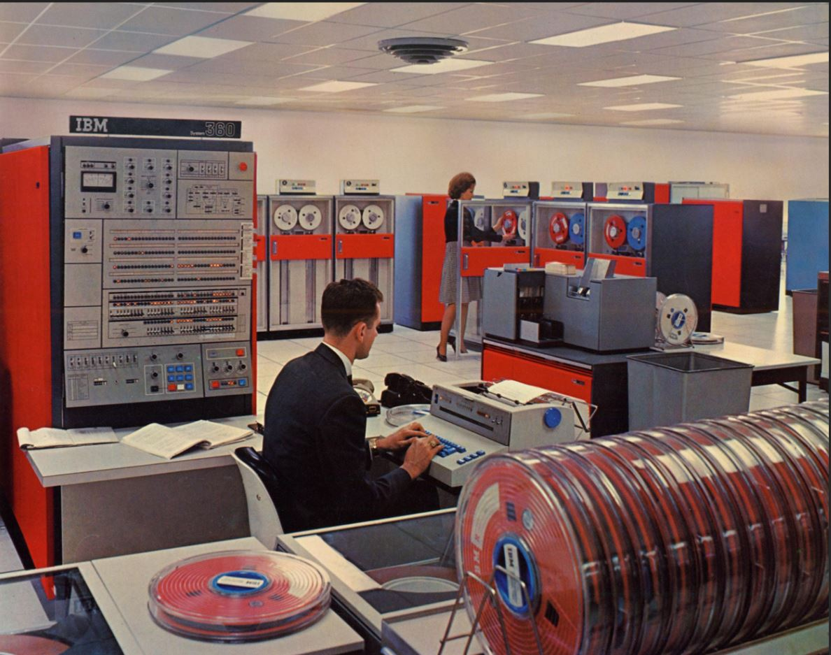
IBM “360” main-frame computer

Slide 6
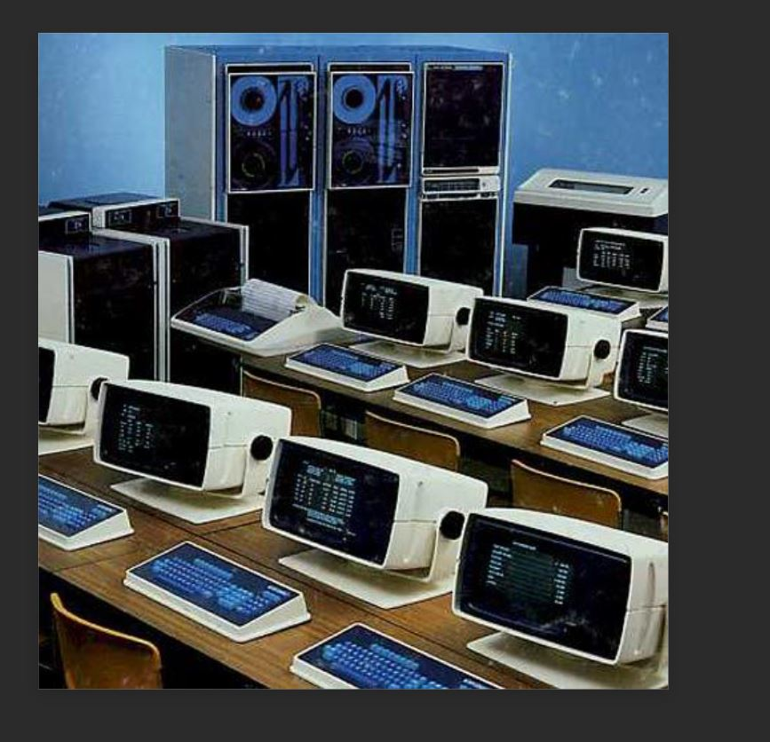
Data General “Eclipse” model mini-computer

Slide 7
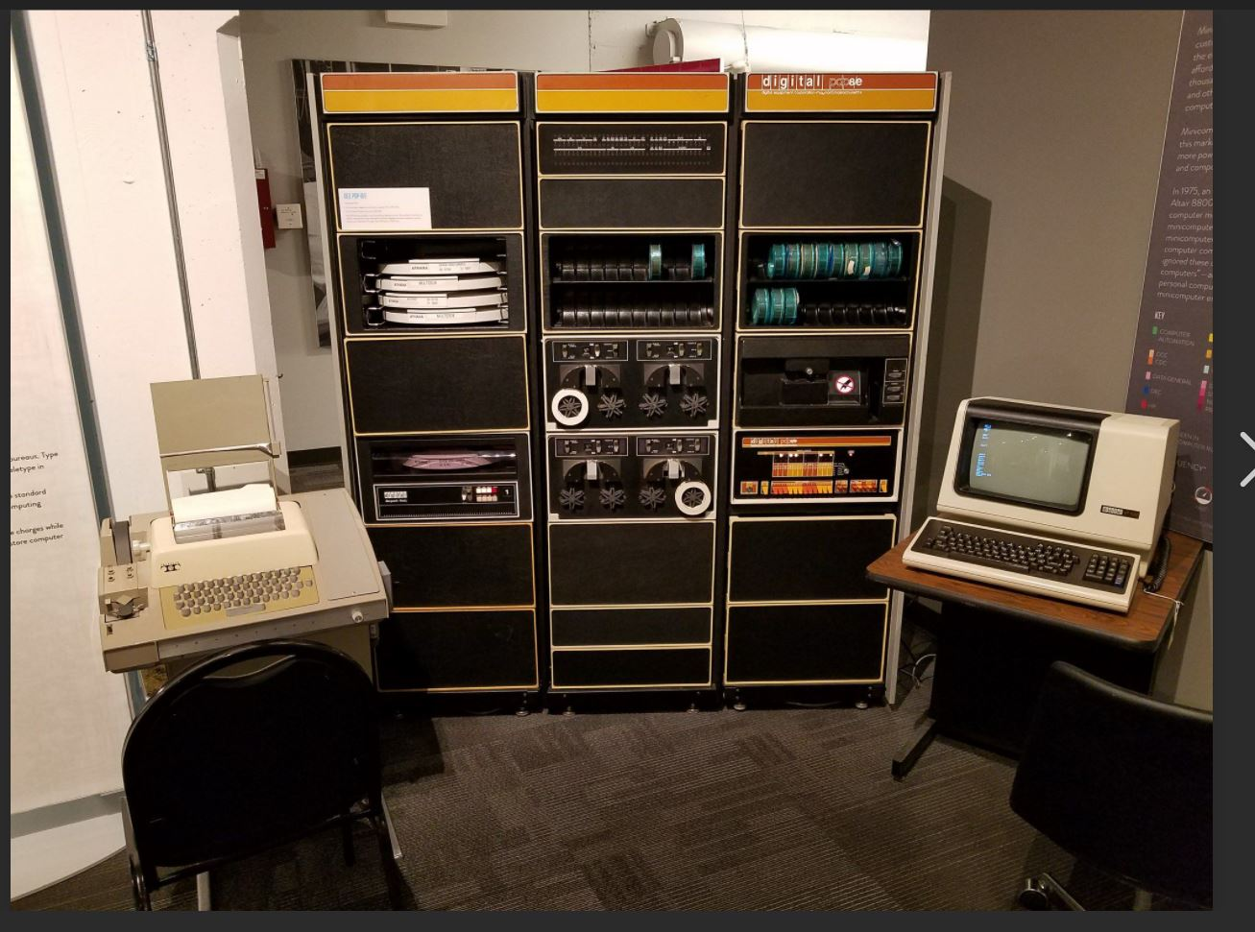
Digital Equipment Corporation “PDP/11” mini-computer

Slide 8
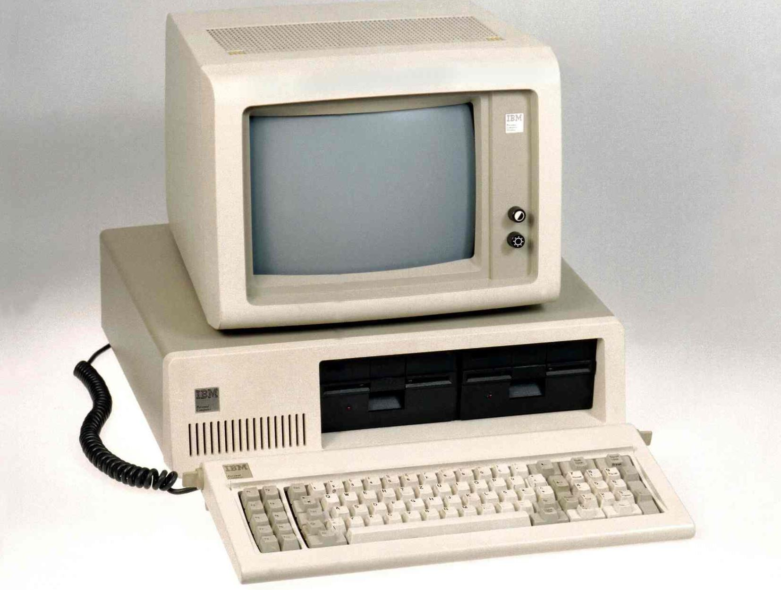
IBM PC O/S not written by IBM, processor not developed by IBM

Slide 9
IBM PC specs
August 1981 – 40 years ago
Two 360 Kbyte removable disks
640 Kbyte RAM
4.77 MHz 8-bit processor
1-bit speaker (it could only beep or buzz)
Starting at US $1,565 (equivalent to $4,401 now)
No mouse, no graphics
Initially white on black, green on black, or amber on black; eventually 16 colors

Slide 10
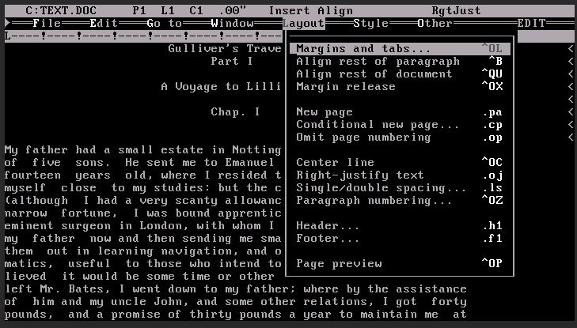

Slide 11
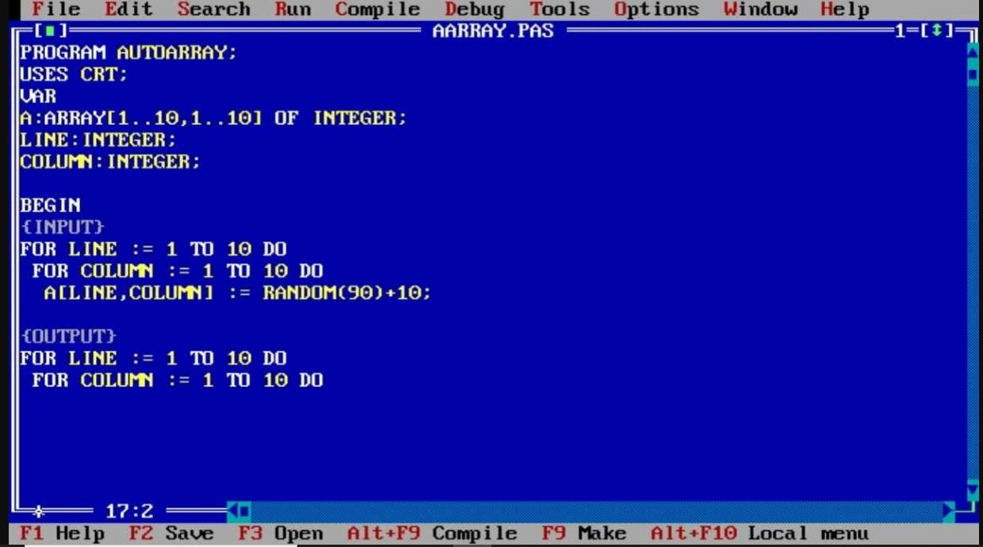

Slide 12



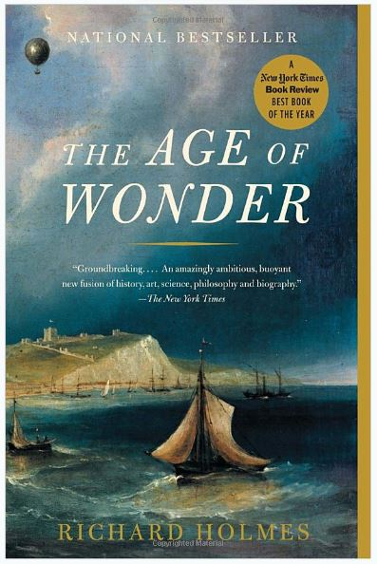
These are about the intellectual and math history of England. I am looking for books on the intellectual and math history of India, the Middle East, China, and France.

