Slide 1
Rats with backpacks could help rescue earthquake survivors | CNN

Slide 2
Oct. 24
Starting Phase 3 – “The Project Plan” – Due Nov 13.

Slide 3
Wednesday’s class (10/26) will be REMOTE. The ZOOM link is on the class web site.
We will finish Software Errors and move on to “The Tao Of Pooh” and “Levels Of Thought” on Wednesday.

Slide 4
Grades
To get an A in CSE442/542, you must do substantially better than what is asked-for. All grading for this course grants a C for answering the requirements, a B for showing a level of understanding, and an A for insight sufficient to apply the material to real life.
If you do not add to your submissions with level-2 thinking (a nuanced understanding of the material), real-life examples based on experience, empathy toward the user, or supplemental reading with references, you will get a very well-deserved B.
If you submit only what is asked-for, you will get a C.

Slide 5
Phase 2 Grades
A : 11
B+ /A- : 1
B: 3
B- : 1
B-/C+ : 1
C: 2
C- : 1
C- / D+ : 1
D: 1

Slide 7
Every document in the process is a transitional document, meant to move the project forward.
Project Plan
Phase 3
Requirements
Phase 1
Design
Phase 2
Demo
Phase 4
Code

Slide 8
Therefore
Your design document must be sufficient to plan the project

Slide 10
So lets do Phase 3 now, together
You must produce a Project Plan, using Microsoft Project, or OpenOffice Project Libre.
The core of a project plan is a list of tasks to perform, with length and precedence (more later).

Slide 11
Critical Paths, or "Pert" charts: A Project Management Tool
If you’re not doing Critical Paths, you’re not doing project management.
Shows the time sequence of events, including parallel efforts.
Determines length (calendar time) of a project.

Slide 12
Draw a Pert Chart for this job:
Task Title Duration Precedence
start 0 -
think 1 a
plan 2 b
procrastinate 5 a
assign to someone else 1 c,d
hide 3 e
finish 1 e
grab credit 1 f,g

Slide 13
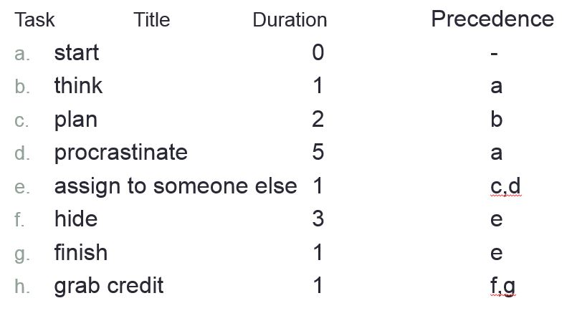
a
b
c
e
f
A
B
C
C&D
E
F
F&G
H
1
2
1
3
1
0
g
d
1
5
D
G
Critical Path = A D E F H slack in B C, G

Slide 14
Phase 3 - Due Nov 13
Use Project Libre to Create a Labor-Only Project Plan - Imagine your team to be part of a company with unlimited resources. Imagine your target to be the successful completion of the entire system. Imagine that you are about to plan the labor for the entire job to the finest detail.
List all the tasks to be completed. EVERY TRACKABLE TASK MUST BE INCLUDED:
The “number of days” estimate for each task
the precedent (or predecessor) tasks - task(s) that must be completed prior to performing this task
use the indentation (subordinate) task capability to “roll up” subtasks into meaningful larger tasks.

Slide 16
Do NOT include hardware costs. However, the labor to select and purchase hardware should be included.
Using the Network ( i.e.Critical Path) Chart, calculate the calendar time of the complete job.
Submit the Project file
Notes: the Project Plan is your guide for both time and money. Every trackable effort must be included. If there is a particular component to be implemented, it must include Specification, Design, Coding, and Testing tasks. There may be partial and full integration efforts, design reviews, status reports, everything that needs to be paid-for.

Slide 17
get Project Libre
https://sourceforge.net/projects/projectlibre/

Slide 19
A “Work Breakdown Structure” – the task list, the left side of the Plan
Work Breakdown Structure
Every trackable non-free $$$ task
Everything
How many people (not in our Phase 3), how much time (in days), and precedent tasks

Slide 20
some tasks we forget
meetings
document preparation
status and project management
customer training

Slide 21
typical - done once
Customer meetings
System Spec
Review
SRS
Review
Top Level Design
Test Plan
Review
Integration
Documentation
Customer Site Deployment

Slide 22
typical - done for each module
Detailed Design
Code
Walk-thru / Review
Unit Test

Slide 23
Career Advice – you will do as much planning as you do coding
When you get skilled at it, a good estimate can be done in a day.
Estimation is an exercise in disassembly (and is therefore integral with design), and interpersonal skills.
NOT a negotiation (negotiation implies compromise, but there should be no compromise of reality).
Time and cost sacrifices must be offset by features and effort.
“You can have it cheap, quick, and high quality. Pick two”

Slide 24
Estimates are done and redone at the end of requirements, analysis, and design.
# of people? length of task?
Lines-of-code? The LOC charts are good, but per-person productivity history for your company is better.
The industry standard LOC is 8 lines / person / day
Danger - there is a temptation to up the LOC/person/day just to lower estimates.
From Steve McConnell “Code Complete”: Cultivate an attitude of “stunned disbelief” when asked to adjust an estimate on non-technical factors. Practice in front of a mirror.

Slide 25
Estimating is not negotiation.
Estimating is not adjusting numbers to the known right answer.
Estimates not to be trusted:
those responsible (will be conservative) and
those who interface to the customer (will be optimistic).
Use those estimates, but reduce the first by 30%, increase the second by 30%. Why 30%? It’s the universal feel-good multiplier.

Slide 26
The usual estimation path:
Vague description of job
Told by marketing/management what is the absolute maximum that can be spent, or you’re fired
You agree to it and stress out

Slide 27
Avoid gamesmanship -
do not pad estimates
do not expand work to fill available time
do not code-like-crazy from day 1

