Slide 1
The Plant Database

Slide 2
Primary Goals
Store and Retrieve 1 million+ plant records (currently 3000)
Each record contains up to 300 fields of information (currently 55)
Scientific name, Genus, $Value, Date acquired, Location, Collection, etc.
Including images of the actual plant
Viewable by the public
Editable by staff
Web-based, accessible anywhere, on any computer or mobile device

Slide 4
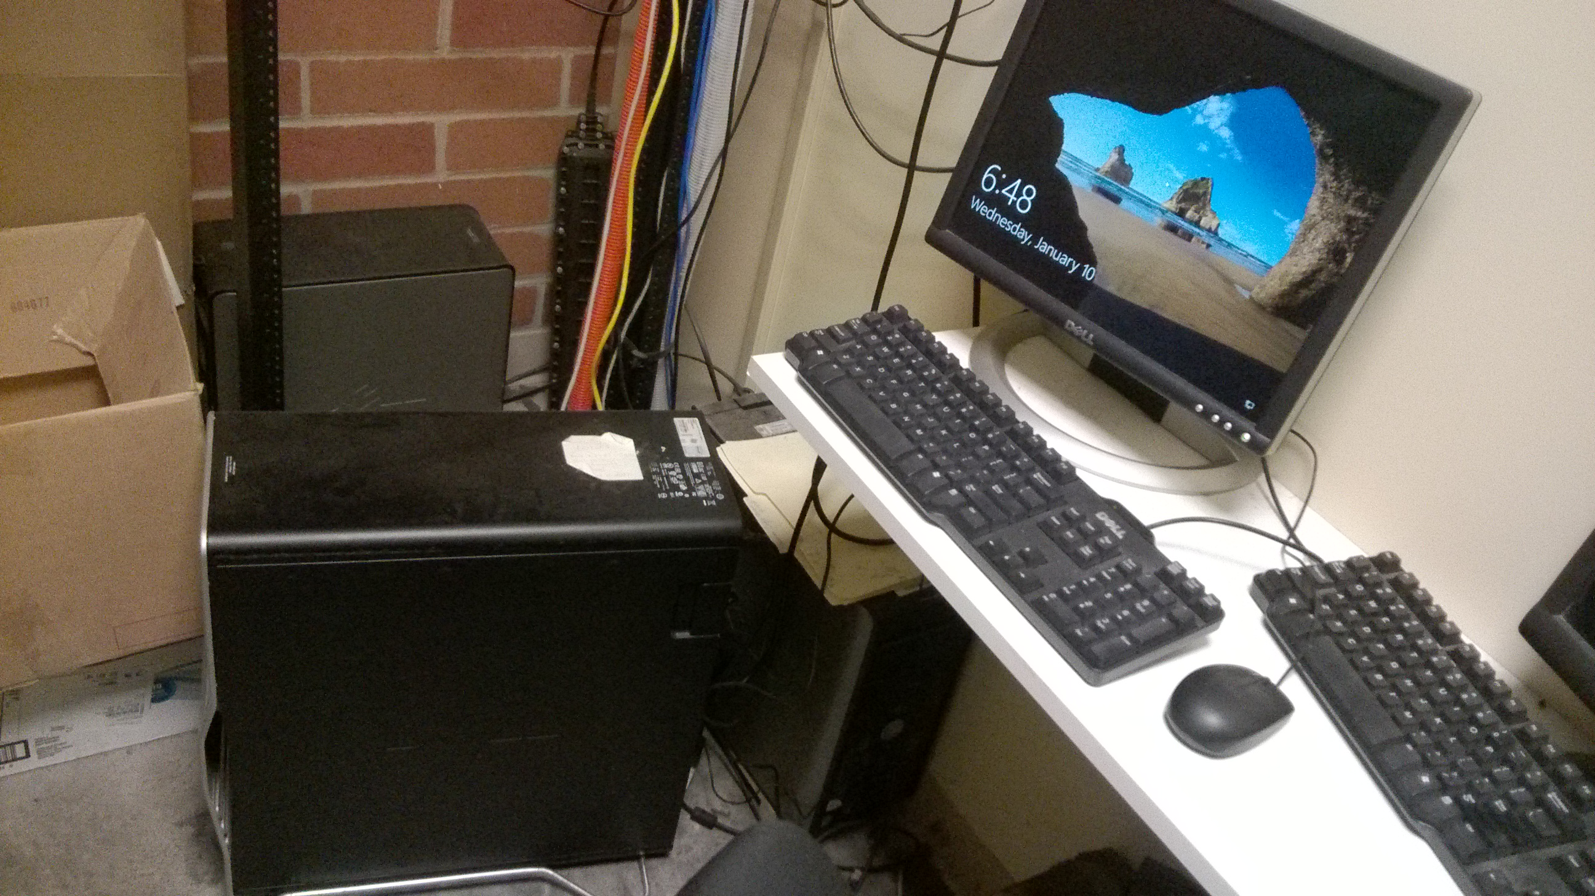
Secondary Goals
No monthly costs
Residing at the Gardens, native hardware, long life
Cloud storage only if we want it, and we don’t
Image storage – currently10,000 photographs of Garden-based plants
Staff, volunteer, and public contributions
Copy-able, all or in-part, for private versions
Accomplished via the use of common,
Microsoft components

Slide 5
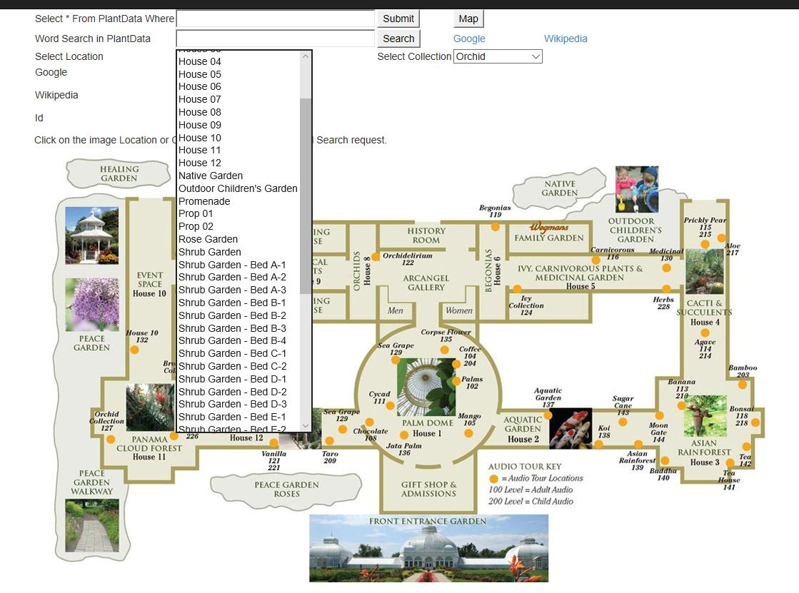
Searching the Database
Searchable in common language
“Collection = Bonsai” lists all plants in the database matching exactly that criteria
“Value > 1000” lists all plants greater than $1000 in value
etc.
Selectable from a Map
Selectable from pull-down lists

Slide 6
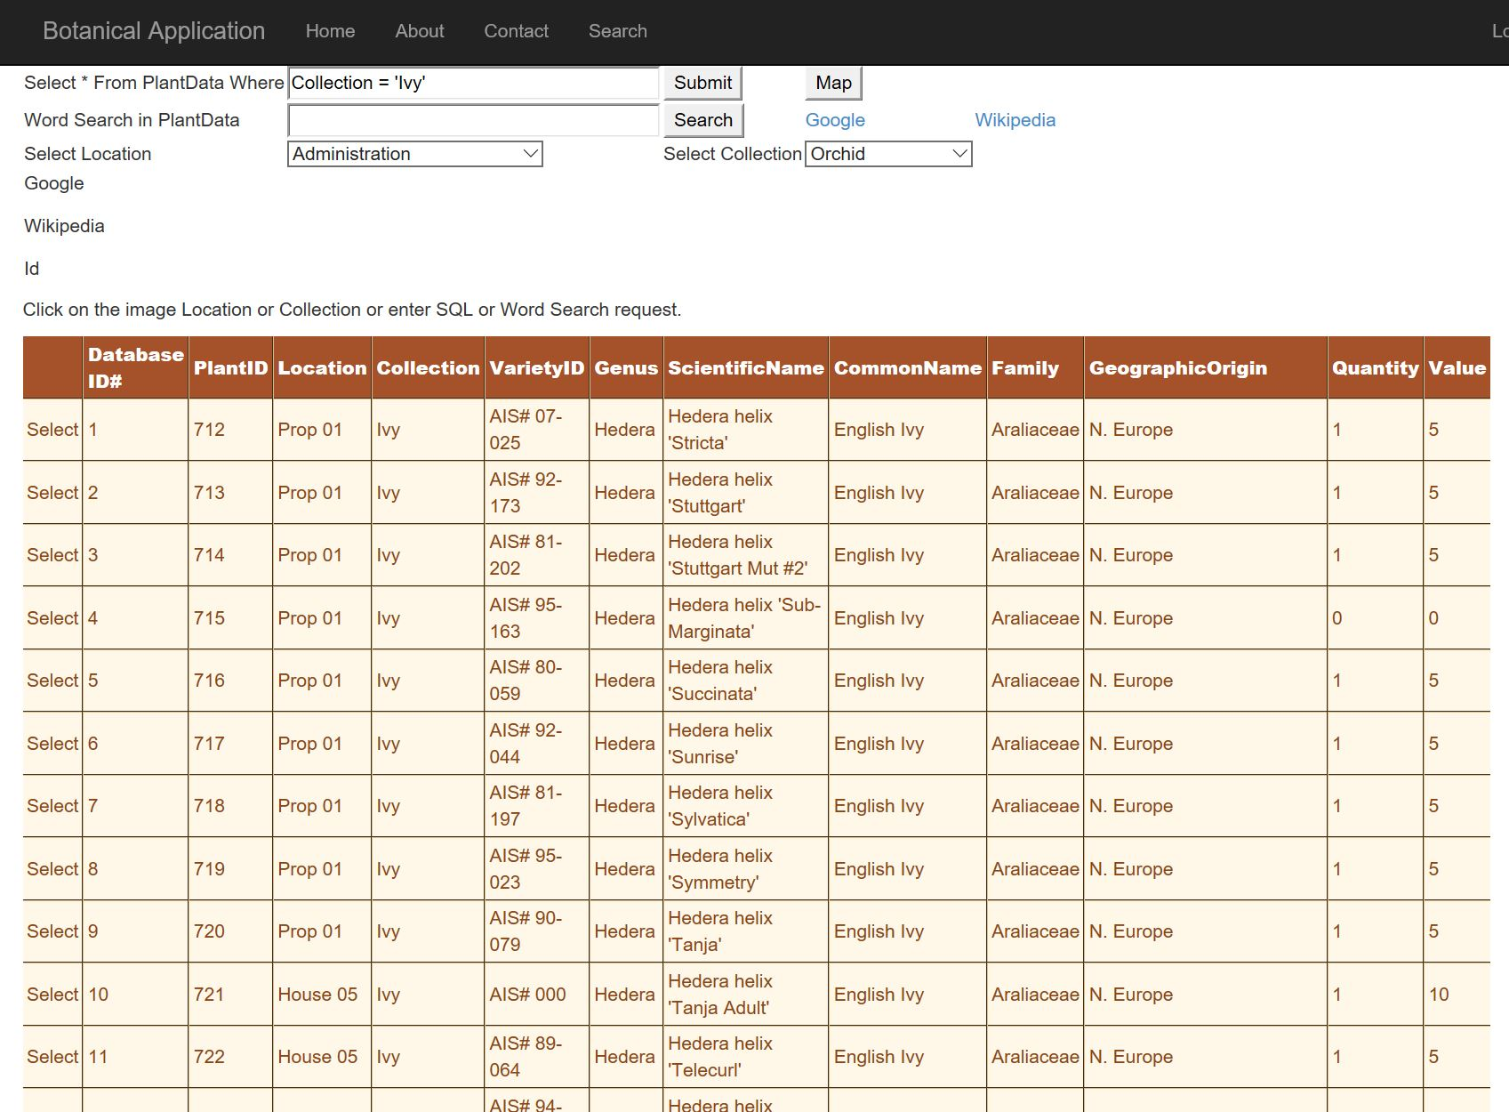
Search results are presented in an abbreviated, simple list
Select the plant you want, go to a more detailed screen

Slide 7
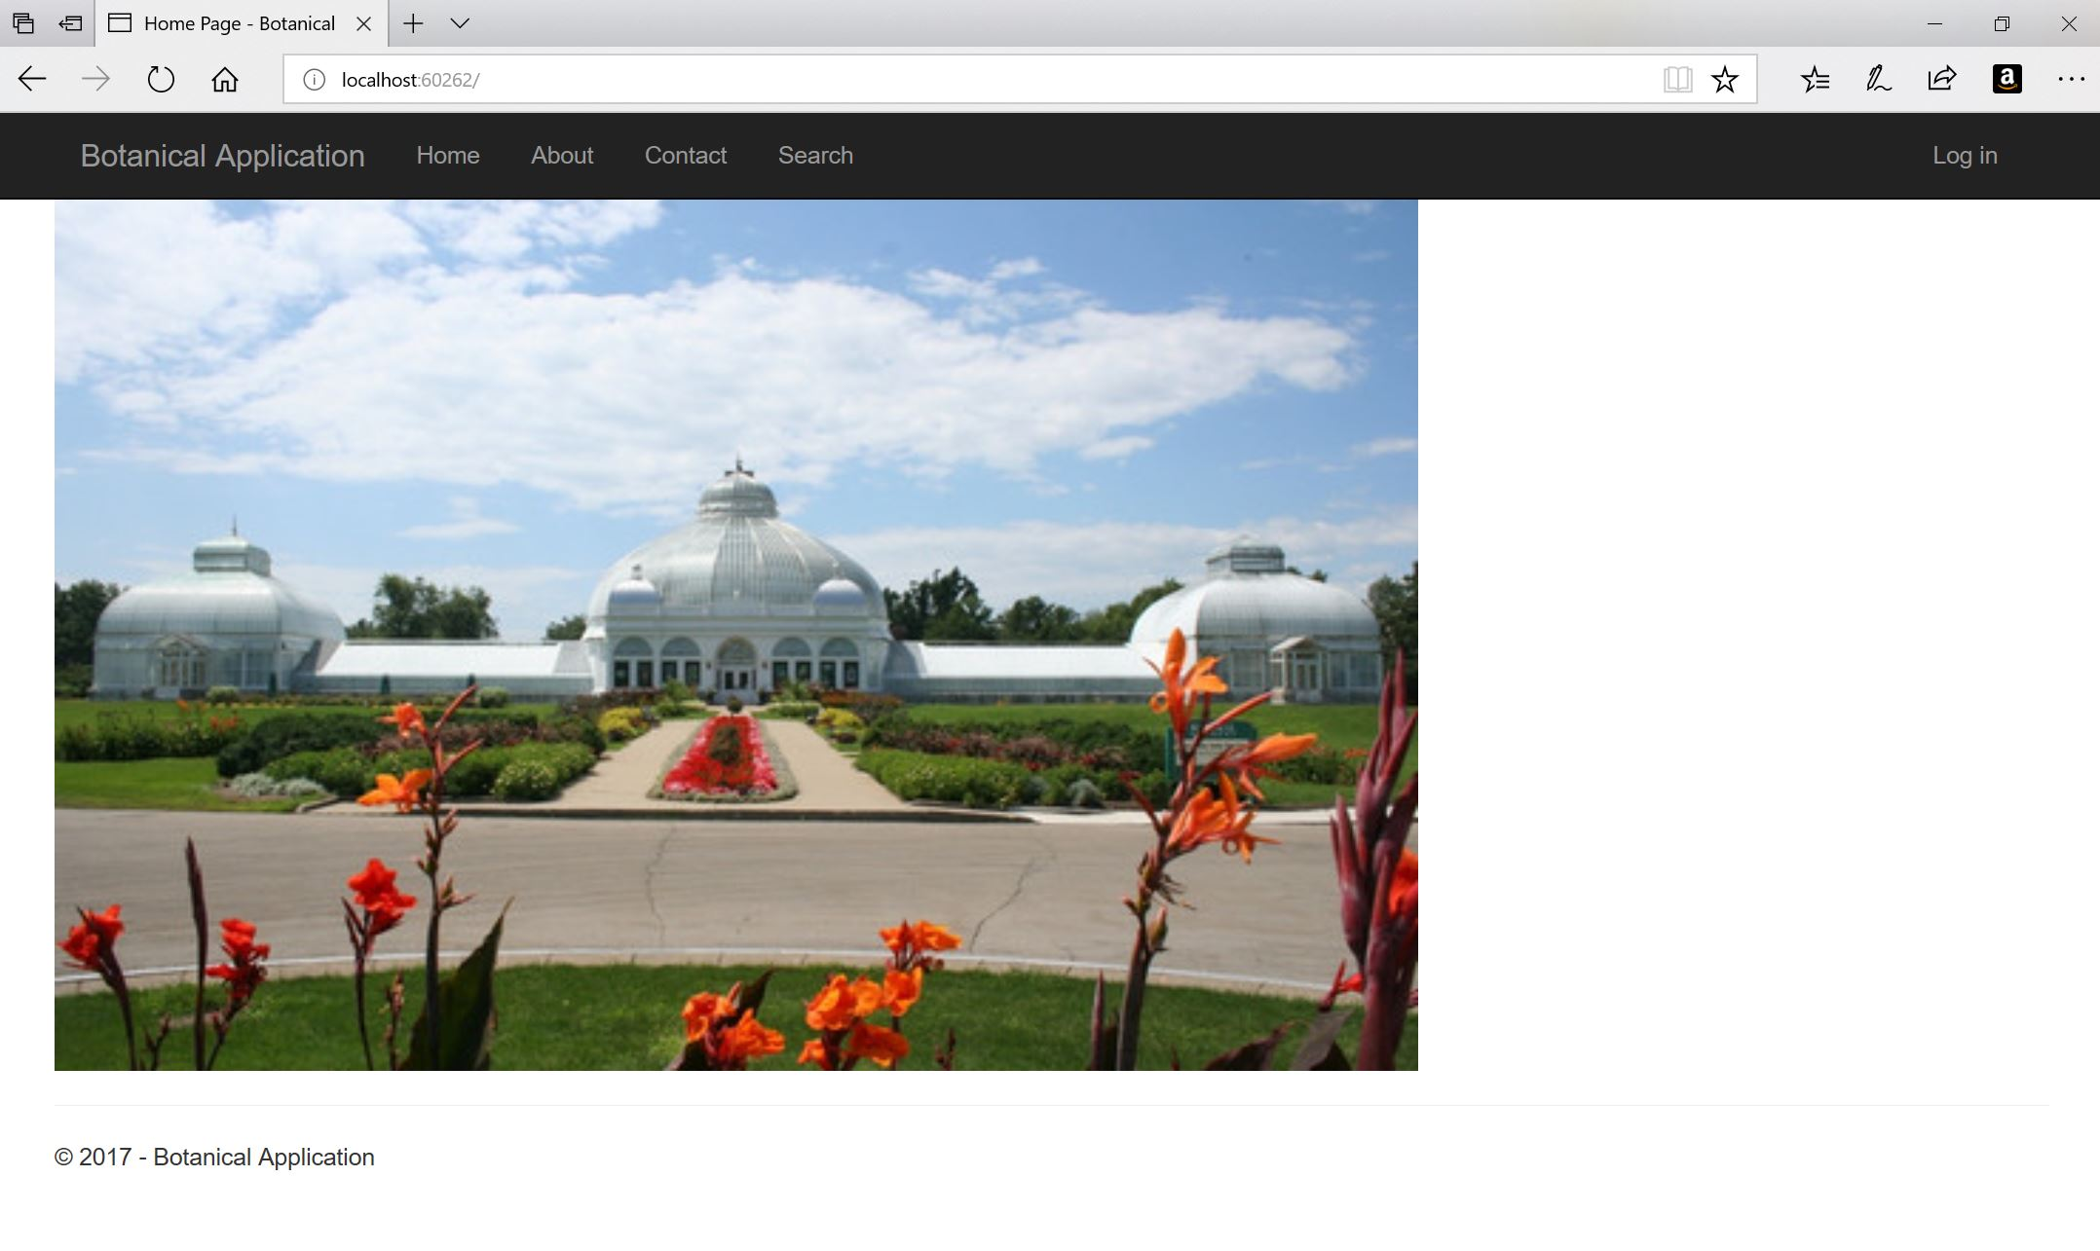
On the web
Remember, we are in the function-first phase
Available at http://71.186.160.170/website11 if anyone wants to sample it

Slide 8
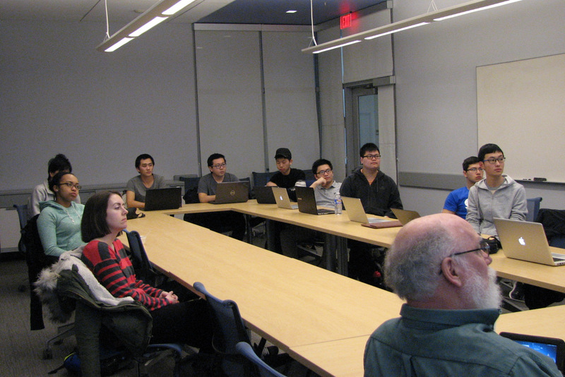
Remaining Work
Image browser to make available our 10,000 photographs
Business-quality (not student-quality) web pages

