Slide 1
Three Camera Epipolar Geometry
Image Correspondence and Depth Recovery
Gene Wang 4/26/2011

Slide 2
Problem Statement
Stereopsis and epipolar geometry can be used to determine 3D point information from 2D images.
Does adding a third camera give the system any more information for solving the correspondence problem and depth recovery?

Slide 3
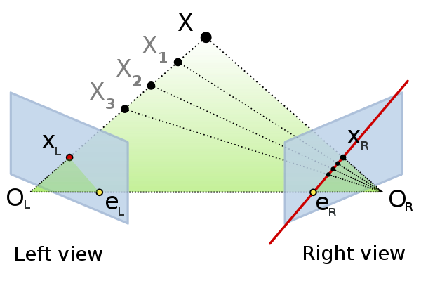
Review of Stereopsis
Source: http://en.wikipedia.org/wiki/File:Epipolar_geometry.svg

Slide 4
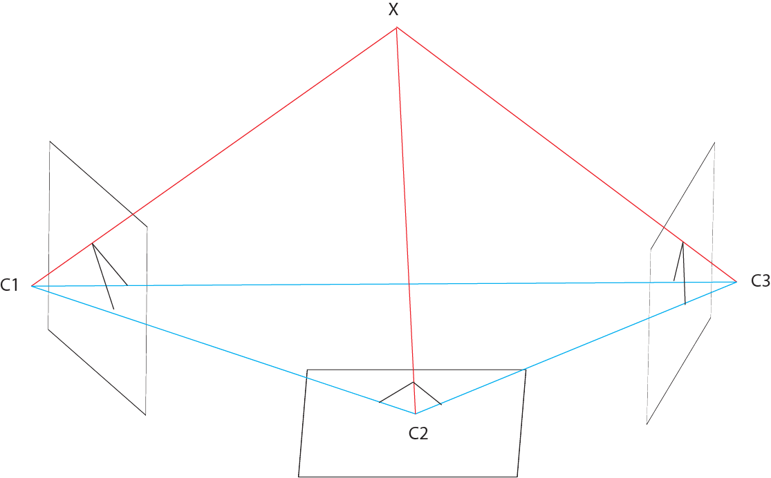
Trinocular Geometry
Given three cameras with centers C₁, C₂, C₃.
X, C₁, C₂, C₃ forms a triangular prism.
The plane C₁C₂X and C₁C₃X intersects image 1 in a line.
The two lines intersect at the projected point of X on image 1. (Likewise for images 2 and 3).

Slide 5
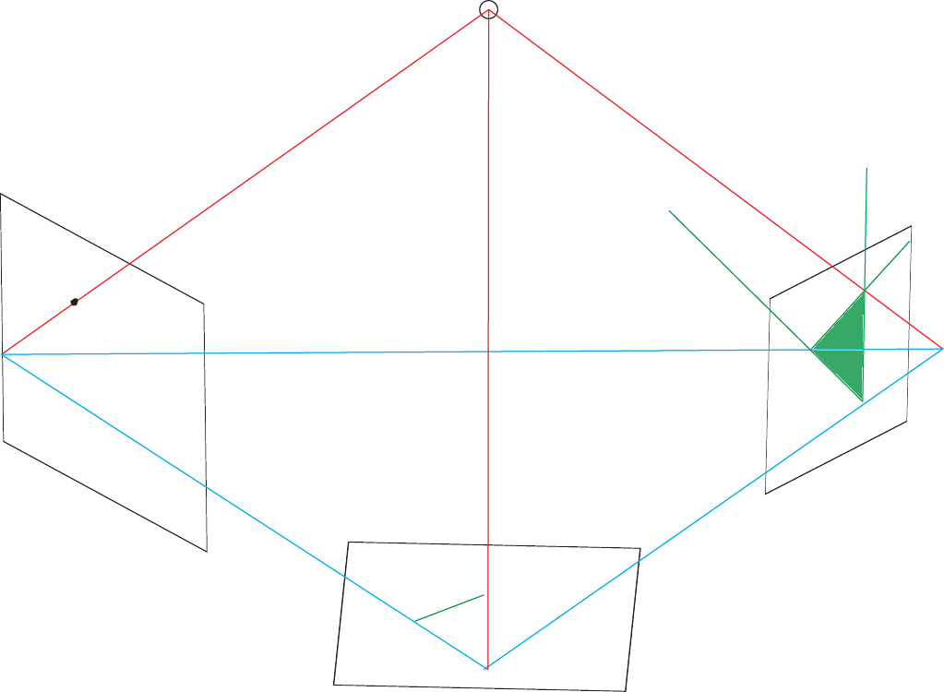
Correspondence Problem
Given projected point x₁ on image 1, find the corresponding points on the other images.
x₁

Slide 6
Fundamental Matrix
Given:
Camera calibration matrices K₁,K₂
Translational matrix S(t)
Rotational matrix R
Point x₁ in image 1
Then: x₁^{T} F e = 0
Where F = (K₁⁻¹ ) ^{T} S(t) R⁻¹ K₂⁻¹
Can be used to find a linear set of candidates for corresponding points in image 2.
Source: http://www.cse.buffalo.edu/courses/cse668/peter/lec/02.html 02-34

Slide 7
Correspondence Problem
By repeating the fundamental matrix calculation for camera 3, the correspondence problem can be done with 2 linear searches.
However, this is simply repeating the two camera solution twice.

Slide 8
Using All Three Cameras
With the same method, the projected point x₁ on image 1 will determine one epipolar line on each of the other images.

Slide 9
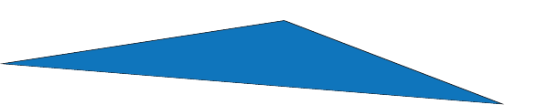
Camera base plane (analogous to the base line in stereopsis)
C₁
C₂
C₃

Slide 10

C₁C₂X half plane
C₁
C₂
C₃

Slide 11

C₁C₃X half plane
C₁
C₂
C₃

Slide 12
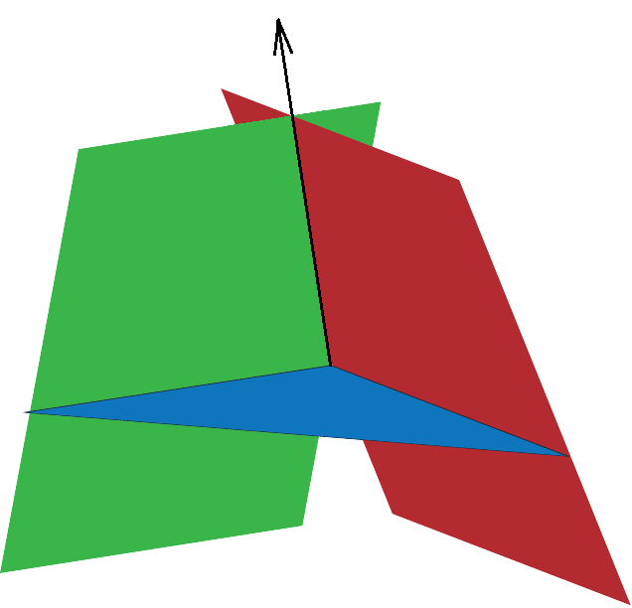
ray C₁X
C₁
C₂
C₃

Slide 13
Using the epipolar lines in images 2 and 3, it’s only possible to “undo” the projections and recover the ray C₁X
Any possible new information must come from between cameras C₂ and C₃.

Slide 14
Image 2 and 3 both contain 1 epipolar line.
Each line represents a half plane in the world space.
Projected back on to the other camera results in a region.

Slide 16
So the information between cameras 2 and 3 is actually a 2D search range.
It does not help in any way to improve the search range from the original epipolar line derived from image 1.

Slide 17
Depth Recovery
Depth recovery is predicated on having completed image correspondence.
Given two corresponding points and the camera calibration matrices, the world coordinates for any point X can be easily calculated.
Using camera angles and triangulation.

Slide 18
Practical Applications
In real world situations, estimations and probability are involved.
Having a trinocular system can reduce error and increase robustness.

Slide 19
Once a point is located in 3D space, its projection on any calibrated camera can be calculated.
Error reduction can be done by calculating projection for the third camera using the other two for each camera and find the best match.

Slide 20
Additional Goals
Testing and evaluating trade-off between extra correspondence calculations and error reduction.

Slide 21
Thank you

