Slide 1
Lagrangian Particle Tracking In Isotropic Turbulent Flow via Holographic and Intensity based stereoscopy
By Kamran Arjomand

Slide 2
Outline
Background
    Holographic Imaging
      Acquire Hologram
      Preprocessing
      Numerical Reconstruction
      Particle Extraction
      Velocity Extraction
    Turbulence
Minimum Goals
    Holographic Simulation with Gaussian Blur
    Single particle holographic image and intensity based image correspondence
    Single particle velocity calculation at given time step
Additional Goals if time permits
    Multiple Particle Image Correspondence
    Multiple Velocity Particle Extraction
    Particle Matching for a non-uniform particle field
References

Slide 3
Holography
Concept of using a wave front imaging to do a three dimensional reconstruction first introduced by (Gabor,1949)
After introduction of the laser in the 1960’s did holography really start to flourish(Collier ,1971;Vikram,1992).
Film Based Holography
  Intensity only reconstruction
  Time consuming to reconstruct Holograms from Film
Digital Holography
  Easier acquisition of Data analysis (Intensity as well as complex amplitude)
  Resolution restricted due to angular aperture as well as size
I Background
A . Holographic Imaging
1.Aqure raw hologram
2. Preprocessing
3.Numerical Reconstruction
4. Particle Extraction
5. Velocity Extraction
B. Turbulence
III Minimum Goals
A. Holographic Simulation with Gaussian Blur
B. Single particle holographic image and intensity based
image correspondence
C. Single Particle Velocity calculation at given time step
IV. Additional Goals if time permits
A. Multiple Particle image correspondence
B. Multiple Particle matching by
Neighbor
V. References

Slide 4
Digital holographic Process
Acquire Raw Hologram
Intensity Based Image
Matlab image processing toolbox
  Subtract Background Image
  Smooth with imfilter
  Contrast-limited adaptive histogram equalization (adapthisteq)
Based on Huygens Principle which states that if the wave front is known in one plane, it is known in any other 3D space
Rayleigh-Sommerfeld diffraction theory
(use Fourier Transform)
Particles imaged range between 8-20 micrometers
Optical Recording Schemes
  In-line
  Off-axis (our group)
Preprocessing
Region building base on connectivity relationships between adjacent foreground pixels in three dimensions(DeJong,2008)
Nearest Neighbor
Particle Relaxation Method
Numerical
Reconstruction
Particle Extraction
Improve Depth Location/Determine
Particle Size
Velocity Extraction
I Background
A . Holographic Imaging
1.Aqure raw hologram
2. Preprocessing
3.Numerical Reconstruction
4. Particle Extraction
5. Velocity Extraction
B. Turbulence
III Minimum Goals
A. Holographic Simulation with Gaussian Blur
B. Single particle holographic image and intensity based
image correspondence
C. Single Particle Velocity calculation at given time step
IV. Additional Goals if time permits
A. Multiple Particle image correspondence
B. Multiple Particle matching by
Neighbor
V. References

Slide 5
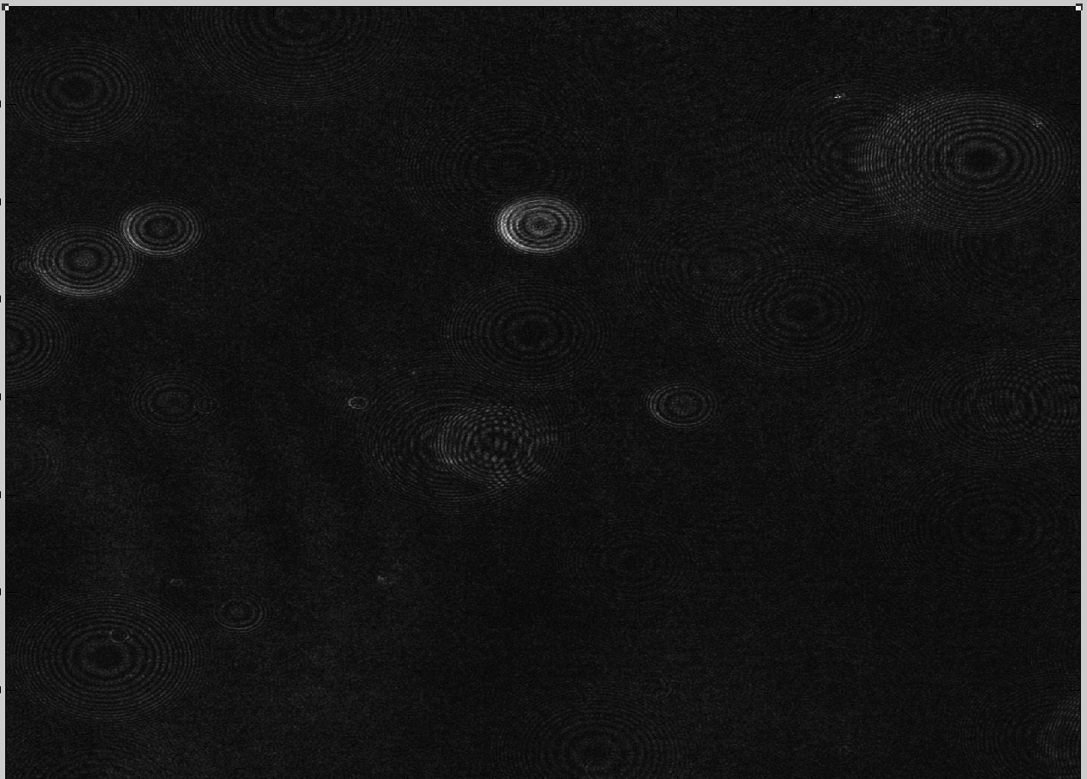
Raw Hologram
I Background
A . Holographic Imaging
1.Aqure raw hologram
2. Preprocessing
3.Numerical Reconstruction
4. Particle Extraction
5. Velocity Extraction
B. Turbulence
III Minimum Goals
A. Holographic Simulation with Gaussian Blur
B. Single particle holographic image and intensity based
image correspondence
C. Single Particle Velocity calculation at given time step
IV. Additional Goals if time permits
A. Multiple Particle image correspondence
B. Multiple Particle matching by
Neighbor
V. References

Slide 6
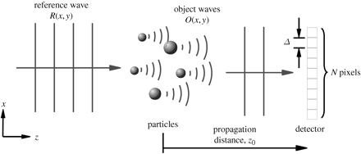
Raw Hologram Acquisition
I Background
A . Holographic Imaging
1.Aqure raw hologram
2. Preprocessing
3.Numerical Reconstruction
4. Particle Extraction
5. Velocity Extraction
B. Turbulence
III Minimum Goals
A. Holographic Simulation with Gaussian Blur
B. Single particle holographic image and intensity based
image correspondence
C. Single Particle Velocity calculation at given time step
IV. Additional Goals if time permits
A. Multiple Particle image correspondence
B. Multiple Particle matching by
Neighbor
V. References

Slide 7
Angular Aperture
angular aperture is a function of the camera pixel size, ∆, and the image size, a function of the number of pixels, N. Given the system parameters: ,
Critical Pixel Size:
Our CCD camera is 2650x2650 pixels with an effective pixel size of 2 micrometers with a long distance microscopic lens system
I Background
A . Holographic Imaging
1.Aqure raw hologram
2. Preprocessing
3.Numerical Reconstruction
4. Particle Extraction
5. Velocity Extraction
B. Turbulence
III Minimum Goals
A. Holographic Simulation with Gaussian Blur
B. Single particle holographic image and intensity based
image correspondence
C. Single Particle Velocity calculation at given time step
IV. Additional Goals if time permits
A. Multiple Particle image correspondence
B. Multiple Particle matching by
Neighbor
V. References

Slide 8
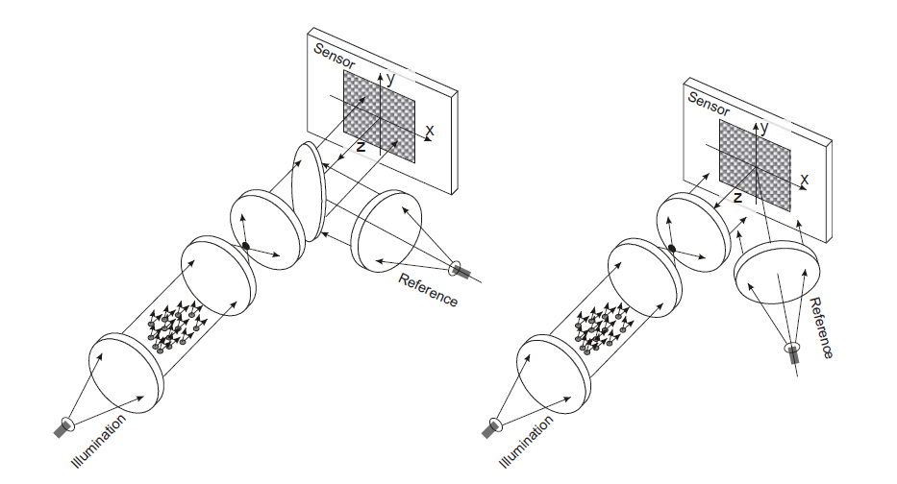
In-Line Recording Object Beam Configurations
Off-axis
Reference beam
On-axis
Reference beam
(Pan,2003)
I Background
A . Holographic Imaging
1.Aqure raw hologram
2. Preprocessing
3.Numerical Reconstruction
4. Particle Extraction
5. Velocity Extraction
B. Turbulence
III Minimum Goals
A. Holographic Simulation with Gaussian Blur
B. Single particle holographic image and intensity based
image correspondence
C. Single Particle Velocity calculation at given time step
IV. Additional Goals if time permits
A. Multiple Particle image correspondence
B. Multiple Particle matching by
Neighbor
V. References

Slide 9
Advantages/Disadvantages of In-line
Advantages
  Greater Intensity Hologram
  Complex amplitude Particle Extraction
  Potential for particle size determination
Disadvantages
  Excessive Speckle Noise from particles outside of region of interest resulting in large depth resolution errors
  Low Particle Seeding Density
I Background
A . Holographic Imaging
1.Aqure raw hologram
2. Preprocessing
3.Numerical Reconstruction
4. Particle Extraction
5. Velocity Extraction
B. Turbulence
III Minimum Goals
A. Holographic Simulation with Gaussian Blur
B. Single particle holographic image and intensity based
image correspondence
C. Single Particle Velocity calculation at given time step
IV. Additional Goals if time permits
A. Multiple Particle image correspondence
B. Multiple Particle matching by
Neighbor
V. References

Slide 10
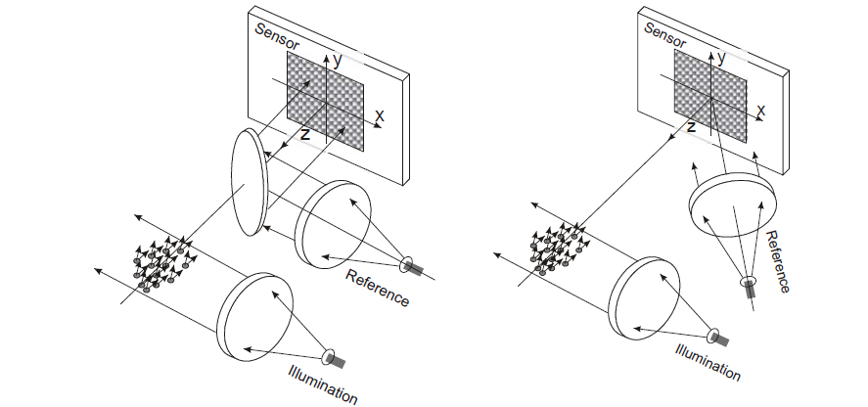
Off-Axis Recording Object Beam Configurations
Off-axis
Reference beam
On-axis
Reference beam
Pan,2003
I Background
A . Holographic Imaging
1.Aqure raw hologram
2. Preprocessing
3.Numerical Reconstruction
4. Particle Extraction
5. Velocity Extraction
B. Turbulence
III Minimum Goals
A. Holographic Simulation with Gaussian Blur
B. Single particle holographic image and intensity based
image correspondence
C. Single Particle Velocity calculation at given time step
IV. Additional Goals if time permits
A. Multiple Particle image correspondence
B. Multiple Particle matching by
Neighbor
V. References

Slide 11
Advantages/Disadvantages of Hybrid Holographic Recording
Advantages
  Speckle Noise suppression resulting from smaller imaged region
  Lower resolution requirement then off-axis reference wave configuration
  Facilities with higher particle concentrations can be imaged
  More accurate z location
Disadvantages
  No complex amplitude particle extraction methods
I Background
A . Holographic Imaging
1.Aqure raw hologram
2. Preprocessing
3.Numerical Reconstruction
4. Particle Extraction
5. Velocity Extraction
B. Turbulence
III Minimum Goals
A. Holographic Simulation with Gaussian Blur
B. Single particle holographic image and intensity based
image correspondence
C. Single Particle Velocity calculation at given time step
IV. Additional Goals if time permits
A. Multiple Particle image correspondence
B. Multiple Particle matching by
Neighbor
V. References

Slide 12
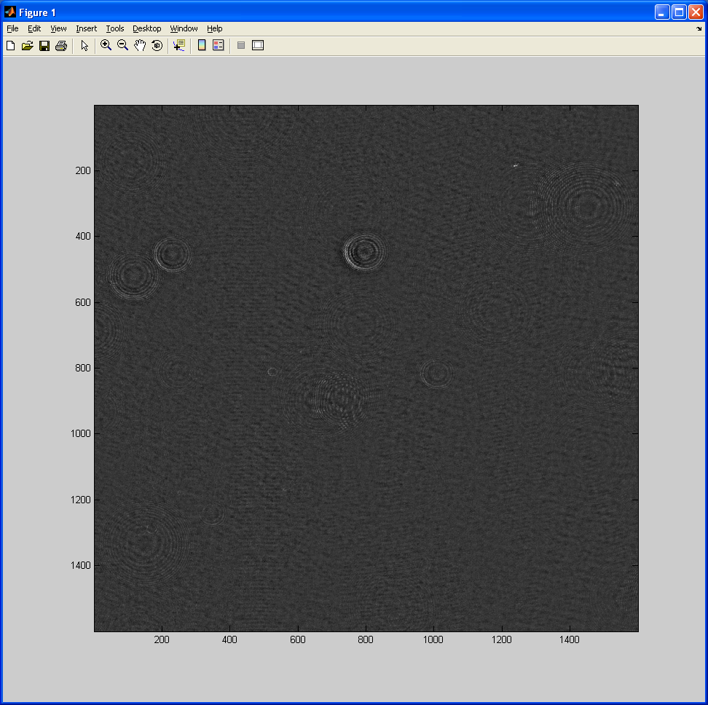
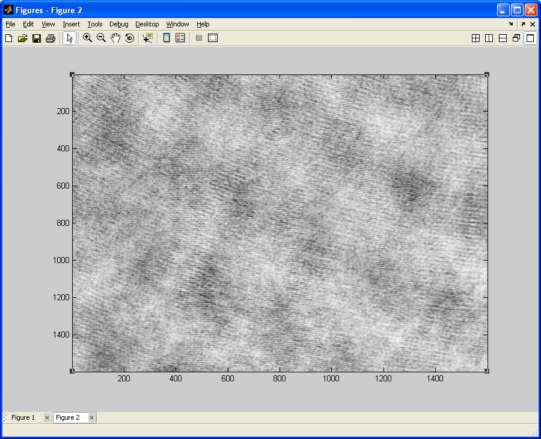
Subtraction with Background Image
-
Raw Hologram
Image after
Background Image
I Background
A . Holographic Imaging
1.Aqure raw hologram
2. Preprocessing
3.Numerical Reconstruction
4. Particle Extraction
5. Velocity Extraction
B. Turbulence
III Minimum Goals
A. Holographic Simulation with Gaussian Blur
B. Single particle holographic image and intensity based
image correspondence
C. Single Particle Velocity calculation at given time step
IV. Additional Goals if time permits
A. Multiple Particle image correspondence
B. Multiple Particle matching by
Neighbor
V. References

Slide 13
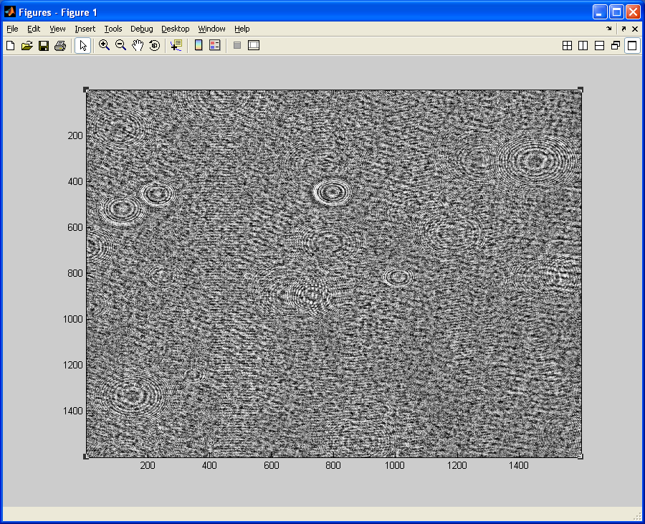
Contrast-limited adaptive histogram equalization and Imfilter
I Background
A . Holographic Imaging
1.Aqure raw hologram
2. Preprocessing
3.Numerical Reconstruction
4. Particle Extraction
5. Velocity Extraction
B. Turbulence
III Minimum Goals
A. Holographic Simulation with Gaussian Blur
B. Single particle holographic image and intensity based
image correspondence
C. Single Particle Velocity calculation at given time step
IV. Additional Goals if time permits
A. Multiple Particle image correspondence
B. Multiple Particle matching by
Neighbor
V. References

Slide 14
Holography with on-axis reference wave
R= reference wave
O=object wave
Z= distance from focus plane
r = radial coordinate in the hologram recording system
= wavelength
= phase shift
I Background
A . Holographic Imaging
1.Aqure raw hologram
2. Preprocessing
3.Numerical Reconstruction
4. Particle Extraction
5. Velocity Extraction
B. Turbulence
III Minimum Goals
A. Holographic Simulation with Gaussian Blur
B. Single particle holographic image and intensity based
image correspondence
C. Single Particle Velocity calculation at given time step
IV. Additional Goals if time permits
A. Multiple Particle image correspondence
B. Multiple Particle matching by
Neighbor
V. References

Slide 15
Numerical Reconstruction
(Direct Method(Takaki,1999))
Fourier Transforms:
Diffraction kernel
Discrete Form
Fourier Transform of:
m,n= matrix indices
N_{x},N_{y}= number of pixels
, = pixel size in x an y directions
I Background
A . Holographic Imaging
1.Aqure raw hologram
2. Preprocessing
3.Numerical Reconstruction
4. Particle Extraction
5. Velocity Extraction
B. Turbulence
III Minimum Goals
A. Holographic Simulation with Gaussian Blur
B. Single particle holographic image and intensity based
image correspondence
C. Single Particle Velocity calculation at given time step
IV. Additional Goals if time permits
A. Multiple Particle image correspondence
B. Multiple Particle matching by
Neighbor
V. References

Slide 16
Particle Extraction
Particle Extraction using Intensity(PEI)
Only available method for side scattering due to irregular distribution of scattered wave in side scattering
The intensity based centroid of the particle (x_{p},y_{p},z_{p}) is calculated from the relationships,
where a moment of order (p+q+r) of the intensity I is given by,
(DeJong,2008)
I Background
A . Holographic Imaging
1.Aqure raw hologram
2. Preprocessing
3.Numerical Reconstruction
4. Particle Extraction
5. Velocity Extraction
B. Turbulence
III Minimum Goals
A. Holographic Simulation with Gaussian Blur
B. Single particle holographic image and intensity based
image correspondence
C. Single Particle Velocity calculation at given time step
IV. Additional Goals if time permits
A. Multiple Particle image correspondence
B. Multiple Particle matching by
Neighbor
V. References

Slide 17
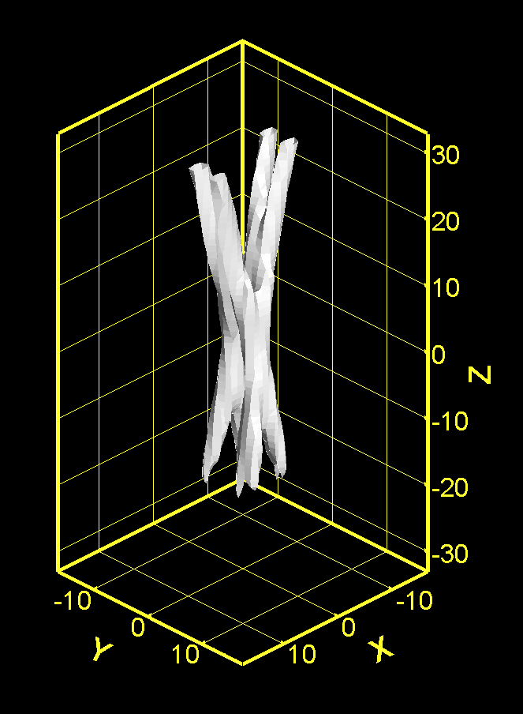
Problems with particle centroid calculation
I Background
A . Holographic Imaging
1.Aqure raw hologram
2. Preprocessing
3.Numerical Reconstruction
4. Particle Extraction
5. Velocity Extraction
B. Turbulence
III Minimum Goals
A. Holographic Simulation with Gaussian Blur
B. Single particle holographic image and intensity based
image correspondence
C. Single Particle Velocity calculation at given time step
IV. Additional Goals if time permits
A. Multiple Particle image correspondence
B. Multiple Particle matching by
Neighbor
V. References

Slide 18
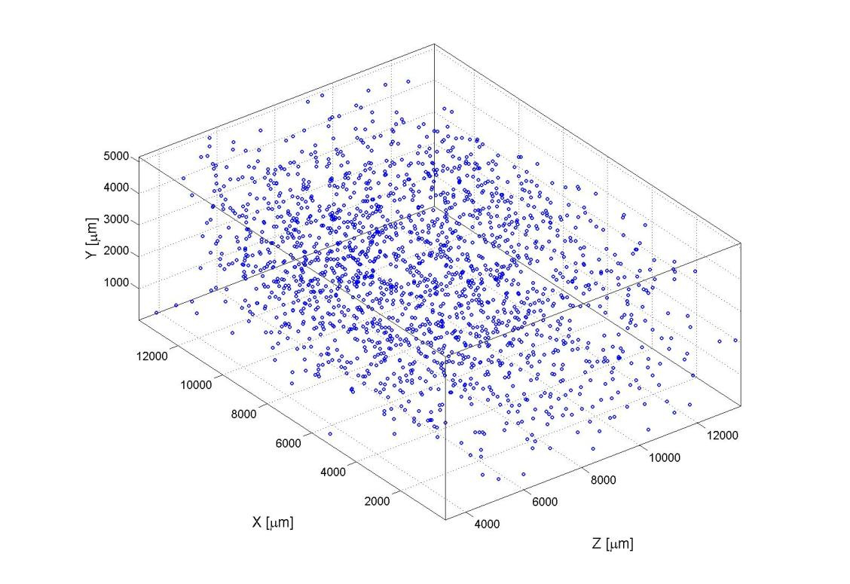
3D Reconstructed Particle Field
(DeJong,2008)
I Background
A . Holographic Imaging
1.Aqure raw hologram
2. Preprocessing
3.Numerical Reconstruction
4. Particle Extraction
5. Velocity Extraction
B. Turbulence
III Minimum Goals
A. Holographic Simulation with Gaussian Blur
B. Single particle holographic image and intensity based
image correspondence
C. Single Particle Velocity calculation at given time step
IV. Additional Goals if time permits
A. Multiple Particle image correspondence
B. Multiple Particle matching by
Neighbor
V. References

Slide 19
Velocity Extraction
Nearest Neighbor(Ouellette,2006)
I Background
A . Holographic Imaging
1.Aqure raw hologram
2. Preprocessing
3.Numerical Reconstruction
4. Particle Extraction
5. Velocity Extraction
B. Turbulence
III Minimum Goals
A. Holographic Simulation with Gaussian Blur
B. Single particle holographic image and intensity based
image correspondence
C. Single Particle Velocity calculation at given time step
IV. Additional Goals if time permits
A. Multiple Particle image correspondence
B. Multiple Particle matching by
Neighbor
V. References

Slide 20
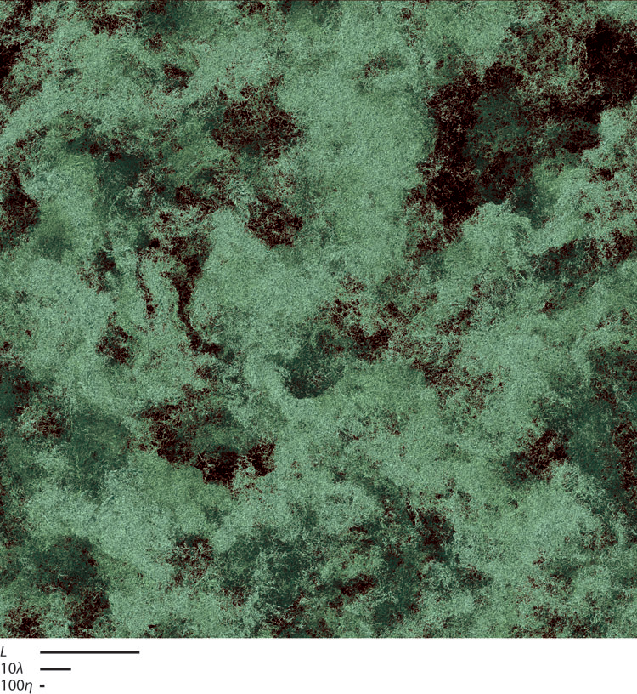
What is Turbulence ?
Rotational and Dissipative
Non-linear
Stochastic(random)
diffusive
I Background
A . Holographic Imaging
1.Aqure raw hologram
2. Preprocessing
3.Numerical Reconstruction
4. Particle Extraction
5. Velocity Extraction
B. Turbulence
III Minimum Goals
A. Holographic Simulation with Gaussian Blur
B. Single particle holographic image and intensity based
image correspondence
C. Single Particle Velocity calculation at given time step
IV. Additional Goals if time permits
A. Multiple Particle image correspondence
B. Multiple Particle matching by
Neighbor
V. References

Slide 21
Isotropic Turbulence
Singlepoint Velocity Correlations
Homogeneous Turbulence in which all the fluctuation statistics have no preferred directionality. All statistics are independent of coordinate rotations and reflections
I Background
A . Holographic Imaging
1.Aqure raw hologram
2. Preprocessing
3.Numerical Reconstruction
4. Particle Extraction
5. Velocity Extraction
B. Turbulence
III Minimum Goals
A. Holographic Simulation with Gaussian Blur
B. Single particle holographic image and intensity based
image correspondence
C. Single Particle Velocity calculation at given time step
IV. Additional Goals if time permits
A. Multiple Particle image correspondence
B. Multiple Particle matching by
Neighbor
V. References
Notes:
Only two independent , non-trivial, two point velocity correlations, longitudinal covariance and the transverse covariance, length scale can be given a precise definition

Slide 22
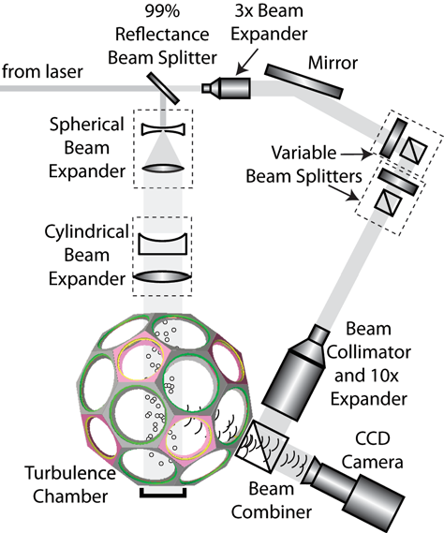
My Research
I Background
A . Holographic Imaging
1.Aqure raw hologram
2. Preprocessing
3.Numerical Reconstruction
4. Particle Extraction
5. Velocity Extraction
B. Turbulence
III Minimum Goals
A. Holographic Simulation with Gaussian Blur
B. Single particle holographic image and intensity based
image correspondence
C. Single Particle Velocity calculation at given time step
IV. Additional Goals if time permits
A. Multiple Particle image correspondence
B. Multiple Particle matching by
Neighbor
V. References

Slide 23
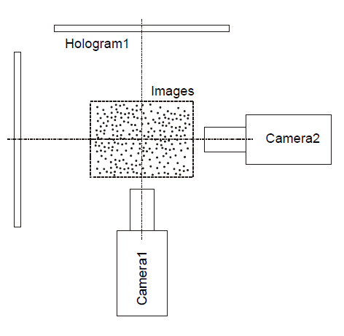
For my experiment
(first assume perfectly orthogonal setup has been completed)
Intensity Based Image
I Background
A . Holographic Imaging
1.Aqure raw hologram
2. Preprocessing
3.Numerical Reconstruction
4. Particle Extraction
5. Velocity Extraction
B. Turbulence
III Minimum Goals
A. Holographic Simulation with Gaussian Blur
B. Single particle holographic image and intensity based
image correspondence
C. Single Particle Velocity calculation at given time step
IV. Additional Goals if time permits
A. Multiple Particle image correspondence
B. Multiple Particle matching by
Neighbor
V. References

Slide 24
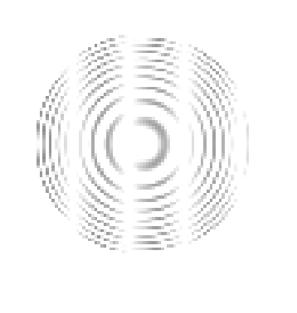
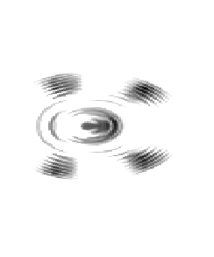
Simulation of Holographic Particle
(completed)
Synthesized Hologram
Hologram after Gaussian Blurr
I Background
A . Holographic Imaging
1.Aqure raw hologram
2. Preprocessing
3.Numerical Reconstruction
4. Particle Extraction
5. Velocity Extraction
B. Turbulence
III Minimum Goals
A. Holographic Simulation with Gaussian Blur
B. Single particle holographic image and intensity based
image correspondence
C. Single Particle Velocity calculation at given time step
IV. Additional Goals if time permits
A. Multiple Particle image correspondence
B. Multiple Particle matching by
Neighbor
V. References

Slide 25
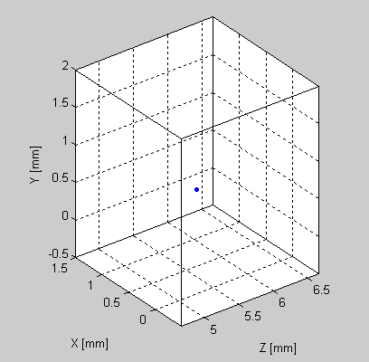
Correspondence of Reconstructed Hologram with Intensity Based Image (currently working on)
I Background
A . Holographic Imaging
1.Aqure raw hologram
2. Preprocessing
3.Numerical Reconstruction
4. Particle Extraction
5. Velocity Extraction
B. Turbulence
III Minimum Goals
A. Holographic Simulation with Gaussian Blur
B. Single particle holographic image and intensity based
image correspondence
C. Single Particle Velocity calculation at given time step
IV. Additional Goals if time permits
A. Multiple Particle image correspondence
B. Multiple Particle matching by
Neighbor
V. References

Slide 26
Other Minimum goals to be completed
Determination of Particle Size via pixel count
Simulate Movement of particles for a given Time Step
I Background
A . Holographic Imaging
1.Aqure raw hologram
2. Preprocessing
3.Numerical Reconstruction
4. Particle Extraction
5. Velocity Extraction
B. Turbulence
III Minimum Goals
A. Holographic Simulation with Gaussian Blur
B. Single particle holographic image and intensity based image correspondence
C. Single Particle Velocity calculation at given time step
D. Determination of Size via Pixel Count
IV. Additional Goals if time permits
A. Multiple Particle image correspondence
B. Multiple Particle matching by Neighbor
V. References

Slide 27
Long Term Goals
Multiple Particle Image Correspondence
Multiple Particle Velocity Extraction
Particle matching for a non-uniform particle field
I Background
A . Holographic Imaging
1.Aqure raw hologram
2. Preprocessing
3.Numerical Reconstruction
4. Particle Extraction
5. Velocity Extraction
B. Turbulence
III Minimum Goals
A. Holographic Simulation with Gaussian Blur
B. Single particle holographic image and intensity based image correspondence
C. Single Particle Velocity calculation at given time step
D. Determination of Size via Pixel Count
IV. Additional Goals if time permits
A. Multiple Particle image correspondence
B. Multiple Particle Velocity Extraction
C. Particle matching for a non-uniform particle field
V. References

Slide 28
References
Gabor D. 1949. Microscopy by reconstructed wave fronts. Proc. R. Soc. Lond. Ser. A 197:454–87
Collier RJ, Burckhardy CB, Lin LH. 1971. Optical Holography. New York: Academic
Vikram CS. 1992. Particle Field Holography. Cambridge, UK: Cambridge Univ. Press
Takaki Y;Ohzu H(1999) “Fast numerical reconstruction technique for high-resolution hybrid holographic microscopy,” Appl Ot 38:2204-2211.
Pan,G (2003)”Digital Holographic Imaging for 3D Particle and Flow Measurements”, thesis.
DeJong,J(2008)”Particle Field Clustering and Dynamics Experiments with Holographic Imaging.thesis
Ishihara,(2009)” Study of High–Reynolds Number Isotropic Turbulence by Direct Numerical Simulation
I Background
A . Holographic Imaging
1.Aqure raw hologram
2. Preprocessing
3.Numerical Reconstruction
4. Particle Extraction
5. Velocity Extraction
B. Turbulence
III Minimum Goals
A. Holographic Simulation with Gaussian Blur
B. Single particle holographic image and intensity based image correspondence
C. Single Particle Velocity calculation at given time step
D. Determination of Size via Pixel Count
IV. Additional Goals if time permits
A. Multiple Particle image correspondence
B. Multiple Particle matching by Neighbor
V. References

