Slide 1
3D Terrain Modeling with Real Elevation Data
Qiang Gao
10/13/2009

Slide 2
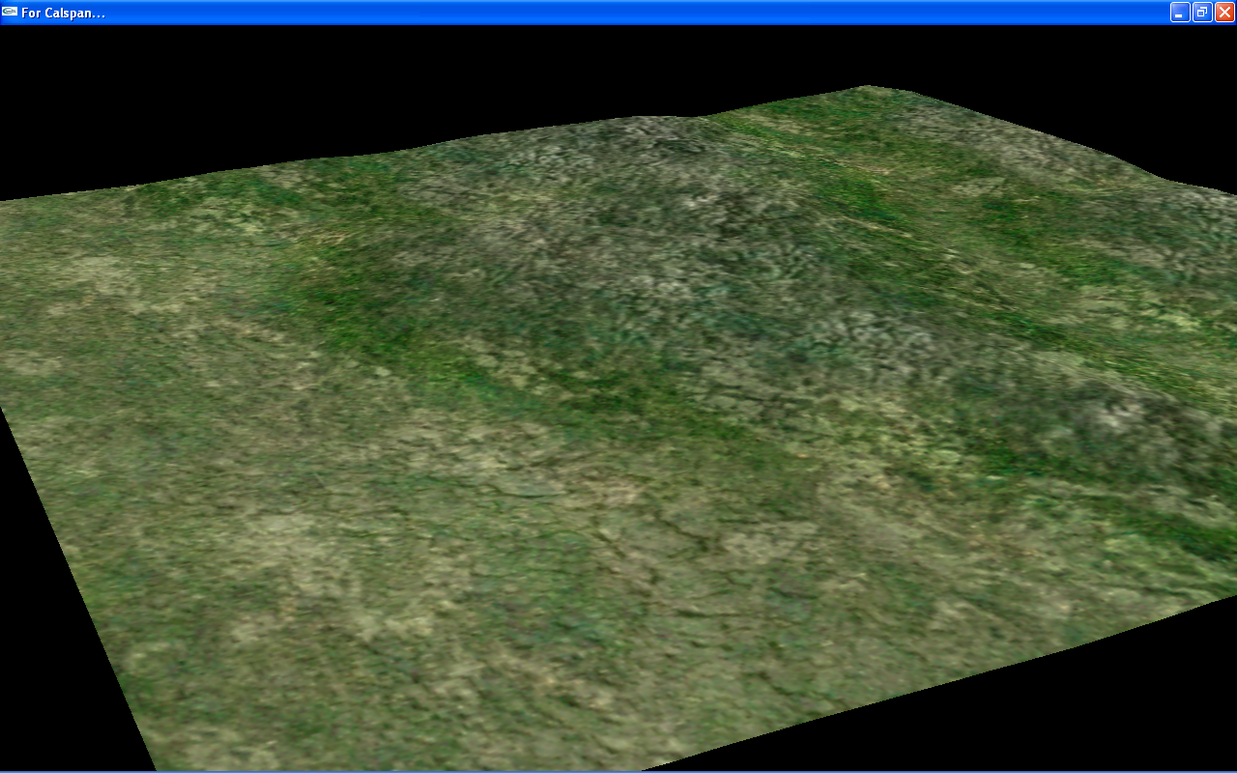
A Terrain Snapshot from Demo

Slide 3
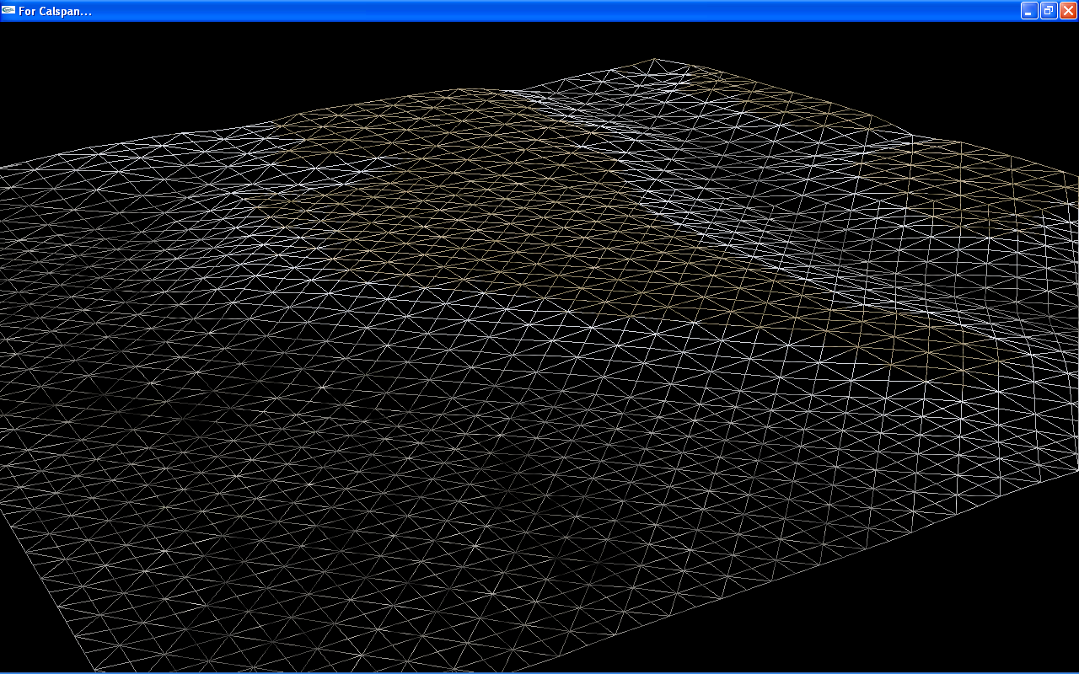
A Terrain Snapshot from Demo
(Wire Frame View)

Slide 4
We meet terrain modeling technologies everywhere……
Video Games (Flight Simulator):
  Online (real-time) rendering;
  Randomly create height (elevation) map;
  Performance is a big issue;
Cartoons or Movies with special effects
(The Lord of Rings):
  Offline rendering;
  Higher quality;
  Time-consuming;

Slide 5
We are talking about……
Online (real-time) rendering;
Real elevation data (non-randomly created data);
Use ranged random elevation data to improve the quality.

Slide 6
The Issues involved
Geometry:
  (Longitude, Latitude), plus Elevation
Texturing:
  Procedural Technique
Lighting
Viewpoint (camera)

Slide 7
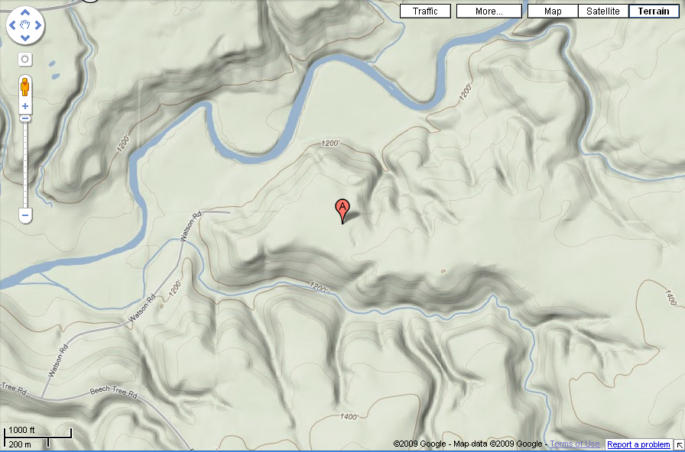
Case Study Location: Terrain View From Google Map
42.49933,-78.61354

Slide 8
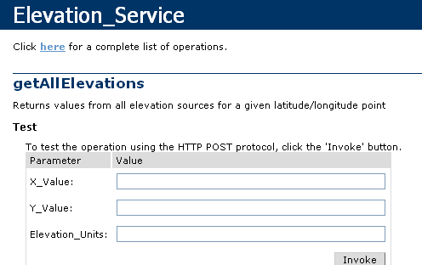
Where to get the real elevation data?
USGS:
  Download from the National Map Seamless Server (http://seamless.usgs.gov/index.php)
  Use web service:

Slide 9
The data from USGS Server
(NED) 1 arc second data (about 10 meters)
  NED: National Elevation Database
Format: GeoTiff
Resolution: 128 X 128

Slide 10
Higher Resolution?
From 128 X 128 to 2048 X 2048

Slide 11
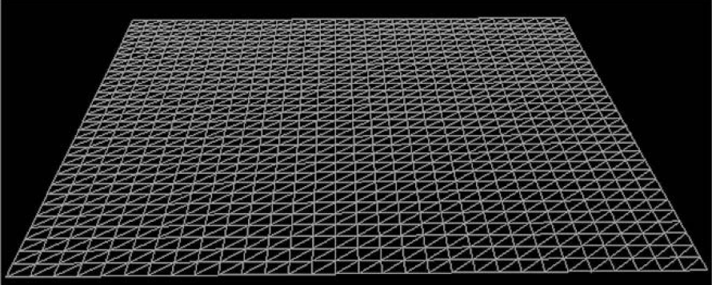
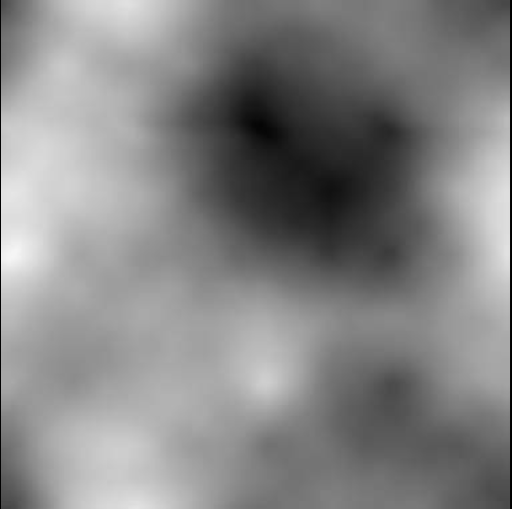
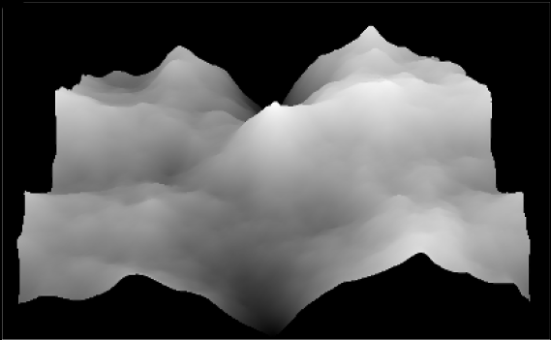
Geo-Mapping
+
=

Slide 12
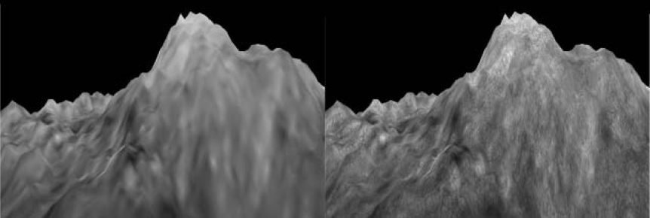
Use Detail Map

Slide 13
CLOD Algorithm
What is CLOD?
  Continuous Level of Detail
Why CLOD?
  Performance issue;
Basic Idea:
  The basic ideas of CLOD is that we want to add more detail (more triangles) where it is needed.
  The closer, the more details needed;
  The more chaotic, the more details needed;

Slide 14
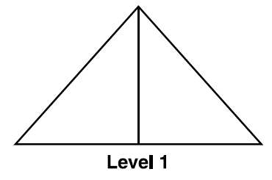
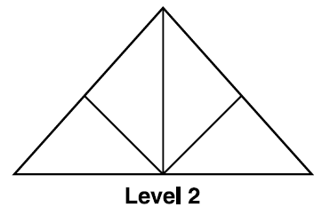
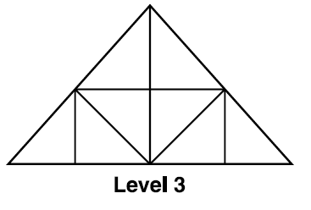
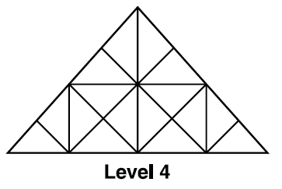
CLOD Algorithm (cont.)

Slide 15
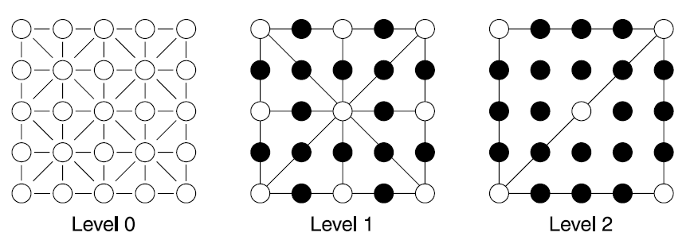
CLOD Algorithm (cont.)

Slide 16
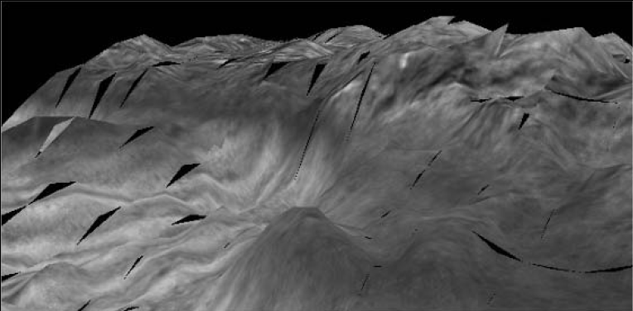
What happened?

Slide 17
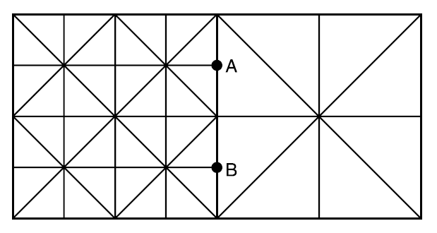
The reason of cracks

Slide 18
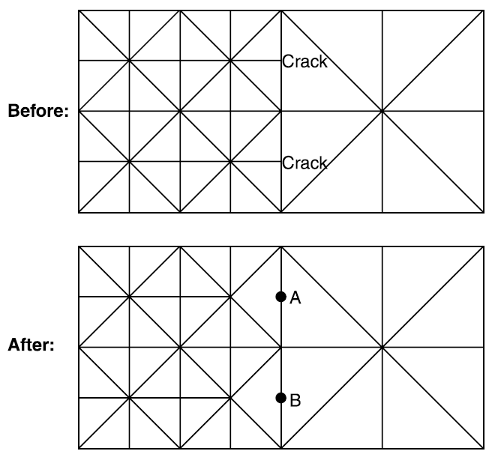
Crack Removing

Slide 19
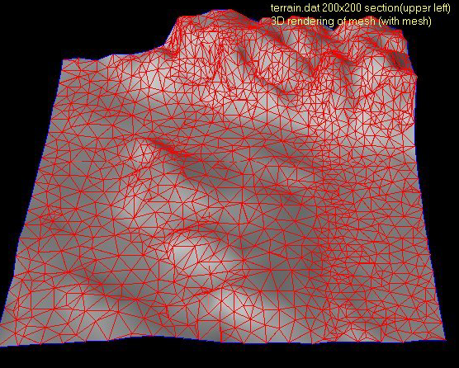
“Adaptive Surface Mesh” in [4]

Slide 20
Lighting
Height-Based Lighting:
  lighting based off the height of a vertex.
  It is simple, however, unrealistic.
Lightmapping:
  A lightmap is exactly like a, except that instead of having information for heights, the lightmap contains only lighting information.
Slope Lighting:
  shades vertices according to their height in relation to a nearby vertex.
  Simple and more realistic.

Slide 21
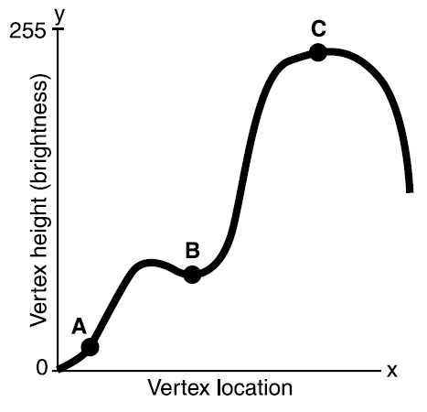
Hight-based Lighting

Slide 22
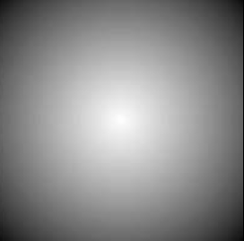
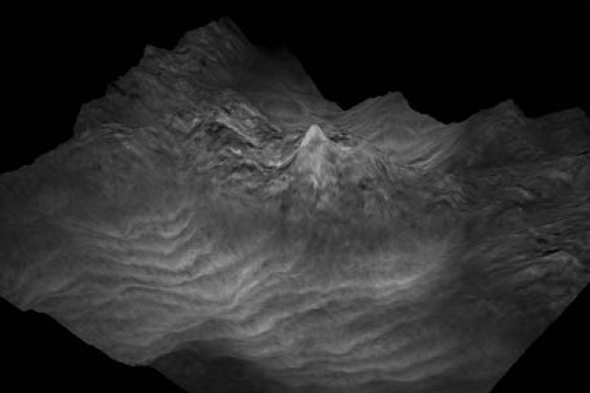
Lightmapping

Slide 23
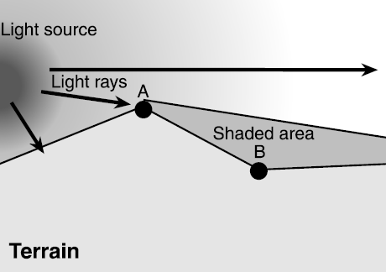
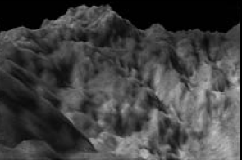
Slope Lighting

Slide 24
References
1. Trent Polack. 2002. Focus On 3D Terrain Programming.
2. David S. Ebert et al. 2006. Texturing and Modeling: A Procedural Approach.
3. Adrian G. Bors, Edwin R. Hancock and Richard C. Wilson. Terrain Modeling in Synthetic Aperture Radar Images using Shape-from-Shading.
4. Richard C. Wilson and Edwin R. Hancock. Terrain Reconstruction with an Adaptive Surface Mesh.
5. http://en.wikipedia.org/wiki/Wiki
6. http://seamless.usgs.gov/index.php

Slide 25
Thank you!
Questions and Comments?

