Slide 1
CAPTCHA

Slide 3
CAPTCHA Completely Automated Public Turing test to tell Computers and Humans Apart
A Computer Program that can generate and grade test that:
Most Humans can pass
Computers programs cannot pass

Slide 4
Example
Randomly select some
alphabets & digits
8r3F5z
Creates an image and randomly distorts it….

Slide 5
… generates a test
Type the characters

Slide 6
Applications
Protecting Website Registration
Preventing Comment Spam in Blogs
Online Polls
Preventing Dictionary Attacks
Protecting Email Addresses From Scrapers

Slide 7
Online Polls
MIT finished with 21,156
Carnegie Mellon with 21,032
other school with less than 1,000.

Slide 8
Preventing Dictionary Attacks

Slide 9
Protecting Email Addresses From Scrapers

Slide 13
Types of Image CAPTCHAs
MAILBLOCKS.COM
REGISTER.COM
MSN.COM

Slide 14
YAHOO.COM
TICKETMASTER.COM
GMAIL.COM

Slide 15
Using machine learning to break CAPTCHA
Algorithm
Locate the characters (Segmentation)
Use Machine Learning for recognition

Slide 16
Register
Original CAPTCHA image
Smoothen the image
Binarize it
All Connected Components are identified.

Slide 17
Yahoo
Original CAPTCHA image
Dilate and erode
Select large CC’s

Slide 18
Ticketmaster
Original CAPTCHA image
Convert to grayscale, then
dilate &erode
Select large CC’s

Slide 19
Gmail
Original CAPTCHA image
Convert to grayscale , up-sample,
threshold
Separate connected components

Slide 20
Segmentation a difficult task….
Computationally Expensive
Segmentation function is complex
Program must learn successfully from valid & in-valid patters. Since space input for both valid & in valid is too vast , defining exact features for machine to learn from becomes a difficult task.
Randomly guessing doesn't help much Correctly identifying 8 characters among 20 has 1 in 125,970 chance….

Slide 21
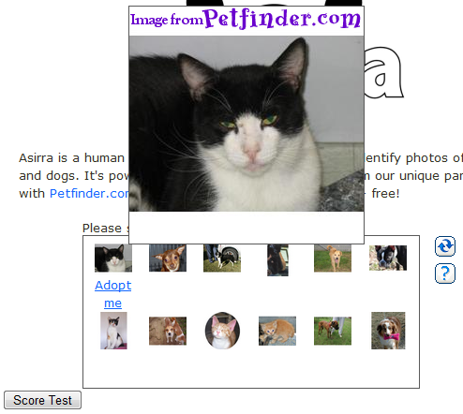
Microsoft
Asirra (Animal Species Image Recognition for Restricting Access)

Slide 22
Interesting Fact
200 million CAPTCHAs are solved by humans around the world every day.
These little puzzles consume more than 150,000 hours of work each day
Can we make some positive use of this Human effort…?

Slide 23
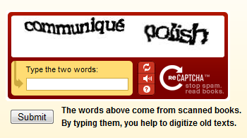
reCAPTCHA
In order to digitize old Reading material (Books,Newspapers etc) it is being scanned and then transformed into text using OCR(Optical Character Reading).

Slide 25
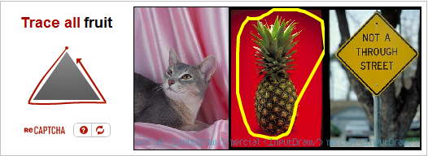
SQUIGL-PIX

Slide 26
ESP-PIX

Slide 27
CAPTCHA Sweat Shops
SPAM Companies hire people to solve CAPTCHAs all day long.
2.50$ per hour for each human
720 CAPTCHAS per hour per human.

Slide 28
IMAGE
Type the word if you want to see the next image….

Slide 29
CAPTCHAs are a win-win situation
CAPTCHA is not broken and there is a way to differentiate humans from computers
CAPTCHA is broken and an AI problem is solved

Slide 30
YOU
THANK

