Slide 1
CSE501
Yin Yan
Notes:
Introduction: …
In the project, We are looking at adding real-time capacity into Android system.
The reason why do we need the real-time Android?

Slide 2
Research in Reliable Mobile System
Blue seal
RTDroid
Record and replay
Resource Accounting
RT Linux
RTEMS

Slide 3
RTDroid
Real-time system + Android compatibility
  Strict timing guarantee
  System designer’s point of view: Predictability
    Execution predictability: Priority-based execution
    Memory predictability：Garbage collection shouldn’t interfere.
    External resource predictability: Priority-based allocation
RTEMS
Notes:
Real-time systems are a special class of systems, that require a timing guarantees.
What we mean by timing guarantee, there is a deadline associate with each task and the task has to finish within that deadline
From system designer’s point of view, what this means is that
the system should be predictable from three aspects:
The system should be predictable in its memory usage, external resource usage, and execution timing.
Execution predictability means that the tasks in the system should be prioritized. Low-priority tasks shouldn’t interfere with high-priority tasks.
Memory predictability means that the system’s garbage collector shouldn’t interfere with normal tasks.
External resource predictability means the resource allocation should also be prioritized.
If a system provides predictability in all three aspects, then it can provide timing guarantees.
Why can we use Android as real-time system?
Because Android is not predictable, let us examine why it is not perdictable.

Slide 4
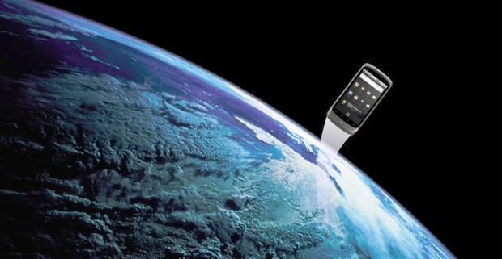
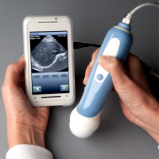
Use Cases---Industry
Aerospace
Health Monitoring
UK http://www.sstl.co.uk/
NASA http://www.phonesat.org/
PathCare http://goo.gl/G5UXq.
Mentor Graphic http://goo.gl/DYVOtq
Notes:
Question raised in the first slide---”Why are we looking into this problem?”
The first sentence you speak in this slide is: “The reason is that industry is interested in leveraging Android in real-time context.”
UK and NASA are interested in using Android as their control system.
They are experimenting to see the possibility of leveraging Android to as the nanosatellite operating system.
Similarly, health industry is also trying to leverage Android for healthcare devices.
Simplify the slide.

Slide 5
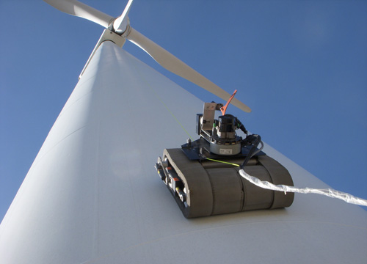
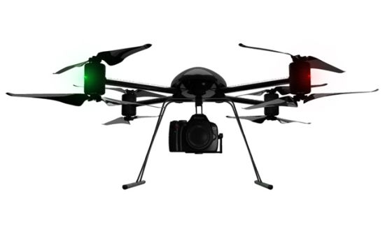
Use Cases---Academia
Smart Wind Farm
jUAV
Notes:
Question raised in the first slide---”Why are we looking into this problem?”
The first sentence you speak in this slide is: “The reason is that industry is interested in leveraging Android in real-time context.”
UK and NASA are interested in using Android as their control system.
They are experimenting to see the possibility of leveraging Android to as the nanosatellite operating system.
Similarly, health industry is also trying to leverage Android for healthcare devices.
Simplify the slide.

Slide 6

Can We Use Android As-Is?
Applications
Application Framework
Message Passing
System Service
Constructs And APIs
System
Service
Libraries
Android
Runtime
Garbage Collection
No Support for RT Java Threads
Dalvik VM
Completely Fair Scheduling
Interrupt Service Routine
Out of Memory Killer
Advance Configuration And Power Interface
Linux with Android Modifications
Android Stack
Notes:
In order to see why Android is not predictable, we have to examine each layer in Android stack.
In bottom layer, it is well-known.
Many features are not predictable, for example ….
In nutshell, there is not predictability in kernel layer
In VM Layer, it is also well-known that it is not predictable.
In framework, our research show it is not predictable.
There layers are known no predictable,
The Android Linux Kernel is developed to achieving full CPU utilization, the predictability of the system were not taken into account.
VM: Dalvik was design for mobile devices and consider more about the memory optimization, battery lift and low frequent CPU.

Slide 7
RTDroid Architecture
Applications
Preserve APIs
Application Framework
Re-designing Message Passing
Re-designing System Services
Libraries
Real-time Garbage Collection
Real-time Java Threads
Android
Runtime
Fiji Runtime
Dalvik VM
Fiji VM
Priority Based Scheduling
Interruption Handling
PIP Locks && Preemption
Linux with Android Modifications
RT Linux or RTEMS
RTDroid Stack
Notes:
In order to see why Android is not predictable, we have to examine each layer in Android stack.
In bottom layer, it is well-known.
Many features are not predictable, for example ….
In nutshell, there is not predictability in kernel layer
In VM Layer, it is also well-known that it is not predictable.
In framework, our research show it is not predictable.
There layers are known no predictable,
The Android Linux Kernel is developed to achieving full CPU utilization, the predictability of the system were not taken into account.
VM: Dalvik was design for mobile devices and consider more about the memory optimization, battery lift and low frequent CPU.

Slide 8
Re-designed Components
Application Framework
Constructs and APIs
Runtime System Services
RT Handler
RT AlarmManager
RTSJ
RT SensorManager
Notes:
The point of this slide is to mention what the general challenges are. Mention the following:
What the application framework does.
All components heavily rely on message passing.
There is no predictability in message passing (no timing guarantee, no memory guarantee, etc.).

Slide 9
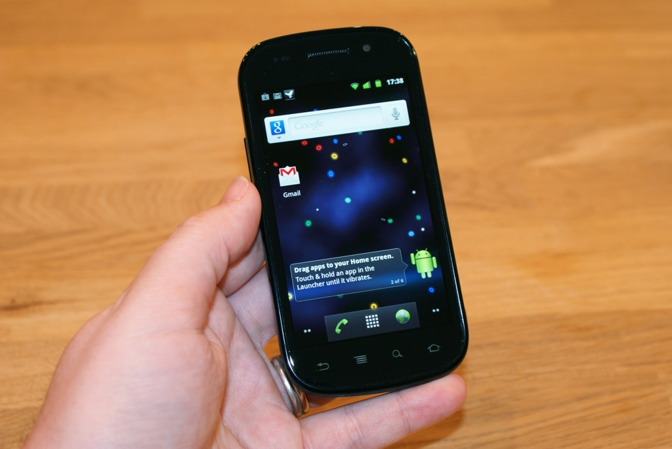
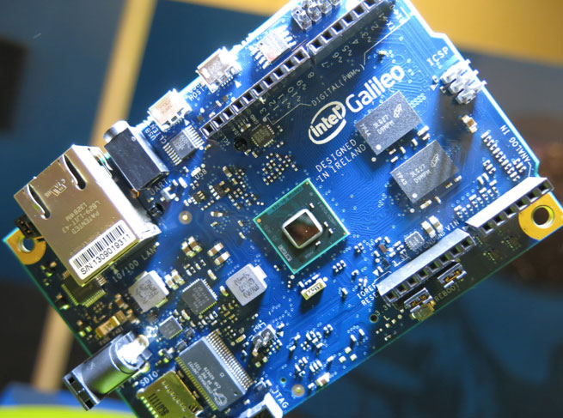
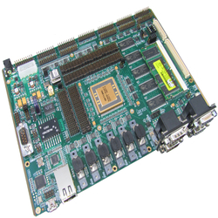
  Target Platforms
Soft Real-time on
ARM-based Smartphone
Soft Real-time on
x86 Development
Board
Hard Real-time on
SPARC Development Board
Notes:
Question raised in the first slide---”Why are we looking into this problem?”
The first sentence you speak in this slide is: “The reason is that industry is interested in leveraging Android in real-time context.”
UK and NASA are interested in using Android as their control system.
They are experimenting to see the possibility of leveraging Android to as the nanosatellite operating system.
Similarly, health industry is also trying to leverage Android for healthcare devices.
Simplify the slide.

Slide 10
Difficulties
Technical perspective
  OS + VM + Compiler
  Hardware + Driver
Academic perspective
  Motivating examples
  Necessity of Real-time Android
  Completeness of RTDroid

Slide 11
Research Flow
Paper Submission
Camera Ready
Presentation
Topic/Problems
Ideas/ Solution
Implementation
Experiments
Paper rejection
More work need to be done
Challenging questions
Not Motivated
Not convincing
Design deficiency
Unexpected results
Can’t find what to do
Uncertainty
Deadline Missing

Slide 12
How to Overcome the Pitfalls
Find the area that you are really interested or good at
Read the related papers in fields
Talk to others
Increase the visibility of your results
Never give up

Slide 13
I Wish I Knew These in Advance
Balance study and research
Start research as early as possible
Early publication
conference talk
Practice writing skills

