Slide 1

Bina Ramamurthy (Computer science and Eng. Department): bina@buffalo.edu
Jessica Poulin (Biology Department): jpoulin@buffalo.edu
Katharina Dittmar (Biology Department): kd52@buffalo.edu
*This project is partially supported the NSF-OCI-CITEAM grant# 1041280 (2010-2012)
Introducing Pop!World: A Cloud-Enabled Learning and Discovery Environment for Evolutionary Biology*

Slide 2
Bio Intro Course Redevelopment
An email I received on 8/31/2009
“My name is Jessica Poulin and I am working in the department of biological sciences to redevelop our first year lab curriculum for our (recently redeveloped) evolutionary biology intro course. As part of that I am hoping to develop some computer simulations of evolutionary processes (mutation, genetic drift, non random mating, and gene flow) that our students can explore. It is my great hope that I can work with a faculty member or graduate student in computer science at UB who is interested in using computer programs for educational purposes to design a program we can use. ……

Slide 3

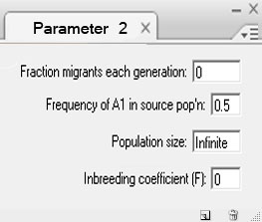
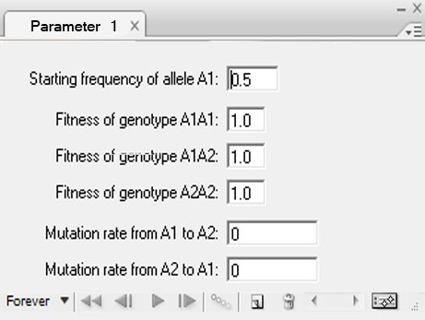



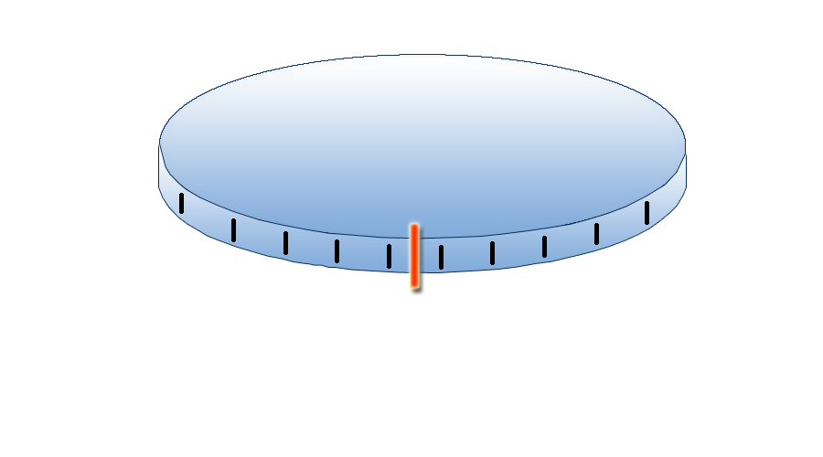
Design concept
From Bina and Kim (CSE grad student) 9/18/2009
Parameter input boxes
80%
20%
0
40
50
Menu bar
10
20
30
Generation

Slide 4
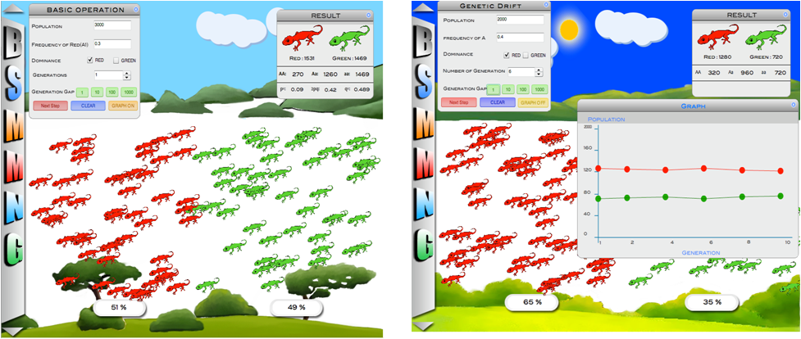
Prototype
Prototype by the Dec 2009/Jan 2010

Slide 5
Pop!World Application Architecture
_{Pop!World (Cloud-client)}
K-12
(Pipeline)
K-21 (Undergraduate)
K-∞
(Research)
Biological Sciences Applications: Population Genetics and Evolutionary Biology,…
Computer Science and Engineering: Bioinformatics Applications, …
Interfaces, visualization services:
Observation, Measurement, Experiment fabrication
Cloud-based computational services
Cloud-based collaboration services
Networking, Operating systems, middleware
Cloud infrastructure (Ex: Amazon, Google App Engine, Azure)

Slide 6
Technical Details
Current version of Pop!World uses Adobe Flash premium and Action Script
The Pop!World core design follows all the best practices in object-oriented design; this allows extensibility and customizability to other simpler and sophisticated versions of the tool.
Currently deployed on Google App Engine since it is free.
User accesses Pop!World through a browser and there is no need to download any specific software (Adobe Flash, or .swf or .exe files).

Slide 7
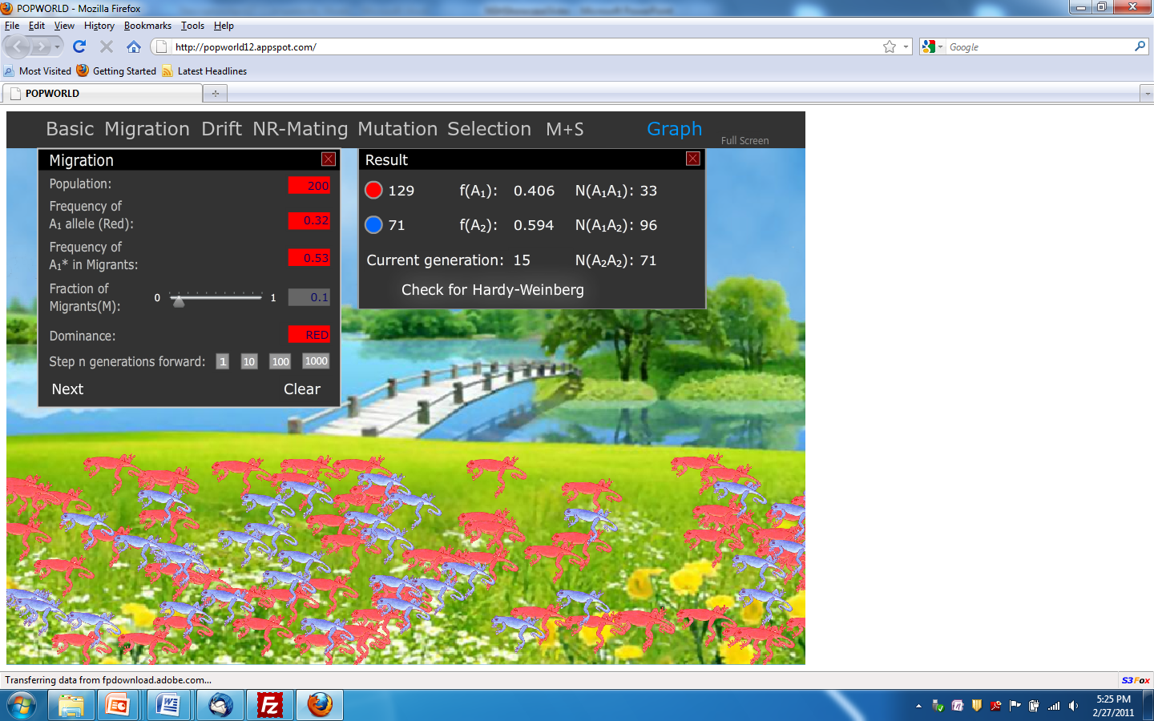

Slide 8
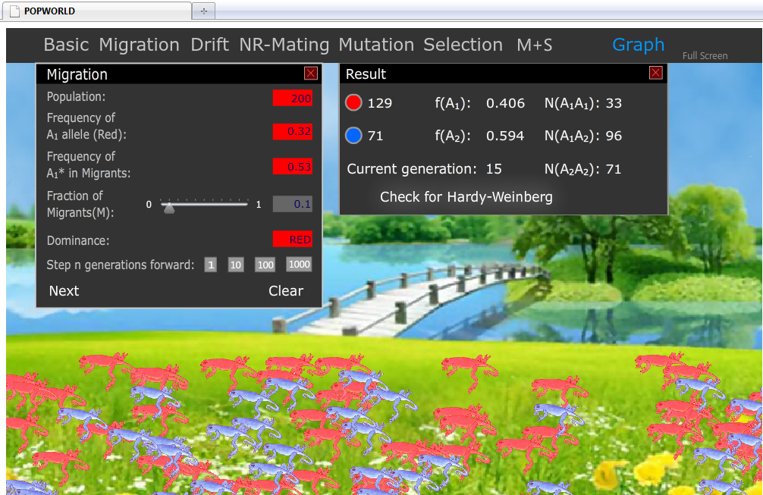

Slide 9
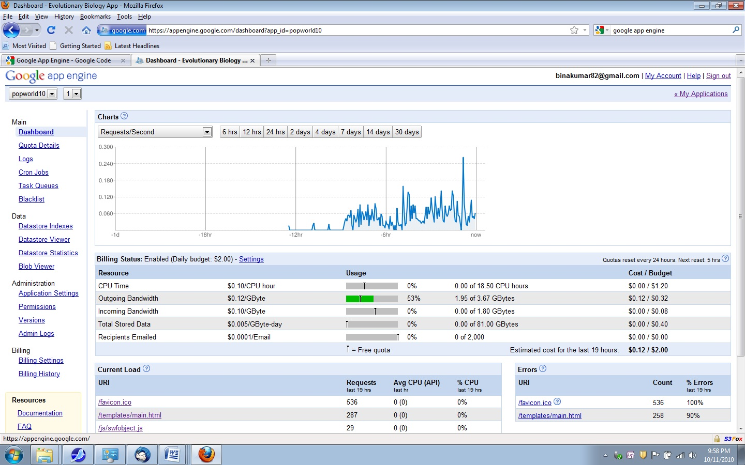
Google App Engine Load Monitoring on 10/11/2010

Slide 10
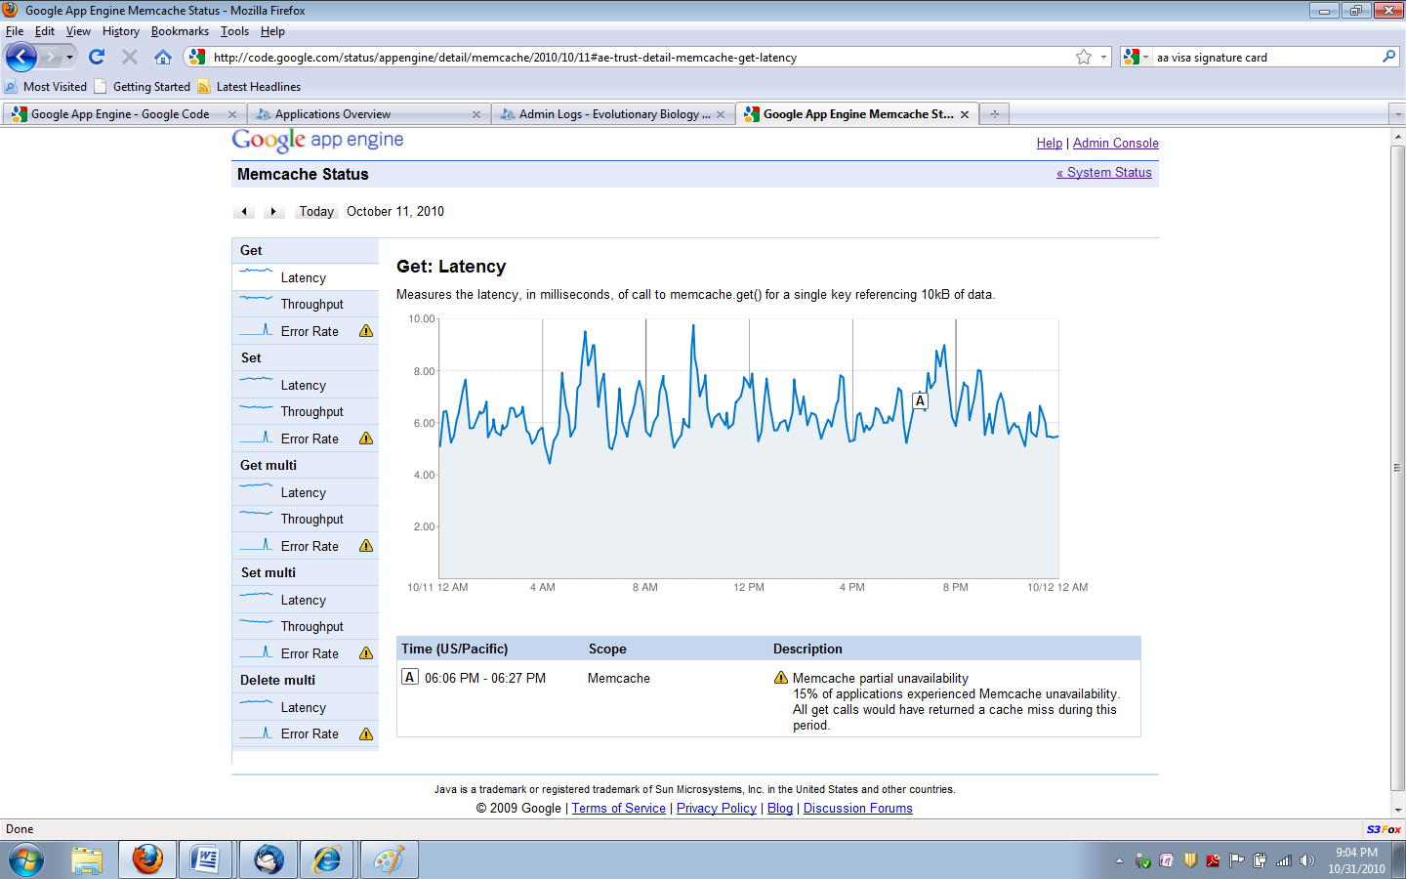
MemCache on Google App Engine on 10/11/2010
Memcache partial unavailability

Slide 11
Public interest
With Cloud Computing, the Mathematics of Evolution May Get Easier to Learn in College...and Easier to Teach in High School, by Ellen Goldbaum, http://www.buffalo.edu/news/12197, Jan 24, 2011, also on ACM Tech News, Jan 24, 2011.
Biology Professors use Cloud Computing to Reach Students, The Chronicle of Higher Education, by Tushar Rae, http://chronicle.com/blogs/wiredcampus/biology-professors-use-cloud-computing-to-reach-students/29330, Jan 28, 2011.
Taking a Highly Visual Look at the Mathematics of Evolution, Scientific Computing: Information Technology for Science, Jan 26, 2011, http://www.scientificcomputing.com/news-DA-Taking-a-Highly-Visual-Look-at-the-Mathematics-of-Evolution-012611.aspx

Slide 12
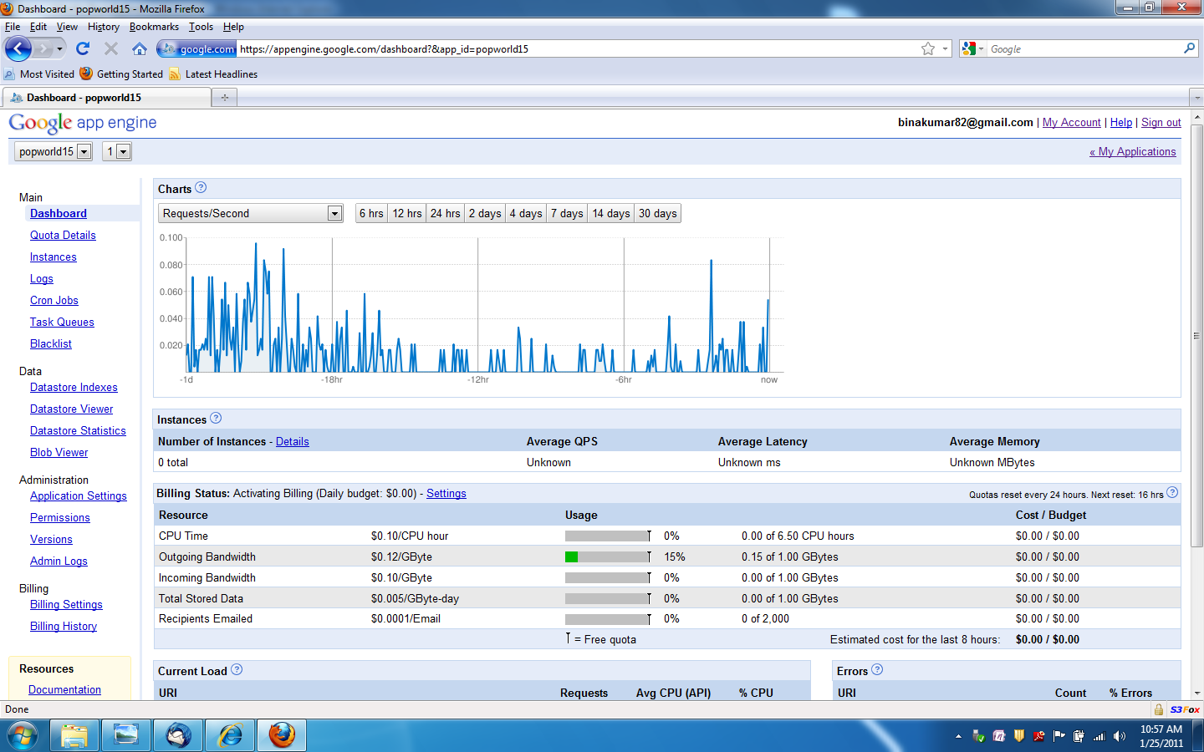
Pop!World Traffic after Chronicle of Higher Education Article

Slide 13
People
The faculty investigators are: Dr. Bina Ramamurthy (Computer Science and Engineering - CSE), Dr. Jessica Poulin and Dr. Katharina Dittmar (Biological Sciences - BIO)
Pop!World version 1.0 (K-21: Teaching) was built by Thomas J. Harnett and Shuang Wu, graduate students in CSE, Tayler Tyler, a BIO undergraduate, and Shesh Patel a CSE undergraduate.
Pop!World K-12 (Gateway) is being built by Shuang Wu.
The Pop!World prototype was built by Hongsik Kim, Jungeun Lee and Byunghun Jang, all former UB graduate students in the Department of Computer Science and Engineering.
External Consultant: Dr. Jeannette Neal, SUNY Chancellor’s award winning Professor emeritus of Erie Community college

Slide 14
On to the demo
Pop!World (K-21) http://popworld15.appspot.com/
Pop!World (K-12: Gateway) http://popworldtesting2.appspot.com/
Pop!World Web page: http://www.cse.buffalo.edu/popworld/

Slide 15
Questions?

