Slide 1
Ethics in Research
Bharat Jayaraman
CSE Department

Slide 2
Ph.D. Scholars
As doctoral students, you have three important roles:
  Student
    When attending courses yourself
  Teacher
    When serving as teaching assistant or course instructor
  Researcher
    When performing research under the guidance of a professor

Slide 3
Academic Integrity, a Fundamental University Value*
“The academic degrees and the research ﬁndings produced by our Department are worth no more than the integrity of the process by which they are gained.
If we do not maintain reliably high standards of ethics and integrity in our work and our relationships, we have nothing of value to offer one another or to offer the larger community outside this Department, whether potential employers or fellow scholars.”
* CSE Graduate Handbook

Slide 4
Examples of Academic Dishonesty*
Plagiarism (coursework as well as research)
Cheating (unauthorized collaboration)
Falsifying Academic Materials
Misrepresentation of Documents
Submitting Previously Submitted Work
Purchasing Academic Assignments
Selling Academic Assignments
Violating Confidentiality of Academic Materials
* https://grad.buffalo.edu/succeed/current-students/policy-library.html#academic-integrity

Slide 5
Advice for Students
Preparation is the key to success:
    - Attend all classes. Take good notes.
    - Start promptly on homeworks and projects; helps avert
    last-minute crisis.
    - Avoid unauthorized collaboration; instead seek help
    directly from the TAs and instructor.
Maintaining academic integrity in your work builds confidence in yourself, earns the respect of faculty and peers, and enables you to grow in stature in your field.

Slide 6
Ethics for Teachers and Teaching Assistants
Teachers/TAs are held to a higher ethical standard because they are entrusted with educating students.
  Treat students with respect and politeness
  Be impartial – no favorites or prejudice
  Don’t give/take gifts, unless it is of a trivial nature
  Maintain confidentiality of student information
  Use university resources for academic purposes only
  Be punctual to class; make alternate arrangements if
    you need to miss class.

Slide 7
Research – Brief Definition
Systematic Study or Inquiry
Leading to new knowledge or theory, or creation of a new artifact, process, etc.
Goal of research is to advance a field, be it science, engineering, or the arts.

Slide 8
Doctoral Research
  Take advanced courses and build technical skills
  Identify research advisor and meet regularly
  Study important papers from conferences and journals
  Identify open problems that you can investigate
  Attend and present at research group meetings
  Write papers and submit to conferences/journals
  Attend conferences and workshops

Slide 9
Qualities of a Good Researcher
Logical Thinking and Ability to Abstract
Attentive to Details
Well-informed, has broad background
Creative and Innovative
Communicates Well
Passionate about the Subject
Perseverance, take success/failure in stride
Maintains high standards of ethics

Slide 10
Research Ethics
Some of the later slides are adapted from material from:
Prof. Lee Brown,
http://faculty.fullerton.edu/leebrown/,
for his course on Research Methods.
Additional material taken from
“Politics of Research”
and
“Research Ethics – Summary”.

Slide 11
http://en.wikipedia.org/wiki/
Unethical_human_experimentation_in_the_United_States
Many of the modern day guidelines for ethical research originated from human subjects’ abuses in the 1800’s and 1900’s:
  Nazi experiments using war chemicals, environmental extremes, food and sleep deprivation, etc
  Tuskegee Alabama study where men with syphilis were “treated” with a placebo instead of a drug
    US Congress formed the National Commission for the Protection of Human Subjects in Biomedical and Behavioral Research (1974)

Slide 12
Institutional Review Board (IRB)
In the US, the IRB is a panel of research experts that pass judgment on the quality and safety of studies before they can be conducted.
Primarily responsible for protecting the rights of subjects – health, safety, privacy – but also the researchers and the institution.
Provides potential subjects with information to make a good decision about participating in a study.
Provides simple but comprehensive information about the study.

Slide 13
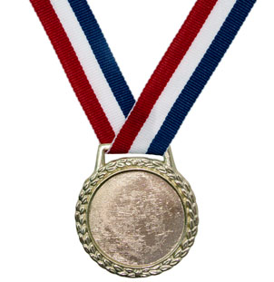
Scientific Dishonesty in Research
Plagiarism
Fabrication and falsification
Non-publication of data
Faulty data-gathering procedures
Poor data storage and retention
Misleading authorship
Sneaky publication practices
13

Slide 14
Don’t Plagiarize – Cite References
Internet has made it easy to cut and paste.
Plagiarism = putting your name on the ideas, writings, drawings, and codes of others.
Plagiarism is not just copying verbatim, but also taking ideas without attribution.
Any copied passage must be given in quotes.
Definitions, theorems, etc., from other sources can be taken with attribution, such as:
“The following definitions are taken from Smith and Jones [25]: …”
and then reproduce their definitions verbatim.
14

Slide 15
Why do people fabricate and falsify in their research ?
Pressure on the job.
Need to complete research study and get a job.
Need to increase one’s publication count.
Need to obtain external funding.
Obtain rewards in the field and become famous
  “The Fugitive” starring Harrison Ford, Tommy Lee Jones
  In this movie, a “reputable” scientist hides the fact that a certain drug that he invented causes liver damage in order to profit from stake in a billion-dollar pharmaceutical company.

Slide 16
Right Attitude Towards Research
Develop a genuine liking for your work. This comes with reading, discussion, conferences.
Strive for excellence.
Be honest with yourself.
Don’t ignore small issues – they can lead to bigger openings in your research.
Take critical reviews in stride – they help you improve your research.

Slide 17


Maximizing Publications – Unethically!
Salami-Slicing: breaking up work into large number of small papers, often called “minimal publishable units”
Tiling: publishing a sequence of substantially overlapping papers.
Double Publishing: publishing the same work twice
Parallel Submissions: send same paper to simultaneously to two journals or conferences

Slide 18
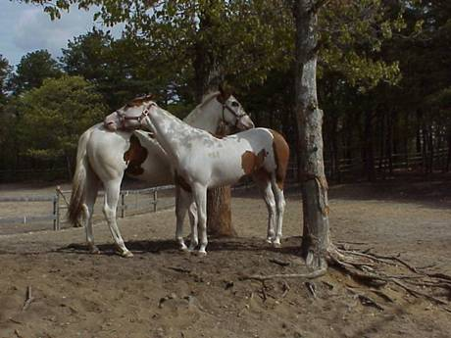
Peer Review Process
Prior to acceptance, conference and journal papers are rigorously reviewed by fellow researchers – none of whom are paid for their service.
Peer review is also used for proposal evaluation, tenure evaluation, etc.
The importance of being an ethical reviewer.
Today, double-blind reviewing of papers has become
common, to protect anonymity of authors as well.

Slide 19
ACM and IEEE Codes of Ethics and
Professional Conduct
Please read:
https://www.acm.org/code-of-ethics
https://www.ieee.org/about/corporate/governance/p7-8.html

Slide 20
ACM Code of Ethics
1.1 Contribute to society and human well-being.
1.2 Avoid harm to others.
1.3 Be honest and trustworthy.
1.4 Be fair and take action not to discriminate.
1.5 Honor property rights including copyrights and patent.
1.6 Give proper credit for intellectual property.
1.7 Respect the privacy of others.
1.8 Honor confidentiality.
Sections 2 and 3 deal with professional responsibility and
imperatives for organizational leaders.

Slide 21
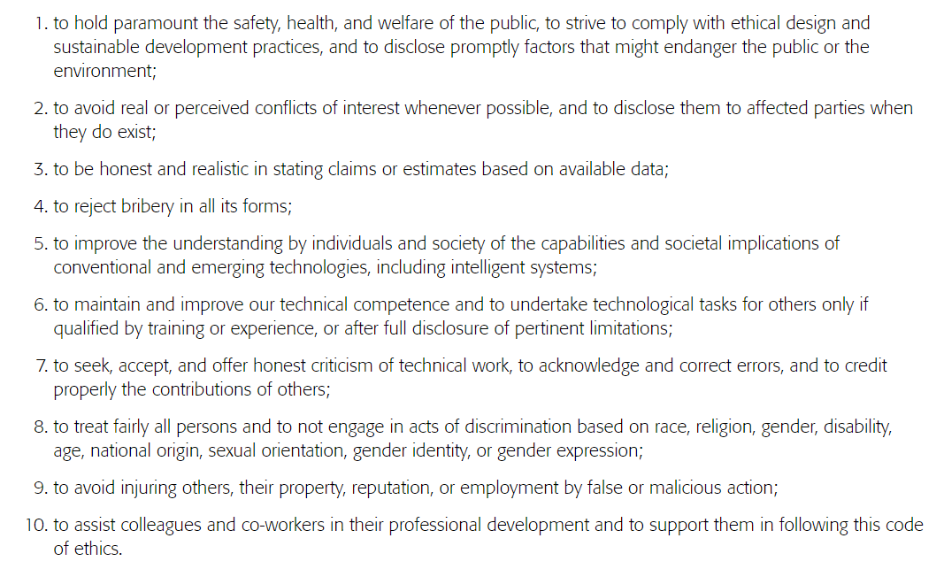
IEEE Code: Ethics & Professional Conduct
Taken from the website mentioned on previous slide.

Slide 22
Story of the Black Belt
(from karate folklore)
After years of hard work, the student appears before his master who asks one final question:
"What is the true meaning of the black belt?“
"The end of my journey," says the student. "A well-deserved reward for all my hard work."
“You are not ready for the black belt,” says the master, “return after one year!”

Slide 23
Story of the Black Belt (cont’d)
After another year of hard work, the student appears before his master who again asks:
"What is the true meaning of the black belt?“
"A symbol of distinction,” says the student, “the highest achievement in our art."
“You are not ready for the black belt,” says the master, “return after one year!”

Slide 24
Story of the Black Belt (cont’d)
After another year of hard work, the student appears before his master who again asks the same question. Now the student replies:
"The black belt is just the start of a never-ending journey of discipline, hard work, and the pursuit of an ever-higher standard."
“You are now ready for the black belt,” says the master, “go and get started on your work!”

