Slide 1


Specifying modalities in the mglair architecture
Stuart C. Shapiro and Jonathan P. Bona
Department of Computer Science and Engineering
And Center for Cognitive Science
University at Buffalo, The State University of New York

Slide 2
Outline
The Architecture
Specifying Modalities

Slide 3
Motivations for MGLAIR
Add acting and sensing to a reasoning agent.
  First person reasoning; on-line acting & sensing.
Layers
  Motivated by mind/body connections/distinctions.
  Let same mind be plugged into different bodies.
Embodiment
  Origin of beliefs in sensation & proprioception.
  First-person privileged knowledge of own body.
Situatedness
  Has a sense of where it is in the world.
Symbol grounding
  In body-layer structures.
  Symbol as pivot between various modalities.

Slide 4
Motivations for Modalities
Independent but limited resources
Sensors and effectors are the resources
Different modalities can be used independently
Single modality has limited use

Slide 5
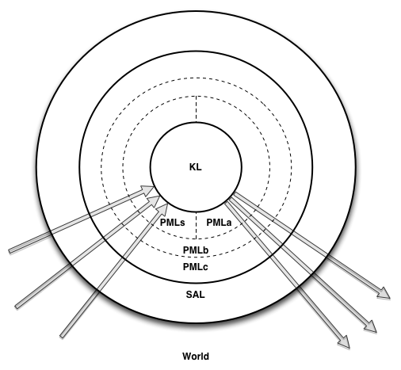

MGLAIR Architecture

Slide 6
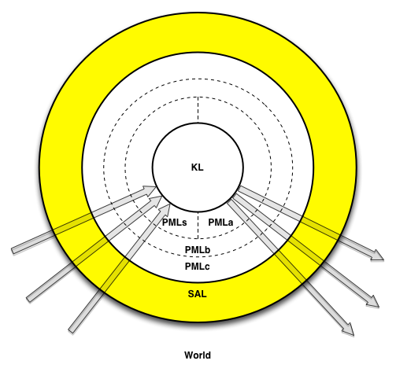
Sensori-Actuator Layer
Sensor and effector controllers

Slide 7
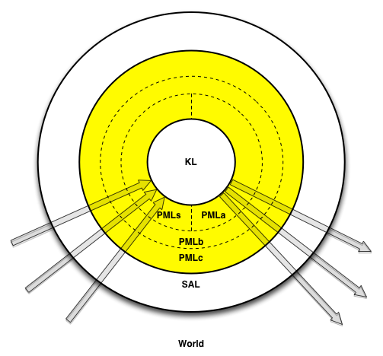
Perceptuo-Motor Layer
PMLa
PMLs
PMLb
PMLc

Slide 8
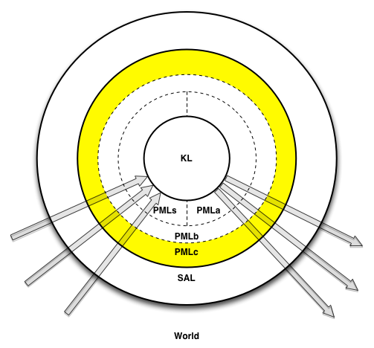
PMLc
Abstracts sensors & effectors
Body’s behavioral repertoire
Specific to body implementation

Slide 9
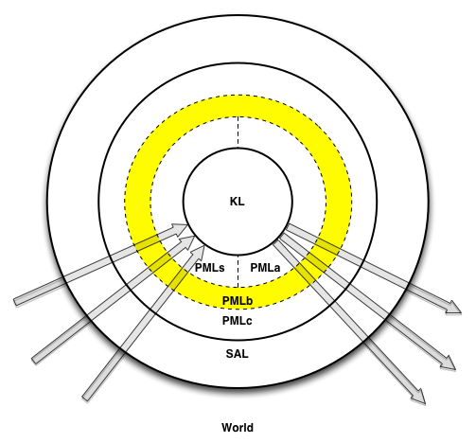
PMLb
Translation & Communication
  Between PMLa/s & PMLc
Highest layer that knows
body implementation

Slide 10
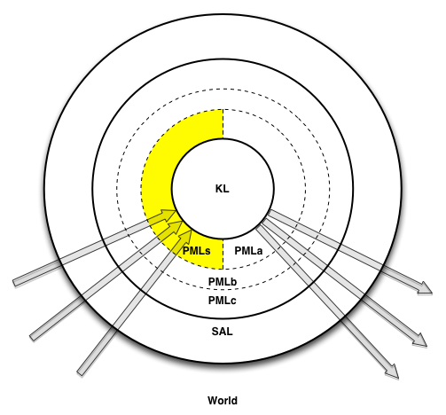
PMLs
Grounds KL symbols
  Perceptual structures
  Lowest layer that knows KL terms
Registers for
Embodiment & Situatedness
  Deictic Registers
  Modality Registers

Slide 11
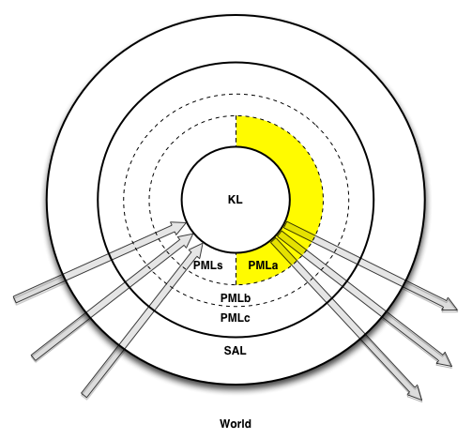
PMLa
Grounds KL symbols
  Implementation of primitive actions
  Lowest layer that knows KL terms
Registers for
Embodiment & Situatedness
  Deictic Registers
  Modality Registers

Slide 12
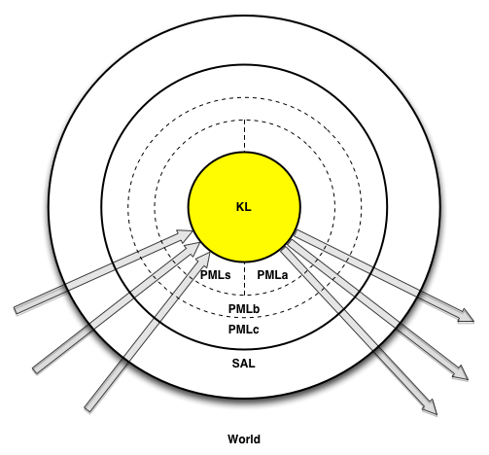
The Knowledge Layer
Implemented in SNePS
Agent’s Beliefs
Representations of
conceived of entities
Semantic Memory
Episodic Memory
Quantified & conditional beliefs
Plans for non-primitive acts
Plans to achieve goals
Beliefs re. preconditions
& effects of acts
Policies: Conditions
for performing acts
Self-knowledge
Meta-knowledge

Slide 13
Afferent Modalities
Sensors
to Perceptual Structures
to Perception
to KL Terms

Slide 14
Efferent Modalities
KL Primitive Acts
to PMLa Methods
to act Impulses
to Effectors

Slide 15
Alignment
Afferent
Modality
Efferent
Modality
Mind (KL)
Thing
Action
Body (PML/SAL)
PMLs structure
PMLa method
World
Object/Phenomenon
Action

Slide 16

Entities, Terms, Symbols, Objects
Agent’s mental entity: a person named Stu
SNePS term: b4
Object in world:

Slide 17
Ontology of Mental Entities
Entity
  Proposition
    Agent can believe it or its negation
    Includes quantified & conditional beliefs
  Act
    Agent can perform it
  Policy
    Condition-act rule agent can adopt
  Thing
    Action: What some agent can perform on some object(s)
    Category: A category/class of entities
    Other entities: individuals, properties, times, etc.

Slide 18
Modality: A Nine-Tuple
Name | Unique name for modality
Type | afferent/efferent
Predicates | KL predicates to use
Channel | Data channel
Access | Allow/Deny agent conscious access
Focus | Default level; Permit/Forbid agent adjustment …
Conflict | Conflict handler for multiple use …
Description | Human readable description
Relations | Relations to other modalities

Slide 19
Act Impulses in Efferent Modalities
KL primitive acts implemented by PMLa methods
PMLa method to be executed
added as act impulse to modality buffer

Slide 20
Efferent Modality Buffers
In PMLb of efferent modality
Fixed capacity or expiration interval
New act impulse queued or replaces old impulse
When impulse arrives that can’t fit,
handled by conflict handler
Discarded impulses are never performed
Impulses removed by buffer management process
and processed in PMLc

Slide 21
Perceptual Buffers
In PMLb of afferent modality
Queues perceptual (PML) structures (sensory data)
Fixed capacity or expiration interval
When structure arrives that can’t fit,
either it or oldest structure discarded
depending on conflict handler
Discarded structures are never perceived
Structures removed by buffer management process
and given to perceptual function

Slide 22
Perceptual Functions
Specific to each afferent modality
Input: a PML structure representing what was sensed
Output: KL term(s) representing what was perceived

Slide 23
Afferent Modality Focus
Affects frequency of execution of internal processes
From “ignore” to maximal focus
Initially at default setting
Agent might be permitted to adjust
Agent might miss
perceiving phenomena in low-focused modalities
So adjust relative focus of different modalilties appropriately
  Watching the road vs. talking on cell phone!

Slide 24
Summary
MGLAIR adds acting/sensing to reasoning agents.
Layers capture Mind/Body distinction & connection.
Modalities are independent, limited resources
for acting and sensing.
Modality buffers queue act impulses & afferent structures
but discard ones not processed.
Focus level determines how much a modality is ignored.

Slide 25
For More Information/Papers/Downloads
http://www.cse.buffalo.edu/~shapiro/
http://www.cse.buffalo.edu/sneps/

