Slide 1
Learning and Teaching Data Science
Bina Ramamurthy
bina@buffalo.edu
http://www.cse.buffalo.edu/~bina
This research is partially funded by NSF-DUE-CCLI grant 0920335
bina@buffalo.edu

Slide 2
Goals
To share my experience with teaching data science: what worked and what did not
To discuss approaches for teaching date science
To share curriculum, course material and tools to introduce data science into undergraduate curriculum
Target audience: teachers and administrators of 2-year and 4-year CSE programs
Notes:
Take home tangible objects they can use.

Slide 3
Overview
What is DS?
Entry points for adoption of DS
Entry points into DS
How did we do it?
Courses: Distributed Systems & Data-intensive computing course
Certificate program
What worked? Learning outcomes
What needs work?
Best practices
Summary

Slide 4
My Journey Learning DS
Yahoo! Big Data Computing conference: NSF, CRA supported
Hadoop cluster in 6 months: presented at CCSCNE April 2009
NSF grant for creating a data-intensive computing certificate program and courses
Certificate program approved by SUNY system and is listed in the catalog (2011-12)
Courses have become permanent and have been assimilated into the degree program

Slide 5
What is DS?
Data Science is not single subject: it is a combination of many topics and skills [1]
According to this DS comprises:
Computer science,
Mathematics,
Probability & Statistics,
Machine learning,
Visualization,
Communication and
Domain expertise
To that I have added “Coding” as in problem solving and programming.

Slide 6
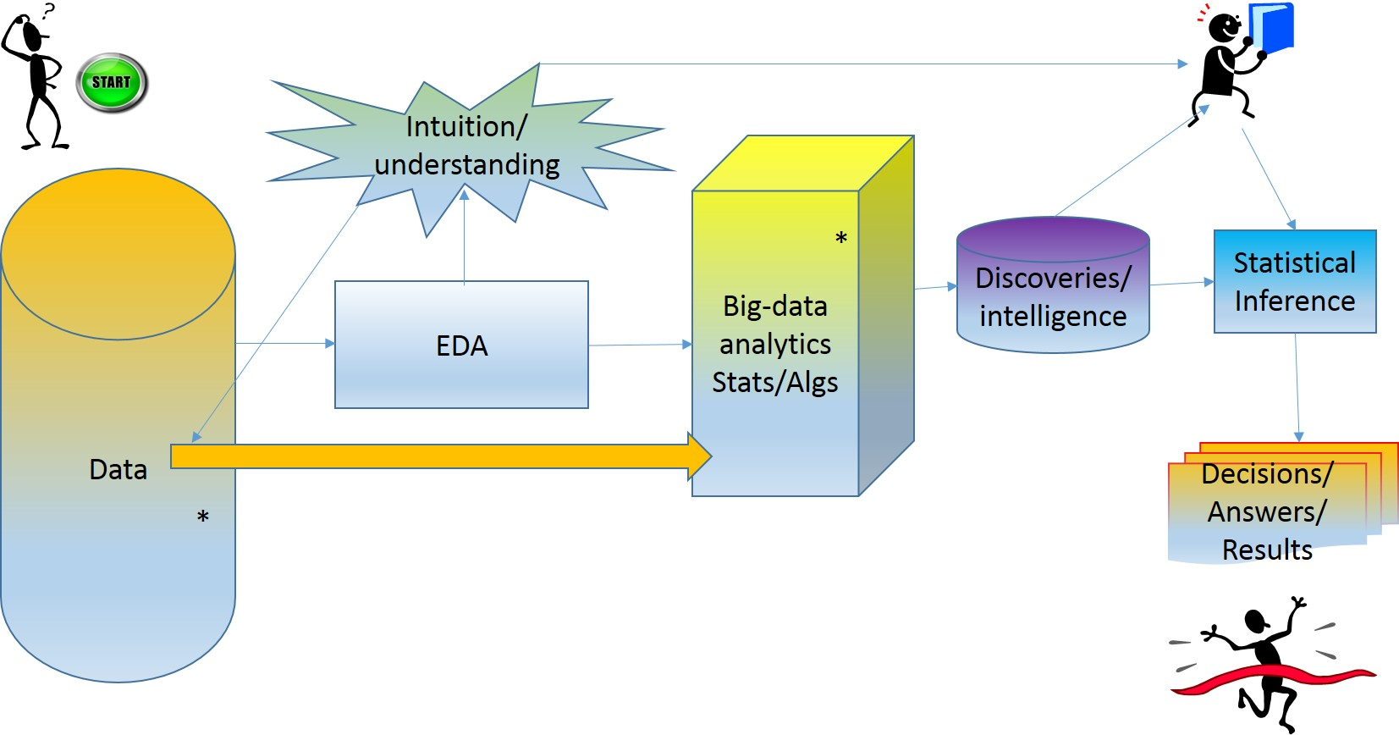
Data Science Process
EDA: Exploratory Data Analysis [J. Tukey]

Slide 7
Entry Points for DS
Level I. Introduce one DS topic in one of your courses (1 week)
Example 1: Beauty of classical MapReduce-version page rank algorithm
Example 2: Hadoop distributed file system (HDFS) in an operating systems course
Example 3: Visualization in a quantitative analytics course
Level II. Teach DS as a special topics course (full semester/ 6-week summer)
Example 1: Try it out with a combination of DS topics
Example 2: Statistical models and machine learning using R
Level III. Approved courses in a program (2 or more courses)
Example: We created a Distributed Systems course and a Data-intensive computing
These started as electives and have become courses satisfying “core” requirements in the program
Level IV. A full certificate program in alignment with the courses in an existing program
combination of DS courses + courses in the program + capstone
Level V. Master of Science/Ph.D degree in Data science or closely related area.

Slide 8
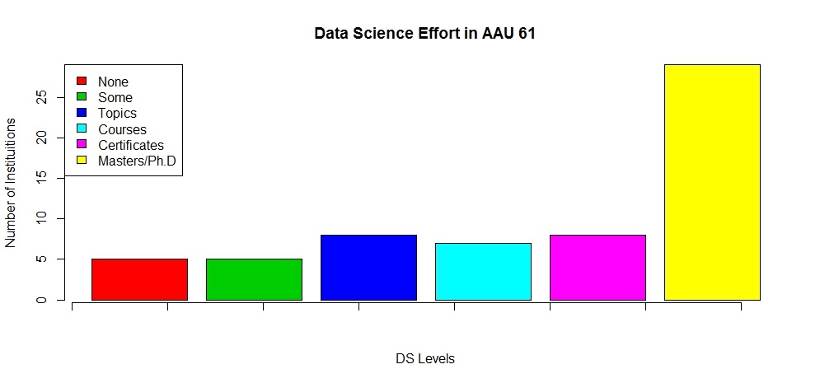
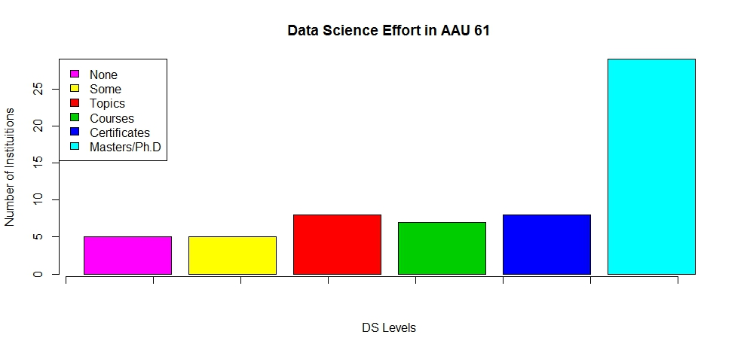
Positioning our DS Effort Among AAU
We are here

Slide 9
Our DS Program
We began with Level II and with the help of a NSF CCLI A&I grant created a “grid-computing” based distributed systems course.
Then implemented Level III and Level IV
Senior level/ entry graduate level, cross listed
Prerequisite; Data structures and algorithms (CS2/3)
Courses:
CSE486 Distributed Systems
CSE487 Data-intensive Computing

Slide 10
Distributed Systems Course (CSE486)
We began with Level II and with the help of a NSF CCLI A&I grant created a “grid-computing” based distributed systems course.
Then implemented Level III and Level IV
Then: We (Buffalo CSE) did NOT have a distributed systems courses before 2004!
Now: Taught every semester (high demand) by new tenured faculty hired in this area.
Textbook - Distributed Systems: Concepts and Design, 5th Edition (George Coulouris, Jean Dollimore, Tim Kindberg, Gordon Blair)

Slide 11
Data-intensive Computing Course (CSE 487)
Part II: Parallelizing Data Processing
Hadoop
MapReduce Ecosystem
Part I:
EDA
Part III: Optimized & Integrated Data Processing
Spark Ecosystem
Statistical Inference
Big data
Performance

Slide 12
Data-intensive Computing Course
Divided into three major topics: approximately 1 month duration
Exploratory data analysis
Statistical inference/modeling
Machine learning algorithms
R language
Data analysis using RStudio
Where to find information: Chapter 1-5 of DS text [1]
Suggestion: If you prefer you can continue with the rest of the chapters in the text for a full course

Slide 13
Data-intensive Computing course
Parallelizing data processing
Working with large data sets
Hadoop eco-system
MapReduce like algorithms
Text book: Lin & Dyer’s [2]
Apache Hadoop [3]
Amazon AWS or Virtual box or VMware
Optimizing and integrating data operations
RDD (Resilient Distributed Data)
Optimization of operations in a DAG (directed acyclic graphs)
Apache Spark [4]
Emerging applications

Slide 14
Part I: Exploratory Data Analysis
Formally introduced by John Tukey [5]
He is also the one recognized “software” , “bit”, robust analysis
EDA example: stem-leaf-display (Tukey’s), measures of central tendency (mean, median, etc.)
Literally explore data with various assumptions, try out different graphing and discover data behaviors.
Look at the data first and let it drive the theories (rather writing theorems/algorithms and proving them).
We studied: statistical models, linear regression and K-means and K-NN and their application to real data problems
Tool Used : R and Rstudio : Project 1
(Can use MS Excel, Tableau, SPSS, MATlab…)

Slide 15
EDA in Data Science Process [1]
Exploratory data analysis
Raw data collected
Data is processed
Data is cleaned
Machine learning algorithms;
Statistical models
Build data products
Communication
Visualization
Report Findings
Make decisions

Slide 16
Part II: Parallelizing Data for Processing
Grace Hopper on tackling large problems [6]:
"In pioneer days they used oxen for heavy pulling, and when one ox couldn't budge a log, they didn't try to grow a larger ox. We shouldn't be trying for bigger computers, but for more systems of computers."
Large storage for data: WORM data
Large data 2K blocks vs 128Mbyte
MTBF is 1/1000, with 1000 blocks of data, the probability of a block failure at a given time is very high (nearly 100%)
Duplicate or triplicate data blocks
What to do with this redundancy? Run parallel programs
MR like algorithms
Hadoop eco system
Alternatively one can introduce MPI, OpenMP, kernel threads and other approaches to parallel computation

Slide 17
Part III: Optimizing Data Computing
Refined coding: less code
Faster computation
Keep it in-memory
Build on related data
Optimized execution engine
Different tools implemented for Hadoop are unified into one on Spark
Data: Resilient Distributed Data Sets (RDDs)
Operations: transformations, actions
Execution model: Single Instruction and Multiple Data

Slide 18
Data-intensive computing Pedagogy
Part | Lecture: Book/Concepts | Hands-on Project | Resources | Data
I | Data Science[1] | R & real data | RStudio, Shiny | Numerical, categorical; Stock market
II | Data-intensive Processing [2] | Hadoop & MR | Virtual Images | Text: unstructured; news feed; twitter data
II | Data Computing & Performance issues | Apache Spark | Cloud resources | Graph data; network analysis; people network
Cloud resources are helpful if you are infrastructure is not adequate or IT people/services are not good enough to support these courses

Slide 19
Certificate
It is more like choosing a track of specialization in a student’s plan of study
Convenient path for students working on their CSE minors

Slide 20
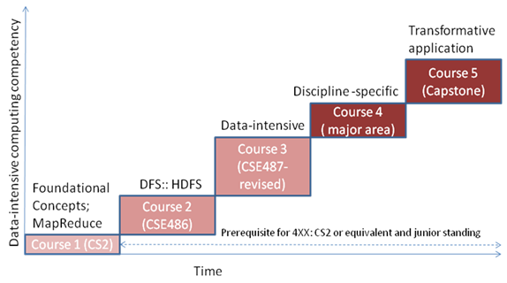
Certificate Program Courses

Slide 21
What worked?
Student learned the subject and got jobs
Collaborations: interdisciplinary: Biology and Math; extensive, sustained collaborations
External industry collaborations
All these resulted in grants awarded and collaborative research that is still ongoing
Newer interactions with Arts and Humanities
Undergraduate student researcher won the SIGCSE Microsoft 2015 undergraduate research award and the ACM undergraduate research grand finals. [7]

Slide 22
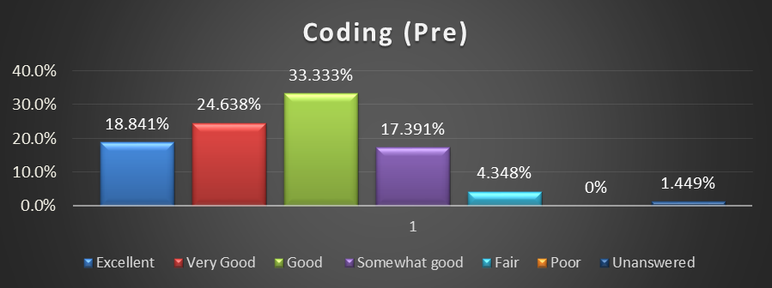
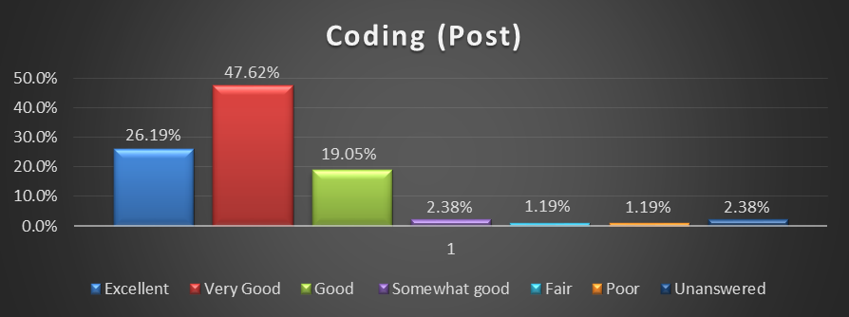
Assessment: Coding

Slide 23
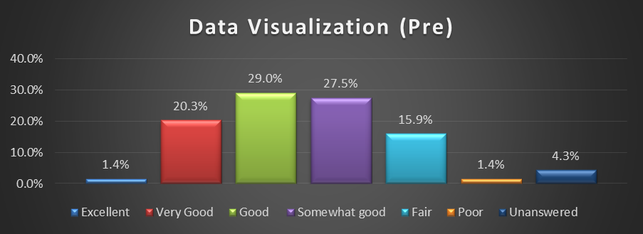
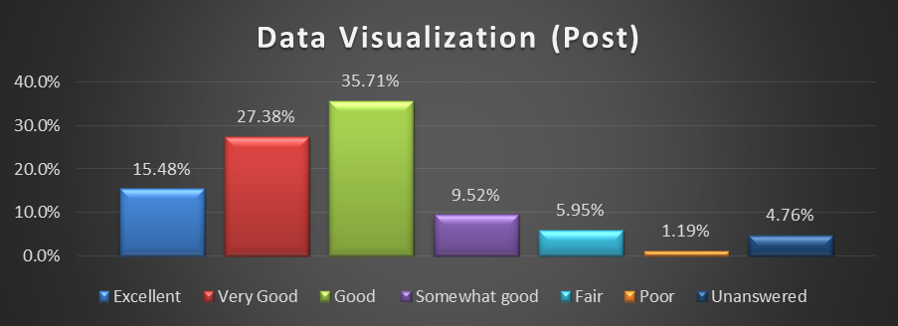
Visualization

Slide 24
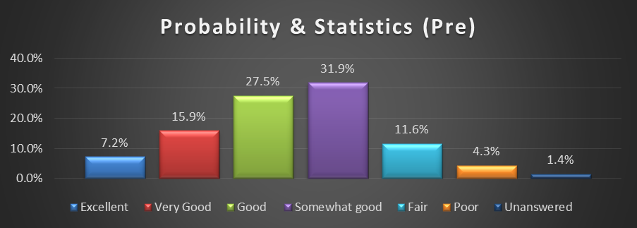
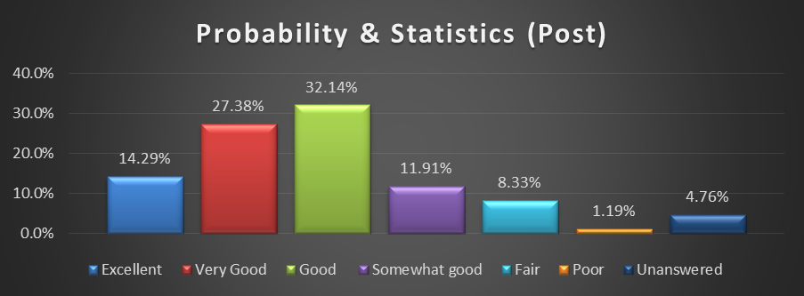
Probability & Statistics

Slide 25
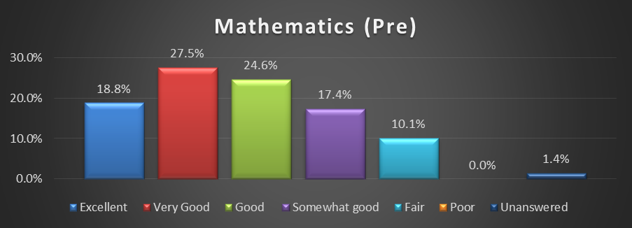
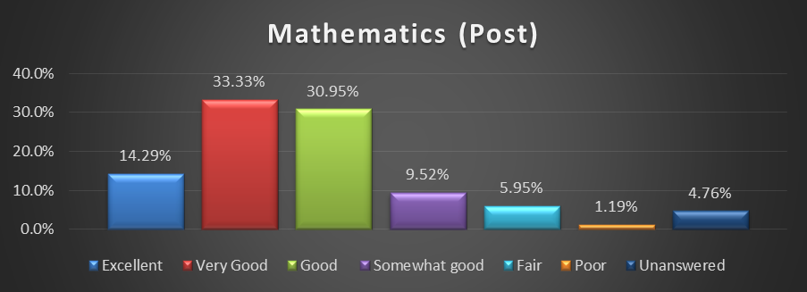
Mathematics

Slide 26
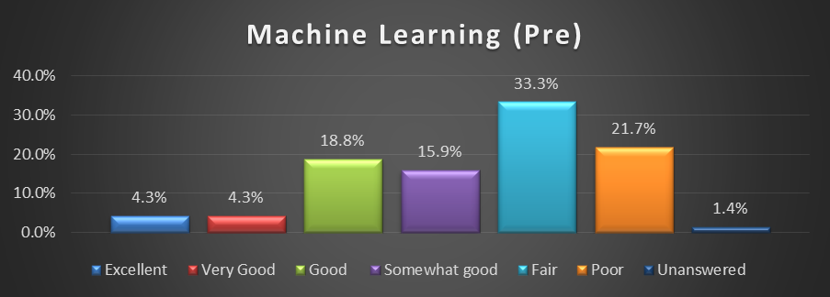
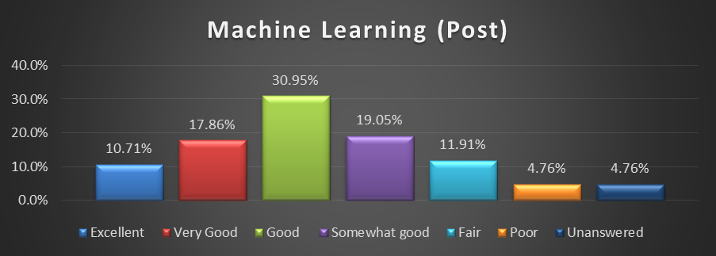
Machine Learning

Slide 27
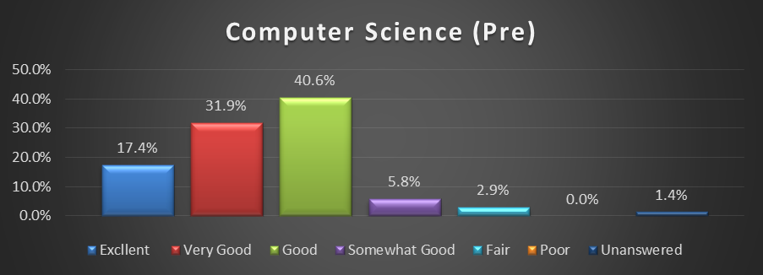
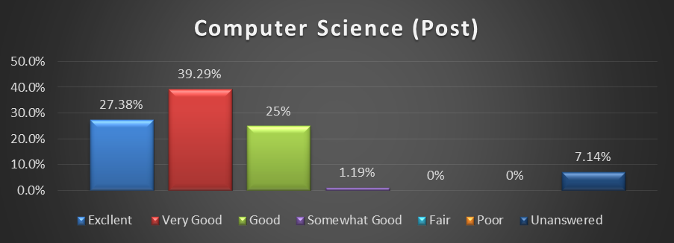
Computer Science

Slide 28
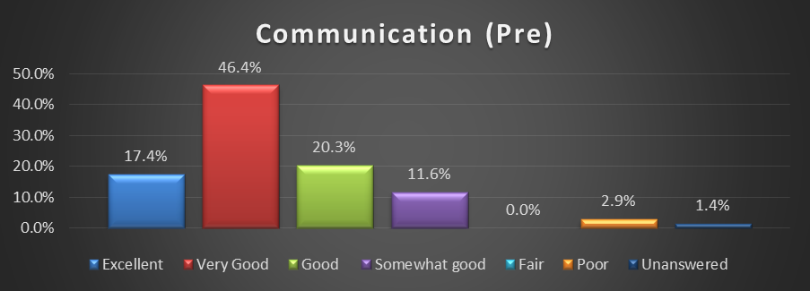
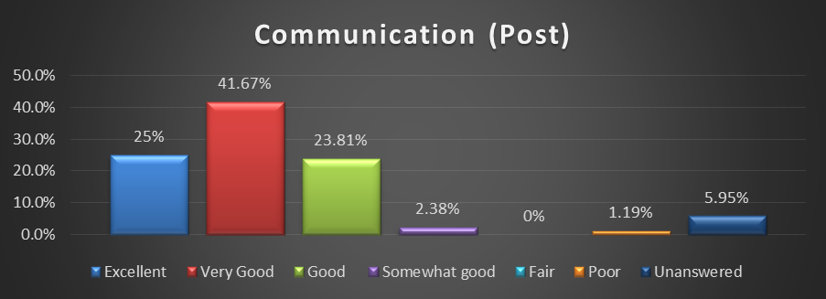
Communication

Slide 29
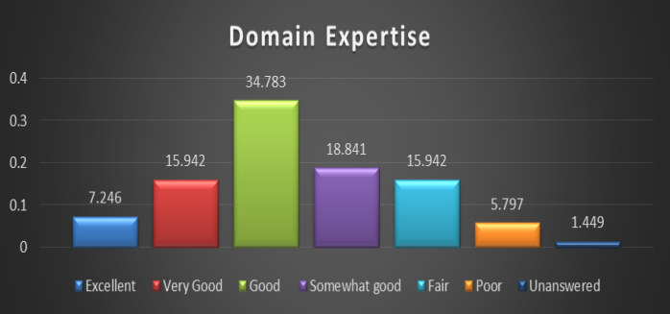
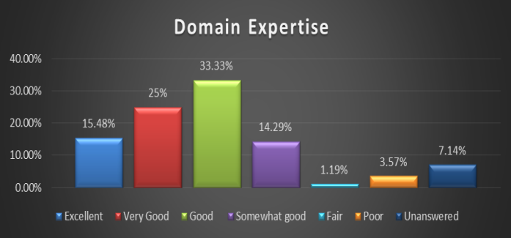
Domain Expertise

Slide 30
What did not work?
Enrollment in the certificate program is just picking up after 5 years. Solution: Publicity and planning
Participation of working adults in the certificate program was not satisfactory
Infrastructure needed changing with every offering of the course
Text book: Not a single text book that covers all the topics

Slide 31
Desirable (Best) Practices
Professional development for faculty
Incremental curriculum development
Hands-on lab/project components
Capstone project that leads to research papers
Continuous improvement to keep up with emerging concepts
Multi-disciplinary collaborations
Outreach to community colleges and K-12 schools

Slide 32
Acknowledgement
NSF for the CCLI grant to support the creation of the courses and the certificate program
CSE Dept, University at Buffalo, SUNY: For supporting my journey from a single lecture to a full fledged, comprehensive Certificate program
External evaluator Dr. Jeanette Neal
Reviewers of this papers: Very thorough, from a extra space character to a feedback on terminology used, suggestions for print and presentation, data analysis
SIGCSE for letting me share my experience

Slide 33
References
[1] C. ONeil and R. Schutt, Doing Data Science, ISBN:978-1-4493-5865-5. Oreilly Media, Doing Data Science, http://shop.oreilly.com/product/0636920028529.do, 2013.
[2] J. Lin & C. Dyer. Data-intensive text processing with MapReduce, https://lintool.github.io/MapReduceAlgorithms/
[3] Apache Hadoop. https://hadoop.apache.org/, August 2015.
[4] Apache Spark: Lightning Fast Cluster Computing. http://spark.apache.org/, last viewed August 2015.
[5] D. Leonhardt, John Tukey, New York Times July 2000.
[6] P. Schieber. The wit and Wisdom of Grace Hopper. The OCLC Newsletter, March/April, 1987, No. 167. http://www.cs.yale.edu/homes/tap/Files/hopper-wit.html
[7] ACM Student Research Competition 2015, http://src.acm.org/, Last viewed Aug. 2015.

