Slide 1
Introduction to Data Acquisition, Storage, and MapReduce Using Amazon Cloud
B. Ramamurthy
Bina@buffalo.edu
CSE Department, University at Buffalo
This work is partially supported by the following grants from National Science Foundation:
NSF-TUES-0920335, NSF-OCI-1041280

Slide 2
Outline of the talk
Golden Era in Computing
Data and Computing challenges
Cloud Computing
Popular Cloud Providers
MR programming model
Data collection, storage, MR on amazon cloud demos
Pagerank (if we have time)
Summary
References
Questions and Answers

Slide 3
A Golden Era in Computing
Heavy societal involvement
Superior software methodologies
Virtualization leveraging the powerful hardware
Wider bandwidth for communication
Proliferation of devices
Explosion of domain applications
Powerful multi-core processors

Slide 4
Computing Challenges
Scalability issue: large scale data, high performance computing, automation, response time, rapid prototyping, and rapid time to production
Mapreduce like parallelism, clusters, stacks and pipelines of computing
Need to effectively address (i) ever shortening cycle of obsolescence, (ii) heterogeneity and (iii) rapid changes in requirements
Virtualization and machines images
Transform data from diverse sources into intelligence and deliver intelligence to right people/user/systems
Eg. collecting twitter data
How to store the big-data? What new computing models are needed?
We need cloud storage, colossal storage
What about providing all this in a cost-effective manner?
How to make computing available and accessible as a public resource?
Democratizing computing, storage and applications

Slide 5
Enter the cloud
Cloud computing is Internet-based computing, whereby shared resources, software and information are provided to computers and other devices on-demand, like the electricity grid.
The cloud computing is a culmination of numerous attempts at large scale computing with seamless access to virtually limitless resources.
on-demand computing, utility computing, ubiquitous computing, autonomic computing, platform computing, edge computing, elastic computing, grid computing, …

Slide 6
The Cloud Computing
Cloud provides processor, software, operating systems, storage, monitoring, load balancing, clusters and other requirements as a service
Pay as you go model of business
When using a public cloud the model is similar to renting a property than owning one.
An organization could also maintain a private cloud and/or use both.
Cloud computing models:
platform (PaaS), Eg., Windows Azure
software (SaaS), Eg., Google App Engine
infrastructure (IaaS), Eg., Amazon AWS
Services-based application programming interface (API)

Slide 7

Google App Engine
This is more a web interface for a development environment that offers a one stop facility for design, development and deployment Java and Python-based applications in Java, Go and Python.
Google offers the same reliability, availability and scalability at par with Google’s own applications
Interface is software programming based
Comprehensive programming platform irrespective of the size (small or large)
Signature features: templates and appspot, excellent monitoring and management console;
Free version to explore at: http://code.google.com/appengine/
Software as a service: Evolutionary Genetics Testbed

Slide 8

Amazon EC2
Amazon EC2 is one large complex web service.
EC2 provides an API for instantiating computing instances with any of the operating systems supported.
It can facilitate computations through Amazon Machine Images (AMIs) for various other models.
Signature features: S3, Cloud Management Console, MapReduce Cloud, Amazon Machine Image (AMI)
Excellent distribution, load balancing, cloud monitoring tools
You can explore amazon using the free account at:
http://aws.amazon.com/free/

Slide 9
MapReduce Programming Model
You have been discussing MR in your course.
Wordcount is like the hello world for MR and it is the fundamental operation for many other operations such as search, co-occurrence, sentiment analysis etc.
Mapper: breaks down the given problem into numerous parallel tasks and reducer aggregates the individual computed components to form the result
MR is for big-data and NOT for programming in the small or for small data
Lets now explore and discover how amazon cloud supports data acquisition, storage, computation and MR applications.

Slide 10
Large scale data splits
Map <key, 1>
<key, value>pair
Reducers (say, Count)
Parse-hash
Count
P-0000
, count1
Parse-hash
Count
P-0001
, count2
Parse-hash
Count
P-0002
Parse-hash
,count3

Slide 11
Summary
We are entering a watershed moment in the internet era.
This involves in its core and center, big data analytics and tools that provide intelligence in a timely manner to support decision making.
Newer storage models, processing models, and approaches have emerged.
Among these cloud computing has the potential to significantly improve accessibility to computing
See: UB-implemented a SUNY-wide a Certificate Program in Data-intensive Computing

Slide 12
Demos
Amazon console
Ec2, S3, Elastic Mapreduce (EMR)
Twitter data collection using CloudFormation
Note access to instance using PKI keypairs
Storing data in S3
MR computation on EMR: word count
Reference for the demos: http://docs.aws.amazon.com/gettingstarted/latest/emr/getting-started-emr-overview.html

Slide 13
PageRank
Original algorithm (huge matrix and Eigen vector problem.)
Larry Page and Sergei Brin (Standford Ph.D. students)
Rajeev Motwani and Terry Winograd (Standford Profs)

Slide 14
General idea
Consider the world wide web with all its links.
Now imagine a random web surfer who visits a page and clicks a link on the page
Repeats this to infinity
Pagerank is a measure of how frequently will a page will be encountered.
In other words it is a probability distribution over nodes in the graph representing the likelihood that a random walk over the linked structure will arrive at a particular node.

Slide 15
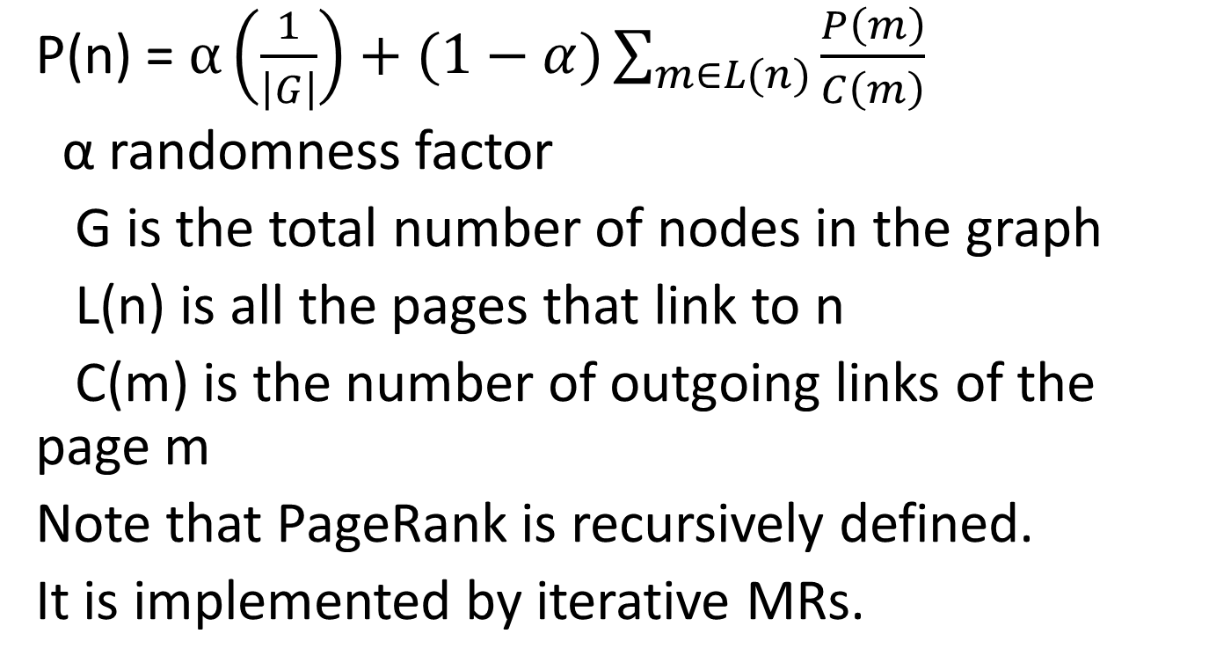
PageRank Formula
P(n) = $α\left(\frac{1}{\left|G\right|}\right)+(1−α)\sum_{m∈L(n)}{\frac{P\left(m\right)}{C\left(m\right)}}$
α randomness factor
G is the total number of nodes in the graph
L(n) is all the pages that link to n
C(m) is the number of outgoing links of the page m
Note that PageRank is recursively defined.
It is implemented by iterative MRs.

Slide 16
PageRank: Walk Through
0.066
0.166
0.2
0.2
n1
n2
n1
0.1
n2
0.033
0.1
0.066
0.033
0.1
0.066
0.1
0.1
0.083
0.1
0.083
n5
n5
0.3
0.2
0.2
0.066
0.3
0.1
n3
n3
n4
0.2
n4
0.166
0.2
0.166
0.2
0.3
0.1
0.133
n1
n2
n5
0.383
n3
n4
0.183
0.2

Slide 17
Mapper for PageRank
Class Mapper
method map (nid n, Node N)
p ← N.Pagerank/|N.AdajacencyList|
emit(nid n, N)
for all m in N. AdjacencyList
emit(nid m, p)
“divider”

Slide 18
Reducer for Pagerank
Class Reducer
method Reduce(nid m, [p1, p2, p3..])
node M ← null; s = 0;
for all p in [p1,p2, ..]
{ if p is a Node then M ← p
else s ← s+p }
M.pagerank ← s
emit (nid m, node M)
“aggregator”

Slide 19
Discussion
How to account for dangling nodes: one that has many incoming links and no outgoing links
Simply redistributes its pagerank to all
One iteration requires pagerank computation + redistribution of “unused” pagerank
Pagerank is iterated until convergence: when is convergence reached?
Probability distribution over a large network means underflow of the value of pagerank.. Use log based computation
MR: How do PRAM alg. translate to MR? how about other math algorithms?

Slide 20
References & useful links
Amazon AWS: http://aws.amazon.com/free/
AWS Cost Calculator: http://calculator.s3.amazonaws.com/calc5.html
Google App Engine (GAE): http://code.google.com/appengine/docs/whatisgoogleappengine.html
For miscellaneous information: http://www.cse.buffalo.edu/~bina
http://www.cse.buffalo.edu/~bina/DataIntensive

