Slide 1
A Peek into Millions of Years of Evolution
Dr. Katharina Dittmar (Biology)
Dr. Jessica Poulin (Biology)
Dr. Bina Ramamurthy (Computer Science and Engineering)
This work is supported by a grant from NSF-ACI-1041280

Slide 2
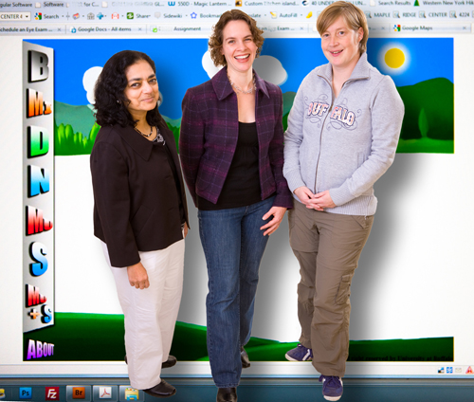
NSF Grant (2010-2014) Collaborators
Katha
Jess
Bina

Slide 3
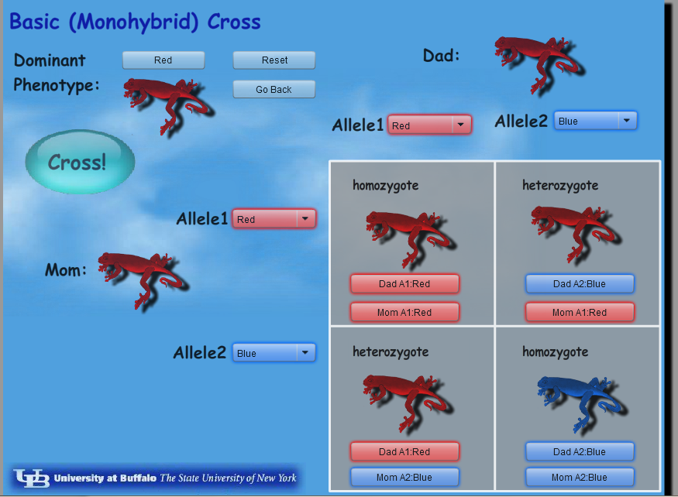
Pop!World Gateway (K-12)

Slide 4
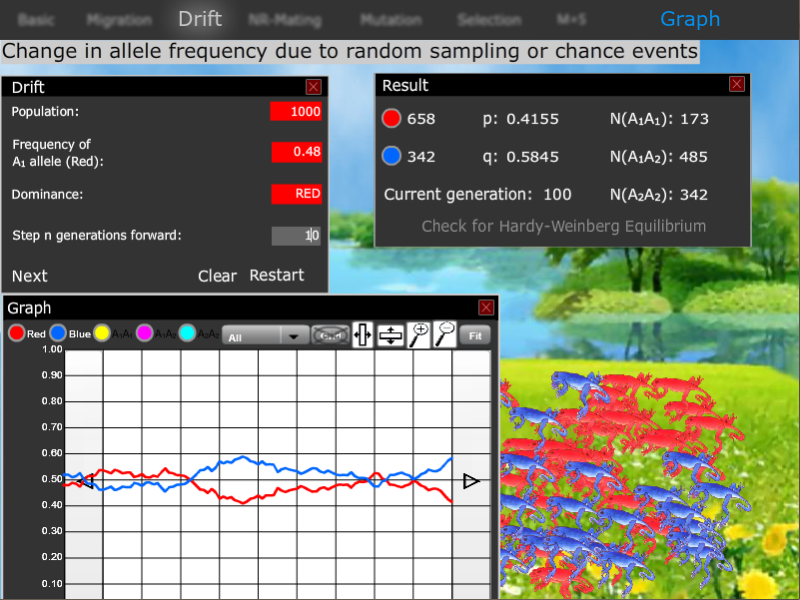
Pop!World Discovery (K-21)

Slide 5
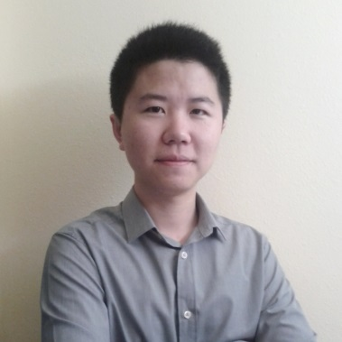
Our Research Assistant
Yunfei Hou is a Ph.D. candidate with CSE. His recent research project experience includes: Human factors Challenges in Cyber-Transportation Systems, and development of Mobile cloud-based educational platforms for population genetics and evolutionary theory.

Slide 6
Links for the App
Web
Pop!world Original http://popworld2.appspot.com/
Pop!world Gateway http://popworldtesting2.appspot.com/
Mobile
Android phone: http://goo.gl/ArYu27
Android tablet: http://goo.gl/h9HROC
iPad: Open iTunes and search for popworld
Our web page
http://popworld.buffalo.edu

