Slide 1
CSE524: Realtime and Embedded Systems
B. Ramamurthy
University at Buffalo
bina@buffalo.edu

Slide 2
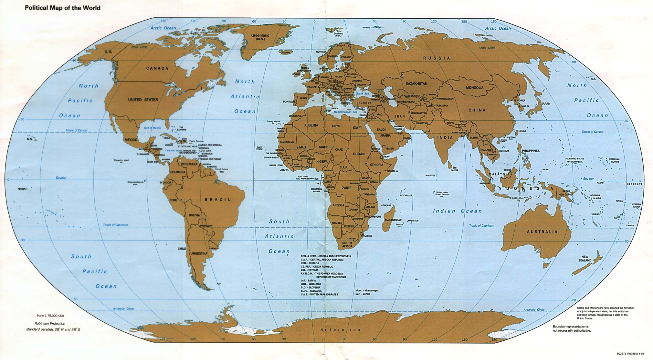
Amrita-UB-MSES Collaboration

Slide 3
Outline of Topics
Acknowledge organizers
Instructor and students
Overview of the course
Policies and expectations
Syllabus: First-day handout
Format of the course
Learning is a two way street…
Foundations of RTOS
Finally something important, feedback on today’s class: content, format, pace, missing items,…

Slide 4
Motivation
What is a realtime system?
What is an embedded system?
What is a realtime embedded system?
Embedded system but not a realtime system
Realtime system but not an embedded system
Why realtime&/embedded system?
How do realtime embedded systems differ from regular computational systems?
Now lets define and identify some examples of realtime embedded systems in your work/home environment.
We will attempt a simple design process.

Slide 5
Defining RTOS

Slide 6
Lets define realtime systems
Timing: RT systems (RTOS) are required to compute and deliver correct results within a specified period of time. Ex: traffic light controller
Interrupt driven: event-driven preemption; RTOS are often involved with handling events.
  Events manifest themselves in terms of interrupt signals arising from the arrival data at an input port or ticking of a hardware clock, or an error status alarm.

Slide 7
RTOS Definition (contd.)
Low-level programming: RTOS often deal with devices; C language is still a favorite for writing device drivers for new hardware.
Specialized hardware: Most RTOS work within, or at least close beside, specialized electronic and mechanical devices. Often closed loop systems.
Volatile data IO: Variables that change their value from moment to moment. RTOS software must be structured to check for changes at the correct rate, so as not to miss a data update.

Slide 8
RTOS Definition (contd.)
Multi-tasking: RTOS are often multitasking. Several processes cooperate to carry out the overall job. Divide RTOS problem into tasks as a design strategy.
Run-time scheduling: Separation of activities into tasks leads to question of task sequencing or scheduling. Moreover the external events and required response to these lead to run-time scheduling or dynamic scheduling.
Unpredictability in inputs/stimulus: Being event-driven, RTOS are at the mercy of unpredictable changes in their environment.
Predictability response requirement!
Life-critical code: failure to run correctly may result in death or at least injury to the user and/or others. Life-critical systems requires extra testing, documentation and acceptance trials.

Slide 9
Types of RTOS
Hard RTOS: tight limits on response time, so that a delayed result is a wrong result.
  Ex: jet fuel controller and camera shutter unit
Soft RTOS: need to meet only time-average performance target. As long as most results are available before deadline the system will run successfully.
  Ex: audio and video transmission, single frame skip is fie, but repeated loss is unacceptable
Firm RTOS: somewhere between the two.
  Ex: Space station solar panel unit

Slide 10
Microprocessor
Examples: vending machines, mobiles phones, alarm systems, washing machines, motor car engine controllers, heart monitors, microwave ovens all operate using embedded microcontrollers running dedicated software.
Microprocessors are the enabling hardware for realtime systems.

Slide 11
Embedded Systems
Dedicated functionally
Special purpose
Optimized for a certain operations
Small (typically)
Lower power consumption
Embedded within other large systems

Slide 12
Embedded Systems
Embedded systems are computing systems with tightly coupled hardware and software integration.
Designed to perform dedicated function
Embedded means that the system is a integral part of a larger system
Multiple embedded systems can co-exist in a single system.
General purpose processor are typically not aware of the applications.
An embedded processor is application-aware.

Slide 13
Embedded Systems (contd.)
Hardware and software co-design: hardware and software for the embedded system are developed in parallel.
Cross-platform development: Both embedded system and its application use the cross-platform development method.
  Software is developed on one platform but runs on another.
Software storage will have to be chosen to allow for upgradeability.
Of course, the SoC (system on a chip), PoE (Power on Ethernet), etc.

Slide 14
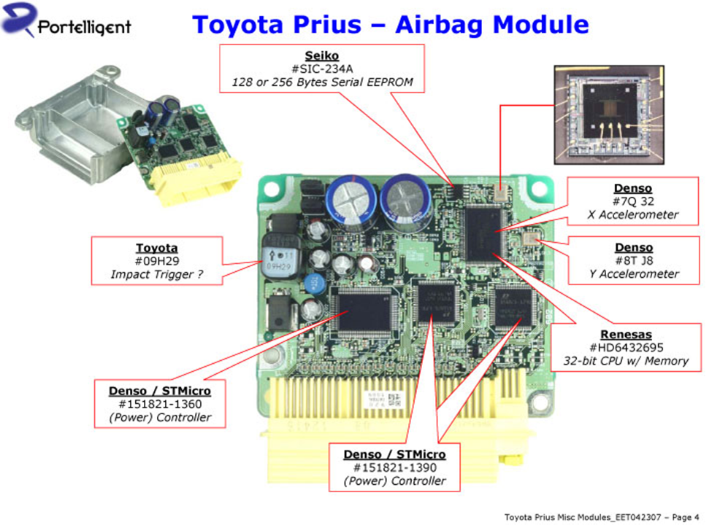
Examples
From everyday applications
From automotive domain: Electronic Control Unit (ECU)
Any examples from Bosch?

Slide 15
Realtime Embedded Systems
RTOS
EMB
RTEMB
Railway monitoring and scheduling : RTOS
Cell phone: EMB
Heart pacemaker: RTSEMB

Slide 16
Exercise#1
Lets identify 10 embedded systems, realtime systems and realtime/embedded system
I will begin with Arduino Uno
Example | Type; justification

Slide 17
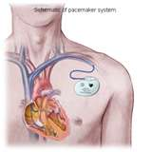

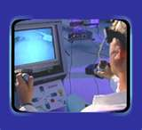

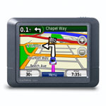

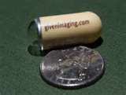

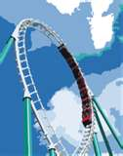
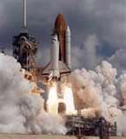
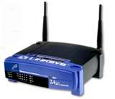
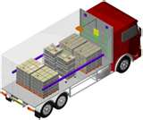

Embedded Systems

Slide 18
Functional and non-functional requirements
Functional: Describes the explicit operations to be performed by the RTOS.
If you consider the climate control system in an automobile:
Sense temperature: T1
Compare with user set temperature: Tset
If T1 > Tset, start cold air fan
Else if T1 < Tset, start hot air fan
Non-functional: describes the quality of the operations
Example: Need to control temperature within 0.5 degree error
Accuracy
Precision
Reliability
Safety
Response time
Responsiveness
Predictability
Deadlines

Slide 19
Hardware Requirements
Hardware support for functional requirements
Hardware support for non-functional requirements
Size of the device
Power of the processor
Power consumption
Speed of the device
Support for devices, interrupts
Electronic Control Units (ECU): typical modern automobile has 100’s of ECUs [Takada]

Slide 20
Software requirements
Software functions to implement the operations
Driver that dispatches calls to these operations
Interrupt handlers
Device drivers
Operating system
Typical modern automobile has millions of lines of software [Takada]

Slide 21
Software Quality Assurance
QA is especially important to RTS since many of these are deployed in life critical environments / situations.
Patriot missile failure

Slide 22
Design Representation
Discovering modules: CRC Classes, Responsibilities, and Collaboration
For teams working together to discover modules of the system
Once modules are discovered, UML (Unified Modeling Language) state diagrams offer a convenient method to represent a RTES.
We will look at CRC later;
Today we will look at a finite state machine (FSM) for representing the design of a RTOS.
On to activities…

Slide 23
Design Considerations
Requirements → Design representation
Design representation → prototype
Prototype testing
Production system

Slide 24
Exercise #2
Automatic vending machine money counter
Embedded system (Rs.5 counter)
Coins: 1, 2 and 5 rupees
S1
2
S3
1
1
5
1
5
2
S2
2
S4
1
5
2,5
S0
1
2
S5+
5
S5

Slide 25
Finite State Machine (FSM)
An FSM M = five tuple ➔ { S, i, T, Σ, δ }
S = set of states
i = initial state
T = terminal state (s)
Σ = events that bring about transitions
δ = transitions
Lets do this exercise for the avionics for fighter aircraft

Slide 26
Summary
We studied the basic definitions of realtime and embedded system.
We studied key issues which make development of realtime software more challenging than desktop or traditional data processing applications.
Timing is very critical for RTOS input, output, computing and response.
UML state diagram is a useful tool for design representation.
We will study the design and implementation of RTOS system in detail later on.

