Slide 1
Relevance of Thread Model to Embedded and RT Systems
Bina Ramamurthy
bina@buffalo.edu

Slide 2
Topics
Reference: https://computing.llnl.gov/tutorials/pthreads
Process space vs thread space
When to use threads?
Some examples in using threads: Pthread
We will explain it using code and demos

Slide 3
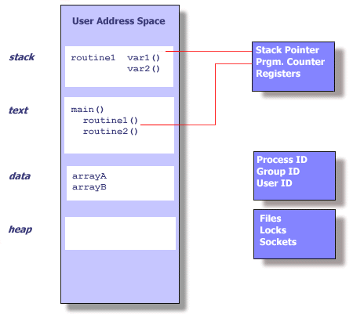
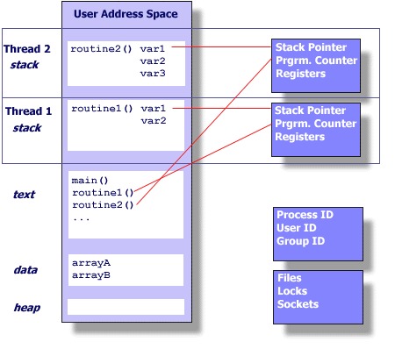
Process vs thread

Slide 4
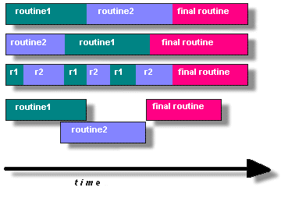
When to use threads?
“…a program to take advantage of Pthreads, it must be able to be organized into discrete, independent tasks which can execute concurrently. For example, if routine1 and routine2 can be interchanged, interleaved and/or overlapped in real time, they are candidates for threading.”

Slide 5
Thread States
Enter: thread created
Ready: Allocated resources
Run: CPU allocated
Blocked: waiting for an event/IO resource
Ready
Run
Exit
Blocked/wait

Slide 6
Sample programs
Source 1: Simple program with multiple threads overlapping
Source 2: MT_safe passing of arguments to threads
What is MT_safe? Thread functions should be non-reentrant / non-self-modifying
Source 3: thread join
Source 4: Stack size
Source 5: About mutual exclusion among parallel threads’ accessing shared resources

