Slide 1
Capstone Design
B. Ramamurthy

Slide 2
Course Model
Emerging Applications
Capstone
Research methods
Communication of research results

Slide 3
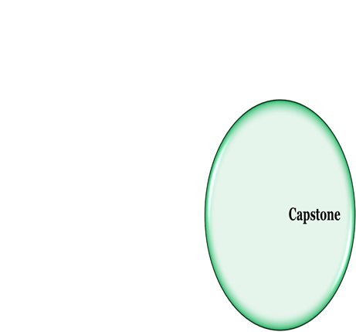
Course Model

Slide 4
References
J.R. Goldberg. Capstone Design Courses: Producing Industry-Ready Biomedical Engineers, Morgan-Claypool, 2007

Slide 5
What is Capstone?
It provides them with the opportunity to apply what students have learned in previous courses;
Develop their communication (written, analytical, oral, and graphical (Visualization)), interpersonal (teamwork, conflict management, and negotiation), project management, and design skills;
Reinforce the design and development process of a product;
It also provides students with an understanding of the economic, financial, legal, and regulatory aspects of the design, development, and commercialization of technology.

Slide 6
Why Capstone?
Development of design and technical skills
Development of “soft skills” such as teamwork, communication, and interpersonal skills
Develop the ability to manage the product development process
Oral, written, and graphical/ Visualization communication skills
Experience with solving a real-life, open-ended problem
Development of an understanding of the industry perspective (including financial, regulatory, and legal issues): in this case automotive industry
Exposure to results-oriented evaluations of their projects
It is a culmination of all the knowledge from other courses and application of the same.
Capstone projects are important components in a program accreditation process (esp. in United States)

Slide 7
Goal of Capstone Project
Ability to design a system, component, or process to meet desired needs within realistic constraints such as economic, environmental, social, political, ethical, health and safety, manufacturability, and sustainability.

Slide 8
How do you do it?
Define the requirements based on customer/client needs
Determine / understand the constraints (e.g. the memory constraint in Arduino boards)
Define the problem to be solved
Define the project scope
Study alternative solutions and compare
Make a selection of final design
Build prototype to meet needs
Validates performance of prototype
Document all the steps.

Slide 9
Capstone project deliverables
Project definition document: contains project objective statement (which defines problem and project scope
Requirements document: contains list of needs along with design constraints
Generated concepts document: rough sketch or schematic of what you want to do
Final concept document: defends selection of proposed final design
Experimental validation document: contains test protocols, test results, data analysis,
Conclusions regarding how well prototype meets performance requirements
Final report: contains final design, test results, information regarding how well the requirements were met
Prototype

Slide 10
Deliverables Template
See the project report we discusses earlier
We will prepare a JavaScript-based web page for presenting our project report
Multi-media presentation/screen shots/movie clips
The paper you will write also helps in achieving the goal of the capstone course.

Slide 11
Requirements
A clear and well defined requirements-document is important
Correctness of design, implementation and testing
There are different approaches to specifying the requirements
Use case diagram specifies the uses of the system, with user stimulus that invokes a particular use.
It also specifies error conditions, and how it is handled.
See https://www.andrew.cmu.edu/course/90-754/umlucdfaq.html
It can in a pictorial form or in a text form/document

Slide 12
Analysis and Design
Typically OO design
Class diagrams, sequence diagrams, etc.
During the analysis phase you will discover the classes and the relationship (has a, is a, etc) among them. These are represented using class diagrams.
The class diagrams are then used as design for the implementation of the prototype.
There are other model for analysis and design.
You will learn more about these in your OO course.

Slide 13
Prototype Implementation
In the prototype implementation for this course you will have a hardware and a software component.
Clearly document the implementation details and steps taken.
An IDE (integrated development environment) will be used in the design of your project.

Slide 14
Testing and Modification of Design
Your project document should provide the test set used to determine the correctness of your implementation
There may functional as well as non-functional requirements that need to be tested.

Slide 15
Newer Approaches
Probabilistic approaches: many events can be modeled as stochastic or random processes
Big data approaches : enormous amount of data is being collected by various sensors inside an automobile, how to analyze this and learn from it, extract useful knowledge, discover anomalies

