Slide 1
Data Mining , Statistical Analysis and Predictive Analytics for Automotive Domain
B. Ramamurthy

Slide 2
Data Collection in Automobiles
Large volumes of data is being collected the increasing number of sensors that are being added to modern automobiles.
Traditionally this data is used for diagnostics purposes.
How else can you use this data?
How about predictive analytics?
  For example, predict the failure of a part based on the historical data and on-board data collected?
  Discover unusual pattern, in say, fuel consumption. Traditionally, 55mph the optimal speed for fuel consumption...may be not so today.
How can we do this?

Slide 3
Introduction
Data represents the traces of the real-world processes.
  What traces we collect depends on the sampling methods
Two sources of randomness and uncertainty:
  The process that generates data is random
  The sampling process itself is random
Your mind-set should be “statistical thinking in the age of big-data”
  Combine statistical approach with big-data
Our goal for this emerging application area: understand the statistical process of dealing with automobile data and practice it using R
How can you use this idea in your term project/capstone project?

Slide 4
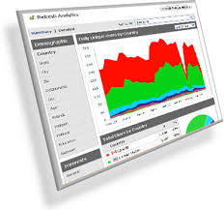
Transforming data into analytics➔ Strategies/decisions
Vertical domain
Probability-Statistics-Stochastic
Randomness,
Uncertainty
Machines learning algorithms
Automotive (sensor) data
Results
Decisions
Diagnosis
Strategies
Horizontal domain
Social/ media data/ web data

Slide 5
Uncertainty and Randomness
A mathematical model for uncertainty and randomness is offered by probability theory.
A world/process is defined by one or more variables. The model of the world is defined by a function:
Model == f(w) or f(x,y,z) (A multivariate function)
The function is unknown➔ model is unclear, at least initially. Typically our task is to come up with the model, given the data.
Uncertainty: is due to lack of knowledge: GM’s faulty ignition switch; Toyota’s faulty acceleration pedal; Reasons for Gopinath Munde’s accident …
Randomness: is due lack of predictability: 1-6 face of when rolling a die
Both can be expressed by probability theory

Slide 6
Statistical Inference
World ➔ Collect Data➔ Capture the understanding/meaning of data through models or functions ➔ statistical estimators for predicting things about➔ The same world
Development of procedures, methods, and theorems that allow us to extract meaning and information from data that has been generated by stochastic (random/non-deterministic) processes

Slide 7
Population and Sample
Population is complete set of traces/data points
  US population 314 Million, world population is 7 billion for example
  All voters, all things
Sample is a subset of the complete set (or population): how we select the sample introduces biases into the data
See an example in http://www.sca.isr.umich.edu/
Here out of the 314 Million US population, 250000 households are form the sample (monthly)
Population ➔mathematical model ➔ sample
Lets look at a automobile data collection example: complaint in India and about India is that there are very few studies about these accidents…

Slide 8
Population and Sample (contd.)
Example: Emails sent by people in the Bosch in a year.
Method 1: 1/10 of all emails over the year randomly chosen
Method 2: 1/10 of people randomly chosen; all their email over the year
Both are reasonable sample selection method for analysis.
However estimations pdfs (probability distribution functions) of the emails sent by a person for the two samples will be different.

Slide 9
Big Data vs statistical inference
Sample size N
For statistical inference N < All
For big data N == All

Slide 10
What is you model?
What is your data model?
Linear regression (lm): Understand the concept. Use Simpler package to explore lm.
Naïve Bayes and Bayesian classification
Classification vs clustering
Logistic regression: Computing the odds.

Slide 11
From the nutshell book
A model is a concise way to describe a set of data, usually with a mathematical formula. Sometimes, the goal is to build a predictive model with training data to predict values based on other data.
Other times, the goal is to build a descriptive model that helps you understand the data better.

Slide 12
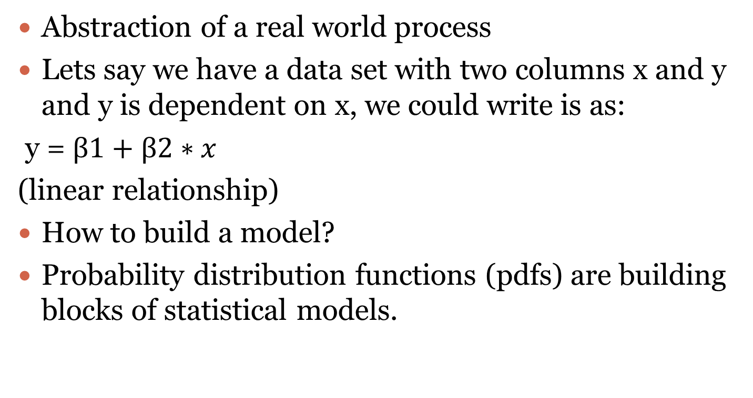
Modeling
Abstraction of a real world process
Lets say we have a data set with two columns x and y and y is dependent on x, we could write is as:
y = $β1+β2∗x$
(linear relationship)
How to build a model?
Probability distribution functions (pdfs) are building blocks of statistical models.

Slide 13
Probability Distributions
Normal, uniform, Cauchy, t-, F-, Chi-square, exponential, Weibull, lognormal,..
They are know as continuous density functions
Any random variable x or y can be assumed to have probability distribution p(x), if it maps it to a positive real number.
For a probability density function, if we integrate the function to find the area under the curve it is 1, allowing it to be interpreted as probability.
Further, joint distributions, conditional distribution..

Slide 14
Fitting a Model
Fitting a model means estimating the parameters of the model: what distribution, what are the values of min, max, mean, stddev, etc.
Don’t worry a statistical language R has built-in optimization algorithms that readily offer all these functionalities
It involves algorithms such as maximum likelihood estimation (MLE) and optimization methods…
Example: y = β1+β2∗𝑥 ➔ y = 7.2 + 4.5*x

Slide 15
What if?
The variable is not a continuous one as in linear regression?
What if you want to determine the probability of an event (e.g. ABS activation ) happening given some “prior” probabilities? Ans: Naïve Bayes and Bayesian approaches
What if you want to find the “odds” of an event (say, an engine failure) happening over not happening given their probabilities: Logistic regression
There are many models for various situations… we will look into just these two above.

Slide 16
Summary
An excellent tool supporting statistical inference is R
R statistical language and the environment supporting it will be the second emerging technology an d platform we consider in this course.
We will examine R next
We will also look into some machine learning (ML) approaches (algorithms) for clustering and classification.
Then we will look into Naïve Bayes and logistic regression as two of the many approaches for analytics.

