Slide 1
Emerging Applications and Platforms#7: Big Data Algorithms and Infrastructures
B. Ramamurthy

Slide 2
Big-Data computing
What is it?
  Volume, velocity, variety, veracity (uncertainty) (Gartner, IBM)
How is it addressed?
Why now?
What do you expect to extract by processing this large data?
  Intelligence for decision making
What is different now?
  Storage models, processing models
  Big Data, analytics and cloud infrastructures
Summary

Slide 3
Big-data Problem Solving Approaches
Algorithmic: after all we have working towards this for ever: scalable/tracktable
High Performance computing (HPC: multi-core) CCR has machines that are: 16 CPU , 32 core machine with 128GB RAM: openmp, MPI, etc.
GPGPU programming: general purpose graphics processor (NVIDIA)
Statistical packages like R running on parallel threads on powerful machines
Machine learning algorithms on super computers
Hadoop MapReduce like parallel processing.

Slide 4
Data Deluge: smallest to largest
Internet of things/devices: collecting huge amount of data from MEMS and other sensors, devices. What (else) can you do with such data?
Your everyday automobile is going to be a data collecting machine that is most probably going to be stored on the cloud.
Bioinformatics data: from about 3.3 billion base pairs in a human genome to huge number of sequences of proteins and the analysis of their behaviors
The internet: web logs, facebook, twitter, maps, blogs, etc.: Analytics …
Financial applications: that analyze volumes of data for trends and other deeper knowledge
Health Care: huge amount of patient data, drug and treatment data
The universe: The Hubble ultra deep telescope shows 100s of galaxies each with billions of stars: Sloan Digital Sky Survey: http://www.sdss.org/

Slide 5
Intelligence and Scale of Data
Intelligence is a set of discoveries made by federating/processing information collected from diverse sources.
Information is a cleansed form of raw data.
For statistically significant information we need reasonable amount of data.
For gathering good intelligence we need large amount of information.
As pointed out by Jim Grey in the Fourth Paradigm book enormous amount of data is generated by the millions of experiments and applications.
Thus intelligence applications are invariably data-heavy, data-driven and data-intensive.
Data is gathered from the web (public or private, covert or overt), generated by large number of domain applications.

Slide 6
Characteristics of intelligent applications
Google search: How is different from regular search in existence before it?
  It took advantage of the fact the hyperlinks within web pages form an underlying structure that can be mined to determine the importance of various pages.
Restaurant and Menu suggestions: instead of “Where would you like to go?” “Would you like to go to CityGrille”?
  Learning capacity from previous data of habits, profiles, and other information gathered over time.
Collaborative and interconnected world inference capable: facebook friend suggestion
Large scale data requiring indexing
…Do you know amazon is going to ship things before you order? Here

Slide 7
Data-intensive application characteristics
Models
Algorithms (thinking)
Data structures (infrastructure)
AggregatedContent (Raw data)
Reference
Structures
(knowledge)

Slide 8
Basic Elements
Aggregated content: large amount of data pertinent to the specific application; each piece of information is typically connected to many other pieces. Ex: DBs
Reference structures: Structures that provide one or more structural and semantic interpretations of the content. Reference structure about specific domain of knowledge come in three flavors: dictionaries, knowledge bases, and ontologies
Algorithms: modules that allows the application to harness the information which is hidden in the data. Applied on aggregated content and some times require reference structure Ex: MapReduce
Data Structures: newer data structures to leverage the scale and the WORM characteristics; ex: MS Azure, Apache Hadoop, Google BigTable

Slide 9
Examples of data-intensive applications
Search engines
Automobile design and diagnostics
Recommendation systems:
  CineMatch of Netflix Inc. movie recommendations
  Amazon.com: book/product recommendations
Biological systems: high throughput sequences (HTS)
  Analysis: disease-gene match
  Query/search for gene sequences
Space exploration
Financial analysis

Slide 10
More intelligent data-intensive applications
Social networking sites
Mashups : applications that draw upon content retrieved from external sources to create entirely new innovative services.
Portals
Wikis: content aggregators; linked data; excellent data and fertile ground for applying concepts discussed in the text
Media-sharing sites
Online gaming
Biological analysis
Space exploration

Slide 11
Algorithms
Statistical inference
Machine learning is the capability of the software system to generalize based on past experience and the use of these generalization to provide answers to questions related old, new and future data.
Data mining
Deep data mining
Soft computing
We also need algorithms that are specially designed for the emerging storage models and data characteristics.

Slide 12
Different Type of Storage
Internet introduced a new challenge in the form web logs, web crawler’s data: large scale “peta scale”
But observe that this type of data has an uniquely different characteristic than your transactional or the “customer order” data, or “bank account data” :
The data type is “write once read many (WORM)” ;
  Privacy protected healthcare and patient information;
  Historical financial data;
  Other historical data
Relational file system and tables are insufficient.
Large <key, value> stores (files) and storage management system.
Built-in features for fault-tolerance, load balancing, data-transfer and aggregation,…
Clusters of distributed nodes for storage and computing.
Computing is inherently parallel

Slide 13
Big-data Concepts
Originated from the Google File System (GFS) is the special <key, value> store
Hadoop Distributed file system (HDFS) is the open source version of this. (Currently an Apache project)
Parallel processing of the data using MapReduce (MR) programming model
Challenges
  Formulation of MR algorithms
  Proper use of the features of infrastructure (Ex: sort)
  Best practices in using MR and HDFS
An extensive ecosystem consisting of other components such as column-based store (Hbase, BigTable), big data warehousing (Hive), workflow languages, etc.

Slide 14
Data & Analytics
We have witnessed explosion in algorithmic solutions.
“In pioneer days they used oxen for heavy pulling, when one couldn’t budge a log they didn’t try to grow a larger ox. We shouldn’t be trying for bigger computers, but for more systems of computers.” Grace Hopper
What you cannot achieve by an algorithm can be achieved by more data.
Big data if analyzed right gives you better answers: Center for disease control prediction of flu vs. prediction of flu through “search” data 2 full weeks before the onset of flu season! http://www.google.org/flutrends/

Slide 15



Cloud Computing
Cloud is a facilitator for Big Data computing and is an indispensable in this context
Cloud provides processor, software, operating systems, storage, monitoring, load balancing, clusters and other requirements as a service
Cloud offers accessibility to Big Data computing
Cloud computing models:
  platform (PaaS), Microsoft Azure
  software (SaaS), Google App Engine (GAE)
  infrastructure (IaaS), Amazon web services (AWS)
  Services-based application programming interface (API)

Slide 16
Enabling Technologies for Cloud computing
Web services
Multicore machines
Newer computation model and storage structures
Parallelism

Slide 17
Evolution of the service concept
A service is a meaningful activity that a computer program performs on request of another computer program.
Technical definition: A service a remotely accessible, self-contained application module.
From IBM,
Object/
Class
Component
Service

Slide 18
An Innovative Approach to Parallel Processing Data
Bina Ramamurthy
Partially Supported by
NSF DUE Grant: 0737243, 0920335

Slide 19
The Context: Big-data
Man on the moon with 32KB (1969); my laptop had 2GB RAM (2009)
Google collects 270PB data in a month (2007), 20PB a day (2008) …
2010 census data is a huge gold mine of information
Data mining huge amounts of data collected in a wide range of domains from astronomy to healthcare has become essential for planning and performance.
We are in a knowledge economy.
  Data is an important asset to any organization
  Discovery of knowledge; Enabling discovery; annotation of data
We are looking at newer
  programming models, and
  Supporting algorithms and data structures
National Science Foundation refers to it as “data-intensive computing” and industry calls it “big-data” and “cloud computing”

Slide 20
More context
Rear Admiral Grace Hopper: “In pioneer days they used oxen for heavy pulling, and when one ox couldn't budge a log, they didn't try to grow a larger ox. We shouldn't be trying for bigger computers, but for more systems of computers.”
---From the Wit and Wisdom of Grace Hopper (1906-1992), http://www.cs.yale.edu/homes/tap/Files/hopper-wit.html

Slide 21
Introduction
Text processing: web-scale corpora (singular corpus)
Simple word count, cross reference, n-grams, …
A simpler technique on more data beat a more sophisticated technique on less data.
Google researchers call this: “unreasonable effectiveness of data”
--Alon Halevy, Peter Norvig, and Fernando Pereira. The unreasonable effectiveness of data. Communications of the ACM, 24(2):8{12}, 2009.

Slide 22
MapReduce

Slide 23
What is MapReduce?
MapReduce is a programming model Google has used successfully in processing its “big-data” sets (~ 20 peta bytes per day in 2008)
  Users specify the computation in terms of a map and a reduce function,
  Underlying runtime system automatically parallelizes the computation across large-scale clusters of machines, and
  Underlying system also handles machine failures, efficient communications, and performance issues.
-- Reference: Dean, J. and Ghemawat, S. 2008. MapReduce: simplified data processing on large clusters. Communication of ACM 51, 1 (Jan. 2008), 107-113.

Slide 24
Big idea behind MR
Scale-out and not scale-up: Large number of commodity servers as opposed large number of high end specialized servers
  Economies of scale, ware-house scale computing
  MR is designed to work with clusters of commodity servers
  Research issues: Read Barroso and Holzle’s work
Failures are norm or common:
  With typical reliability, MTBF of 1000 days (about 3 years), if you have a cluster of 1000, probability of at least 1 server failure at any time is nearly 100%

Slide 25
Big idea (contd.)
Moving “processing” to the data: not literally, data and processing are co-located versus sending data around as in HPC
Process data sequentially vs random access: analytics on large sequential bulk data as opposed to search for one item in a large indexed table
Hide system details from the user application: user application does not have to get involved in which machine does what. Infrastructure can do it.
Seamless scalability: Can add machines / server power without changing the algorithms: this is in-order to process larger data set

Slide 26
Issues to be addressed
How to break large problem into smaller problems? Decomposition for parallel processing
How to assign tasks to workers distributed around the cluster?
How do the workers get the data?
How to synchronize among the workers?
How to share partial results among workers?
How to do all these in the presence of errors and hardware failures?
MR is supported by a distributed file system that addresses many of these aspects.

Slide 27
MapReduce Basics
Fundamental concept:
Key-value pairs form the basic structure of MapReduce <key, value>
Key can be anything from a simple data types (int, float, etc) to file names to custom types.
Examples:
  <docid, docitself>
  <yourName, yourLifeHistory>
  <graphNode, nodeCharacteristicsComplexData>
  <yourId, yourFollowers>
  <word, itsNumofOccurrences>
  <planetName, planetInfo>
  <geneNum, <{pathway, geneExp, proteins}>
  <Student, stuDetails>

Slide 28
From CS Foundations to MapReduce (Example#1)
Consider a large data collection:
{web, weed, green, sun, moon, land, part, web, green,…}
Problem: Count the occurrences of the different words in the collection.
Lets design a solution for this problem;
  We will start from scratch
  We will add and relax constraints
  We will do incremental design, improving the solution for performance and scalability

Slide 29
Word Counter and Result Table
{web, weed, green, sun, moon, land, part, web, green,…}
web | 2
weed | 1
green | 2
sun | 1
moon | 1
land | 1
part | 1
Data
collection

Slide 30

Multiple Instances of Word Counter
web | 2
weed | 1
green | 2
sun | 1
moon | 1
land | 1
part | 1
Data
collection
Observe:
Multi-thread
Lock on shared data

Slide 31
Improve Word Counter for Performance
No
No need for lock
web | 2
weed | 1
green | 2
sun | 1
moon | 1
land | 1
part | 1
Data
collection
Separate counters
KEY | web | weed | green | sun | moon | land | part | web | green | …….
VALUE

Slide 32
Peta-scale Data
Data
collection
web | 2
weed | 1
green | 2
sun | 1
moon | 1
land | 1
part | 1
KEY | web | weed | green | sun | moon | land | part | web | green | …….
VALUE

Slide 33
Addressing the Scale Issue
Single machine cannot serve all the data: you need a distributed special (file) system
Large number of commodity hardware disks: say, 1000 disks 1TB each
  Issue: With Mean time between failures (MTBF) or failure rate of 1/1000, then at least 1 of the above 1000 disks would be down at a given time.
  Thus failure is norm and not an exception.
  File system has to be fault-tolerant: replication, checksum
  Data transfer bandwidth is critical (location of data)
Critical aspects: fault tolerance + replication + load balancing, monitoring
Exploit parallelism afforded by splitting parsing and counting
Provision and locate computing at data locations

Slide 34
Peta-scale Data
Data
collection
web | 2
weed | 1
green | 2
sun | 1
moon | 1
land | 1
part | 1
KEY | web | weed | green | sun | moon | land | part | web | green | …….
VALUE

Slide 35
Peta Scale Data is Commonly Distributed
Data
collection
Data
collection
web | 2
weed | 1
green | 2
sun | 1
moon | 1
land | 1
part | 1
Data
collection
Data
collection
Data
collection
Issue: managing the
large scale data
KEY | web | weed | green | sun | moon | land | part | web | green | …….
VALUE

Slide 36
Write Once Read Many (WORM) data
Data
collection
Data
collection
web | 2
weed | 1
green | 2
sun | 1
moon | 1
land | 1
part | 1
Data
collection
Data
collection
Data
collection
KEY | web | weed | green | sun | moon | land | part | web | green | …….
VALUE

Slide 37
WORM Data is Amenable to Parallelism
Data
collection
Data
collection
Data with WORM characteristics : yields to parallel processing;
Data without dependencies: yields to out of order processing
Data
collection
Data
collection
Data
collection

Slide 38
Divide and Conquer: Provision Computing at Data Location
One node
For our example,
#1: Schedule parallel parse tasks
#2: Schedule parallel count tasks
Data
collection
This is a particular solution;
Lets generalize it:
Our parse is a mapping operation:
MAP: input → <key, value> pairs
Our count is a reduce operation:
REDUCE: <key, value> pairs reduced
Map/Reduce originated from Lisp
But have different meaning here
Runtime adds distribution + fault tolerance + replication + monitoring +
load balancing to your base application!
Data
collection
Data
collection
Data
collection

Slide 39
Mapper and Reducer
MapReduceTask
Mapper
Reducer
YourReducer
Counter
YourMapper
Parser
Remember: MapReduce is simplified processing for larger data sets

Slide 40
Map Operation
weed | 1
weed | 1
green | 1
sun | 1
moon | 1
land | 1
land | 1
web | 1
green | 1
… | 1
KEY | VALUE
MAP: Input data ➔ <key, value> pair
web | 1
weed | 1
green | 1
sun | 1
moon | 1
land | 1
part | 1
web | 1
green | 1
web | 1
KEY | VALUE
Map
Data
Collection: split1
web | 1
weed | 1
green | 1
sun | 1
moon | 1
land | 1
part | 1
web | 1
green | 1
green | 1
KEY | VALUE
web | 1
weed | 1
green | 1
sun | 1
moon | 1
land | 1
part | 1
web | 1
green | 1
… | 1
KEY | VALUE
Split the data to
Supply multiple
processors
web | 1
weed | 1
green | 1
sun | 1
moon | 1
land | 1
part | 1
web | 1
green | 1
part | 1
KEY | VALUE
Data
Collection: split 2
Map
……
…
Data
Collection: split n

Slide 41
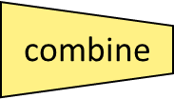
MapReduce Example #2
Cat
Bat
Dog
Other
Words
(size:
TByte)
reduce
combine
map
part0
split
reduce
combine
part1
split
map
reduce
combine
map
part2
split
split
map
barrier

Slide 42
MapReduce Design
You focus on Map function, Reduce function and other related functions like combiner etc.
Mapper and Reducer are designed as classes and the function defined as a method.
Configure the MR “Job” for location of these functions, location of input and output (paths within the local server), scale or size of the cluster in terms of #maps, # reduce etc., run the job.
Thus a complete MapReduce job consists of code for the mapper, reducer, combiner, and partitioner, along with job configuration parameters. The execution framework handles everything else.
The way we configure has been evolving with versions of hadoop.

Slide 43
The code
1: class Mapper
2: method Map(docid a; doc d)
3: for all term t in doc d do
4: Emit(term t; count 1)
1: class Reducer
2: method Reduce(term t; counts [c1; c2; : : :])
3: sum = 0
4: for all count c in counts [c1; c2; : : :] do
5: sum = sum + c
6: Emit(term t; count sum)

Slide 44
Problem#2
This is a cat
Cat sits on a roof
The roof is a tin roof
There is a tin can on the roof
Cat kicks the can
It rolls on the roof and falls on the next roof
The cat rolls too
It sits on the can

Slide 45
MapReduce Example: Mapper
This is a cat
Cat sits on a roof
<this 1> <is 1> <a 1> <cat 1> <cat 1> <sits 1> <on 1><a 1> <roof 1>
The roof is a tin roof
There is a tin can on the roof
<the 1> <roof 1> <is 1> <a 1> <tin 1 ><roof 1> <there 1> <is 1> <a 1> <tin 1><can 1> <on 1><the 1> <roof 1>
Cat kicks the can
It rolls on the roof and falls on the next roof
<cat 1> <kicks 1> <the 1><can 1> <it 1> <rolls 1> <on 1> <the 1> <roof 1> <and 1> <falls 1><on 1> <the 1> <next 1> <roof 1>
The cat rolls too
It sits on the can
<the 1> <cat 1> <rolls 1> <too 1> <it 1> <sits 1> <on 1> <the 1> <can 1>

Slide 46
MapReduce Example: Shuffle to the Reducer
Output of Mappers:
<this 1> <is 1> <a 1> <cat 1> <cat 1> <sits 1> <on 1><a 1> <roof 1>
<the 1> <roof 1> <is 1> <a 1> <tin 1 ><roof 1> <there 1> <is 1> <a 1> <tin 1><can 1> <on 1><the 1> <roof 1>
<cat 1> <kicks 1> <the 1><can 1> <it 1> <rolls 1> <on 1> <the 1> <roof 1> <and 1> <falls 1><on 1> <the 1> <next 1> <roof 1>
<the 1> <cat 1> <rolls 1> <too 1> <it 1> <sits 1> <on 1> <the 1> <can 1>
Input to the reducer: delivered sorted... By key
..
<can <1, 1>>
<cat <1,1,1,1>>
…
<roof <1,1,1,1,1,1>>
..…
Reduce (sum in this case) the counts: comes out sorted!!!
..
<can 2>
<cat 4>
..
<roof 6>

Slide 47
More on MR
All Mappers work in parallel.
Barriers enforce all mappers completion before Reducers start.
Mappers and Reducers typically execute on the same machine
You can configure job to have other combinations besides Mapper/Reducer: ex: identify mappers/reducers for realizing “sort” (that happens to be a Benchmark)
Mappers and reducers can have side effects; this allows for sharing information between iterations.
Notes:
er

Slide 48
MapReduce Characteristics
Very large scale data: peta, exa bytes
Write once and read many data: allows for parallelism without mutexes
Map and Reduce are the main operations: simple code
There are other supporting operations such as combine and partition: we will look at those later.
Operations are provisioned near the data.
Commodity hardware and storage.
Runtime takes care of splitting and moving data for operations.
Special distributed file system: Hadoop Distributed File System and Hadoop Runtime.

Slide 49
Classes of problems “mapreducable”
Benchmark for comparing: Jim Gray’s challenge on data-intensive computing. Ex: “Sort”
Google uses it (we think) for wordcount, adwords, pagerank, indexing data.
Simple algorithms such as grep, text-indexing, reverse indexing
Bayesian classification: data mining domain
Facebook uses it for various operations: demographics
Financial services use it for analytics
Astronomy: Gaussian analysis for locating extra-terrestrial objects.
Expected to play a critical role in semantic web and web3.0

Slide 50
Scope of MapReduce
Data size: small
Single-core
Single-core, single processor
Single-core, multi-processor
Multi-core
Multi-core, single processor
Multi-core, multi-processor
Cluster
Cluster of processors (single or multi-core) with shared memory
Cluster of processors with distributed memory
Grid of clusters
Embarrassingly parallel processing
MapReduce, distributed file system
Cloud computing
Pipelined Instruction level
Concurrent Thread level
Service Object level
Indexed File level
Mega Block level
Virtual System Level
Data size: large

Slide 51
Lets Review Map/Reducer
Map function maps one <key,value> space to another. One to many: “expand” or “divide”
Reduce does that too. But many to one: “merge”
There can be multiple “maps” in a single machine…
Each mapper(map) runs parallel with and independent of the other (think of a bee hive)
All the outputs from mappers are collected and the “key space” is partitioned among the reducers. (what do you need to partition?)
Now the reducers take over. One reduce/per key (by default)
Reduce operation can be anything.. Does not have to be just counting…(operation [list of items]) – You can do magic with this concept.

Slide 52
Hadoop

Slide 53
What is Hadoop?
At Google MapReduce operation are run on a special file system called Google File System (GFS) that is highly optimized for this purpose.
GFS is not open source.
Doug Cutting and Yahoo! reverse engineered the GFS and called it Hadoop Distributed File System (HDFS).
The software framework that supports HDFS, MapReduce and other related entities is called the project Hadoop or simply Hadoop.
This is open source and distributed by Apache.

Slide 54
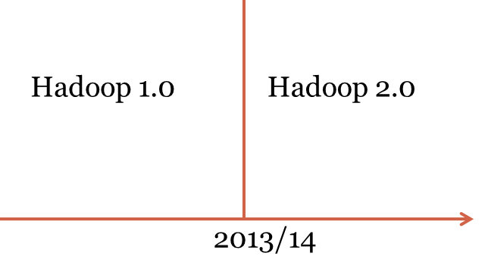
Hadoop

Slide 55
Basic Features: HDFS
Highly fault-tolerant
High throughput
Suitable for applications with large data sets
Streaming access to file system data
Can be built out of commodity hardware
HDFS core principles are the same in both major releases of Hadoop.

Slide 56
Hadoop Distributed File System
HDFS Server
Masters: Job tracker,
Name node,
Secondary name node
HDFS Client
Application
Local file system
Block size: 2K
Slaves: Task tracker, Data Nodes
Block size: 128M
Replicated

Slide 57
Hadoop Distributed File System
HDFS Server
Masters: Job tracker,
Name node,
Secondary name node
HDFS Client
Application
Local file system
Block size: 2K
Slaves: Task tracker, Data Nodes
Block size: 128M
Replicated

Slide 58
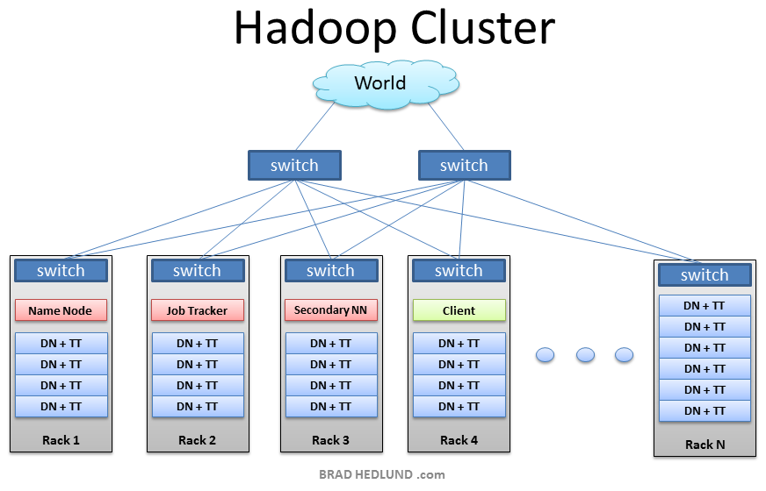
From Brad Hedlund: a very nice picture

Slide 59
More on MR
All Mappers work in parallel.
Barriers enforce all mappers completion before Reducers start.
Mappers and Reducers typically execute on the same server
You can configure job to have other combinations besides Mapper/Reducer: ex: identify mappers/reducers for realizing “sort” (that happens to be a benchmark)
Mappers and reducers can have side effects; this allows for sharing information between iterations.
Notes:
er

Slide 60
Classes of problems “mapreducable”
Benchmark for comparing: Jim Gray’s challenge on data-intensive computing. Ex: “Sort”
Google uses it (we think) for wordcount, adwords, pagerank, indexing data.
Simple algorithms such as grep, text-indexing, reverse indexing
Bayesian classification: data mining domain
Facebook uses it for various operations: demographics
Financial services use it for analytics
Astronomy: Gaussian analysis for locating extra-terrestrial objects.
Expected to play a critical role in semantic web and web3.0
Probably many classical math problems.

Slide 61
Page Rank

Slide 62
General idea
Consider the world wide web with all its links.
Now imagine a random web surfer who visits a page and clicks a link on the page
Repeats this to infinity
Pagerank is a measure of how frequently will a page will be encountered.
In other words it is a probability distribution over nodes in the graph representing the likelihood that a random walk over the linked structure will arrive at a particular node.

Slide 63
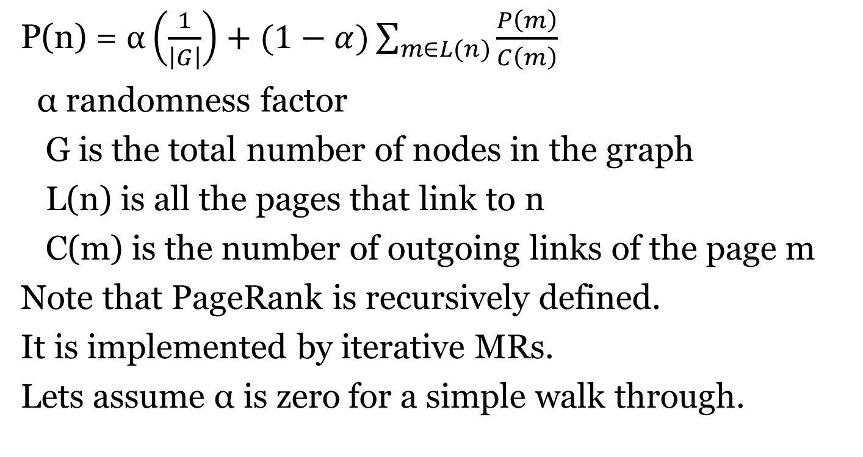
PageRank Formula
P(n) = $α\left(\frac{1}{\left|G\right|}\right)+(1−α)\sum_{m∈L(n)}{\frac{P\left(m\right)}{C\left(m\right)}}$
α randomness factor
G is the total number of nodes in the graph
L(n) is all the pages that link to n
C(m) is the number of outgoing links of the page m
Note that PageRank is recursively defined.
It is implemented by iterative MRs.
Lets assume α is zero for a simple walk through.

Slide 64
PageRank: Walk Through
0.066
0.166
0.2
0.2
n1
n2
n1
0.1
n2
0.033
0.1
0.066
0.033
0.1
0.066
0.1
0.1
0.083
0.1
0.083
n5
n5
0.3
0.2
0.2
0.066
0.3
0.1
n3
n3
n4
0.2
n4
0.166
0.2
0.166
0.2
0.3
0.1
0.133
n1
n2
n5
0.383
n3
n4
0.183
0.2

Slide 65
Mapper for PageRank
Class Mapper
method map (nid, Node N)
p ← N.Pagerank/|N.Adajacency|
emit(nid, N)
for all m in N. Adjacencylist
emit(nid m, p)
“divider”

Slide 66
Reducer for Pagerank
Class Reducer
method Reduce(nid m, [p1, p2, p3..])
Node M ← null; s = 0;
for all p in [p1,p2, ..]
{ if p is a Node then M ← p
else s ← s+p}
M.pagerank ← s
emit (nid m, Node M)
“aggregator”
At the reducer you get two types of items in the list.

Slide 67
Issues; Points to ponder
How to account for dangling nodes: one that has many incoming links and no outgoing links
  Simply redistributes its pagerank to all
  One iteration requires pagerank computation + redistribution of “unused” pagerank
Pagerank is iterated until convergence: when is convergence reached?
Probability distribution over a large network means underflow of the value of pagerank.. Use log based computation
MR: How do PRAM algs. translate to MR? how about math algorithms?

Slide 68
Demo
Amazon Elastic cloud computing aws.amazon.com
CCR: Video of 100-node cluster for processing a billion node k-nary tree

Slide 69
References
Dean, J. and Ghemawat, S. 2008. MapReduce: simplified data processing on large clusters. Communication of ACM 51, 1 (Jan. 2008), 107-113.
Lin and Dyer (2010): Data-intensive text processing with MapReduce; http://beowulf.csail.mit.edu/18.337-2012/MapReduce-book-final.pdf
Cloudera Videos by Aaron Kimball:
http://www.cloudera.com/hadoop-training-basic
4. Apache Hadoop Tutorial: http://hadoop.apache.org http://hadoop.apache.org/core/docs/current/mapred_tutorial.html

Slide 70
Take Home Messages
MapReduce (MR) algorithm is for distributed processing of big-data
Apache Hadoop (open source) provides the distributed infrastructure for MR
Most challenging aspect is designing the MR algorithm for solving a problem; it is different mind-set;
  Visualizing data as key,value pairs; distributed parallel processing;
  Probably beautiful MR solutions can be designed for classical Math problems.
  It is not just mapper and reducer, but also other operations such as combiner, partitioner that have be cleverly used for solving large scale problems.

