Slide 1
Logistic Regression

Slide 2
Introduction
What is it?
  It is an approach for calculating the odds of event happening vs other possibilities…Odds ratio is an important concept
  Lets discuss this with examples
Why are we studying it?
  To use it for classification
  It is a discriminative classification vs Naïve Bayes’ generative classification scheme (what is this?)
  Linear (continuous).. Logistic (categorical): Logit function bridges this gap
  According to Andrew Ng and Michael Jordon logistics regression classification has better error rates in certain situations than Naïve Bayes (eg. large data sets) Big data? Lets discuss this…

Slide 3
Logistic Regression
Predict
Mortality of injured patients
If a patient has a given disease (we did this using Bayes) (binary classification using a variety of data like age, gender, BMI, blood tests etc.)
If a person will vote BJP or Congress
The odds of a failure of a part, process, system or a product
A customer’s propensity to purchase a product
Odds of a person staying at a company
Odds of a homeowner defaulting on a loan

Slide 4
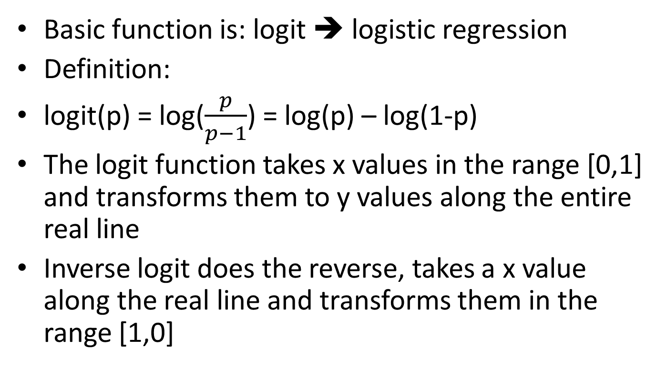
Basics
Basic function is: logit ➔ logistic regression
Definition:
logit(p) = log($\frac{p}{p−1}$) = log(p) – log(1-p)
The logit function takes x values in the range [0,1] and transforms them to y values along the entire real line
Inverse logit does the reverse, takes a x value along the real line and transforms them in the range [1,0]

Slide 5
Demo on R
Consider a hypothetical experiment of auto parts: The data has these details:
(Test) Reading, Total, Tested
Do EDA
Observe the outcome, if sigmoid➔
Fit the logistic regression model➔ use the fit/plot to classify
This is for small data of 25, how about Big data? MR?
Realtime response? Twitter model

Slide 6
R code: data file “parts.csv”
data1 <- read.csv("c://Users/bina/parts.csv")
summary(data1)
head(data1)
plot(Tested/Total ~Reading, data=data1)
glm.out = glm(cbind(Tested, Total-Tested) ~Reading, family=binomial(logit), data=data1)
plot(Tested/Total ~ Reading, data = data1)
lines(data1$Age, glm.out$fitted, col="red")
title(main=“Parts Data with fitted Logistic Regression Line")
summary(glm.out)

Slide 7
Lets derive this from first principles
Let ci be the set of labels .. For binary classification (yes or no) it is i = 0, 1, clicked or not
Let xi be the features for user i , here it is the urls he/she visited
P(ci|xi) =
P(ci=1|xi) =
P(ci=0|xi) =
log Odds ratio = log (eqn4/eqn5)
logit(P(ci=1|xi) = α + β^{t} Xi where xi are features of user i and β^{t} is vector of weights/likelihood of the features.
Now the task is to determine α and β
(many methods are available for this.. Out of the scope our discussion).
Use the logistic regression curve in step 7 to estimate probabilities and determine the class according to rules applicable to the problem.

Slide 8
Multiple Features
click | url1 | url2 | url3 | url4 | url5
1 | 0 | 0 | 0 | 1 | 0
1 | 0 | 1 | 1 | 0 | 1
0 | 1 | 0 | 0 | 1 | 0
1 | 0 | 0 | 0 | 0 | 0
1 | 1 | 0 | 1 | 0 | 1
“train” data
Fit the model using the command
Fit1 <- glm(click~ url1+url2 + url3+url4+url5, data=“train”, family=binomial(logit))
All the examples are by choice “very small” in size➔ EDA

Slide 9
Evaluation
Measures of evaluation:
{lift, accuracy, precision, recall, f-score)
Error evaluation: in fact often the equation is written in with an error factor:
  logit(P(ci=1|xi) = α + β^{t} Xi + err

Slide 10
What is an exam question?
Compute odds ratio given a problem.
General question about logistic regression concept. “intuition”

