Slide 1
JavaScript Programming
B.Ramamurthy

Slide 2

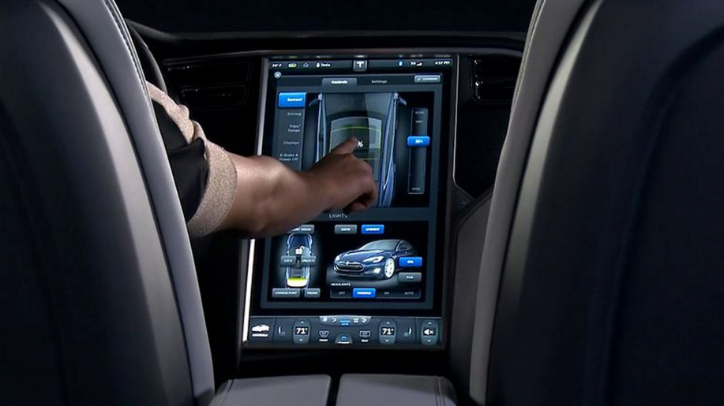
Why JavaScript?

Slide 3
Why JavaScript? (contd.)
JSON: Javascript Object notation
JSON based data exchange; JSON based webservices
From www.json.org
JSON is built on two structures:
A collection of name/value pairs. In various languages, this is realized as an object, record, struct, dictionary, hash table, keyed list, or associative array.
An ordered list of values. In most languages, this is realized as an array, vector, list, or sequence.
These are universal data structures. Virtually all modern programming languages support them in one form or another. It makes sense that a data format that is interchangeable with programming languages also be based on these structures.

Slide 4
Why JavaScript? (Contd.)
Numerous third party libraries for data processing and visualization.
See this recent publication from IBM: JavaScript Everywhere and Three Amigos: Sept.2013 article by J. Cuomo
https://www.ibm.com/developerworks/community/blogs/gcuomo/entry/javascript_everywhere_and_the_three_amigos?lang=en
A representative example:
Also look at Google Maps JavaScript library: https://developers.google.com/maps/documentation/javascript/

Slide 5
Try this code: in notepad++ save as ex3.html
<!DOCTYPE html>
<html>
<head>
<title>Google Maps Example</title>
<script src="
https://maps.googleapis.com/maps/api/js?v=3.exp&sensor=false">
</script>
<script>
var map;
function initialize() {
var mapOptions = {
zoom: 8,
center: new google.maps.LatLng(42.9, -79.8),
mapTypeId: google.maps.MapTypeId.ROADMAP };
map = new google.maps.Map(document.getElementById('map_canvas'),
mapOptions); }
</script>
</head>
<body onload="initialize()">
<div id="map_canvas" style="width: 500px; height: 300px"></div>
</body>
</html>

Slide 6
More lat.long
Now change the lat,long as shown below:
google.maps.LatLng(12.9, 77.56)
Change the lat long to (27.9, 86.9)

Slide 7
On to JavaScript
Lets learn some more features of JS and also how to power an application using JS functions.
Also we want to structure our applications in a modular fashion: no mix of HTML, CSS and JS: three separate files
Lets do that for this Google Map example

Slide 8
HTML+JS
Lets add some widgets like buttons and textboxes and power them using JS functions
Only that we will separate the widgets and function in html and js file separately

Slide 9
ex4.html
<!DOCTYPE html>
<html>
<head>
<title></title>
<script>
</script>
</head>
<body>
<div id="auto_panel" style="width: 500px; height: 300px; background-color: lightblue;"></div>
</body>
</html>
What do you? How will you center this panel/canvas for displaying the widgets?

Slide 10
Lets add some widgets
Add a button within the dvi tags as shown below: understand the various properties of the button widget.
<div id="auto_panel" style="width: 500px; height: 300px; background-color: lightblue;">
<input type="button" name="b1" value="Click Here" onclick=''/>
</div>

Slide 11
Lets respond to the click
Lets write a simple javascript and link it to the main html code
Simple Javascript file has these components
Data area
Functions
Lets add js function to the button. Save the code below in ex4.js and modify ex4.html to link to this file (as shown in the next slide)
function first()
{ alert (" Button was clicked!");
}

Slide 12
Changes in ex4.html
<script type="text/javascript" src="ex4.js">
</script>
</head>
<body>
<div id="auto_panel" style="width: 500px; height: 300px; background-color: lightblue;">
<input type="button" name="b1" value="Click Here" onclick='first()'/>

Slide 13
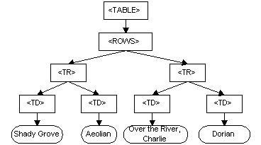
Document Object Model (DOM)
The Document Object Model (DOM) is a programming API for HTML and XML documents. It defines the logical structure of documents and the way a document is accessed and manipulated.
It is hierarchical. Here is the for the html table.

Slide 14
DOM for general HTML document
document
form id/index
table id
div id
button id

Slide 15
DOM nodes
In the HTML DOM (Document Object Model), everything is a node:
The document itself is a document node
All HTML elements are element nodes
All HTML attributes are attribute nodes
Text inside HTML elements are text nodes
Comments are comment nodes

Slide 16
DOM usage
Using the DOM structure we can refer to the various elements of the html document using “OO” dot notation
Example: add this line to first function in the ex4.js file
document.write (“Hello everyone!”);
Save and run the e4.html

Slide 17
DOM objects
Many useful DOM objects are available; One thats of use to us is the Math object
You can use most any math function:
var x = Math.PI; // Returns PI
var y = Math.sqrt(64); // Returns the square root of 64

Slide 18
Lets do some computation
Lets add a text box, do some computation in the javascript and return to the document
Start a new exercise
Save ex4.html as ex5.html, ex4,js as ex5.js
Modify ex4.html to have a textbox element
Change the button to Get Random Number
Make sure to change script file linked to ex5.js
We have also introduced the “form” tag, that is a very useful tag
As shown in the code next

Slide 19
Ex5.html
<script type="text/javascript" src="ex5.js">
</script>
</head>
<body>
<form>
<div id="auto_panel" style="width: 500px; height: 300px; background-color: lightblue;">
<input type="button" name="b1" value="Get Random Number" onclick='myrand()'/>
<br>
<br>
<br>
<input type="text" name="randomNumber" value="0" onchange=''/>
</div>
</form>

Slide 20
Ex5.js
var rnum;
function myrand()
{ alert (" Button was clicked!");
rnum = Math.floor(Math.random()*100 ); // a number between 0-99 inclusive
alert(rnum);
document.forms[0].randomNumber.value = rnum;
}

Slide 21
JS driven by Analytics
Where do the analytics come in?
Lets now make an application with html and js that is driven by one of our simplest statistical models: linear regression
This is basically a template for any other application you may write.
Html interface
Javascript
functions
Analytics

Slide 22
Linear regression Application
Lets plan the interface: y = a + bx
We need input boxes for a, b and x and an output box for displaying the result in y
A button to start the analytics (simple in this case)
Like mentioned before this example is simply a template, the analytics could me more complex than this.
This is an in-class exercise for you.

Slide 23
Summary
We looked basic features of Javascript working with html input interface
Any analytics module can be easily be made to power this workflow that we studied / practiced in this session
Study the material/paper given in the reference for more information on javascript.

Slide 24
References
Third Party JavaScript book
DOM standard: http://www.w3.org/TR/1998/WD-DOM-19980720/introduction.html
DOM: w3schools.com

