Slide 1
Emerging Applications and Platform#3: JavaScript
Bina Ramamurthy

Slide 2
Review of last week
We looked at two emerging platforms last week:
Emerging applications and platforms#1: Arduino
Emerging applications and platform#2: R-Studio
While Arduino is excellent for prototyping embedded systems, R-Studio is great for quickly setting up analytics and visualizing it.
Both have highly impactful and heavily used across many application domains.
We have introduced the topics and provided a fairly strong foundation for you to think about using it in your work as you see fit.

Slide 3
Review R-Studio K-means parameters
K-means may result in different clusters based on the process and the starting point.
So you may want to test it by running it again with specified clusters.
In some cases (esp. large data) this may not be a problem; but in smaller data set it may be.
Be aware of this. (in the test too!)

Slide 4
Review of K-NN
Finding the right value of K is critical for your decision making.
These are effective algorithms for big data
Also look at http://easycalculation.com/statistics/learn-regression.php for test preparation on linear regression
Big data motivators:
“More data usually beats better algorithms”
Where algorithms fall short data can compensate.

Slide 5
For Today Emerging Platform #3: Javascript
Javascript is a language of the web and for the web.
It is simple, easy to learn and at the same very powerful.
Javascript “engine” powers many emerging applications and platforms: See the “Javascript everywhere and the three amigos paper”
It is central to many visual UI (User interfaces): phones, mobiles devices, automobile panels…diagnostics
This is also nice way to ease into Android app development that we are going to learn in our next session
Thats why Javascript is our EAP #3

Slide 6
Hmm…Javascript
HTML5 ➔ HTML + CSS + Javascript a powerful web language
Variations; XHTML, DHTML
Very popular JS libraries:
D3.js (data driven documents) look at d3.org
jQuery.js: small, feature-rich animation,
JSON : javascript data interchange library.. Very popular ; for example twitter data can be retrieved in this format for easy extraction of data
Just like web services (WS), and REST API, Javascript API is getting very popular (E.g. Mongodb has very popular JS API)
JS libraries are equally popular among the rival tech giants Microsoft, Oracle, Amazon, IBM (see the references)

Slide 7
Getting started
We will limit ourselves to pure javascript (HTML5) for this course.
Once you get good foundation in this it is quite simple to include/link the js libraries and work with them.
Here is a very nice link to get started http://www.w3schools.com/js/DEFAULT.asp

Slide 8
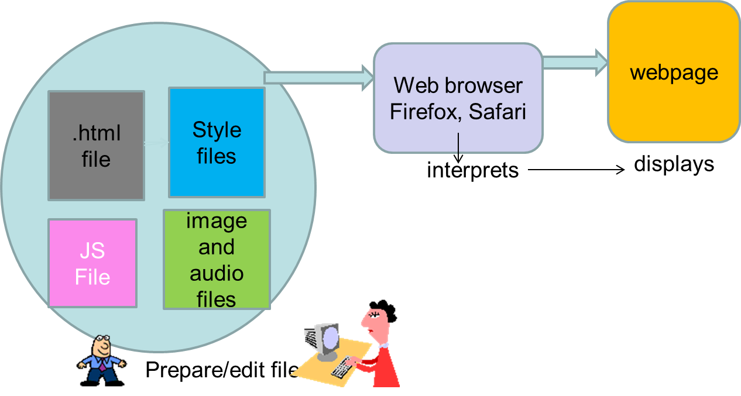
Basic Elements of

Slide 9
HTML5
HTML (Hyper text markup language) file is the central component that provides the structure to a “page” or a “display”
The element of the page are structured using tags or markups.
HTML5 the newest standard includes cascading style sheets (css3) and javascript
CSS provides the style aspect to the elements specified by the html tags
Javascript provides the activities/operations/computations

Slide 10
HTML tags
Tags are words or abbreviations enclosed in angle brackets, < and >
Many tags come in pairs
The second of the pair comes with a slash: <title> CSE651 Emerging Platforms </title>
A few tags are not paired; They do not have a matching ending tag
For those tags, the closing angle bracket > of the singleton tag is replaced by />
Examples: <hr /> produces a horizontal line <br /> continues the text to the next

Slide 11
Required Tags
Every Web page is composed of a head and a body
There are three HTML tags required for every Web page:
<head> and </head> enclose the head
<body> and </body> enclose the body
<html> and </html> to enclose those two parts
Lets try our first application. File type is .html

Slide 12
<!doctype html>
<html>
<head>
<title>
This is CSE651
</title>
</head>
<body>
<center>
<h1>
This is HTML
</h1>
</center>
</body>
</html>

Slide 13
Background color style
Now change the body style to chocolate color by this command:
<body style="background-color:#897867">
Save and reload the page
Every tag can have many style attributes like this: color, font, size, etc.

Slide 14
Lets add some style
We added background color as a style to the page. Instead of creating on the html page itself we will separate all the style items into another file of type .css
We will also add a paragraph
We will use different colors for different items on the page.

Slide 15
Style in .css file
body {background-color:#897867;}
h1 {background-color:red;}
p {background-color:rgb(255,0,255);}
Type the above in a file called first.css
Then link this file from the html head section
<link rel="stylesheet" type="text/css" href="first.css">
Save the files and reload the page on firefox browser
Color scheme used is RGB (Red, Green, Blue) format of 256 shades each (00-FF)

Slide 16
Linking to other pages
Links are what make the connected web and provide quite valuable data for web analytics;
It is also an enabler for the “Internet of Things”
Combine an anchor link tag with an image tag: <a href=“http://www.bosch.com"> <img src=“bosch_logo_english" alt=“Bosch Logo“></a>
What to do?

Slide 17
Exercise #2
Save first.html as ex2.html and first.css as ex2.css
Download Bosch logo into your lab folder
Add these lines in the middle of the body and save
<a href="http://www.bosch.com">
<img src="bosch_logo_english.png" alt="Bosch Logo"></a>
Make sure the quotes are right when you copied. Save and reload your web page with ex2.html
You will see the Bosch logo and when you click on it will take you to Bosch site.

Slide 18
Attributes
Attributes
An additional specification included inside a tag
The abbreviations href, src, and alt are attributes
Attributes have the form name="value”
the name, such as href, is the attribute
the text in quotes, such as, biographies/boschbio.html, is the value
Values are always enclosed in quotes

Slide 19
Style Attribute
The style attribute is the most useful attribute
Used to control a huge list of properties for every feature of a Web page
Properties are characteristics of page components, such as color, size, or position.
The value of the style has a standard form: style = "property_name : specification”
The colon (:) separates the property name from its specification
The spaces on each side of the colon are optional <body style="background-color : black; color : green">
Notice that when more than one property is set with style, the name/specification pairs are separated by a semicolon (;)

Slide 20
Attributes for Image tag
You can scale the image using the attributes.
<a href="http://www.bosch.com">
<img src="bosch_logo_english.png" width=“100” height =“50” alt="Bosch Logo"></a>
Try it with various sizes and check the scaling factor.

Slide 21
Lets add a Table
Lets modify ex2.html to be meaningful.
Remove all the unnecessary tags that you don’t need from the previous exercise.
Now save the file as Proj_Report.html and the css file also accordingly.
Add a table about your project and the abstract.

Slide 22
<table border="1">
<caption><h3>CSE 651 Project Report</h3></caption>
<tr>
<th>Project Title</th>
<td>Speed Limiter </td>
</tr>
<tr>
<th>Designer Name</th>
<td>Your name </td>
</tr>
</table>
<p>
<h3>
Project Abstract
</h3>
This project is about controlling the speed automatically according to the speed limits. <br>
This device
senses the speed limit for the zone and will not let the motorist go over that limit!!!
</p>

Slide 23
Summary
We looked at HTML5 structuring and styling with css.
You will prepare your project report in this format.
You can embellish it as you wish with colors and fonts and styles.
Next lecture we will add the processing components for the page using Javascript.

Slide 24
References
L. Synder. Fluency with Information Technology: Skills, Concepts, and Capabilities, Pearson, 2013.
W3c schools. http://www.w3schools.com/

