Slide 1
Emerging Platform#4: Android
Bina Ramamurthy

Slide 2
What is Android?
Android is an Operating system.
Android is an emerging platform for mobile devices.
Initially developed by Android, Inc., which Google backed financially and later bought in 2005
Android is an open-source software stack for a wide range of mobile devices and a corresponding open-source project led by Google.
It is based on Linux kernel;
it has a user interface that can be directly manipulated.

Slide 3
Android App Components
http://developer.android.com/guide/components/fundamentals.html

Slide 4
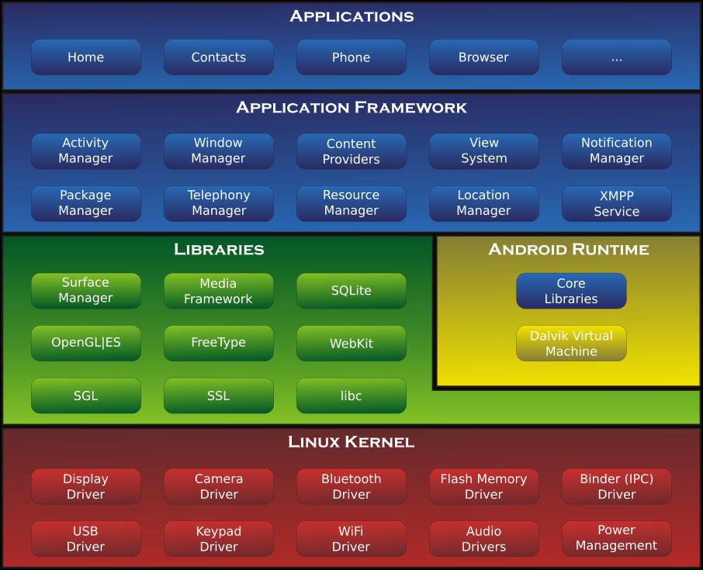
Android App Architecture (from wikipedia)

Slide 5
Android Architecture
Android applications are written in Java.
They run multi-user Linux operating system.
Each application runs on its own sandbox /VM and this provides isolation from other apps
Android SDK compiles the java code and the resources specified into an Android package of type .apk
Each app is assigned a Linux user unique id

Slide 6
Major components
The major components in the Android app development are:
App Components: The core framework components that define your app.
The manifest file: in which you declare components and required device features for your app.
App resources: Resources that are separate from the app code and allow your app to gracefully optimize its behavior for a variety of device configurations.

Slide 7
App Components
Essential building blocks of the app
Entry point for the user as well as the system to the app
There are 4 different types of app components
Activities: represents a single screen within a user app ---subclass of Activity; example : email list of email app
A service is a component that runs in the background to perform long-running operations or to perform work for remote processes. Inherits from Service class.

Slide 8
App Components (contd.)
3. A content provider manages a shared set of app data. You can store the data in the file system, an SQLite database, on the web, or any other persistent storage location your app can access.
-- is a subclass of ContentProvider
4. A broadcast receiver is a component that responds to system-wide broadcast announcements. A broadcast receiver is implemented as a subclass of BroadcastReceiver and each broadcast is delivered as an Intent object.

Slide 9
Activating the Components
Three of the four component types—activities, services, and broadcast receivers—are activated by an asynchronous message called an intent.
An intent is created with an Intent object, which defines a message to activate either a specific component or a specific type of component

Slide 10
The Manifest File
Before the Android system can start an app component, the system must know that the component exists by reading the app's AndroidManifest.xml file (the "manifest" file).
Your app must declare all its components in this file, which must be at the root of the app project directory.
The primary task of the manifest is to inform the system about the app's components.
Things such as permissions, libraries needed, APIs, hardware & software features are declared in an xml file

Slide 11
App Resources
An Android app is composed of more than just code—it requires resources that are separate from the source code, such as images, audio files, and anything relating to the visual presentation of the app. For example, you should define animations, menus, styles, colors, and the layout of activity user interfaces with XML files.
For every resource that you include in your Android project, the SDK build tools define a unique integer ID, which you can use to reference the resource from your app code or from other resources defined in XML.

Slide 12
Summary
We studied various components to be defined for a Android app development.
We need practice this using a complete code example.
That’s what we will do next.
(This is a quite a complex process if you are not familiar with Eclipse, OOP, and Java.)

