Slide 1
Loops and Arrays
Chapter 19 and Material Adapted from Fluency Text book

Slide 2
Learning Objectives
Trace the execution of a given for loop
Write a World-Famous Iteration for loop
Discuss the structure of nested loops
Explain the use of indexes
List the rules for arrays; describe the syntax of an array reference
Explain the main programming tasks for online animations

Slide 3
Terminology
Repeat
5 repeats, means you may have done it once followed by 5 more times (the repeats!)
Iterate
5 iterations means that you do it 5 times
Iteration means looping through a series of statements to repeat them
In JavaScript, the main iteration statement is the for loop

Slide 4
for Loop Syntax
for ( <initialization>; <continuation>; <next iteration> ) {
< statement list>
}
Text that is not in <meta-brackets> must be given literally
The statement sequence to be repeated is in the <statement list>

Slide 5
for Loop Syntax
for ( <initialization>; <continuation>; <next iteration> ) {
< statement list>
}
<statement list> is performed for each iteration
Computer completes the whole statement sequence of the <statement list> before beginning the next iteration

Slide 6
for Loop Syntax
for ( <initialization>; <continuation>; <next iteration> ) {
< statement list>
}
Three operations in the parentheses of the for loop control the number of times the loop iterates
Called the control specification

Slide 7
for Loop Syntax
for (j = 1; j < = 3; j = j + 1 ) {
< statement list>
}
Use an iteration variable
Iteration variables are normal variables and must be declared
This example uses j as the iteration variable

Slide 8
for Loop Syntax
for ( <initialization>; <continuation>; <next iteration> ) {
< statement list>
}
<initialization> sets the iteration variable’s value for the first (if any) iteration of the loop

Slide 9
for Loop Syntax
for ( <initialization>; <continuation>; <next iteration> ) {
< statement list>
}
<continuation> has the same form as the predicate in a conditional statement
If the <continuation> test is false outcome, the loop terminates and <statement list> is skipped

Slide 10
for Loop Syntax
for ( <initialization>; <continuation>; <next iteration> ) {
< statement list>
}
If <continuation> has a true outcome, the < statement list> is performed
When the statements are completed, the <next iteration> operation is performed
<next iteration> changes iteration variable

Slide 11
for Loop Syntax
for ( <initialization>; <continuation>; <next iteration> ) {
< statement list>
}
Next iteration starts with the <continuation> test, performing the same sequence of operations
Iterations proceed until the <continuation> test has a false outcome, terminating the loop

Slide 12
for Loop

Slide 13
for Sequence

Slide 14
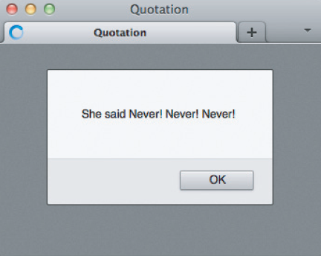
for Example

Slide 15
Continuation/Termination Test
If you can begin an iteration anywhere, you can end it anywhere
The <continuation> test follows the rules for predicates—the tests in if statements.
The test is any expression resulting in a Boolean value
It must involve the iteration variable

Slide 16
Step-by-Step
<next iteration> also allows considerable freedom
It allows you to specify how big or small the change in the iteration variable
The amount of change is known as the step or step size: j=j+1 j=j+10

Slide 17
Iteration Variable does Math!
iteration variable is often used in computations in the <statement list>
Important that you focus on the values of the iteration variable during the loops
For example: fact = 1; for ( j = 1; j <= 5; j = j + 1) { fact = fact * j; {

Slide 18
for Loop Practice: Heads/Tails
Let’s use randNum(2) from Chapter 19
It will return 0 (tails) or 1 (heads)
And flip the “coin” 100 times
Use WFI

Slide 20
Conditional Operators
>= greater than or equal to
> Greater than
< less than
<= less than or equal to
== equal to
!= not equal to

Slide 21
Indexing
Indexing is the process of creating a sequence of names by associating a base name with a number
Each indexed item is called an element of the base-named sequence
An index is enclosed in [square brackets] in JavaScript

Slide 22
Arrays [1]
In programming, an indexed base name is called an array
Arrays must be declared
In JavaScript, arrays are declared: var <variable> = new Array(<number of elements>)
Notice that Array starts with an uppercase “A”

Slide 23
Arrays [2]
Variables either are or are not arrays var week = new Array(7);
week is the identifier being declared,
new Array(7) specifies that the identifier will be an array variable.
number in parentheses gives the number of array elements
To refer to an array’s length, we use <variable>.length

Slide 24
Arrays [3]
Rules for arrays in JavaScript:
Arrays are normal variables initialized by new Array(<number of elements>)
<number of elements> in the declaration is just that—the number of array elements
Array indexing begins at 0
Number of elements in an array is its length
Greatest index of an array is <number of elements> − 1 (because the origin is 0)

Slide 25
Arrays [4]
The number in the bracket is called the subscript
Array reference consists of array name with an index [enclosed in brackets]
Value to which the index evaluates must be less than the array’s length
Example:
var dwarf = new Array(7);
dwarf[0] = "Happy";
dwarf[1] = "Sleepy";

Slide 26
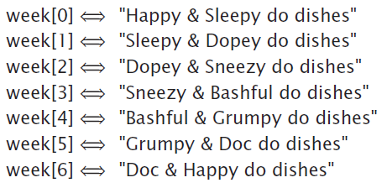
WFI and Arrays
0-origin of the WFI is perfect for 0-origin indexing
Easily allows for iterating through all the values of an array

Slide 27
Summary
The basics of for loop iteration. The control part of a for statement is written in parentheses and the < statement list> is enclosed in curly braces. With each iteration, the entire statement list is performed. The number of iterations is determined by assignments to, and tests of, the iteration variable as specified in the control part.
In the JavaScript for statement, the <initialization> component is executed first. Then, prior to each iteration, including the first, the <continuation> predicate is tested. If it is true, the < statement list> is performed; otherwise, it is skipped, and the for statement terminates. After each iteration, the <next iteration> operation is performed.

Slide 28
Summary
The principles of iteration ensure that every iteration contains a test and that the test is dependent on variables that change in the loop.
The for statement is very flexible. The <initialization> can begin with any number, the <continuation> test can stop the loop at any number, and the <next iteration> operation can increment by various amounts upward or downward.

Slide 29
Summary
In indexing, we create a series of names by associating a number with a base name. If we need more names, we count more numbers. Indexed variables are known as arrays in programming. Like ordinary variables, arrays must be declared, but they use the new Array(<length>) syntax, in which <length> is the number of elements of the array.

Slide 30
Summary
Array elements—referenced by giving the name and a non-negative index in brackets—can be used like ordinary variables. Arrays and iterations can be effectively used together.
Basic concepts of online animation. All animations achieve the appearance of motion by rapidly displaying a series of still frames.

