Slide 1
Introduction to JavaScript
B. Ramamurthy

Slide 2
Overview
We will begin with simple exercises on HTML (UI)+JS (control/action)+CSS (style)
HTML provides the user interface (UI) and the structure for the web page
CSS provides the style such as color, font size etc.
JS (Java Script) provides the action and computation.
We have already worked on simple HTML tags and CSS commands.
Here we will work on learning basic elements of JS.

Slide 3
Structure – Style -- Interaction
HTML provides structure
CSS provides style; CSS provides style attributes for the HTML selector tags
Javascript (JS) provides control for interaction and operations
JS provides functions that can be called to perform operations

Slide 4
Exercise with all three components
<!DOCTYPE html>
<head>
<title> My first JavaScript </title>
<style>
h1{color: blue}
</style>
</head>
<body>
<h1>
<script>
document.write("Hello World!")
</script>
</h1>
</body>
</html>
Head
Style/css
Body
Script/js

Slide 5
Separate files for style and scripts
<!DOCTYPE html>
<head>
<title> My first JavaScript </title>
</head>
<body>
<h1>
js function outside➔
</h1>
</body>
</html>
Head
.css file
Style/css
<style>
h1{color: blue}
</style>
Body
Script/js
.js file
function mywrite()
{document.write("Hello World!");}

Slide 6
Moving CSS, JS to an external files
We can separate style elements in css file, behavioral elements can be moved to an external js file.
This separation of concerns has resulted in explosion of javascript libraries and css style libraries.
Large collection of superior and highly useful js libraries/frameworks are available
Later we ill look into using some popular ones such as bootstrap and angularjs.

Slide 7
JS functions
Javascript “script” consists of functions.
A function consists of function followed by the name of the function
The statement that make up the function go next within curly brackets
Example:
function saySomething() {
alert(“ We are learning basics of JS”);
}

Slide 8
Putting all together
Javascript
Libraries
.html file
.css
file
application
Web browser
Firefox/ Safari
image and audio files
.js
file
interprets
displays
Style(.css)
Libraries
Prepare/edit files

Slide 9
Visualizations
Great visualizations are not just informative but initiate conversations, explosion of free social media communications/messaging/instagramming etc. result in valuable free marketing to target customer segment
Great visualization tells a story instantly
Excel is de facto standard but it is designed as a data entry application and optimized for graphs/plots: not good for unstructured and social media data; look beyond excel tables and graphs
Interactive visualization provides new modes of engagement previously impossible
Opens up previously invisible aspects of data

Slide 10
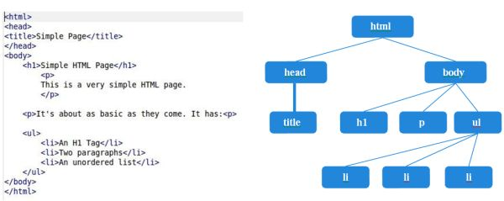
HTML5+DOM (Document Object Model)
No matter what the backend, HTML and JavaScript are the technologies for all web developers for front end.

Slide 11
DOM (https://www.w3schools.com/js/js_htmldom.asp)
With the HTML DOM, JavaScript can access and change
all the elements of an HTML document.
DOM provides a tree structure (hierarchical) structure to HTML elements.

Slide 12
Summary
We introduced the third major element of our web page design: JS.
We will develop this further in the next few weeks.
We will also add JS libraries to make the web page “responsive” and to work on different types of devices such as phone, tablet, laptop, automobiles dashboards, etc.
More importantly JS is a programming language: we will also learn the programming elements of this language.

