Slide 1
Quantitative Reasoning
Topic 1
Organizing Information Pictorially
Using Charts and Graphs

Slide 2
Objectives
Distinguish between quantitative and categorical variables.
Draw bar graphs and pie charts, and interpret them in the context of the data they represent.
Compute percentage of the whole and percent change.
Interpret stemplots and histograms and group data to create them.
Decide when each type of graph is appropriate.

Slide 3
Variables
A variable is a characteristic of an object or a person (called an individual/case).
Numerical variables are quantitative variables.
Eg., age, height, revenue
Variables containing a category called categorical variables.
Eg., movie genre, city, job title, color
Notes:
E.g., means “for example”

Slide 4
Variables
Individuals:
Movie Titles
Categorical Variables:
Studio
Quantitative Variables:
Rank
Total Gross

Slide 5
Variables
Individuals:
Team
Categorical Variables:
Division
Quantitative Variables:
Rank
Points

Slide 6
Variables
Individuals:
Tougher to determine
Based on title: Courses
Categorical Variables:
Professor
Semester
Quantitative Variables:
Enrollment

Slide 7
Percents
A percent represents a fraction out of 100.
Compute by dividing part by whole and multiply by 100%.
E.g., 2 people out of 8 people compose $\frac{2}{8}×100\%=25\%$ of the group.
If we round, we use the symbol $≈$ to say “approximately”
E.g., $\frac{2}{9}×100\%≈22.2\%$ (it’s not exact)
Used in lieu of fractions to compare part of total.
Easier to understand 10% than 3,387,648/33,871,648

Slide 8
Percents
Sum of % for each part is always 100%.
Sum of all parts equals the whole
If 2 people each get 25% of a pizza, and one person gets 50%, you have finished your pizza.
25% + 25% + 50% = 100%.
If the percentages didn’t add back to 100%, there would be remaining pizza unaccounted for.

Slide 9
Percents
Points by Division: Metropolitan vs Total
Points Earned by Metropolitan Division Teams:
$84+75+75+75=309$
Total Points Earned:
$84+80+75+75+75+75+73+70+68+66=741$
% of Points Metropolitan Teams Earned vs Top Teams:
$\frac{309}{741}×100\%=41.7\%$
Current NHL Standings for Top 10 Teams
Rank
Team
Points
Division
1
Washington Capitals
84
Metropolitan
2
Minnesota Wild
80
Central
3
Pittsburgh Penguins
75
Metropolitan
4
Columbus Blue Jackets
75
Metropolitan
5
NY Rangers
75
Metropolitan
6
Chicago Blackhawks
75
Central
7
San Jose Sharks
73
Pacific
8
Montréal Canadiens
70
Atlantic
9
Anaheim Ducks
68
Pacific
10
Edmonton Oilers
66
Pacific

Slide 10
Percents
CSE Enrollment: Semester vs Total
Fall Enrollment:
$228+604+162+243+242=1479$
Spring Enrollment:
$110+49+310+379+380+187=1415$
Total Enrollment:
$1479+1415=2894$
% Enrolled Fall:
$\frac{1479}{2894}×100\%=51.1\%$
% Enrolled Spring:
$\frac{1415}{2894}×100\%=48.9\%$
Sum: 51.1%+48.9% = 100%
2016-2017 Enrollments in Intro CSE Courses at UB
Course
Professor
Semester
Enrollment
CSE 111
Dr. Schindler
Fall
228
CSE 111
Dr. Ramamurthy
Spring
110
CSE 111
Dr. Hughes
Spring
49
CSE 115
Dr. Alphonce
Fall
604
CSE 115
Dr. Hartloff
Spring
310
CSE 116
Dr. Hertz
Fall
162
CSE 116
Dr. Hertz
Spring
379
CSE 191
Dr. Hughes
Fall
243
CSE 191
Dr. Miller
Spring
380
CSE 241
Dr. Ramamurthy
Fall
242
CSE 241
Dr. Ramamurthy
Spring
187

Slide 11
Percent Change
Percent change represents the fraction that a current value changed relative to a previous value.
Evaluate percent change by computing:
$\frac{new value−original value}{original value}×100\%$
Positive percent change represents an increase over previous.
Negative percent change represents a decrease from previous

Slide 12
Percent Change
% Change in Houses Completed: 2001 to 2006
New value: 1979.40
Old value: 1570.80
$\frac{1979.4 −1570.8}{1570.8}×100\%≈26.01\%$
% Change in Houses Completed: 2006 to 2007
New value: 1502.80
Old value: 1979.40
$\frac{1502.8−1979.4}{1979.4}×100\%≈−24.08\%$

Slide 13
Percent Change
CSE 111 Enrollment: Fall vs Spring (% change)
New value: 110 + 49 = 159
Old value: 228
$\frac{159 −228}{228}×100\%=−30.3\%$
Not a very useful data point.
2016-2017 Enrollments in Intro CSE Courses at UB
Course
Professor
Semester
Enrollment
CSE 111
Dr. Schindler
Fall
228
CSE 111
Dr. Ramamurthy
Spring
110
CSE 111
Dr. Hughes
Spring
49
CSE 115
Dr. Alphonce
Fall
604
CSE 115
Dr. Hartloff
Spring
310
CSE 116
Dr. Hertz
Fall
162
CSE 116
Dr. Hertz
Spring
379
CSE 191
Dr. Hughes
Fall
243
CSE 191
Dr. Miller
Spring
380
CSE 241
Dr. Ramamurthy
Fall
242
CSE 241
Dr. Ramamurthy
Spring
187

Slide 14
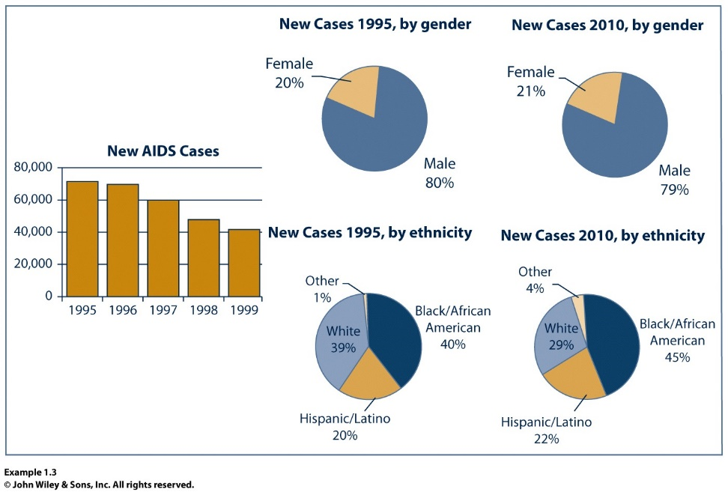
Bar Graphs and Pie Charts
Bar graphs and pie charts are two ways to represent categorical variables pictorially.
Note: graph and chart often used interchangeably.
Charts should be labeled for ease of understanding.
Shouldn’t be cluttered – only good for a few categories/groupings.

Slide 15
Bar Charts
Bar chart to compare top total gross of top 5 movies in 2011:

Slide 16
Bar Charts
Bar chart to compare current top 5 ranked teams.

Slide 17
Bar Charts
In bar charts, bars have height equal to the total value it represents.
Can compare values visually by comparing height.
The horizontal axis is labeled with the name of the object or group it is representing.
The vertical axis is labeled with the values each height represents.
Vertical axis must contain a quantitative variable.
Vertical axis labels must cover the range of values represented.
May start from 0, or start from another value.
Each marking must be equally spaced.

Slide 18
Pie Charts
A pie chart visualizes data as a percentage of the total.
To construct the chart, we need to determine:
The total value of everything we will consider.
The total value of each group.
Multiple items may lump into the same group.
E.g., comparing enrollments for the year between CSE courses – multiple offerings of same course should be lumped together.
The percentage of the total that each group consumes.
Better for visualizing a comparison of ratios.

Slide 19
Pie Charts
Pie chart to compare total gross of each studio:

Slide 20
Pie Charts
To make the chart, we need to complete some intermediate steps.
Compute table aggregating each group.
Compute total gross overall:
$822+742+281+432+210=2487$
Using total gross of $2487 million, determine what fraction each studio represents.

Slide 21
Pie Charts
To make the chart, we need to complete some intermediate steps.
Compute % per studio of total:
Warner Brothers:
$\frac{822}{2487}×100\%≈33.05\%$
Paramount/DreamWorks:
$\frac{742}{2487}×100\%≈29.84\%$
Summit:
$\frac{281}{2487}×100\%≈11.30\%$
Buena Vista:
$\frac{432}{2487}×100\%≈17.37\%$
Universal:
$\frac{210}{2487}×100\%≈8.44\%$

