Slide 1
System Structure
B. Ramamurthy

Slide 2
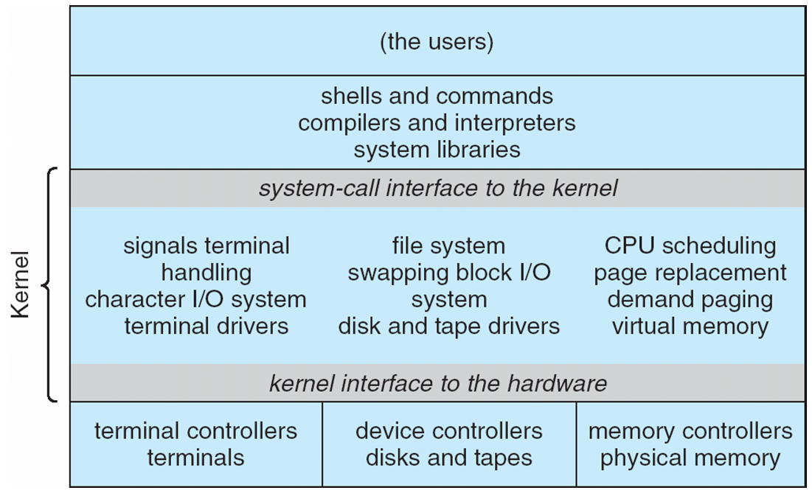
Traditional UNIX System Structure
Notes:
2

Slide 3
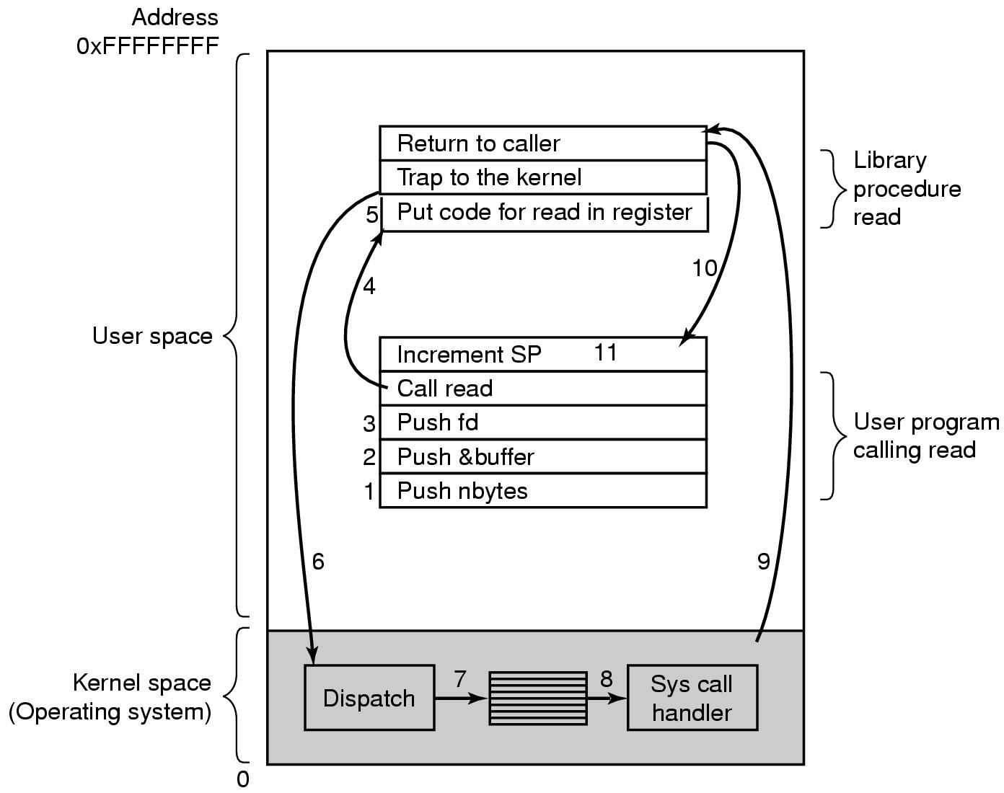
System Call
There are 11 steps in making the system call
read (fd, buffer, nbytes)

Slide 4
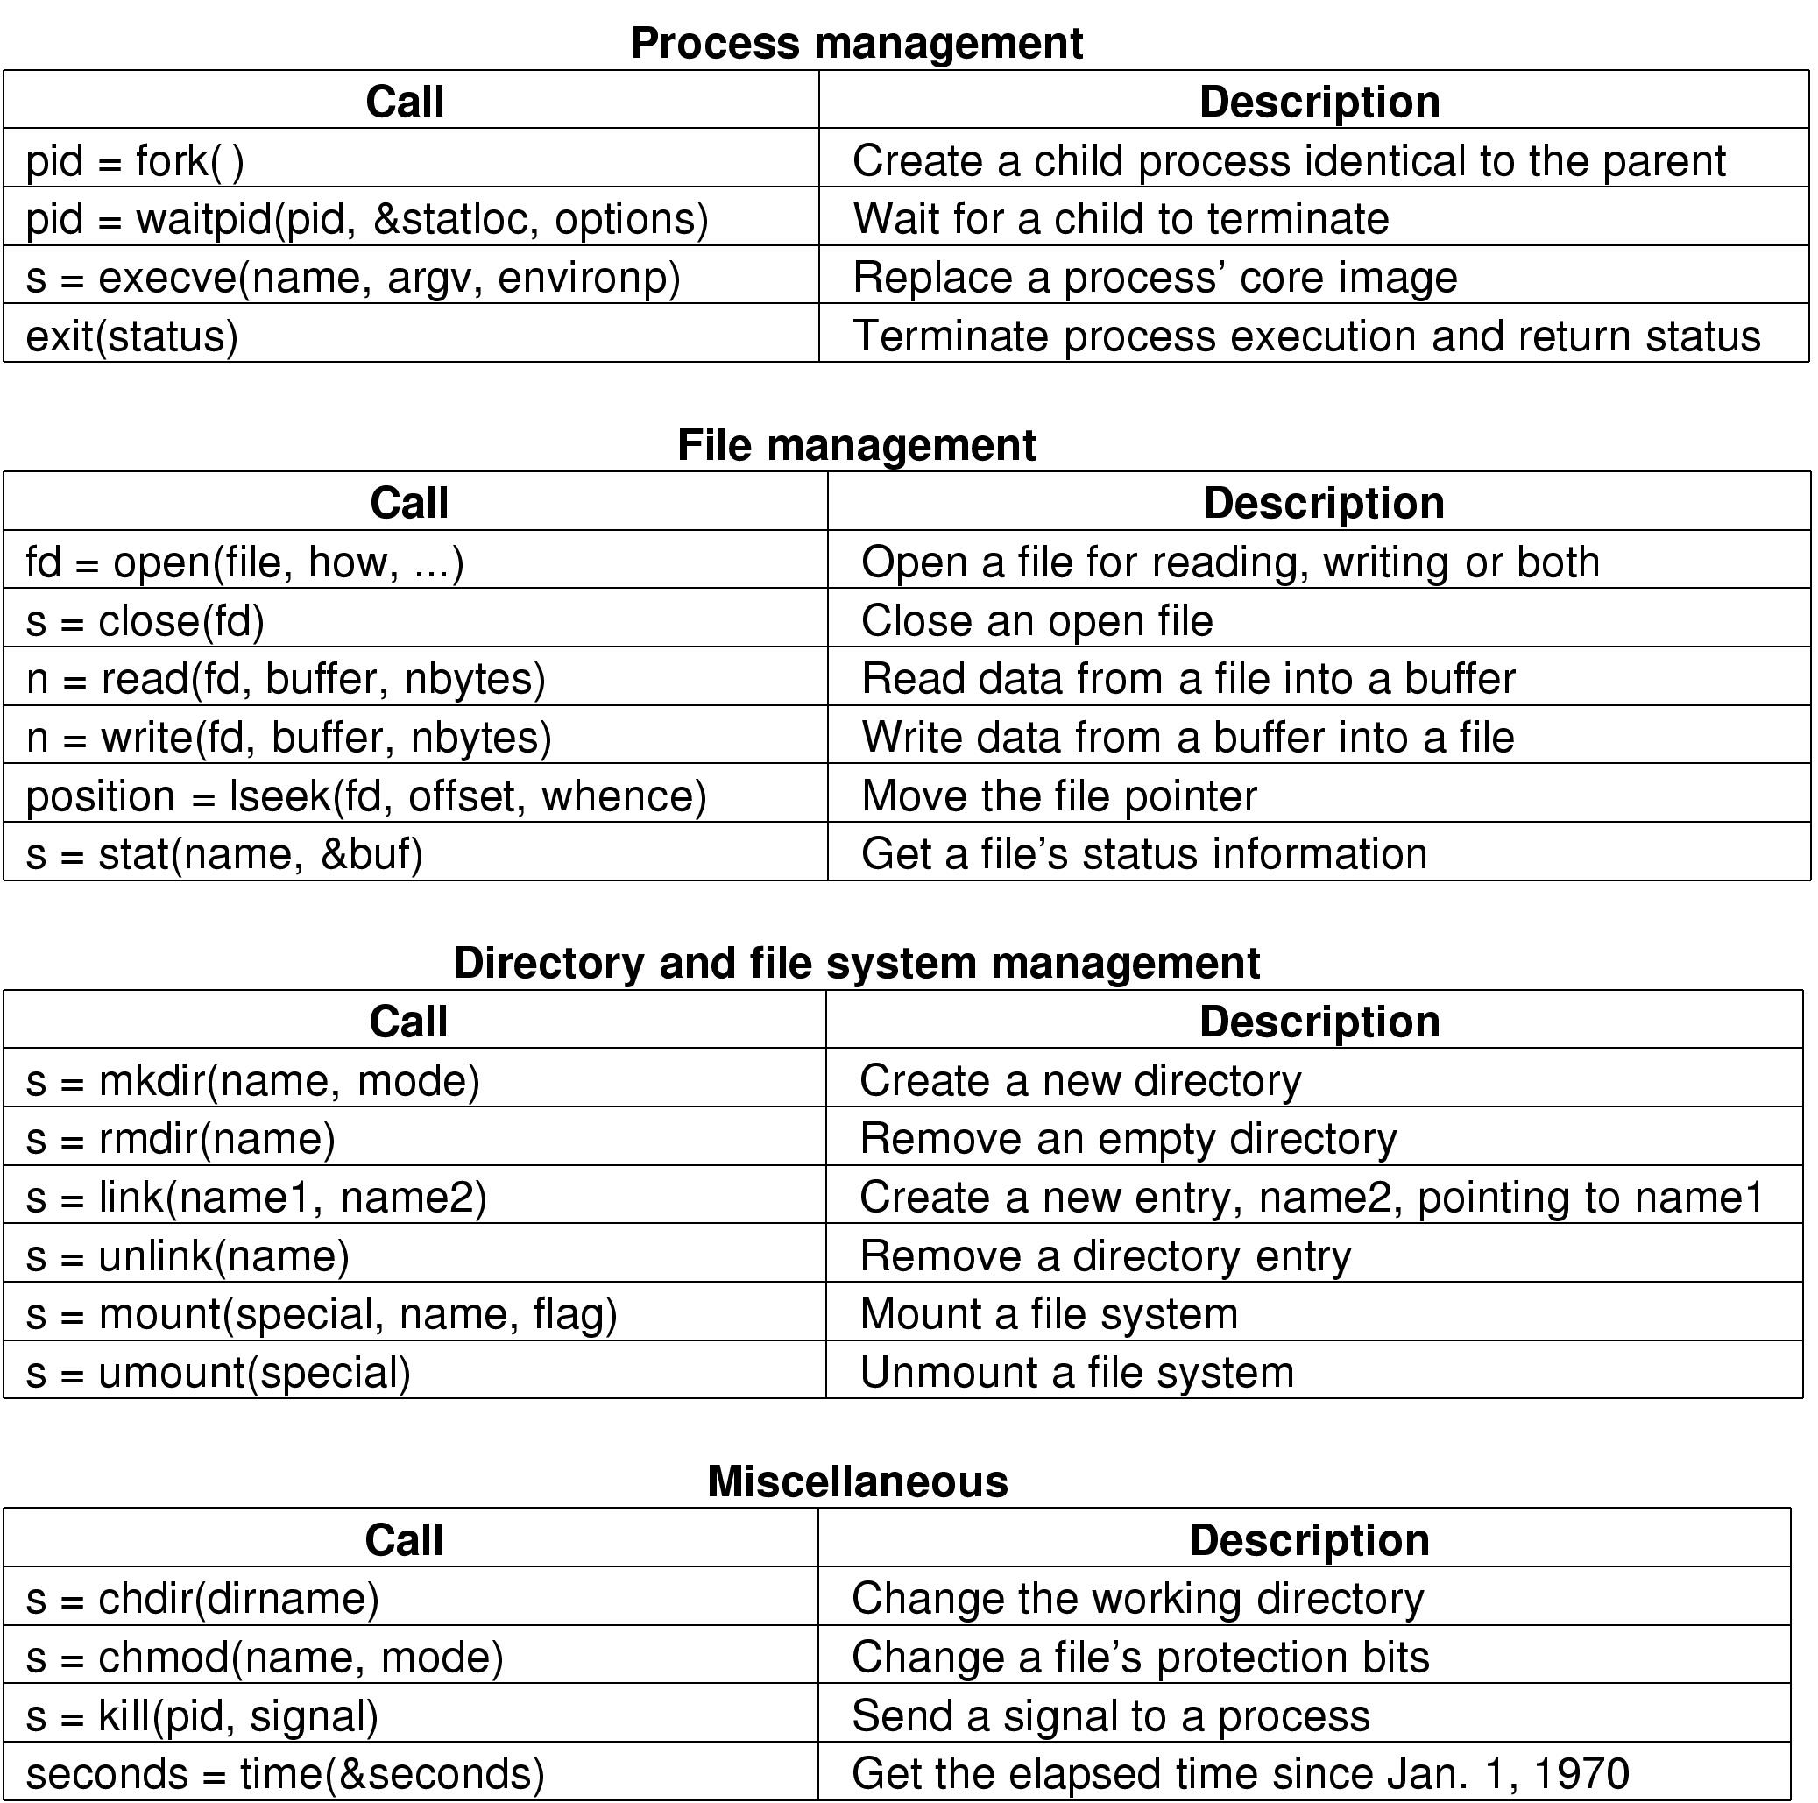
Some System Calls For Process Management and File Management

Slide 5
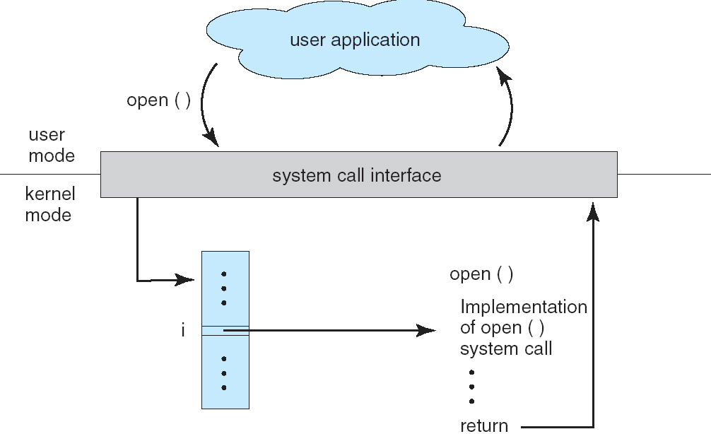
API – System Call – Operating system Relationship
Notes:
5

Slide 6
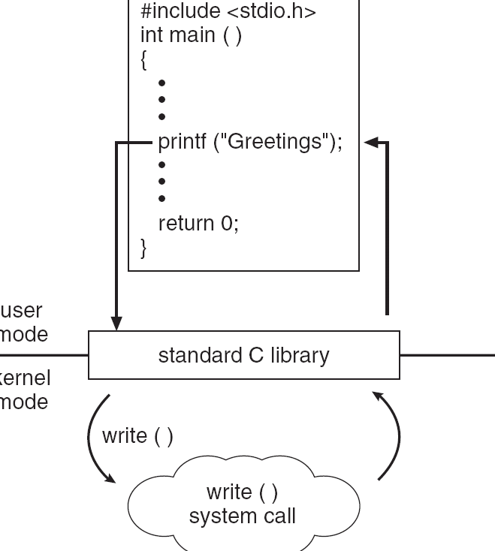
Standard C Library Example
C program invoking printf() library call, which calls write() system call
Notes:
6

Slide 7
What is a process?
A process is simply a program in execution: an instance of a program execution.
Unit of work individually schedulable by an operating system (OS).
A process includes:
program counter
stack
data section
OS keeps track of all the active processes and allocates system resources to them according to policies devised to meet design performance objectives.
To meet process requirements OS must maintain many data structures efficiently.
The process abstraction is a fundamental OS means for management of concurrent program execution. Example: instances of process co-existing.

Slide 8
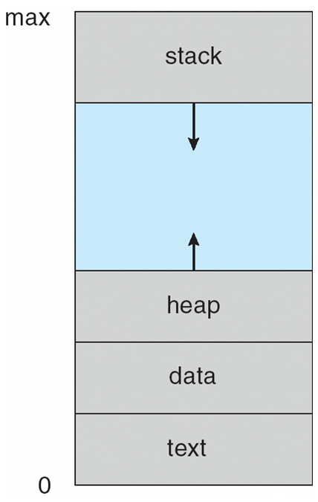
Process in Memory

Slide 9
Process control
Process creation in unix is by means of the system call fork().
OS in response to a fork() call:
Allocate slot in the process table for new process.
Assigns unique pid to the new process..
Makes a copy of the process image, except for the shared memory.
both child and parent are executing the same code following fork()
Move child process to Ready queue.
it returns pid of the child to the parent, and a zero value to the child.

Slide 10
Process control (contd.)
All the above are done in the kernel mode in the process context. When the kernel completes these it does one of the following as a part of the dispatcher:
Stay in the parent process. Control returns to the user mode at the point of the fork call of the parent.
Transfer control to the child process. The child process begins executing at the same point in the code as the parent, at the return from the fork call.
Transfer control another process leaving both parent and child in the Ready state.

Slide 11
Process Creation (contd.)
Parent process create children processes, which, in turn create other processes, forming a tree of processes
Generally, process identified and managed via a process identifier (pid)
Resource sharing
Parent and children share all resources
Children share subset of parent’s resources
Parent and child share no resources
Execution
Parent and children execute concurrently
Parent waits until children terminate

Slide 12
Process Creation (Contd.)
Address space
Child duplicate of parent
Child has a program loaded into it
UNIX examples
fork system call creates new process
exec system call used after a fork to replace the process’ memory space with a new program

Slide 13
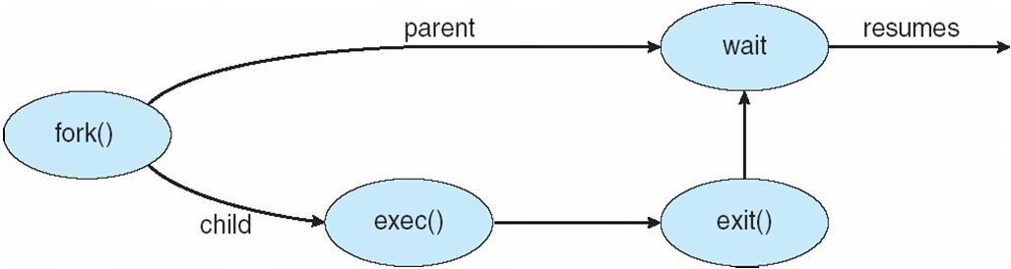
Process Creation (contd.)

Slide 14
A five-state process model
Five states: New, Ready, Running, Blocked, Exit
New : A process has been created but has not yet been admitted to the pool of executable processes.
Ready : Processes that are prepared to run if given an opportunity. That is, they are not waiting on anything except the CPU availability.
Running: The process that is currently being executed. (Assume single processor for simplicity.)
Blocked : A process that cannot execute until a specified event such as an IO completion occurs.
Exit: A process that has been released by OS either after normal termination or after abnormal termination (error).

Slide 15
State Transition Diagram
Dispatch
Release
Admit
READY
RUNNING
EXIT
NEW
Time-out
Event
Wait
Event
Occurs
BLOCKED
Think of the conditions under which state transitions may take place.

Slide 16
Process creation - Example
main () {
int pid;
cout << “ just one process so far”<<endl;
pid = fork();
if (pid == 0)
cout <<“I am the child “<< endl;
else if (pid > 0)
cout <<“I am the parent”<< endl;
else
cout << “fork failed”<< endl;}

Slide 17
Lets look at some code examples
See the demo directory

