Slide 1
Automatic Flight Controller (AFLIC)
B.Ramamurthy

Slide 2
What to do?
Understand the context: survey the landscape
Next is requirement analysis
Data structures and algorithms
Special concepts: concurrency, parallelism, how to simulate probabilities, time lapse (delays), interrupts, sampling (polling), mutual exclusion,…
Active object, passive resources
Remember: design alternatives / design choices (this or that )

Slide 3
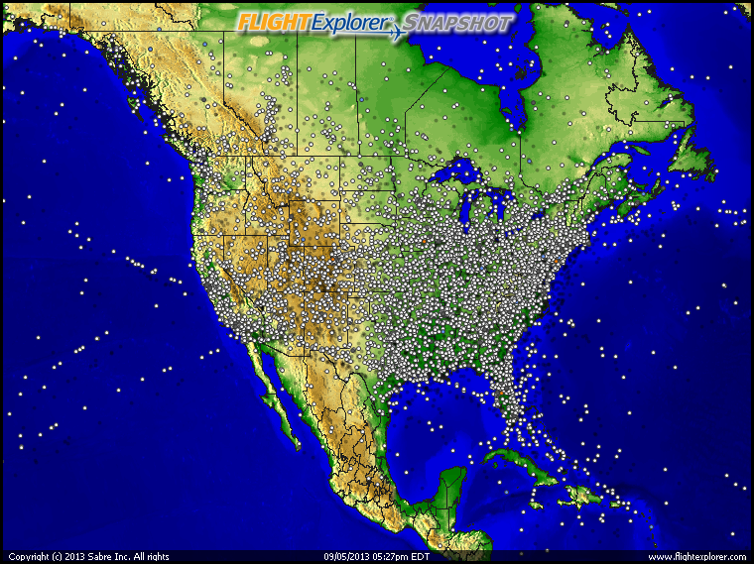
Consider this…

Slide 4
And this
Incident 1: “The near-miss involving three planes operated by US Airways happened on Tuesday in skies close to Reagan Washington National Airport….The FAA added that due to bad weather, air traffic controllers switched landing and departing operations and miscommunication "led to a loss of the required separation" between the jets. …The near-miss comes a year after two passenger planes were forced to land without help from the tower at the same airport, after the lone air traffic controller on duty fell asleep….That incident led to a review of staffing levels and worker fatigue at US airports..” August 2012.
Federal guidelines require craft to be separated by at least 1,000 vertical feet and 3.5 lateral miles.
Incident 2: “According to a statement issued by Hong Kong's Civil Aviation Department, a Cathay Pacific Airways flight that was bound for Hong Kong International Airport came within 1 nautical mile (2 km) of a Dragonair A330 airplane that was in a holding pattern for landing…The two jets, carrying more than 600 passengers and crew members, came within seconds of colliding, the newspaper reported, citing a former Hong Kong aviation official….” Sept 27, 2011.
Incident #3: “Airliners too close for comfort over New York”, CNN, June 25, video, 2013.http://www.cnn.com/2013/06/21/travel/nyc-jfk-airliners-too-close

Slide 5
In spite of this….
A traffic collision avoidance system or traffic alert and collision avoidance system (both abbreviated as TCAS, and pronouced tee-kas) is an aircraft collision avoidance system designed to reduce the incidence of mid-air collisions between aircraft. It monitors the airspace around an aircraft for other aircraft equipped with a corresponding active transponder, independent of air traffic control, and warns pilots of the presence of other transponder-equipped aircraft which may present a threat of mid-air collision (MAC). It is a type of airborne collision avoidance system mandated by the International Civil Aviation Organization to be fitted to all aircraft with a maximum take-off mass (MTOM) of over 5,700 kg (13,000 lb) or authorized to carry more than 19 passengers.
Air traffic control.. TCAS..
http://en.wikipedia.org/wiki/Traffic_collision_avoidance_system

Slide 6
Requirement Analysis
How do you represent the flights?
Concurrent processes/threads
A flight moves from state to state; various “states”: can we specify the operation using a state diagram?
Who creates these threads? The “main” program?
What are threads (of control)?
Presence in a state, say NAVIGATE, simulated by a sleep()/delay?
Others…
How to represent the collision/detection?
Using another thread and a flag?
Generate a random number (100) and use it to simulate probabilities

Slide 7
Requirement Analysis (contd.)
How to represent the runway?
It is a resource with states “avail” and “not avail” (binary)
Only one flight can be on it
How to implement mutual exclusion: using semaphores
(What are semaphores?)
How to show the simulation?
Printf /output the significant “states” , “events”
Parameters:
For prototype testing:
{1 runway, 2 planes}, {2 runway, 6 planes}
For the full simulation use:
Larger numbers {6 runway, 200 planes}

Slide 8
Design
State diagram (FSM) for the life cycle of a flight
Table-driven: Table

Slide 9
Development: Programming
Use best practices
Separate compilations
Makefiles
Lets look at an example

Slide 10
Counter Example (dependency chart)
Counter.cc Counter.h counterTester.cc
g++ -c
g++ -c
Counter.o
counterTester.o
g++
counterTester

