Slide 1
Embedded XINU and WRT54GL

Slide 2
Topics
WRT54GL architecture and internals
Embedded XINU
Logic and shift operators

Slide 3
WRT54GL
History of WRT54G Open source firmware
Common features
Processor architecture (BCM5352)
WRT54GL Block diagram

Slide 4
History
Introduced in 2002
In 2003 Andrew Miklas posted to Linux Kernel Mailing List about Linksys using GPL code in its firmware
Linksys executives gave into the pressure from the community, Linksys released the code to the community under GPL.

Slide 5
Common Features
Power: 12VDC 1.0amp
  This power requirement is standard for embedded devices and wireless access points
  This makes them compatible with Power over Ethernet (PoE)
  This especially significant in mobile environment.
The Reset button: to reset the configuration

Slide 6
Common Features (Contd.)
LED lights to indicate various conditions
Power : indicates presence of power
DMZ: use differs; ex: can show boot progress
WLAN LED
Ethernet
Internet
You can manipulate the LED thru’ your code by changing contents of system files.

Slide 7
Linksys WRT54GL (contd.)
Linux kernel 2.4
Based on Broadcom BCM535E SoC (System on Chip)
All-in-one Internet-sharing router,
  4-port switch
  54Mbps wireless-G (802.11g) access point
  Shares a single internet connection with Ethernet wired and wireless-G –B devices
  Push button setup
  High security: TKIP and AES encryption providing a powerful firewall

Slide 8
Processor Architecture
Processor: Broadcom MIPS (Microprocessor without Interlocked Pipeline Stages) processor, common to embedded devices and game consoles.
RISC (reduced instruction set computer)
MIPS is used Sony playstation for example.

Slide 9
BCM5352
Next generation SoC (System on a Chip)
SoC: combines CPU + Wireless MAC + Ethernet MAC onto one chip
Flash memory
SDRAM
Wireless access (802.11)
Ethernet switch

Slide 10
WRT54GL Block diagram
See next slide
Also follow this model:
CPU
Input
Storage
Output

Slide 11
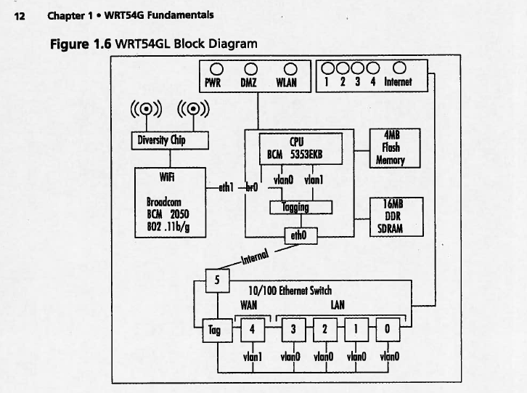

Slide 12
Processor Architecture
WRT54Gl uses Broadcom MIPS (Microprocessor without Interlocked Pipelines Stages) processor, common to embedded devices and game consoles.
Model: BCM5352
Based on Reduced Instruction Set Architecture (RISC)
The BCM5532 family of processors is a next generation SoC architecture that combines the CPU, Wireless MAC (media access controller), Ethernet MAC onto one chip

Slide 13
Storage
On board storage is indeed a limitation when using WRT54GL in situation other than for which it is meant for.
WRT54GL has a flash memory (4 MB), a form of non-volatile storage commonly used in small devices, such as digital camera.
It also use SDRAM (Synchronous Dynamic Random Access Memory) soldered directly into the printed board. DIMM (Dual In-line Memory Module)

Slide 14
Wireless and Ethernet networking
WRT54GL has a powerful networking architecture
It provides 5 port Ethernet switch that is broken down into two virtual LANs VLAN0 and VLAN1 (default)
Wireless interface is bridged by default to the Ethernet switch.
WiFi component is BCM2050, a 802.11b/g radio chipset.
It uses a diversity chip to balance signals between two built-in antenna.
WiFi radio connects to the CPU Wireless MAC on eth1 which is bridged to VLAN0 via br0 interface.
Ethernet switch controls EthernetLAN and Internet lights, whereas Power, DMZ, WLAN are controlled by GPIO port on the CPU
WAN port: plug in cable modem into this port,
  it will pull a DHCP (Dynamic Host Configuration Protocol) address from your ISP (Internet Service Provider).
  Since it belongs to VLAN1 it is separate from VLAN0 and the two are linked by WRT54Gl’s routing capabilities.
  Firewall prevents traffic from flowing from WAN to LAN network, traffic initiated by LAN to exit via WAN.

Slide 15
What does WRT54GL do?
Creates a network between the wireless interface and the LAN ports known as br0.
Router address is 192.168.1.1 by default.
WLAN port (port 4).
Typically you will plug your cable modem into this port; this will pull the DHCP address from your ISP.
WAN and LAN are separate network linked by WRT54GL

Slide 16
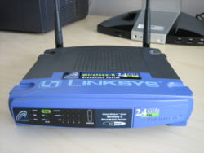
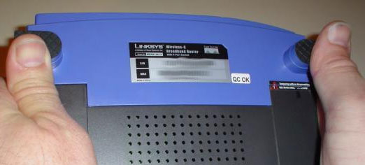
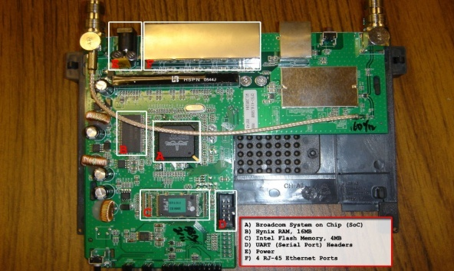
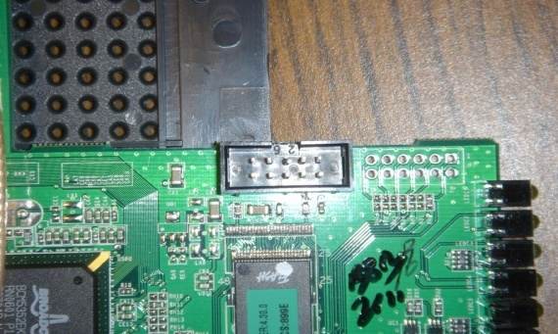
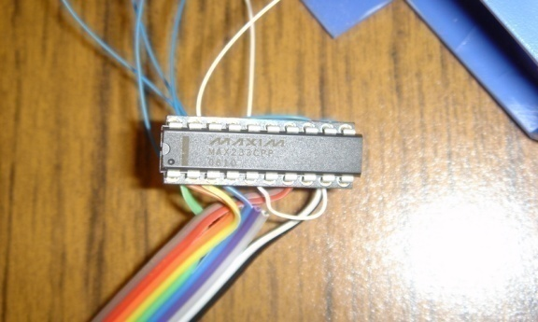
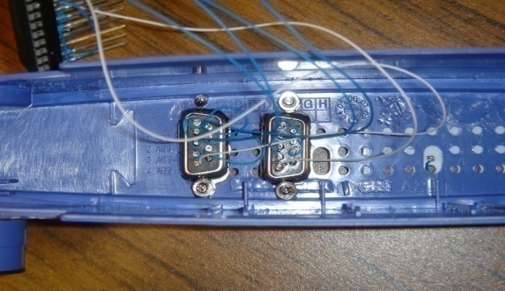
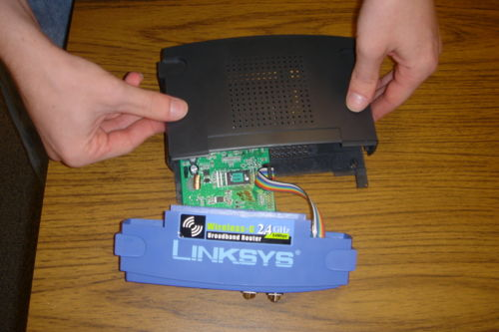
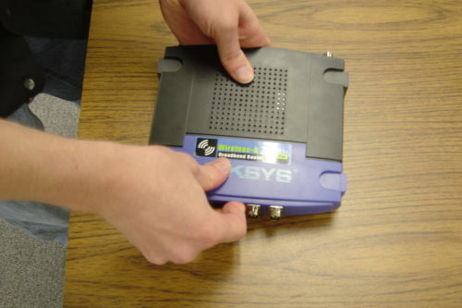
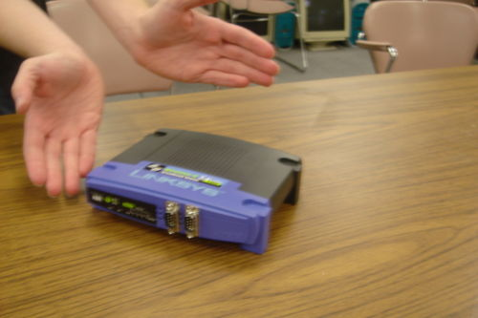
The Basic Hardware modifications

Slide 17
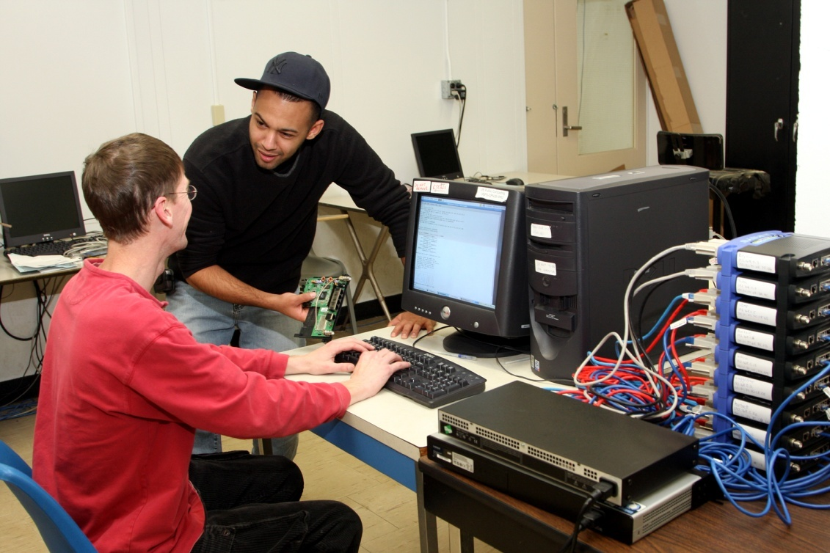
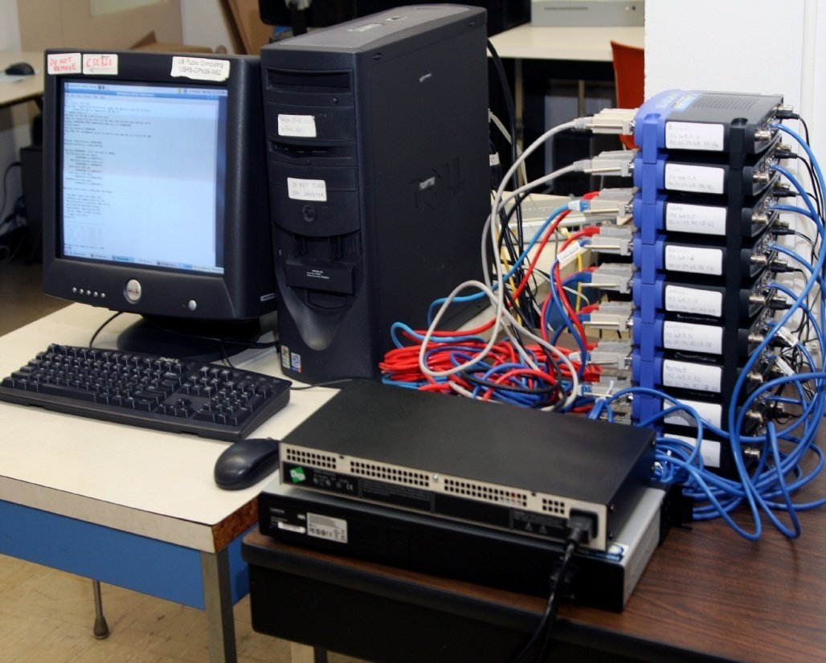
The NSF-Supported Facility at UB

Slide 18
Embedded XINU
http://xinu.mscs.mu.edu/Main_Page
XINU ("XINU Is Not Unix", a recursive acronym) is a Unix-like operating system originally developed by Douglas Comer for instructional purposes at Purdue University in the 1980s.
Embedded XINU is a reimplementation of the original XINU operating system on the MIPS processor which is able to run on inexpensive wireless routers and is suitable for courses and research in the areas of Operating Systems, Hardware Systems, Embedded Systems, and Compilers.

Slide 19
Embedded XINU
http://xinu.mscs.mu.edu/Memory
ls xinu_mips-1.0
AUTHORS README include loader system tty
LICENSE compile lib shell test uart
Above is the xinu kernel directory organization
See attached XINU directory structure and class diagram
We will develop programs into XINU kernel on Timberlake
We will cross compile this kernel and load the firmware into WRT54GL (“upload”) and test it

