Slide 1
Web Crawler with Word Count – Single and Multi Threaded with GAE
By,
Vallisha Keshavamurthy
Rajarshi Chakraborty
CSE 587 Project 1,
Dr. Bina Ramamurthy

Slide 2
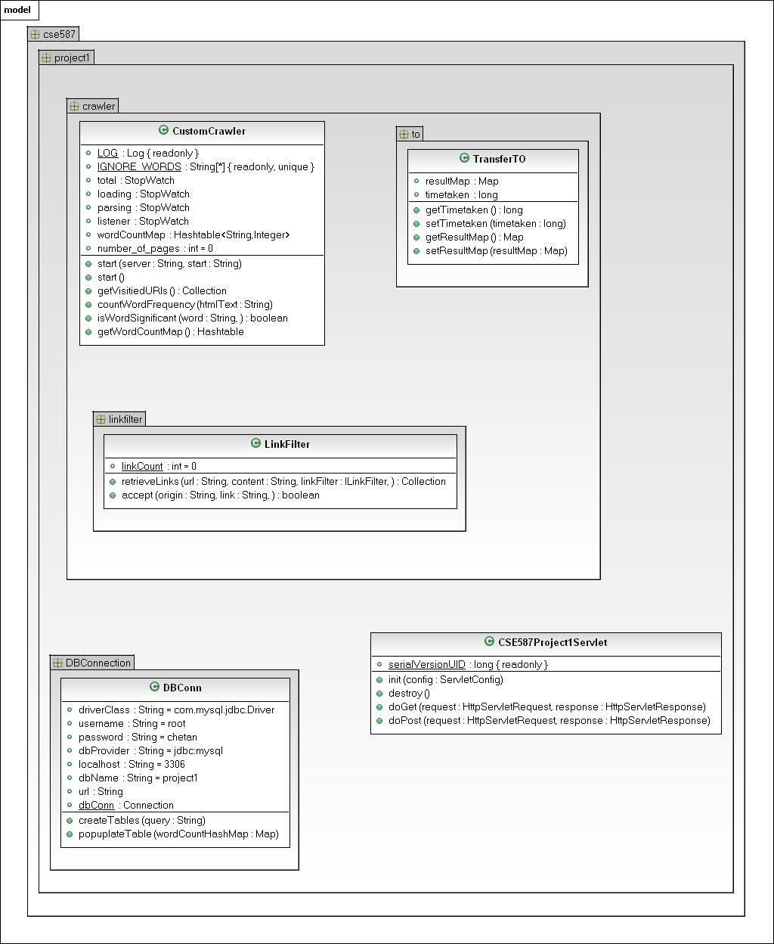
Single threaded

Slide 3
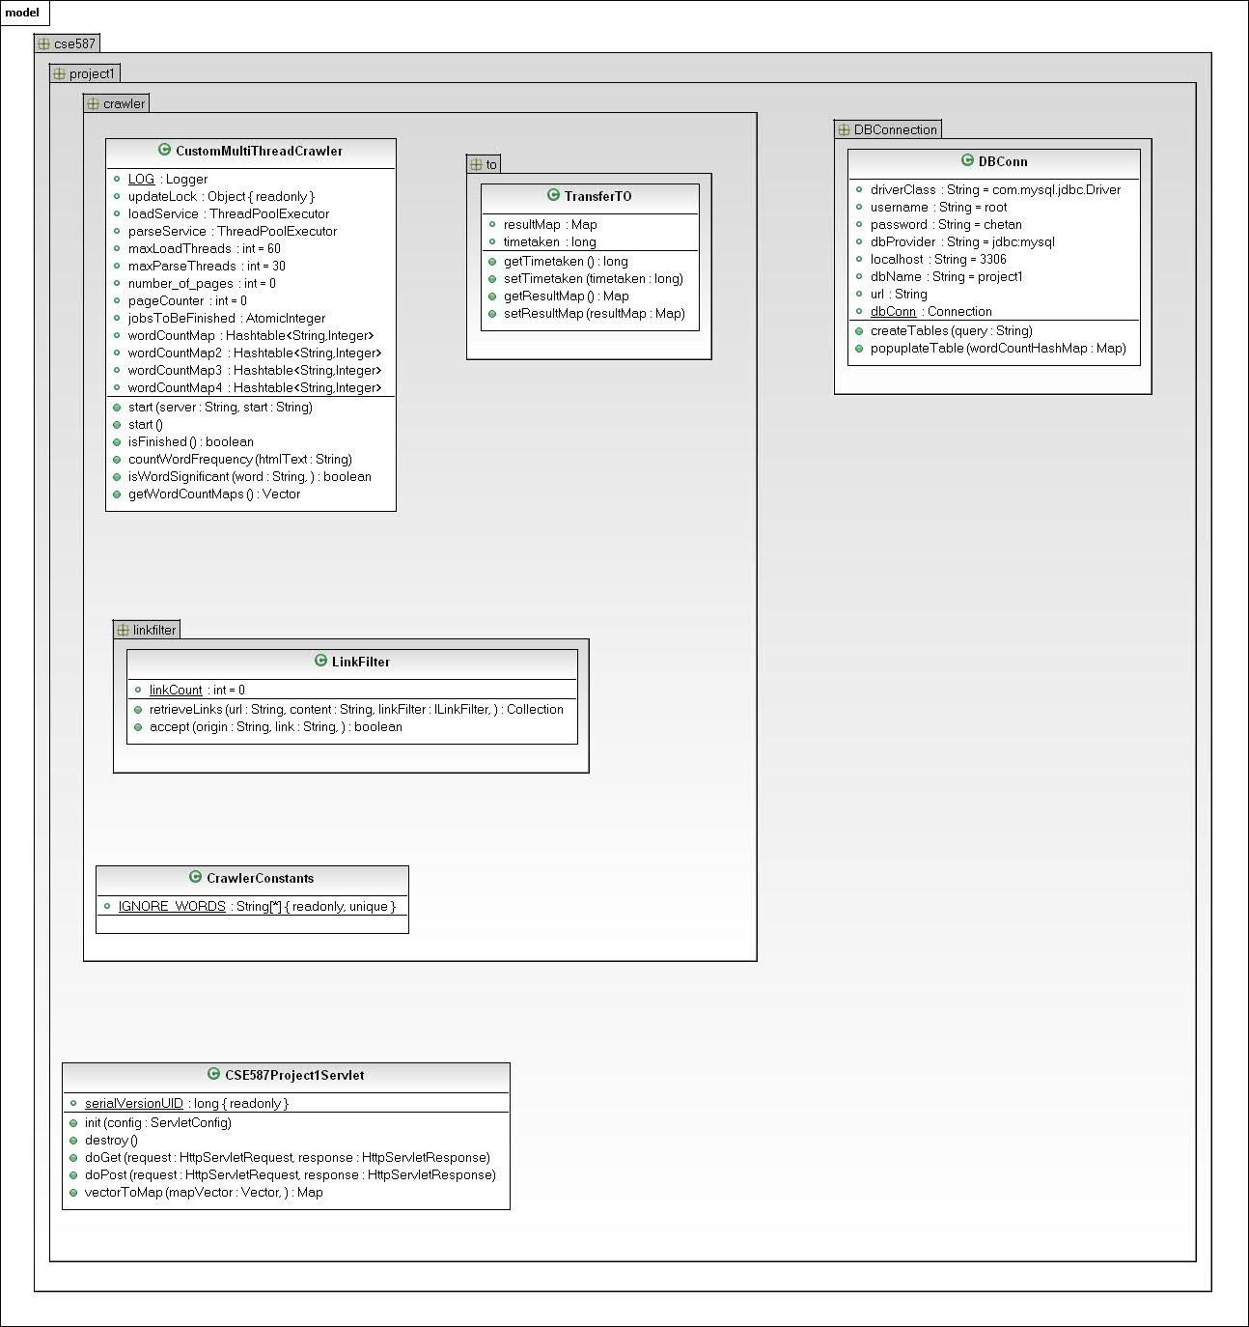
Multi threaded

Slide 4
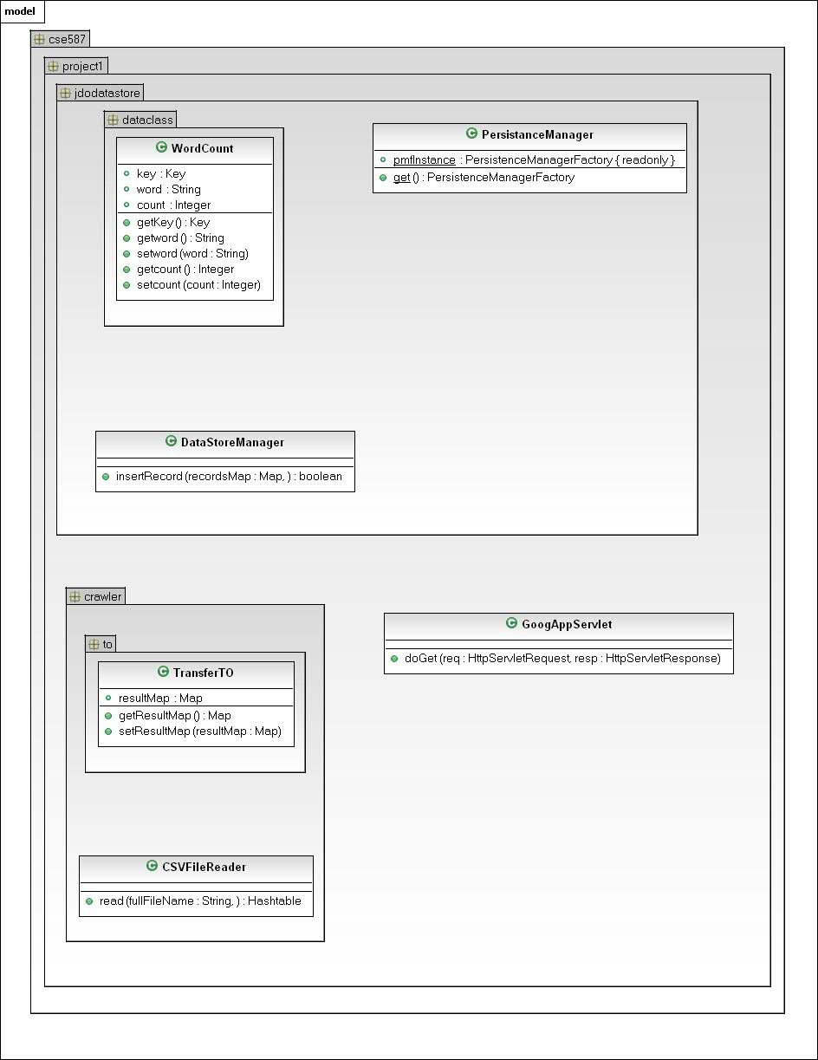
GAE

Slide 5
K-means on Amazon Elastic MapReduce Demo
BY:
JOSEPH LEE
DAVID BERQUIST
Notes:
5

Slide 6
K-mean Clustering
Job Conf
Submits job(specifies mapper, reducer, sets K cluster coordinates depending on iteration etc)
Hadoop Framework
Mapper
No
Reducer
isConverged
Map input: <line number><text>
Output: <cluster id><input coordinates, name>
Reduce Input: <cluster id>
<iterator of input coordinates>
Output: <cluster id> <centroid, names>
Yes
exit
Sudheer, vmuppara@buffalo.edu
Notes:
6

