Slide 1
Understanding Blockchain by Bina Ramamurthy bina@buffalo.edu https://www.linkedin.com/in/bina-ramamurthy/
January 30, 2021

Slide 2
Plan for this talk
Discuss how I got started on blockchain technology
  My journey
  My background
How can you get started?
  Coursera Blockchain Specialization MOOC
  Blockchain in Action book

Slide 3




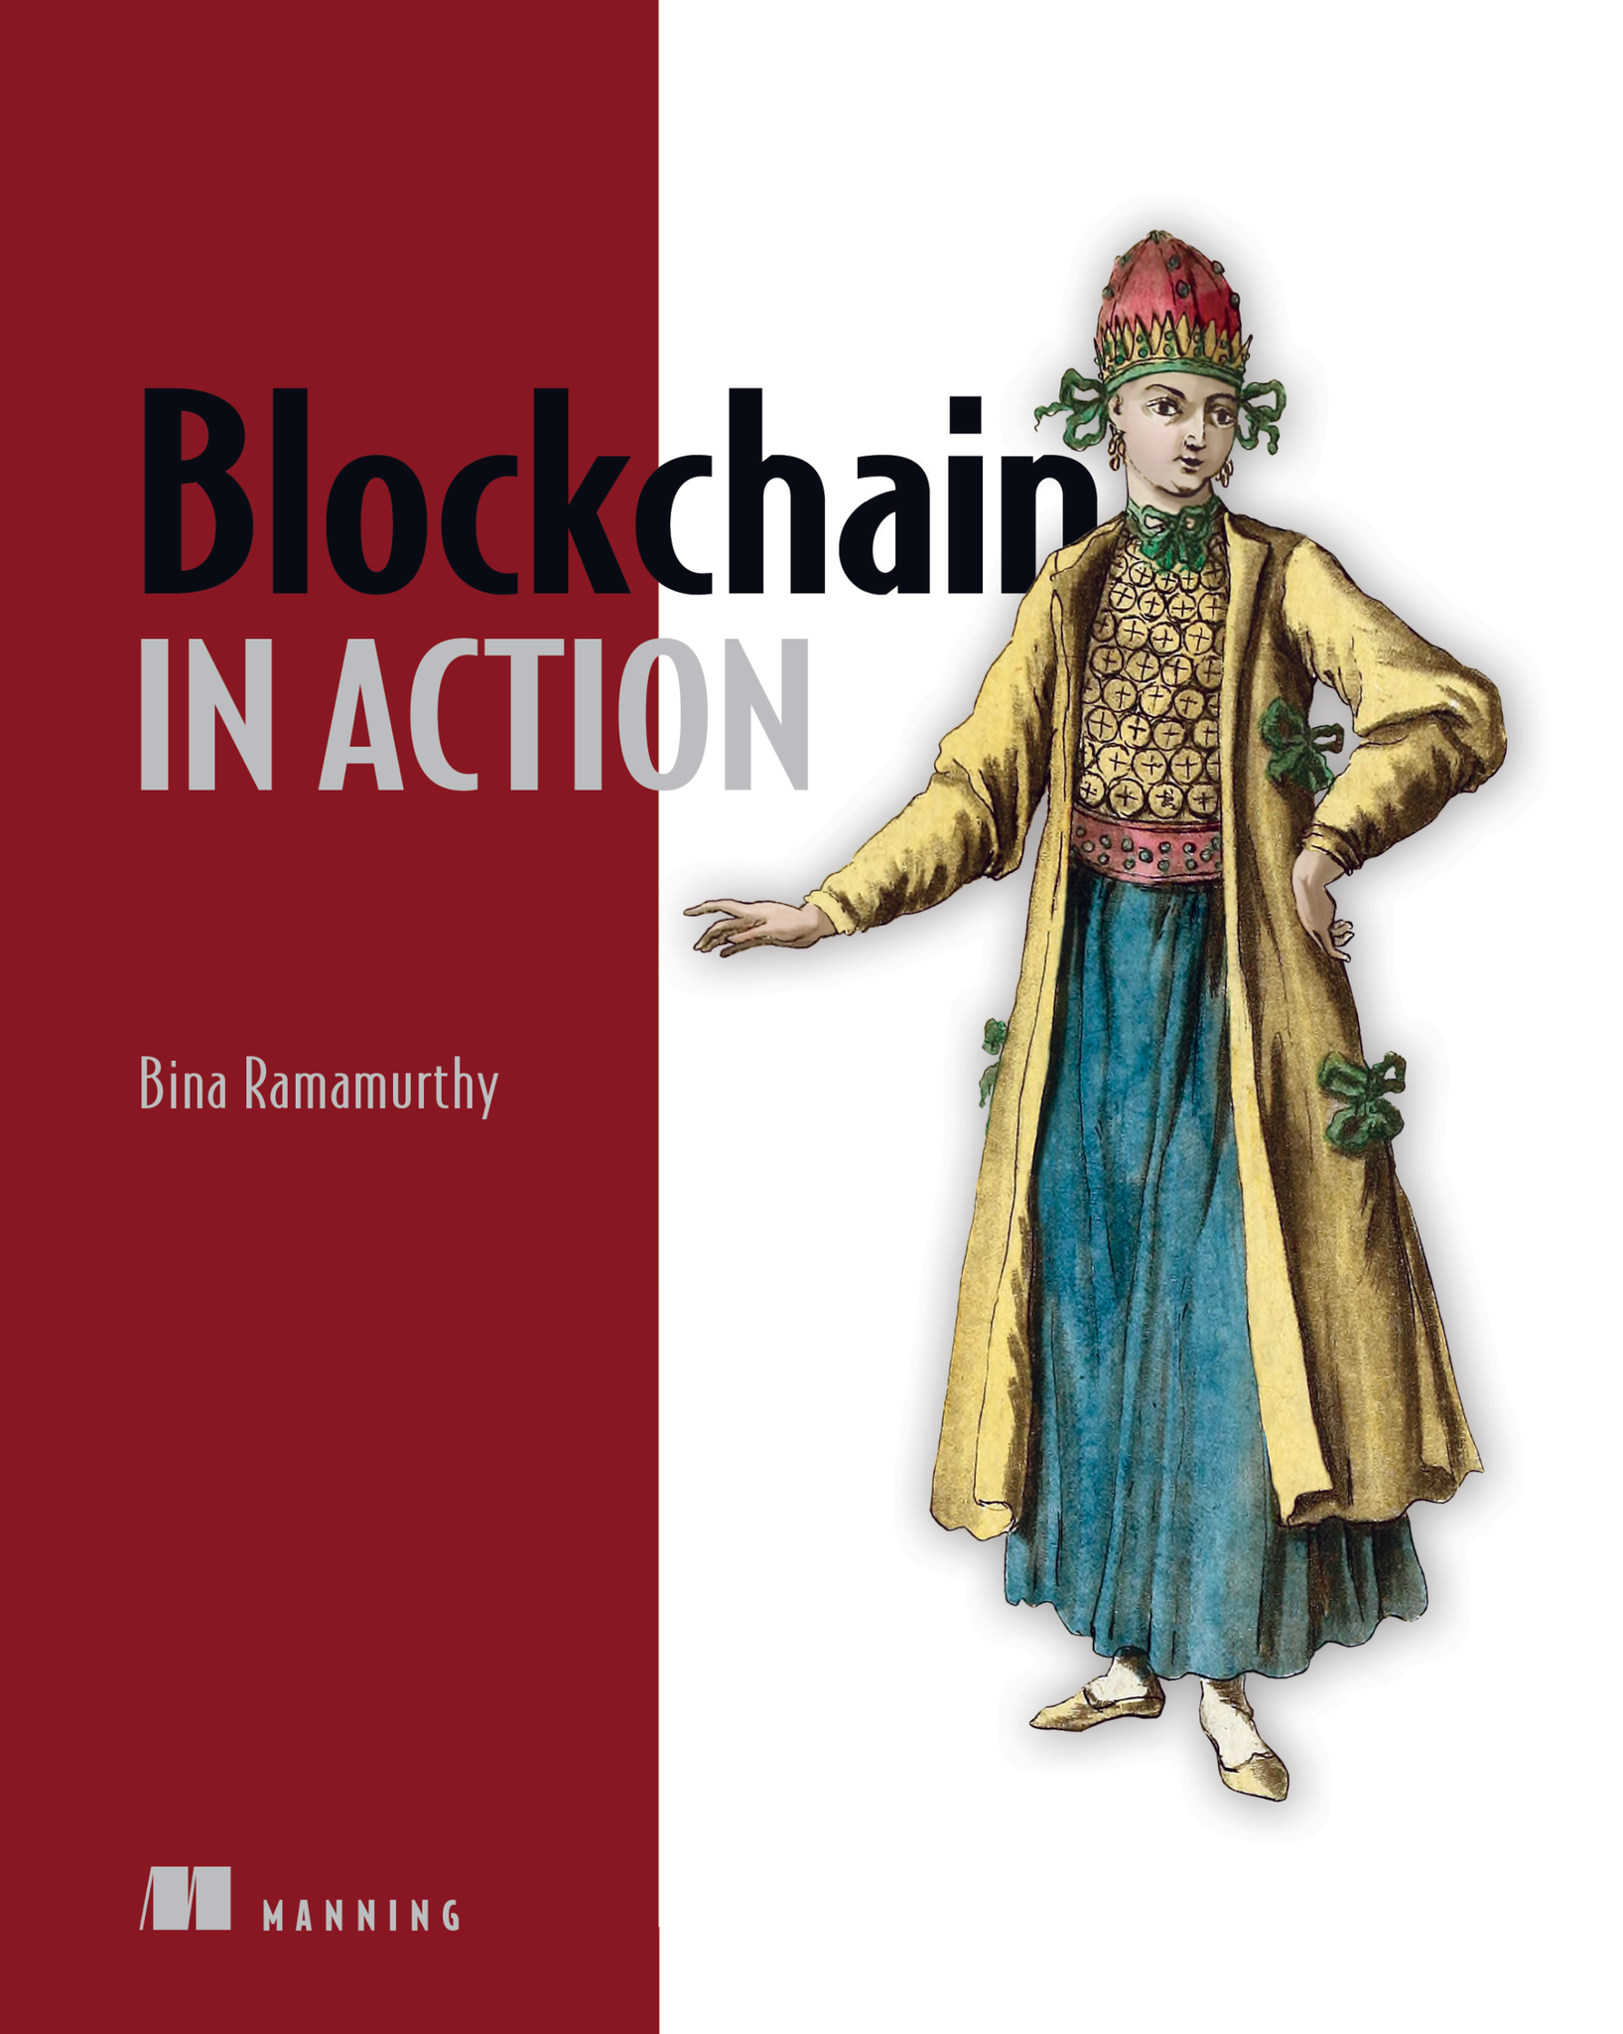
About me
I enjoy teaching and have been teaching for more than three decades.
NSF-supported Data-intensive computing grants and SUNY IITG grant in
blockchain
SUNY chancellor’s award for excellence in teaching
Coursera specialization on blockchain (140,000+ global learners)
I am most proud of is my recent project: writing Blockchain in Action book

Slide 4
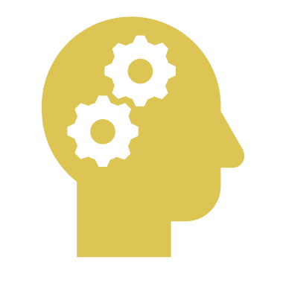

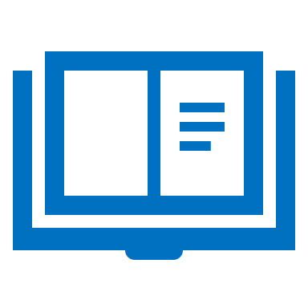
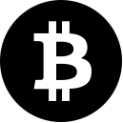


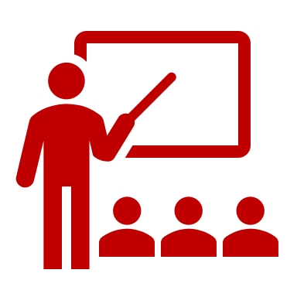
My Blockchain Journey
Learning,
researching
Coursera
blockchain MOOC
Book
…2009 2013 2016-2017 2017-2018 2018-2021 ……..
Blockchain courses 2018 – introduced in the curriculum…

Slide 5
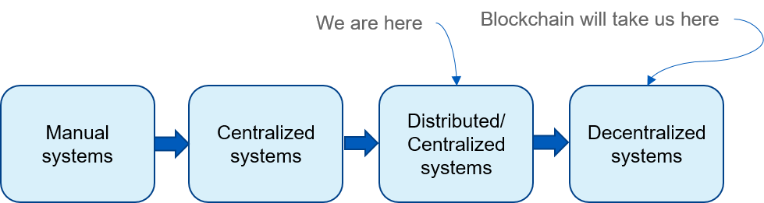
Evolution of computing systems
Personal computing systems

Slide 6
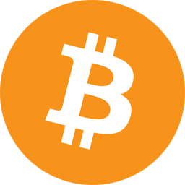
Bitcoin & Blockchain
Bitcoin 0.1.0 was released on
9 January 2009
2007-2008 financial meltdown
Bitcoin showed that -- a fact recorded on a blockchain
can be automatically verified by anybody thus establishing
trust and transactions among unknown peers
Innovation: blockchain technology
Idea: What worked for cryptocurrency should work for other
business transactions

Slide 7
A Brief History of blockchain
E-Commerce
Communication
mobile apps …
Cryptocurrency: Bitcoin: 2008/2009
Peer-to-peer autonomous digital currency system among unknown peers with no intermediaries
Validation, Verification,
Immutable recording
The Blockchain Protocol
The Internet Protocol (TCP/IP)
Notes:
Where is the innovation? Bitcoin is a live proof of a robustness

Slide 8
Bitcoin
Bitcoin : peer-peer cryptocurrency that does not require a middle entity such as a bank to complete a transaction between the sender and receiver.
Created by a secretive person (s) known as Satoshi Nakamoto.
Runs on the Internet
To keep track of the transactions, an ingenious ledger technology has been devised.
This ledger is distributed and is a collection of blocks of transactions.
How do you trust the ledger? The trust model out of this distributed ledger is an important contribution of Bitcoin.
The distributed ledger and associated concepts are called the “blockchain”
Bitcoin technology is the genesis for the advent of blockchain revolution.

Slide 9
BLOCKCHAIN IS NOT JUST ABOUT CRYPTOCURRENCY ANYMORE!
E-Commerce
Communication
mobile apps …
Cryptocurrency: Bitcoin: 2008/2009
Autonomous, Decentralized, applications: 2013
We need code to
verify and validate
application-specific
rules and criteria
Validation, Verification,
Immutable recording
Computing infrastructure:
Smart contracts
The Blockchain
The Internet

Slide 10
Blockchain: A Trust Layer over the Internet
Trust is a critical component for trade and any type of business transaction.
We develop and model our trust based on ad hoc means: Recommendation systems, our own knowledge, business experts on the news, etc.
Blockchain is about “trust automation”.
Take a look at the evolution of our Internet as shown here.
Year 2009,
Blockchain-based trust
No standards yet
Year 1991, RFC 7230
Year 2000, RFC 2818 Standard
Web application
Secure web application
Secure & Trusted web application
HTTP
HTTPS Security
HTTPS Security
Blockchain Trust
The Internet

Slide 11
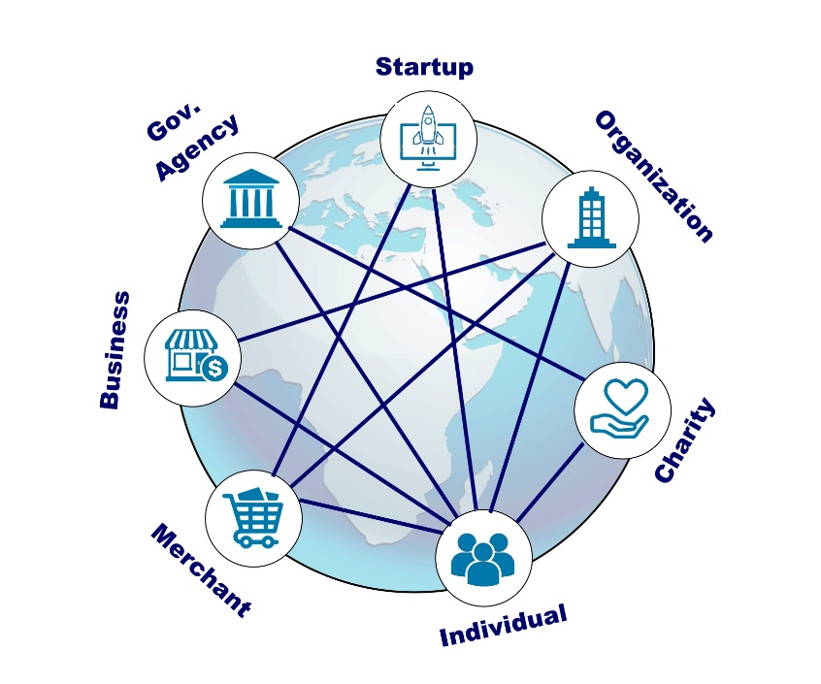
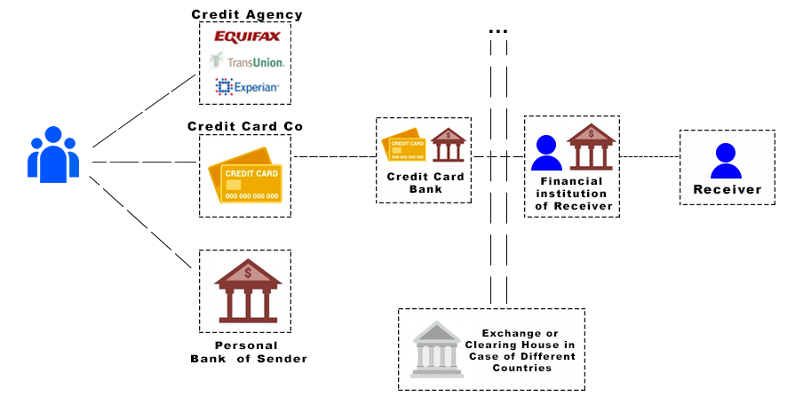
Blockchain: The Decentralization Infrastructure (1)
1: Decentralization
Decentralized System
Traditional Centralized System
Functions of the intermediaries are shifted
to the peer participants and the blockchain nodes:
Disintermediation: validation, recording, verification using blockchain software

Slide 12

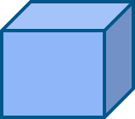
Blockchain: The Distributed Immutable Ledger (2)
Transactions
Eve
Validate
Gather
Block
Chain
invalid
Modify
Consensus
Verify Confirm
Transactions
New
Block
Transactions
Block
Blockchain

Slide 13
Blockchain: The Disintermediator (3)
Verification
Validation
Recording
Consensus
Trust &
Security
All defined by the blockchain protocol, and implemented.
For example, consider checking in for your flight at the airport.

Slide 14
Summarizing, the blockchain is about
  Decentralization
  Disintermediation
  Distributed Immutable Ledger
  Blockchain is a trust layer on the internet.
  On a strong foundation of more than 40 years of scientific research (cryptography, hashing, p2p, consensus protocols)
  Enabling automation, accountability, auditability, efficiency, accuracy, fidelity, fairness, and inclusiveness.

Slide 15
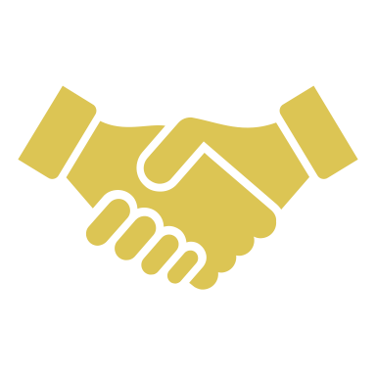
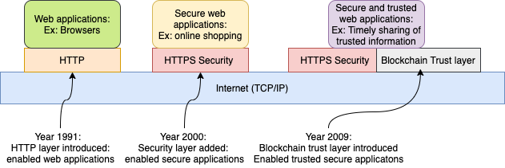
Key takeaway about blockchain
It is trust layer over the internet.

Slide 16
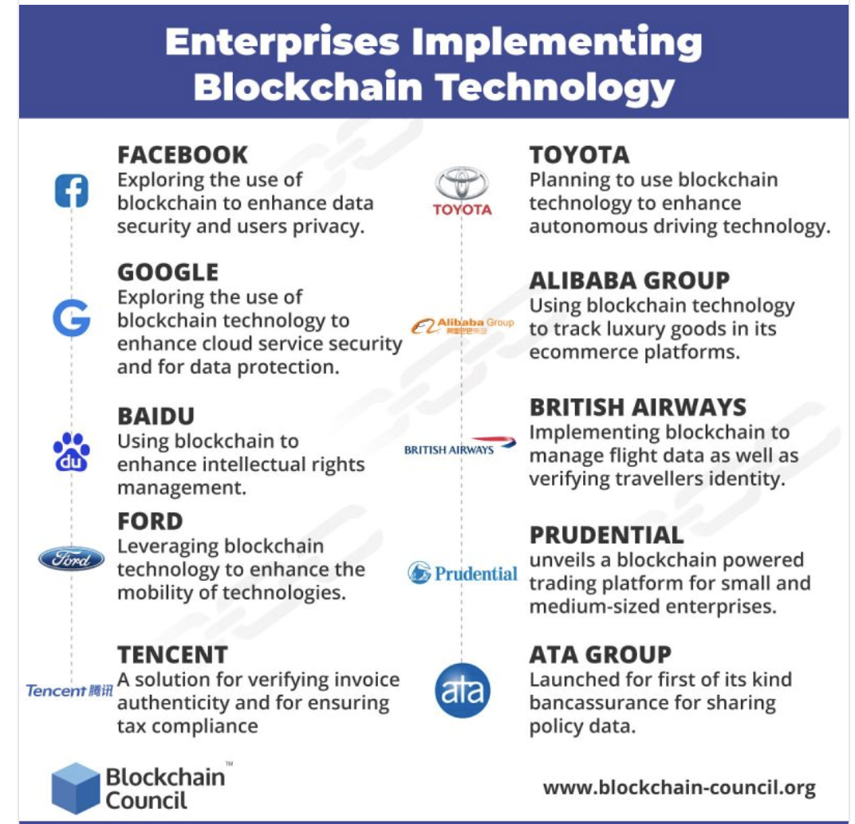
Why should you care about blockchain?
The need is in developing applications, in solving problems and designing solutions using blockchain.

Slide 17
How can you get involved? Where can you get started?
Single stop solution for thought leaders, policy makers, regulators, designers, problem solvers, enterprise architects, developers, programmers and users.

Slide 18
How to read the book?
Look at the first chapter (Chapter 1 and Chapter 12) first.
Read ONLY the problem statements for the problems discussed in the chapters.
  Digital democracy (Ballot-Dapp)
  A marketplace for unused airline seats (ASK-Dapp)
  A blind auction framework (BlindAuction-Dapp)
  An incentivization model and side-channel for micropayments for global level operations such as global plastic cleanup (MPC-Dapp)
  A token model for real estate transactions and for tokenization of assets (RES4-Dapp)
  An educational credentialing model and a new way of thinking about degrees, skills, and education (DCC-Dapp)
Programmers and developers, we have provided a wealth of code for learning through worked out examples and with extensive instructions.

Slide 19
Education recommendation
Step 1: Create courses – 2 courses Basics, Advanced
Step 2: Create a certificate program: 2 courses + capstone project course
Step 3. Think about minor or track in blockchain
Only then think about graduate degree.

Slide 20
I am ready for any questions now.
??

