Slide 1
Blockchain Overview
B. RAMAMURTHY
©2019, ALL RIGHTS RESERVED
BINA@BUFFALO.EDU
HTTP://WW.CSE.BUFFALO.EDU/FACULTY/BINA
TEACHING PROFESSOR
COMPUTER SCIENCE AND ENGINEERING
DIRECTOR, BLOCKCHAIN THINKLAB
PROGRAM DIRECTOR, DATA-INTENSIVE COMPUTING PROGRAM

Slide 2
Topics for Discussion
Blockchain 101 (slides: 4-6)
Bitcoin
Beyond Cryptocurrency: Smart contracts (slides 7,8)
Smart contracts and innovative business instruments
Use case: supply chain management (slides 9-14)
Disrupting Your Business (slides 15 – 25)
Blockchain in your business: known applications
Blockchain Roadmap (slides 26 – 28)
Blockchain Thinklab 1.0→2.0
Summary

Slide 3
My Background
Ph.D. in Computer Engineering
At CSE and UB for the past 3 decades
Not a lawyer
Always work at the leading edge of technology
Launched a 4-courses #1 certification on blockchain technology
More then 40000 learners and 150000 visitors
I gather my blockchain knowledge by reading, implementing systems, writing, speaking to people and lecturing all over the world.
I believe in blockchain technology.

Slide 4
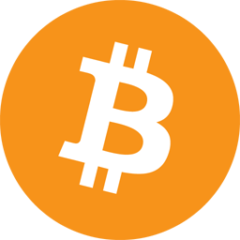
Bitcoin & Blockchain
Bitcoin 0.1.0 was released on
9 January 2009
2007-2008 financial meltdown
Bitcoin showed that -- a fact recorded on a blockchain
can be automatically verified by anybody thus establishing
trust and transactions among unknown peers
Innovation: blockchain technology
Idea: What worked for cryptocurrency should work for other
business transactions

Slide 5
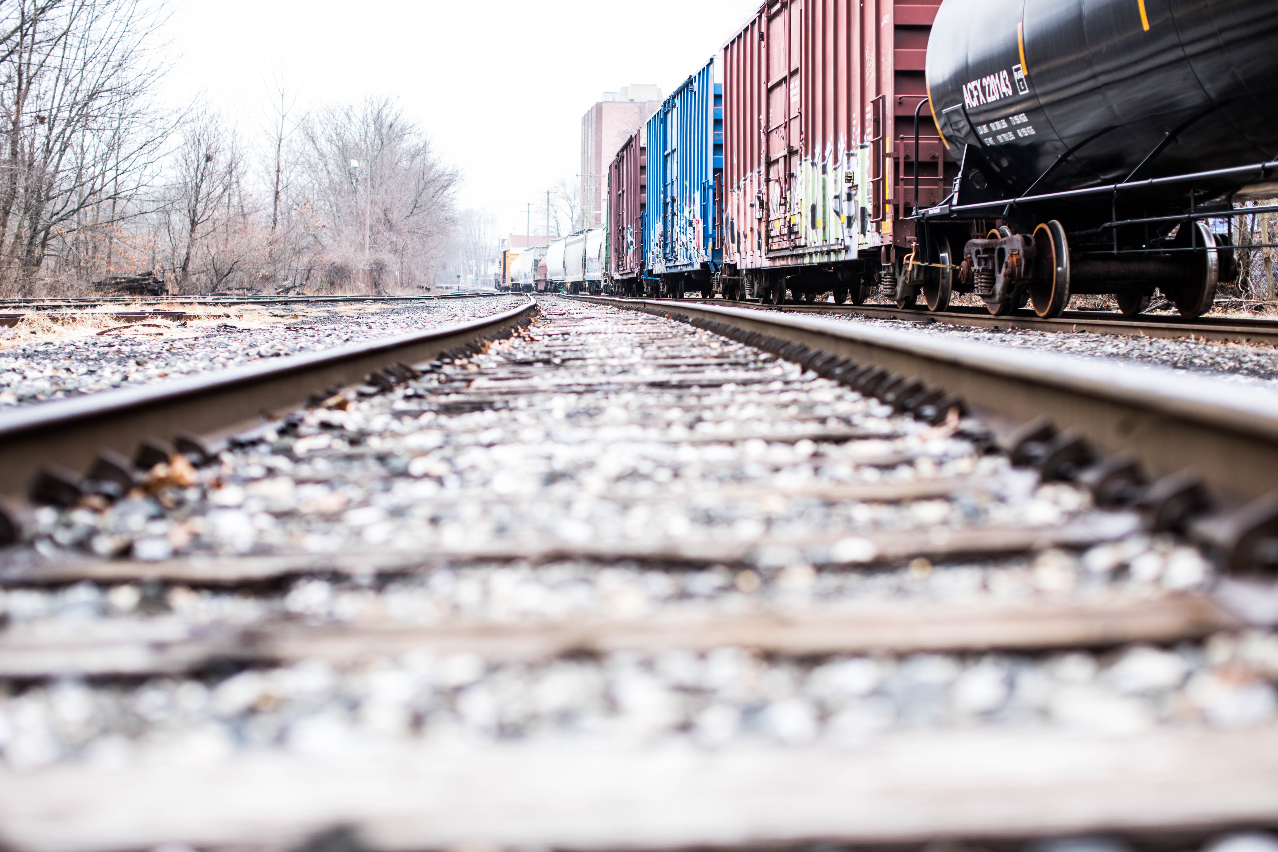
Blockchain and smart contracts
Blockchain is like
a train track
Bitcoin is a train carrying
crypotocurrency; that is
the only thing that it could
do.

Slide 6
Blockchain and smart contracts
Blockchain is like
a train track
The smart contract is also
like a train on the tracks:
But different types;
It can perform other tasks than cryptocurrency.

Slide 7
You want to do more than cryptocurrency transfer?
Financial, legal,
healthcare, government,
non-government applications
E-Commerce
Communication
mobile apps …
Cryptocurrency: Bitcoin: 2008/2009
Autonomous, Decentralized, applications: 2013
Validation, Verification,
Immutable recording
Addition of smart contracts lets you do lot more than cryptocurrency transfer
We are here
The Blockchain
The Internet

Slide 8
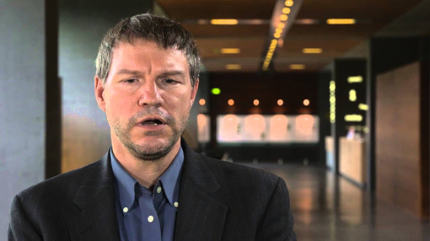
What is a smart contract?
Smart contract is executable code on the blockchain that uses the features of the blockchain.
-- introduced by a Georgetown law school graduate Nick Szabo in 1999
--adopted by Ethereum blockchain in 2013
-- it provides automatics verification, validation and immutable recording of transactions
I discuss more about him in my Coursera
courses

Slide 9
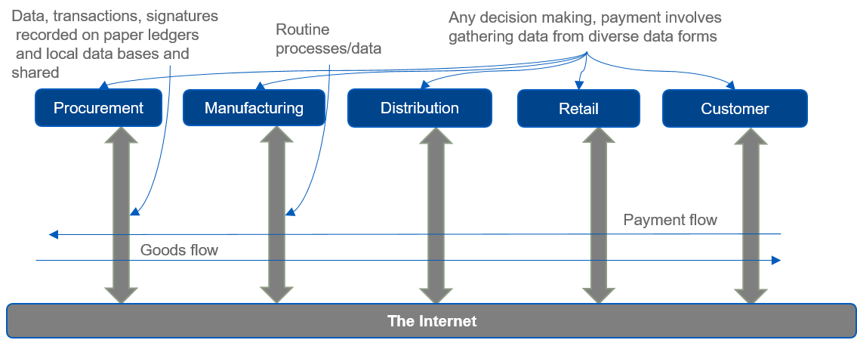
Traditional supply chain system

Slide 10
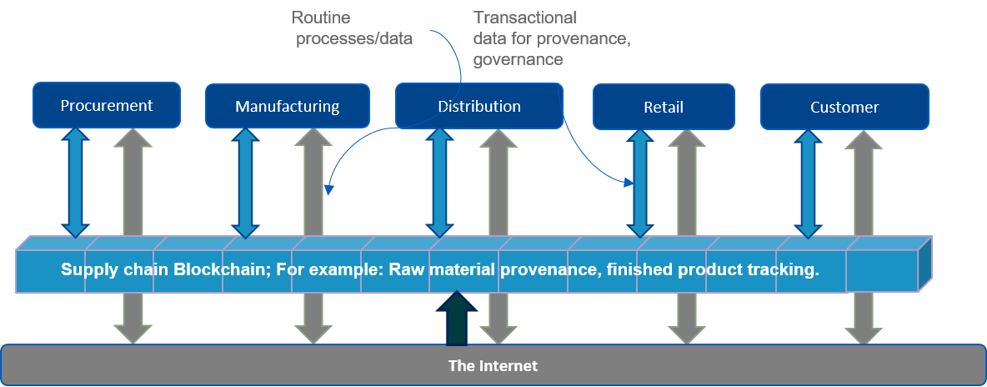
Blockchain-based supply chain (food chain)

Slide 11
Application: Any Supply chain in your business
Blockchain is a trust layer on the internet; it enables a distributed ledger and a verification mechanism.
Traditional supply chain
Blockchain-based supply chain

Slide 12
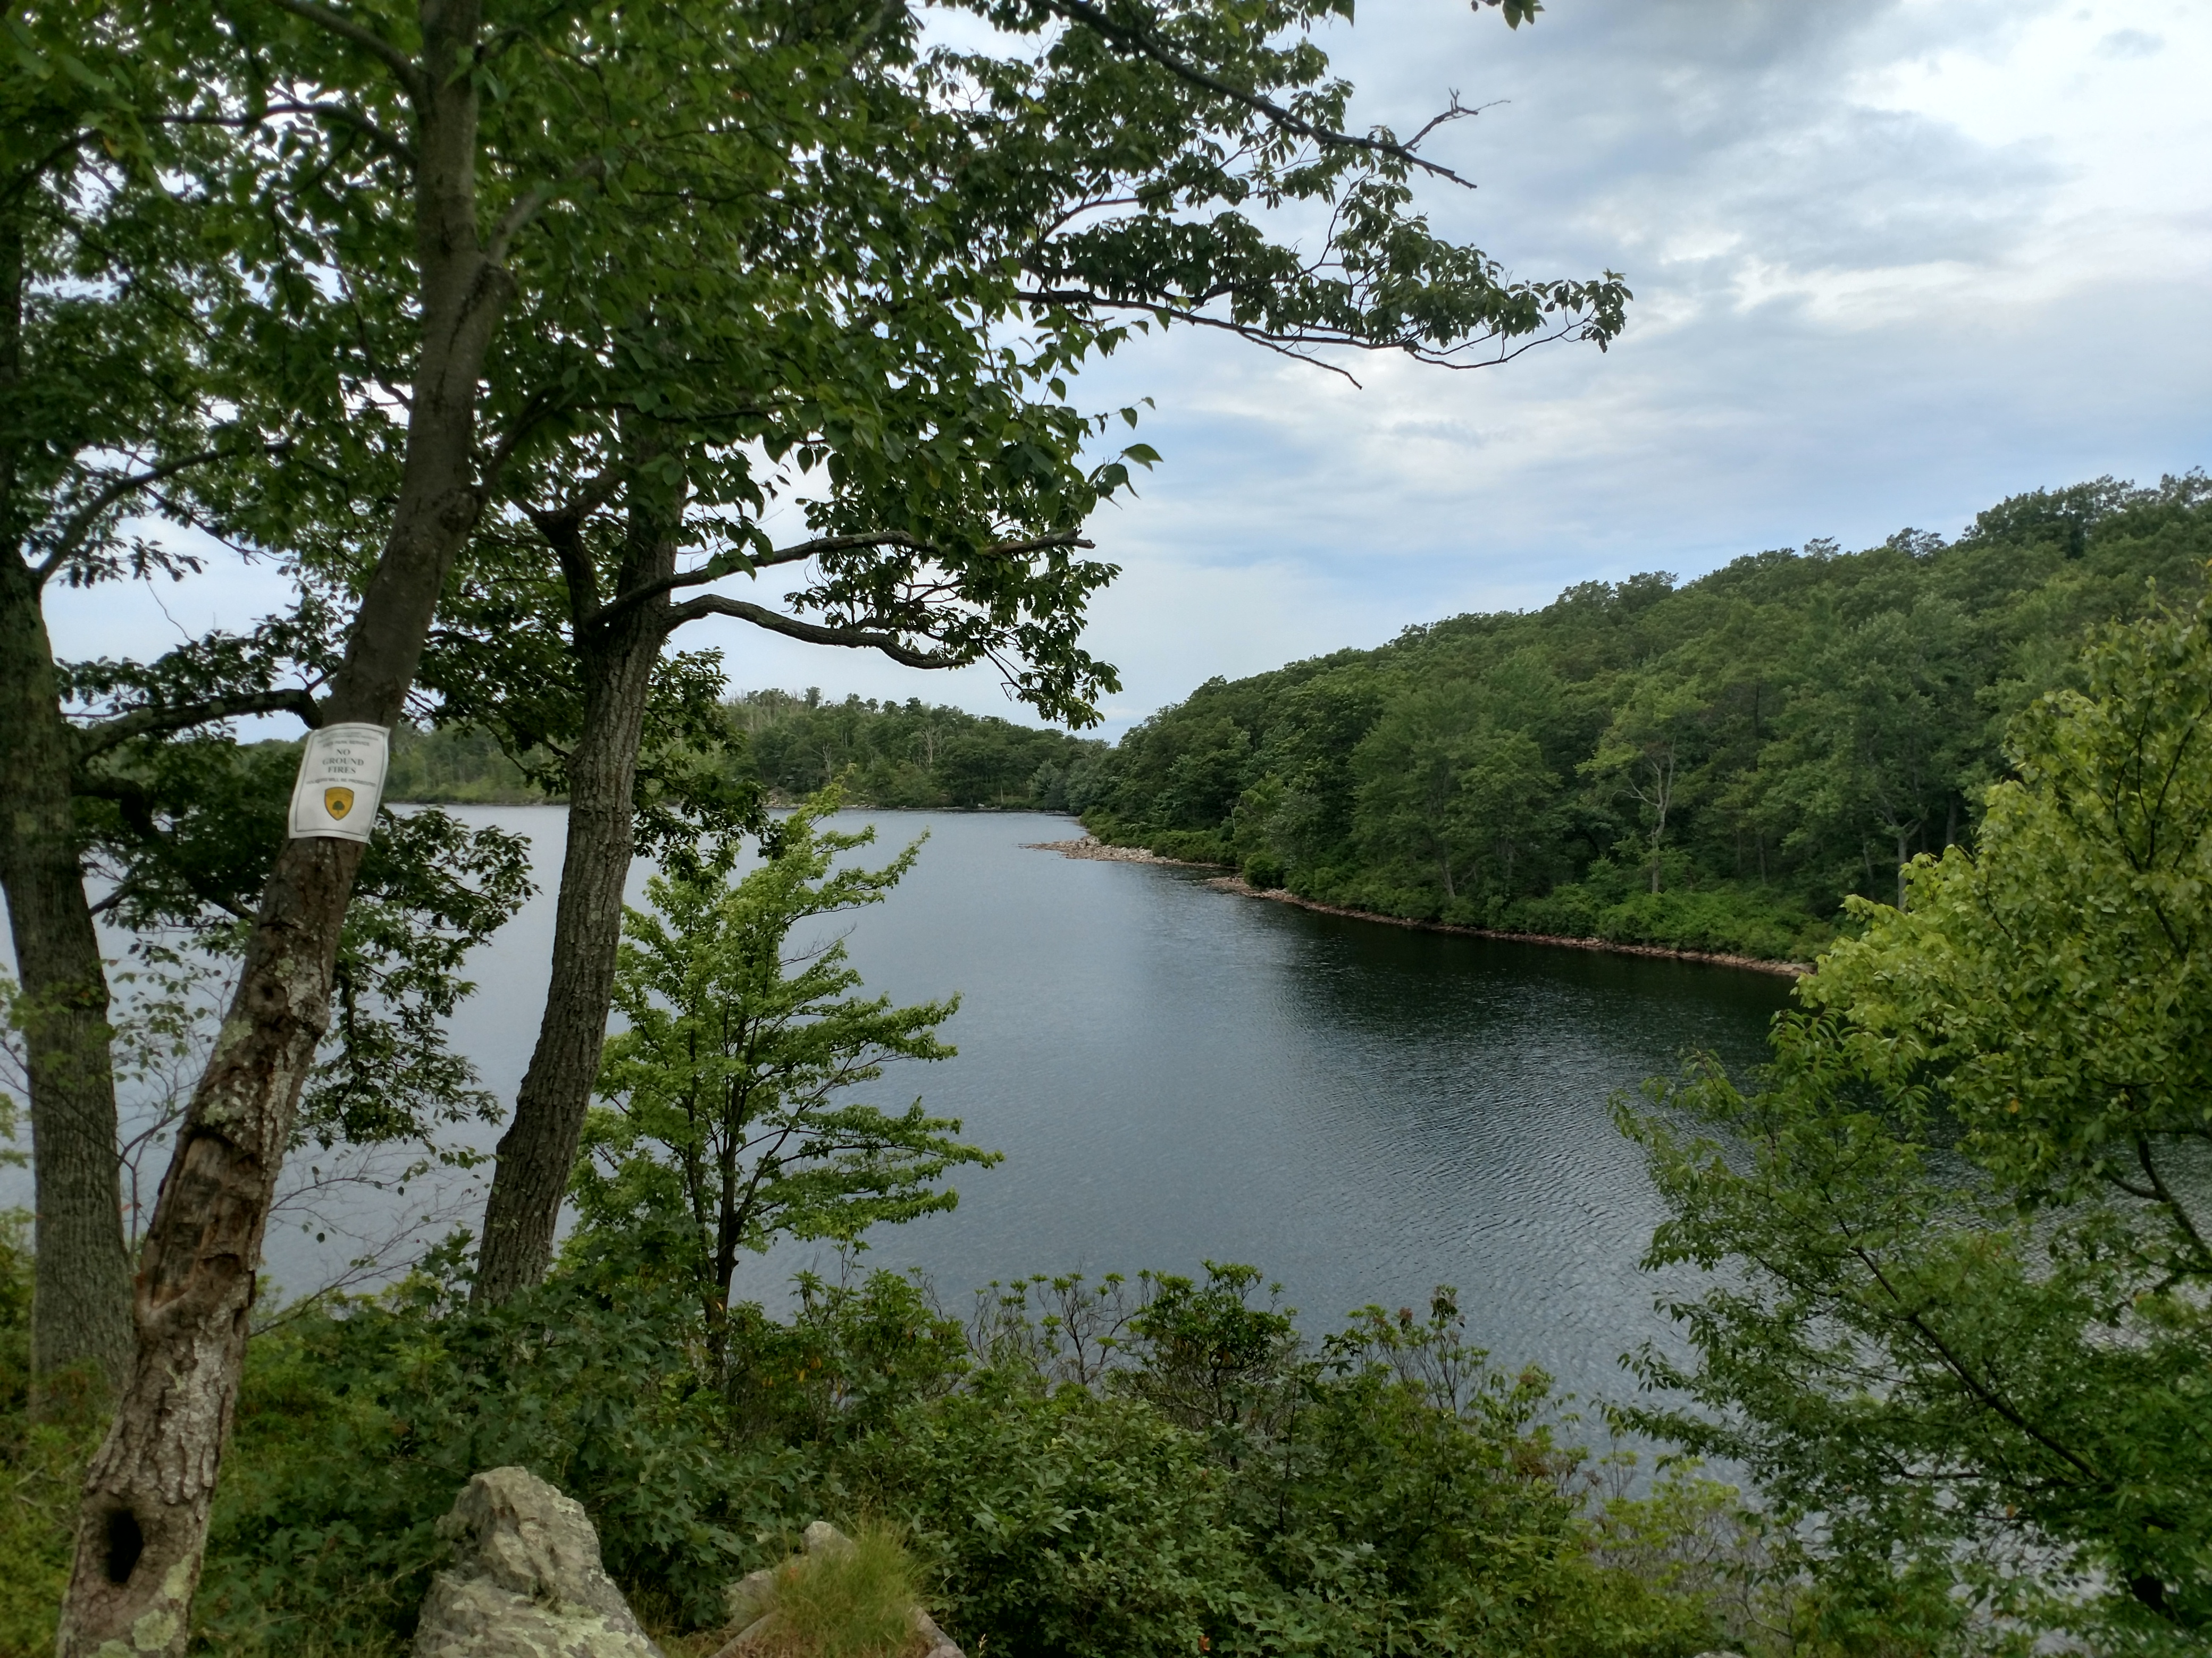
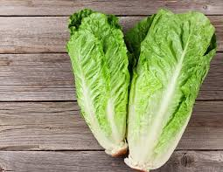
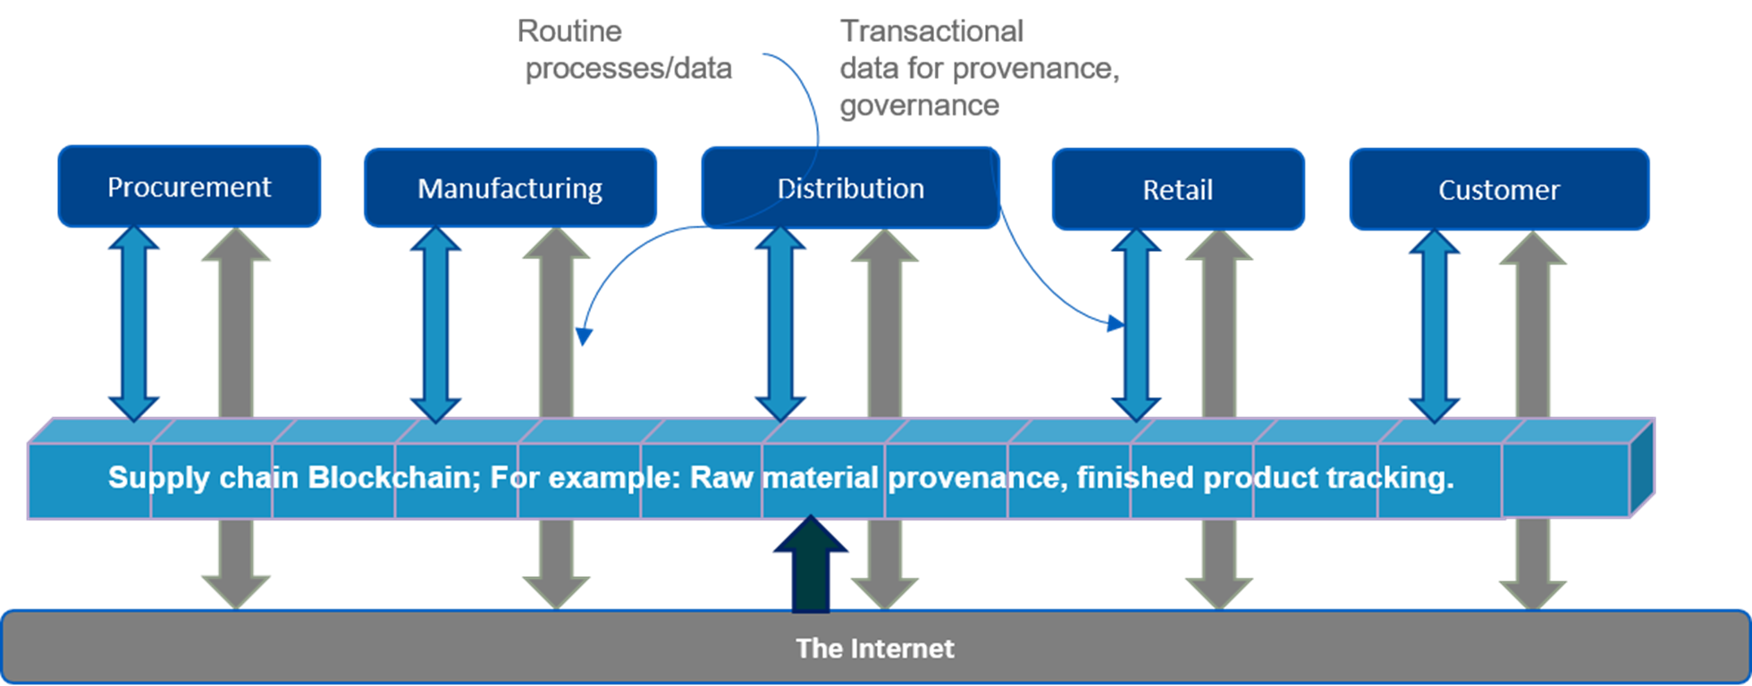
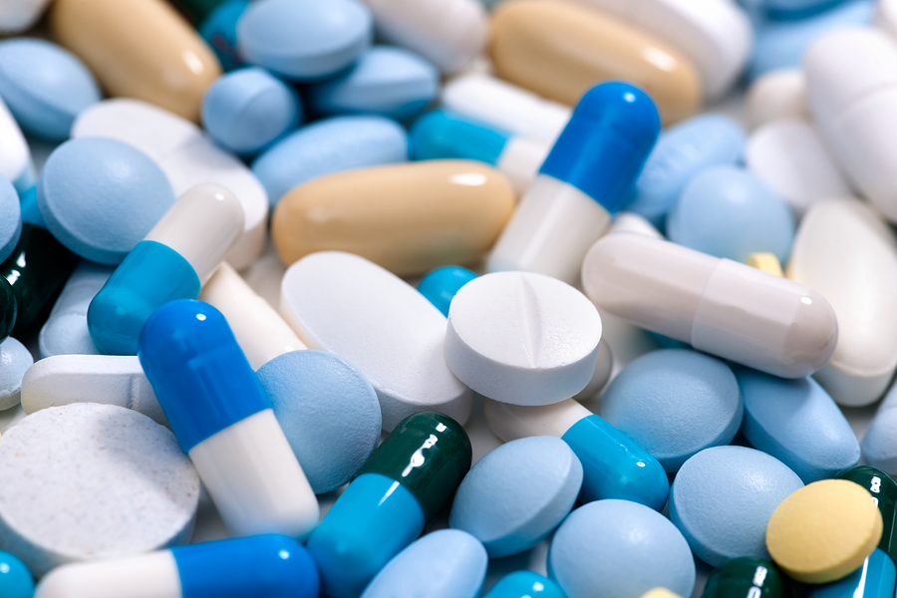
Application: Any Supply chain in your business
Spring water
provenance
Blockchain is a trust layer on the internet; it enables a distributed ledger and a verification mechanism.
Produce
provenance
This supply chain is from
my book: I don’t use lettuce
in that example
Medicine
provenance
Auto-parts
provenance
Blockchain-based supply chain

Slide 13
How does the blockchain help?
farm
customer
Immutable distributed information sharing :
Every stakeholder gets a copy of the ledger at the time of its creation with time stamp and all.
Walmart uses it; IBM blockchain hyperledger fabric.
Verification and validation
Smart contracts act as gatekeepers verifying credential of participants
Smart contracts also validate the actions

Slide 14
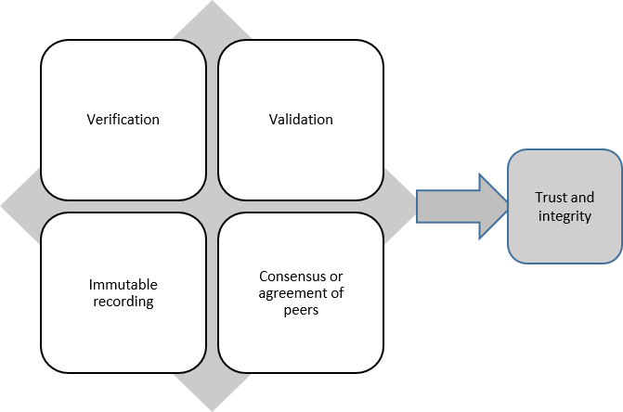
What does a blockchain do?
Verification & validation
by the smart contract
Blockchain, a trust layer,
disintermediation of trust.
recording
agreement

Slide 15
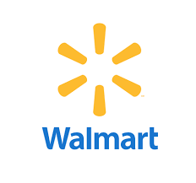
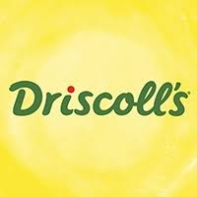
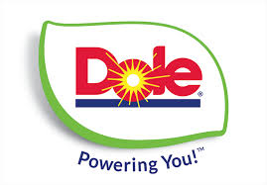
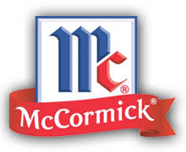
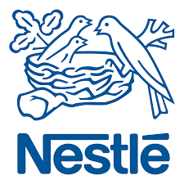
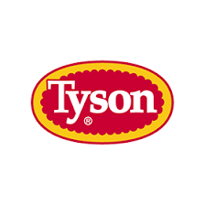
IBM’s Food Provenance Initiative
Started working food provenance on a pilot in 2016
“a blockchain creates an immutable golden record
of time-stamped transactions related to any product
that can be bought and sold. In the supply chain,
blockchain is used as a means to increase
transparency, add visibility and improve
supply chain economics.”
+ Chinese University
2018 expanded the network
to many businesses
Attended
workshops:
DMDII 2018
Chicago, IL
https://www.zdnet.com/article/ibm-blockchain-to-help-prevent-contamination-in-global-food-supply-chain/

Slide 16
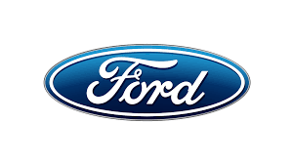
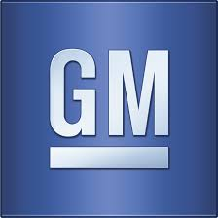
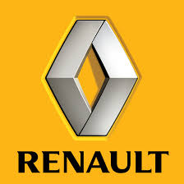
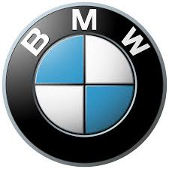
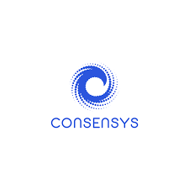
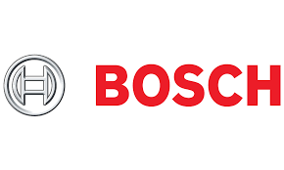
Automobile blockchain
Founding members of MOBI : the Mobility Blockchain Initiative
+ Bosch + ZF (Parts) + Accenture, IBM +Consensys, Hyperledger
Supports both public and private blockchain
Working on standards, interfaces for a new digital mobility ecosystem,
from ride-sharing to self-driving cars and everything in between.
UB:2017
Collaboration
--2 months in India
--parts provenance
2018 UB-Coursera
introduction
recorded on-site ..in DC

Slide 17
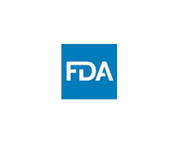
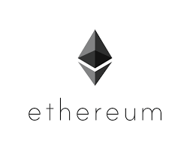
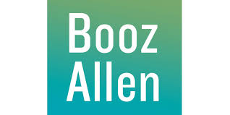
FDA – healthcare blockchain
We use this
blockchain platform
Manage data duplication and integrity
Manage private data access
Uses interplanetary file system
Pilot with 4 hospitals 2018
Plan to move to 20 hospitals
Member of IEEE standards
On medical devices on blockchain

Slide 18
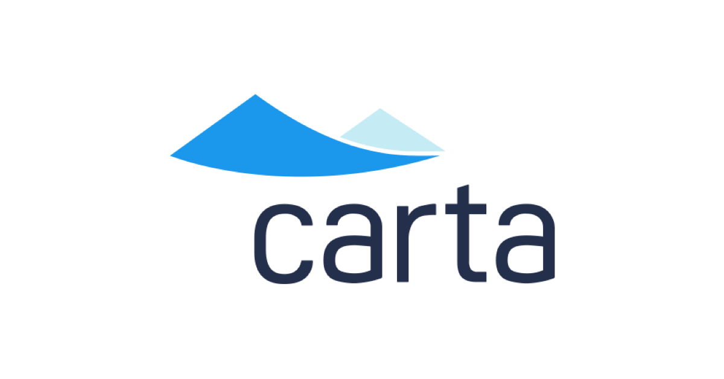
CARTA – Capitalization Table Company
Potential for new and
fractional owners
Newer financial instruments
Ownership management
Who owns what and when transactions recorded on blockchain.
New forms of ownerships: ICOs, DAOs, and blockchain ownership ledgers
After all cap table
is a ledger
“Startups, office buildings, rental homes, railroads, railroad cars, railroad companies, debt for those railroad companies, antarctic territories, oil rigs, helicopters to access those oil rigs, farmland, farm equipment, rice paddies, irrigation equipment for those rice paddies, …pharmaceutical companies, pharmaceutical patents…. it goes on and on. Everything in our world is owned by a person or a group of people.” – Carta Owner Henry Ward
Decentralized Autonomous Organization
Initial coin Offering
I am an advisor for two ICOs: ALZA,Intellishare

Slide 19
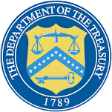
Government Initiatives
Department of Homeland security
Defense Information System Agency (DOD)
Department of commerce
Department of treasury
Deputy Ass. Secretary:
“saved $700 million”
Time saved by blockchain
digital transformation:
timeliness
Representatives form all these
Government agencies presented
at a exclusive blockchain workshop;
by invitation only workshop
Nov 16, 2018, Washington D.C.
Department of health and human services (HHS)
General services administration
I was there

Slide 20
Blockchain Travel Industry
Secure payments
Identity management: Single identity, easy verification, time saved, at airports and other point of entries
Loyalty program management
Baggage tracking
Bed swap and house swap : Inventory management using blockchain
Direct market place with low or no commission
Real estate acquisition management: Compliance, governance, provenance using blockchain
https://www.revfine.com/blockchain-technology-hospitality-industry/

Slide 21
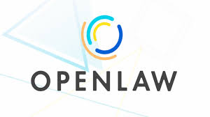
Openlaw Blockchain Platform for Legal Templates
An online platform for creating and storing on cloud, legally binding
digital documents with provenance on blockchain
Digitize, standardize, record
On blockchain
Model all or parts of legal agreements decreasing the cost and friction of creating, securing, and generating binding legal agreements.
Create, store, and execute legal agreements that interact with blockchain-based smart contracts without the need for any intermediaries.

Slide 22
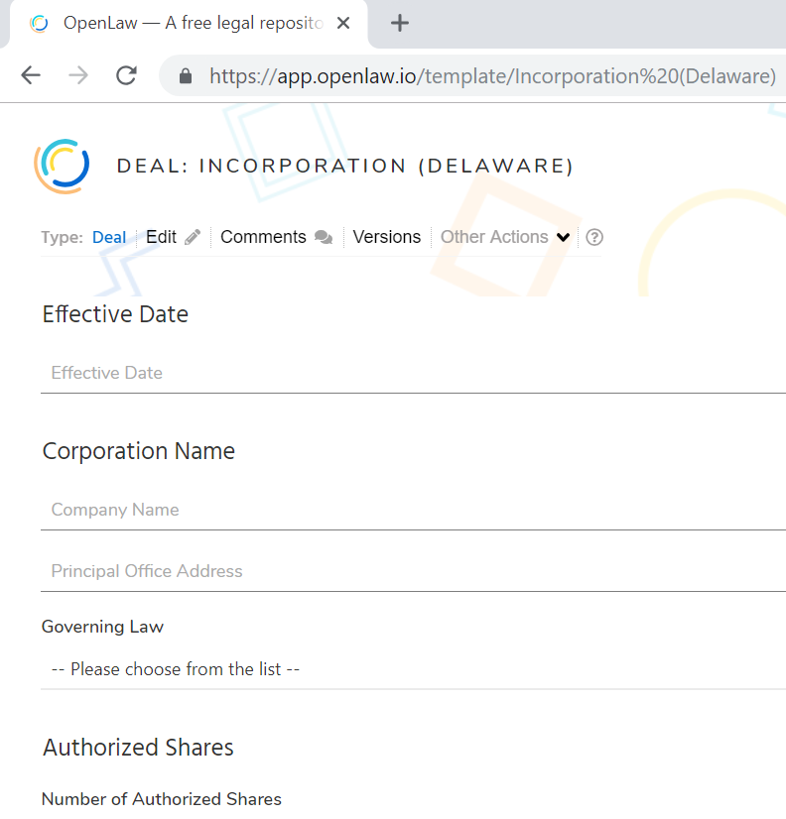
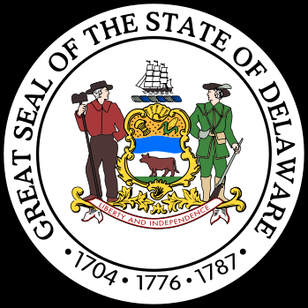
Openlaw : Working Use Cases
OpenLaw, in conjunction with leading Australian law firm, Corrs Chambers Westgarth, has built an end-to-end real estate transaction on the Ethereum blockchain.
Parties sign a standard and legally binding Australian land sale contract using OpenLaw.
The transaction is automated using an Ethereum smart contract, including the deposit, a loan to fund the purchase, the completion payment to the seller, and the transfer of title.
State of Delaware uses Openlaw platform for business incorporation legal documents.
https://app.openlaw.io/
Consensys recommended
OpenLaw for my course.

Slide 23
Blockchain in your business
Do not over-fit blockchain into existing working systems.
It is NOT a database. (Instead, use a decentralized database in tandem with blockchain provenance.)
Blockchain is NOT a panacea for all your problems.
Then what is it good for?
Use cases with
Newer business models, instruments, processes
Inefficiencies,
Barriers to adoption,
Decentralized users,
Peers or users who are operating beyond boundaries of trust, that do not fit well into our centralized model,
Uses cases related to policies, rules, governance, provenance, compliance, audit trails, dispute resolution, complex legal instruments (M&A);

Slide 24
Public VS Permissioned Blockchain
Bitcoin is a public blockchain. Membership is open to all; anybody can join and leave as they wish. All the transactions on the chain are available for the whole world even though they may be encrypted.
In a permissioned and private blockchain membership is limited to identities with verified credentials.
The blockchain protocol features a membership service to control/manage membership.
A private blockchain is local to a specific business or environment.
A permissioned blockchain is also known as consortium blockchain, since its typical application is for consortium of businesses such as in an automobile domain. Ex: Auto consortium, FDA blockchain
Use public blockchain for involvement of
unknown large number of people: stadium survey
Within your own
organization
With your business
partners, suppliers,
financial institutions

Slide 25
Smart New Business Instruments
Supply chain to disaster recovery
Smart contract tokenizes digital assets, products and services.
You can use these tokens for raising capital for a business – treated as securities
You can use these tokens for a payment system for services –Grid+ in Texas – not securities
You may want to take a look at SEC and FTC regulations
SEC is looking for guidance from the courts on these

Slide 26
Blockchain Roadmap
What are inefficiencies, where are the gaps, who are we not reaching (customers)
Can blockchain help? Recall that it adds an autonomous trust layer.
For example, supply chain, food safety and recall, frozen transportation, finance and credit, international trade and shipments etc.
Education
Exploration
Evaluation
Expansion
Expand into production.
At the end of exploration phase you should have some use cases to try out.
Design and implement proof of concept (POC) and assess the impact of using the blockchain technology

Slide 27
Blockchain Thinklab 1.0 Theme: Education
SEAS’ Coursera Blockchain “Specialization”
4 courses of 4 weeks of online instruction each with hands-on components.
Enrollment of 40000+ people all over the world.
Thinklab 1.1: Face-to-face CSE courses in the Spring 2019, Fall 2019
Blockchain Thinklab 2.0 Theme: Exploration
We have CCR/CBLS testbed for supporting explorations by UB community
Can deploy, load test and explore blockchain applications
Thinklab 2.1: Blockchain Buildathon in April 2019
You can try any of your POC at this event

Slide 28
Summary
Blockchain technology is not about cryptocurrency anymore.
It is used for broad range of applications across many industries: finance, healthcare, government, manufacturing, and distribution.
Blockchain can enable an inclusive economy.
Blockchain has created exciting new opportunities and innovative application models:
Global collaboration systems, self-governing systems, open government.
Private, public and permissioned models to meet diverse business needs.
It is here to stay, in one form or another.

