Slide 1
Blockchain, an innovation and an imperative A hands-on exploration and workshop
B. RAMAMURTHY
©2020, ALL RIGHTS RESERVED
BINA@BUFFALO.EDU
HTTP://WW.CSE.BUFFALO.EDU/FACULTY/BINA
PROFESSOR OF TEACHING
COMPUTER SCIENCE AND ENGINEERING
PROGRAM DIRECTOR, DATA-INTENSIVE COMPUTING PROGRAM
COURSERA INSTRUCTOR
DIRECTOR, BLOCKCHAIN THINKLAB
MANNING AUTHOR: BLOCKCHAIN IN ACTION

Slide 2
Introducing myself..
Ph.D. in Computer Engineering: Fault tolerance in distributed systems
Faculty at CSE and University at Buffalo (UB) for the past 3 decades
I believe in hands-on and experiential learning
Always work at the leading edge of technology
Launched a 4-courses certification on blockchain on Coursera MOOC
More then 60000 learners and 400,000 visitors from all over the world
Developing a technical book: Blockchain in Action (Manning.com)
Curriculum development for CSE students and local businesses

Slide 3
Topics for discussion
Blockchain concepts (Blockchain 101)
Decentralized Identity (Activity 1, Survey)
Blockchain logic : Smart contract
Decentralized application (Counter Dapp) (Activity 2)
Dapp: Blind auction on public blockchain (Activity 3)
Educational credentialing Dapp (Activity 4)
Blockchain application models
UB Initiatives including curriculum development
Q&A

Slide 4
Blockchain 101
Basic concepts

Slide 5
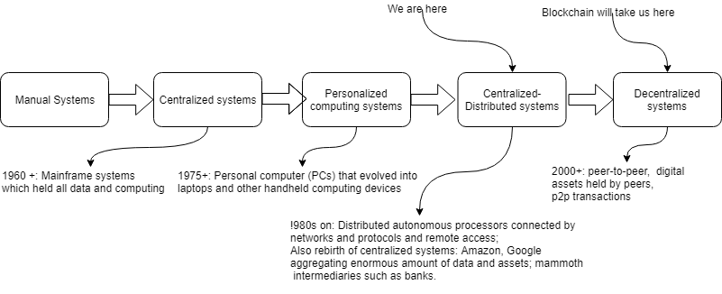
Evolution of computing systems

Slide 6

Blockchain: A Trust Layer over the Internet
Trust is a critical component for trade and any type of business transaction.
We develop and model our trust based on ad hoc means: Recommendation systems, our own knowledge, business experts on the news, etc.
Blockchain is about “trust automation”.
Take a look at the evolution of our Internet as shown here.
Trust layer:
Let us motivate blockchain
with an example I used on
Coursera blockchain course 1.
Year 2009,
Blockchain-based trust
No standards yet
Year 1991, RFC 7230
Year 2000, RFC 2818 Standard
Web application
Secure web application
Secure & Trusted web application
HTTP
HTTPS Security
HTTPS Security
Blockchain Trust
The Internet

Slide 7
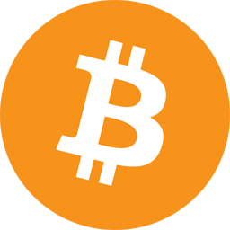
Bitcoin & Blockchain
Bitcoin 0.1.0 was released on 9 January 2009
Bitcoin cracked the trust and
integrity puzzle with its
Mathematics and algorithms
2007-2008 financial meltdown
Bitcoin showed that -- a fact recorded on a blockchain
can be automatically verified by anybody thus establishing
trust and transactions among unknown peers
Innovation: blockchain technology
Idea: What worked for cryptocurrency should work for other
business transactions

Slide 8

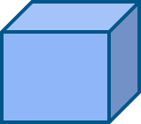
BLOCKCHAIN: THE DISTRIBUTED IMMUTABLE LEDGER (2)
Transactions
Eve
Validate
Gather
Block
Chain
invalid
Modify
Consensus
Verify Confirm
Transactions
New
Block
Transactions
Block
Blockchain

Slide 9
Blockchain: The Dis-intermediator (3)
Verification
Validation
Recording
Consensus
Trust &
Security
All defined by the blockchain protocol, and implemented.
For example, consider checking in for your flight at the airport.

Slide 10
SUMMARIZING, BLOCKCHAIN IS ABOUT
Decentralization
Disintermediation
Distributed Immutable Ledger
Blockchain is a trust layer on the internet.
On a strong foundation of more than 40 years of scientific research (cryptography, hashing, p2p, consensus protocols)
Enabling automation, accountability, auditability, efficiency, accuracy, fidelity, fairness, and inclusiveness.

Slide 11
Decentralized identity
Unknown peer participants

Slide 12
Your identity in a decentralized system
Here are some ways you identity yourself to the business system you are in : Driver’s license, social security number, person number in an education institution, employee number.
Think about these, these are all your affiliations to a centralized institutions.
In a decentralized system, where participants are unknown, and can join and leave as they wish, how can we identify them?
We need a self-generated .secure identity for you. Let’s do that.

Slide 13
Your identity: Ethereum account number
A 256-bit random number is generated and designated as the private key
An Elliptic curve cryptography algorithm is applied to this private key to derive a unique public key
This is the {private, public} key pair of the account; the private key is secured using a password and the public key is open to the world
A hashing function, RIPEMD160, is applied to the public key to obtain the account address (or identity)
This address is shorter than the key: it is 160 bits or 20 bytes in length. This is the account number you see in Remix and the Ganache environment.
The address is represented in hexadecimal for easy readability, as indicated by the 0x as the first two characters; for example, 0xca35b7d915458ef540ade6068dfe2f44e8fa733c.

Slide 14
Generate an identity for you
Activity 1
Survey

Slide 15
Smart contracts
Rules, governance and provenance

Slide 16
You want to do more than cryptocurrency transfer?
Financial, legal,
healthcare, government,
non-government applications
E-Commerce
Communication
mobile apps …
Cryptocurrency: Bitcoin: 2008/2009
Autonomous, Decentralized, applications: 2013
Validation, Verification,
Immutable recording
Addition of smart contracts lets you do lot more than cryptocurrency transfer
We are here
The Blockchain
The Internet

Slide 17
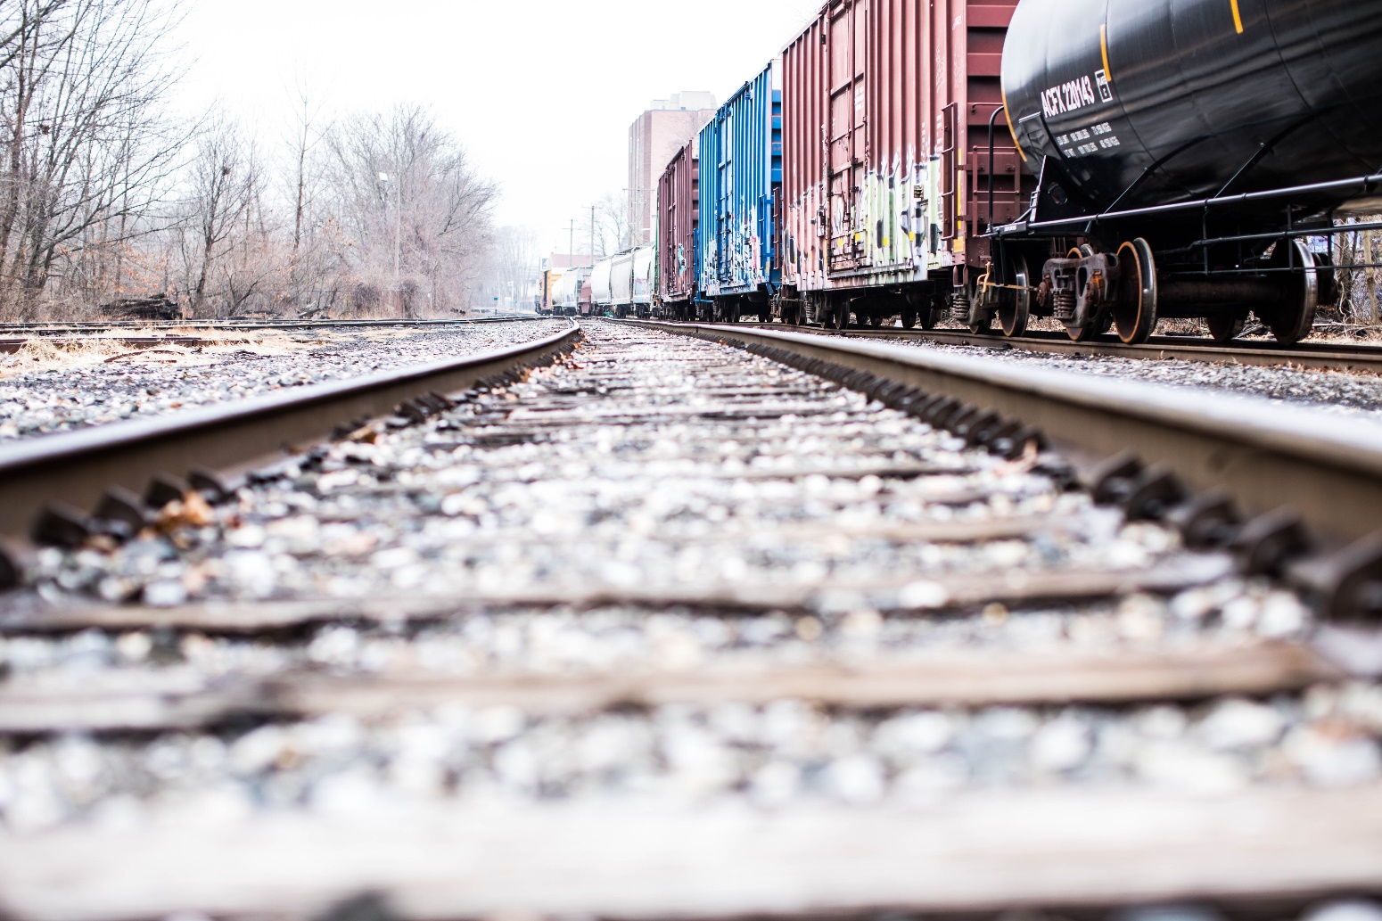
Blockchain and smart contracts
Blockchain is like
a train track
The smart contract is
like a train on the tracks:
But different types;
It can perform other tasks than cryptocurrency transfer

Slide 18
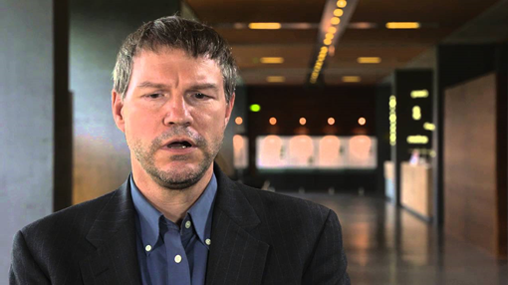

What is a smart contract?
Smart contract is executable code on the blockchain that uses the features of the blockchain.
-- introduced by a Georgetown law school graduate Nick Szabo in 1999
--adopted by Ethereum blockchain in 2013
-- it provides automatics verification, validation and immutable recording of transactions
I discuss more about him in my Coursera
courses

Slide 19
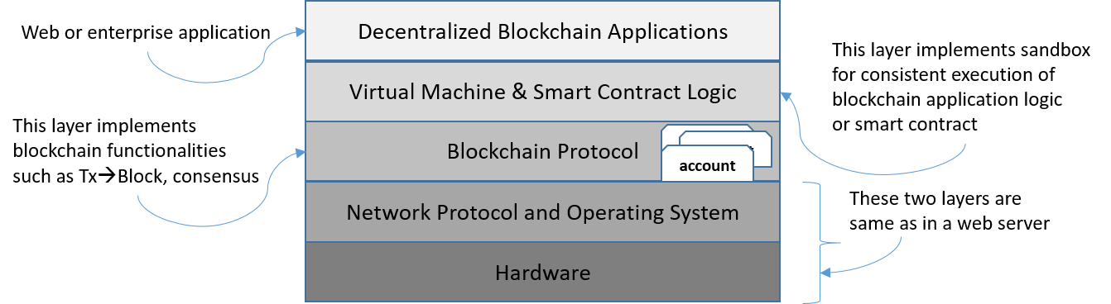
Ethereum stack
Note: In recitation we are covering user interface stack; Today
during lecture we will look at smart contract design.

Slide 20
Lets solve a problem: simple counter
Problem statement: Counters are very versatile and useful device. It could be a part of a decentralized application. For example: population counter; birth and death entry. You cannot get any more decentralized than this.
Step 1: Use case (Unified Modeling Language) diagram. Identify user and operations and supporting operations.
Step 2: Using the use case and the problem statement as guidance, identify, user, digital assets and transactions.
Step 3: Design the “contract” diagram (derivative of “class” diagram)
Step 4: (Optional) Obtain the pseudo code. At this point you can decide to implement it for Ethereum blockchain or for some other blockchain. That is the reason for this step, platform independent step.
Step 5: Implement the contract in a blockchain-specific language. In our case, we will use Solidity and Ethereum blockchain. Ethereum Metropolis—Constantinople to be exact.
Step 6: Test it using a web-IDE call Remix.

Slide 21
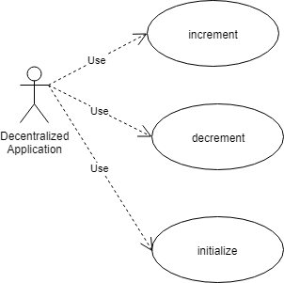
Step 1: Use case diagram
Use draw.io or starML or other
tools to creat a similar one for
your lab1. Can you do it for your
documentation?

Slide 22
Step 2: Identify user, assets and transactions
Users: Actors in any Dapp
Digital or other assets: counter value (type depends on the value: if it is student score: 8-bit, it is world population 256-bit, yes BC works on a 256-bit integer processor.)
Transactions: create, initialize (set), increment, decrement, get (to view)

Slide 23
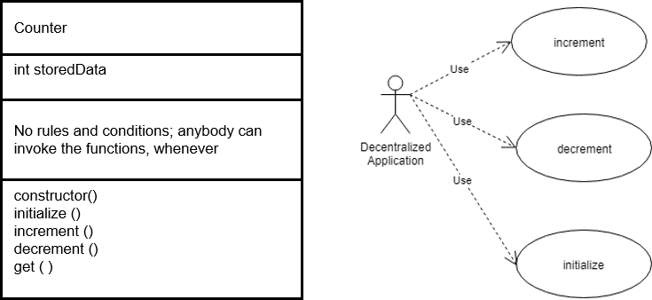
Step 3: Obtain contract diagram

Slide 24
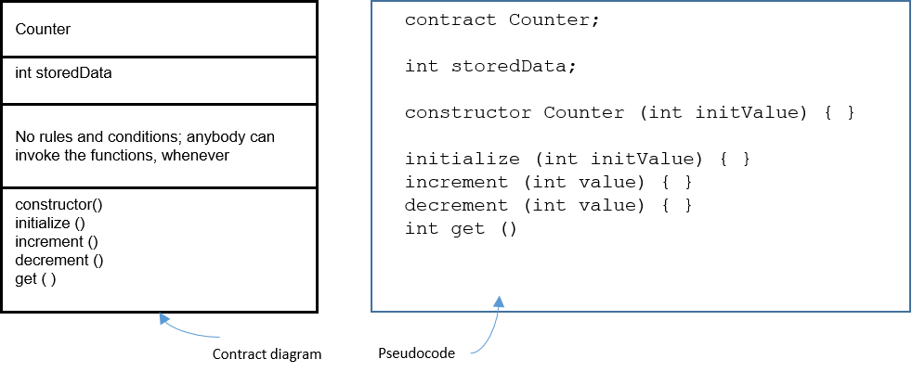
Step 4: Obtain the pseudo code

Slide 25
Step 5: Code it in Solidity
pragma solidity ^0.5.2; // imagine a big integer counter that the whole world could share
contract Counter {
uint storedData;
function initialize (uint x) public {
storedData = x;
}
function get() view public returns (uint) {
return storedData;
}
function increment (uint n) public {
storedData = storedData + n;
return;
}
function decrement (uint n) public {
storedData = storedData - n;
return;
} }

Slide 26
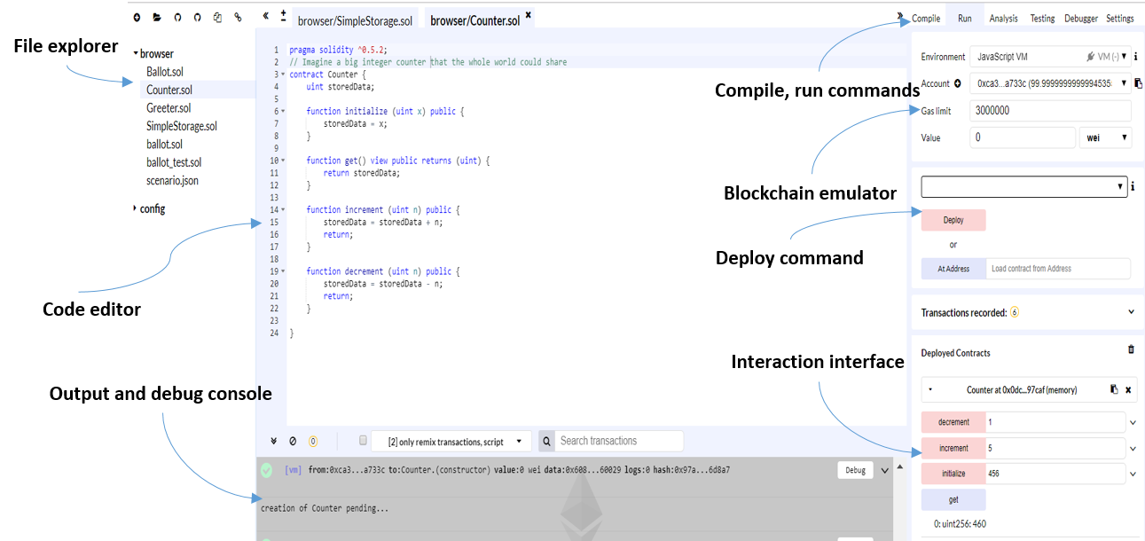
Step 6: Test it in Remix IDE

Slide 27
On to Remix IDE to test our smart contract
On to Remix Ide to test our smart contract
And also Activity 2, on Ropsten public network

Slide 28
Decentralized application
Design and development

Slide 29
End-to-end Dapp development
Read chapter 4 of the text book
The architectural model of a Dapp
Using the Truffle IDE for developing Dapps
Connecting the front end to the smart contract
The MetaMask browser plugin
Deploying and testing an end-to-end Dapp
Summary

Slide 30

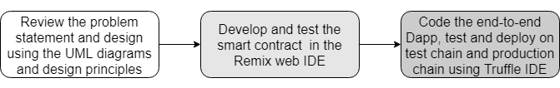
How to develop a Dapp?
You must understand Dapp programming is not your traditional programming. There are many new concepts that you must understand before you start coding.

Slide 31
Dapp web application development
You’ll need these elements for the web application part of the Dapp
HTML, JavaScript, and CSS for rendering the server contents for user interaction
A server to host the base entry script defined in index.js
Server code (app.js) linking the web server and web client
Additional wrappers and plugins for any frameworks such as Bootstrap and the web3 API
Package configuration files such as package.json

Slide 32
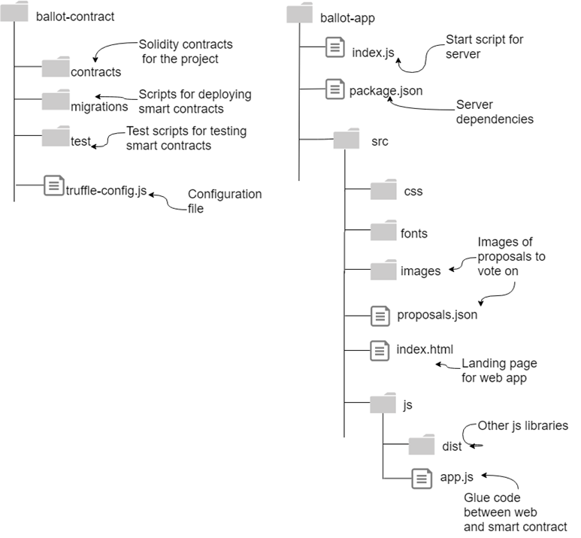
Ballot -Dapp
Part 1:
ballot-contract

Slide 33
You’ll need these tools
Operating system—Linux Ubuntu 18.04
Web server for the web client interface—Node.js
Package manager—npm
IDE—Truffle
Smart contract language toolchain—Solidity (comes with Truffle suite)
Browser/web client—Chrome and the MetaMask (LTS) plugin
Editor—Atom, gedit, or any other of your choice

Slide 34
Install required software
STOP
Truffle: v5.0.27
latest is 5.0.36
https://www.npmjs.com/package/truffle
Node: v10.15.3
latest : v10.16.3.
https://nodejs.org/en/
Solidity : 0.5.8 (latest is 0.5.12)
npm: 6.4.1
latest is 6.11.3
https://www.npmjs.com/get-npm
ganache v2.1.1
https://www.trufflesuite.com/ganache

Slide 35
Contents ballot-contract folder
contracts/—Contains the Solidity source files for your smart contracts. There is an important contract in here called Migrations.sol; this is the smart contract facilitating deployment.
migrations/—Truffle uses a migration system to handle smart contract deployments. A migration is an additional script (in JavaScript) that keeps track of changes in the contracts under development.
test/—Contains both JavaScript and Solidity tests for your smart contracts.
truffle-config.js—Truffle configuration file, containing for example configuration for the blockchain network ID, IP, and RPC port number.

Slide 36
Dapp-app : ballot-app
Now your SC (s), ballot.sol in this case is deployed and ready.
Next step is to get the web UI ready and link it to the deployed contract. For this you’ll need these skills:
HTML, JavaScript, and CSS for rendering the server contents for user interaction
A server to host the base entry script defined in index.js
Server code (app.js) linking the SC via web server and web client
Additional wrappers and plugins for any frameworks such as Bootstrap and the web3 API
Package configuration files such as package.json

Slide 37
Dapp-app: ballot –app : more details
Part 2:
ballot-app

Slide 38
Ballot.zip exploration
Ballot.zip has all these items discussed
Now let’s work with the ballot.zip and interact with ballot.sol
npm install
npm start
Review managing the accounts and interaction with with Metamask
Right-click the MetaMask icon (a fox) and connect to the custom RPC at http://127.0.0.1:7545.
Type your Ganache seed words in the response screen that appears.
Choose a password and type it in; later on you’ll be able to use this password to unlock MetaMask without entering the seed words; (use a password that’s easy to remember during the testing phase).
Now you are ready to interact with ballot Dapp; open the application at localhost:3000 and interact: Activity 3

Slide 39
Blockchain application models
Emerging applications

Slide 40
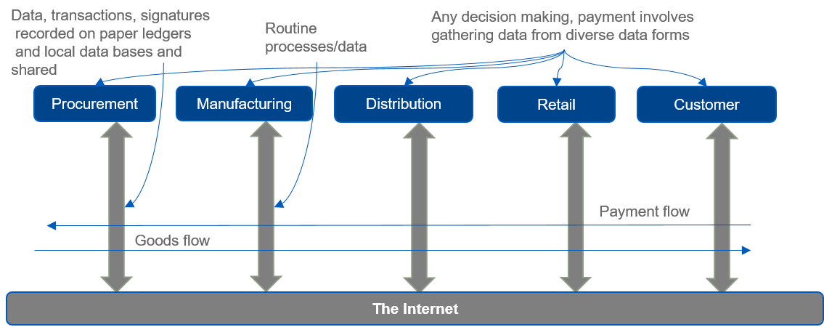
Traditional supply chain system

Slide 41
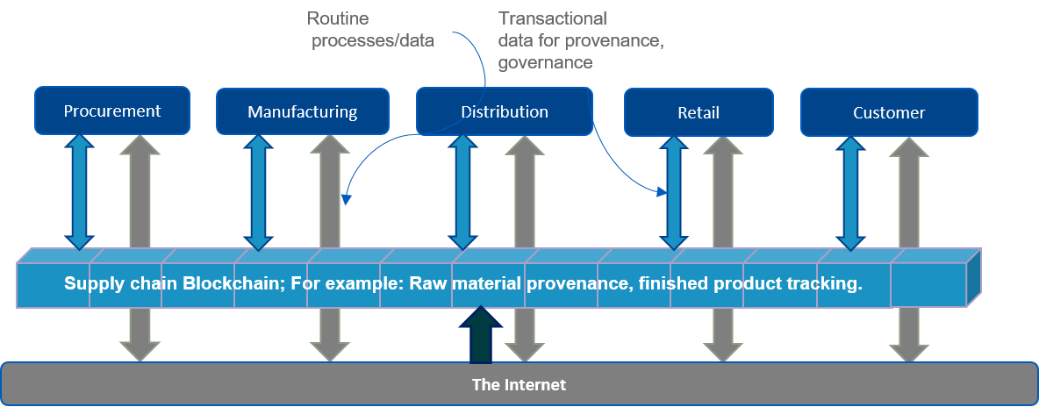
Blockchain-based supply chain (food chain)

Slide 42
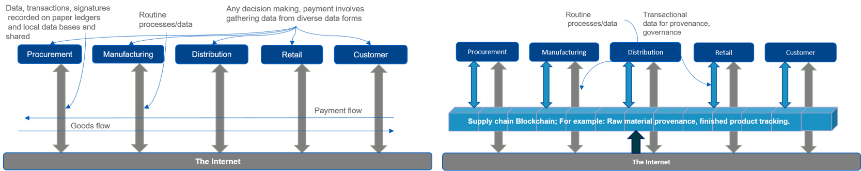
Supply chain application
Blockchain is a trust layer on the internet; it enables a distributed ledger and a verification mechanism.
Traditional supply chain
Blockchain-based supply chain

Slide 43
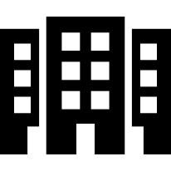
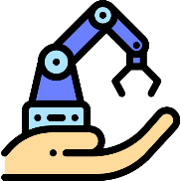

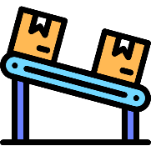
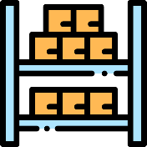

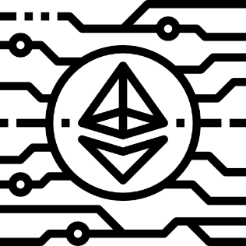
Blockchain-enabled Supply Chain – More details
Administrator
Procurement
Manufacturing
Distribution
Retailer
Customer
Manufacturer is enrolled
Raw materials are procured
Product is manufactured and enrolled
The manufacturer is verified
Manufacturer is verified
Manufacturer, product status are verified
Company prefix specified in EPC
Finished product shipped to distributor
Check recipient, product status
Check recipient, product status
Buyer issues transaction for purchase
Product is shipped to retailer
For example, The genuineness of the product is verified at each step
to avoid sale of counterfeit products;
At each step, status of the product, owner and recipient are verified
Blockchain
1. Icons made by https://www.flaticon.com/authors/freepik 2. K. TOYODA, P. TAKIS MATHIOPOULOS, I. SASASE AND T. OHTSUKI1, A Novel Blockchain-Based Product Ownership Management System (POMS) for Anti-Counterfeits in the Post Supply Chain, IEEE Access, pp. 17465-17477, vol. 5, 2017.

Slide 44
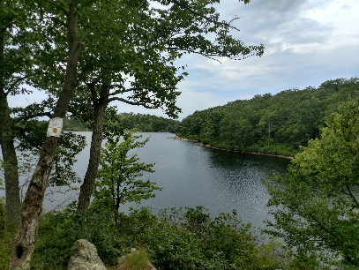
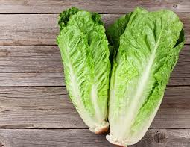
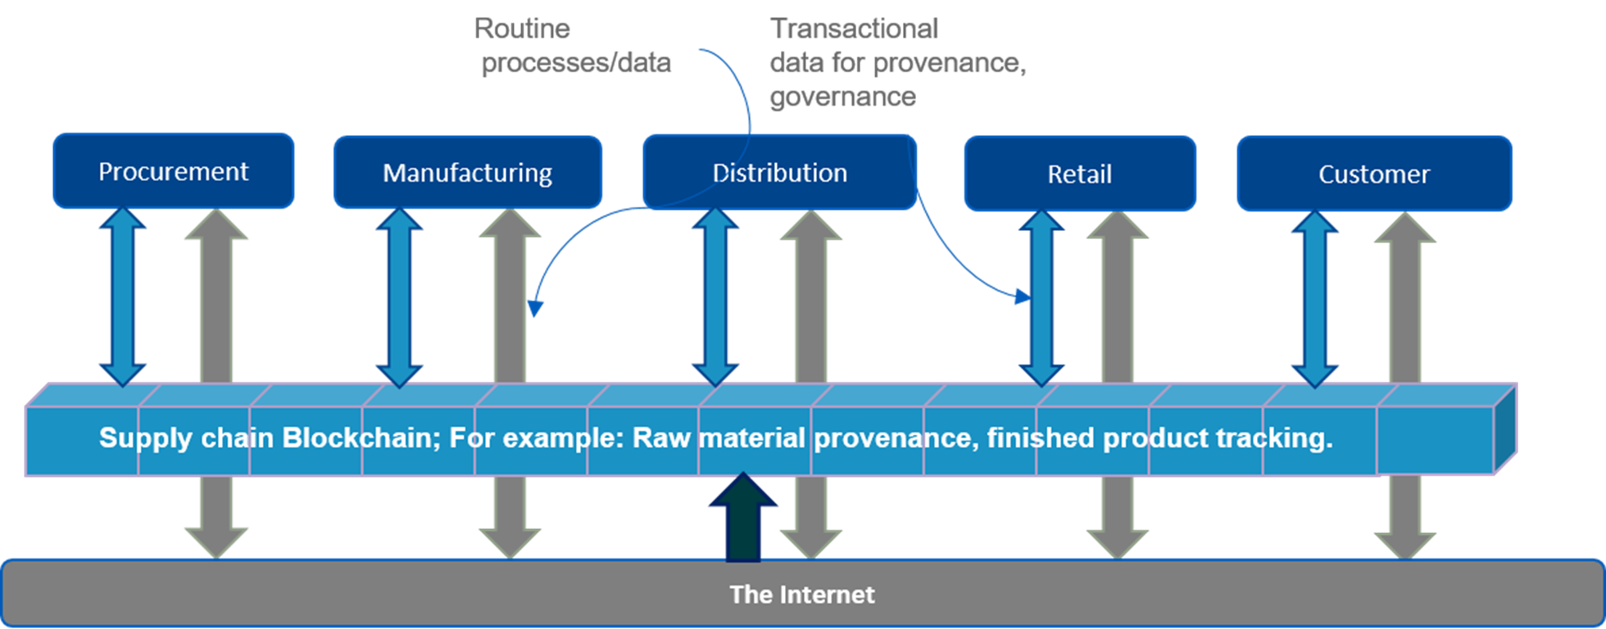


More applications for supply chain
Spring water
provenance
Blockchain is a trust layer on the internet; it enables a distributed ledger and a verification mechanism.
Produce
provenance
Medicine
provenance
Auto-parts
provenance
Blockchain-based supply chain

Slide 45

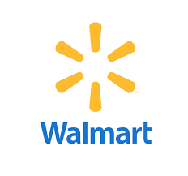
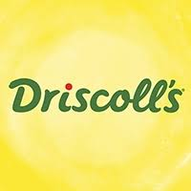

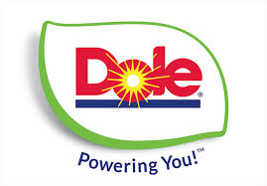


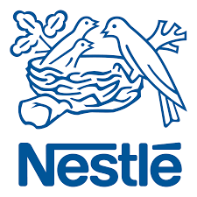




IBM’s Food Provenance Initiative
Started working food provenance on a pilot in 2016
“a blockchain creates an immutable golden record
of time-stamped transactions related to any product
that can be bought and sold. In the supply chain,
blockchain is used as a means to increase
transparency, add visibility and improve
supply chain economics.”
+ Chinese University
2018 expanded the network
to many businesses
Attended
workshops:
DMDII 2018
Chicago, IL
https://www.zdnet.com/article/ibm-blockchain-to-help-prevent-contamination-in-global-food-supply-chain/

Slide 46

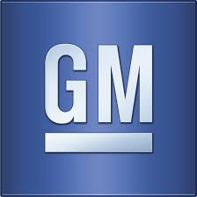


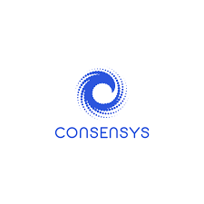
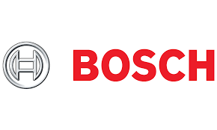
Automobile blockchain
Founding members of MOBI : the Mobility Blockchain Initiative
+ Bosch + ZF (Parts) + Accenture, IBM +Consensys, Hyperledger
Supports both public and private blockchain
Working on standards, interfaces for a new digital mobility ecosystem,
from ride-sharing to self-driving cars and everything in between.
UB:2017
Collaboration
--2 months in India
--parts provenance
2018 UB-Coursera
introduction
recorded on-site ..in DC

Slide 47

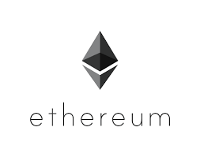
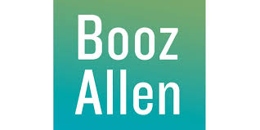
FDA – healthcare blockchain
We use this
blockchain platform
Manage data duplication and integrity
Manage private data access
Uses interplanetary file system
Pilot with 4 hospitals 2018
Plan to move to 20 hospitals
Member of IEEE standards
On medical devices on blockchain

Slide 48
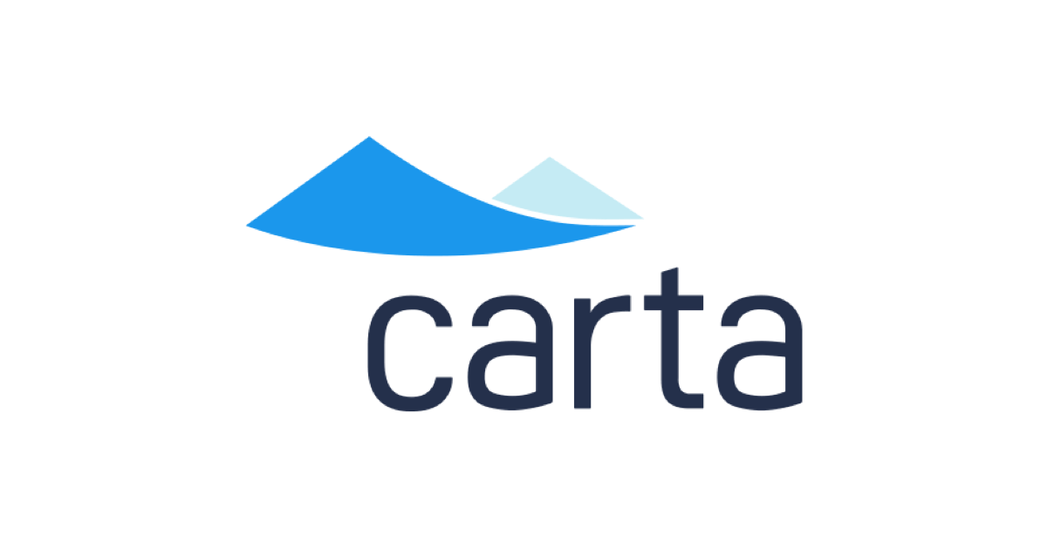
CARTA – Capitalization Table Company
Potential for new and
fractional owners
Newer financial instruments
Ownership management
Who owns what and when transactions recorded on blockchain.
New forms of ownerships: ICOs, DAOs, and blockchain ownership ledgers
After all cap table
is a ledger
“Startups, office buildings, rental homes, railroads, railroad cars, railroad companies, debt for those railroad companies, antarctic territories, oil rigs, helicopters to access those oil rigs, farmland, farm equipment, rice paddies, irrigation equipment for those rice paddies, …pharmaceutical companies, pharmaceutical patents…. it goes on and on. Everything in our world is owned by a person or a group of people.” – Carta Owner Henry Ward
Decentralized Autonomous Organization
Initial coin Offering
I am an advisor for two ICOs: ALZA,Intellishare

Slide 49







Government Initiatives
Department of Homeland security
Defense Information System Agency (DOD)
Department of commerce
Department of treasury
Deputy Ass. Secretary:
“saved $700 million”
Time saved by blockchain
digital transformation:
timeliness
Representatives form all these
Government agencies presented
at a exclusive blockchain workshop;
by invitation only workshop
Nov 16, 2018, Washington D.C.
Department of health and human services (HHS)
General services administration
I was there

Slide 50
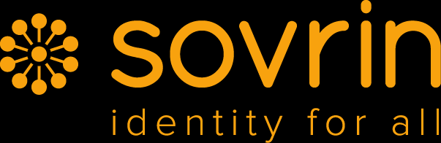

Blockchain Travel Industry
Secure payments
Identity management: Single identity, easy verification, time saved, at airports and other point of entries
Loyalty program management
Baggage tracking
Bed swap and house swap : Inventory management using blockchain
Direct market place with low or no commission
Real estate acquisition management: Compliance, governance, provenance using blockchain
https://www.revfine.com/blockchain-technology-hospitality-industry/

Slide 51
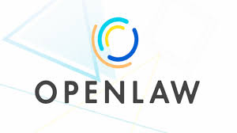
Openlaw Blockchain Platform for Legal Templates
An online platform for creating and storing on cloud, legally binding
digital documents with provenance on blockchain
Digitize, standardize, record
On blockchain
Model all or parts of legal agreements decreasing the cost and friction of creating, securing, and generating binding legal agreements.
Create, store, and execute legal agreements that interact with blockchain-based smart contracts without the need for any intermediaries.

Slide 52

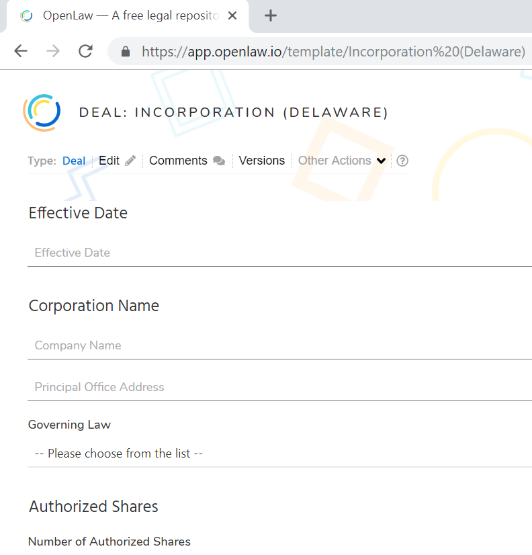
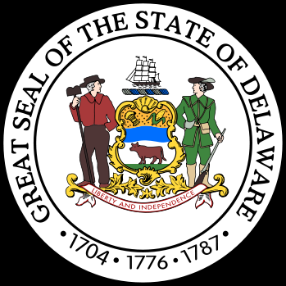
Openlaw : Working Use Cases
OpenLaw, in conjunction with leading Australian law firm, Corrs Chambers Westgarth, has built an end-to-end real estate transaction on the Ethereum blockchain.
Parties sign a standard and legally binding Australian land sale contract using OpenLaw.
The transaction is automated using an Ethereum smart contract, including the deposit, a loan to fund the purchase, the completion payment to the seller, and the transfer of title.
State of Delaware uses Openlaw platform for business incorporation legal documents.
https://app.openlaw.io/
Consensys recommended
OpenLaw for my course.

Slide 53
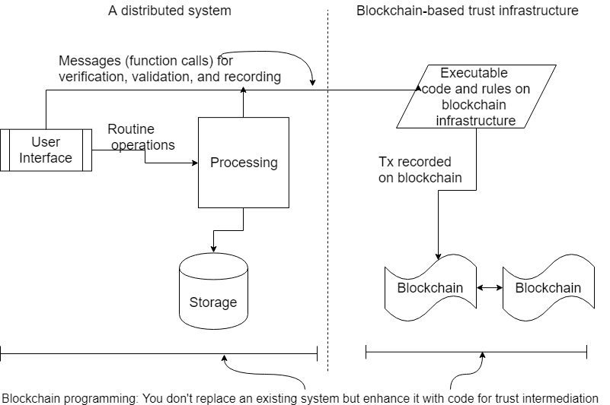

Slide 54
UB initiatives
Educating the world

Slide 55
Blockchain in your research and development
Do not over-fit blockchain into existing working systems.
It is NOT a database. (Instead, use a decentralized database in tandem with blockchain provenance.)
Blockchain is NOT a panacea for all your problems.
Then what is it good for?
Use cases with
Newer business models, instruments, processes
Inefficiencies,
Barriers to adoption,
Decentralized users,
Peers or users who are operating beyond boundaries of trust, that do not fit well into our centralized model,
Uses cases related to policies, rules, governance, provenance, compliance, audit trails, dispute resolution, complex legal instruments (M&A)

Slide 56
Public VS Permissioned Blockchain
Bitcoin is a public blockchain. Membership is open to all; anybody can join and leave as they wish. All the transactions on the chain are available for the whole world even though they may be encrypted.
In a permissioned and private blockchain membership is limited to identities with verified credentials.
The blockchain protocol features a membership service to control/manage membership.
A private blockchain is local to a specific business or environment.
A permissioned blockchain is also known as consortium blockchain, since its typical application is for consortium of businesses such as in an automobile domain. Ex: Auto consortium, FDA blockchain
Use public blockchain for involvement of
large number of unknown people: stadium survey
Within your own
organization
With your business
partners, suppliers,
financial institutions

Slide 57
Blockchain Roadmap (for projects)
What are inefficiencies, where are the gaps, who are we not reaching (customers)
Can blockchain help? Recall that it adds an autonomous trust layer.
For example, supply chain, food safety and recall, frozen transportation, finance and credit, international trade and shipments etc.
Education
Exploration
Evaluation
Expansion
Expand into production.
At the end of exploration phase you should have some use cases to try out.
Design and implement proof of concept (POC) and assess the impact of using the blockchain technology

Slide 58
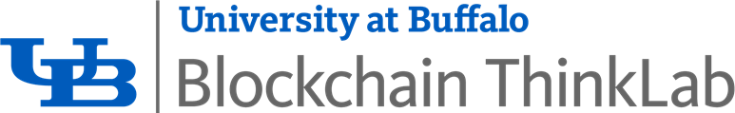

Blockchain Thinklab 1.0 Theme: Education
SEAS’ Coursera Blockchain “Specialization”
4 courses of 4 weeks of online instruction each with hands-on components.
Enrollment of 40000+ people all over the world.
Thinklab 1.1: Face-to-face CSE courses in the Spring 2019, Fall 2019
Created two courses: 1 credit course for local businesses, and
a 3-credit course for developers (Senior level undergrad, entry-level graduate course)
Blockchain Thinklab 2.0 Theme: Exploration
Working on a textbook for blockchain courses
Creating curriculum for an advanced course
For students here:
A good starting point is Coursera Course 1:
The certification itself has been scoped for developers
Application development using smart contracts in Course 2,3
Blockchain ecosystem in Course 4

Slide 59
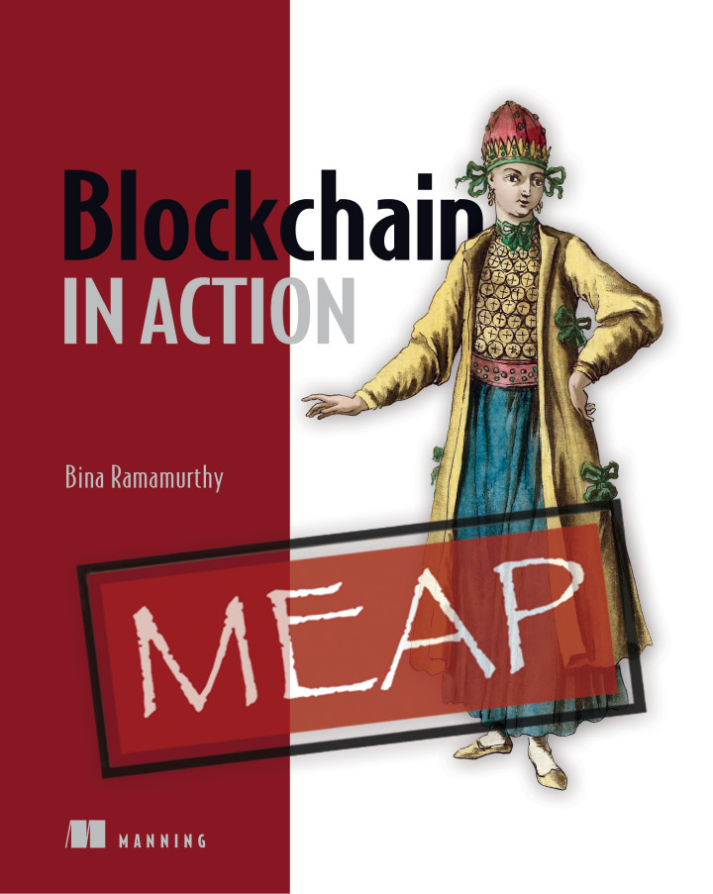
The book
Blockchain in Action
Manning publishers
12 chapters of motivating decentralized applications
Hands-on code
Blockchain in my own words
https://www.manning.com/books/blockchain-in-action
May 2020 release.

Slide 60
Summary
Blockchain technology is not about cryptocurrency anymore.
It is used for broad range of applications across many industries: finance, healthcare, government, manufacturing, and distribution.
Blockchain can enable an inclusive economy.
Blockchain has created exciting new opportunities and innovative application models:
Global collaboration systems, self-governing systems, open government.
Private, public and permissioned models to meet diverse business needs.
It is here to stay, in one form or another.

