Slide 1
Visual Environments for STEM Learning: Experiences and Opportunities
Bina Ramamurthy (Bina)
bina@buffalo.edu
http://www.cse.buffalo.edu/faculty/bina
This talk is partially funded by NSF grants
NSF-CCLI-0311473 NSF-TUES-0920335, NSF-OCI-1041280

Slide 2
Our Quest
For the past ten years or more we have been trying to disseminate difficult concepts in STEM (esp. CSE and BIO) through visual environments
I will discuss three such projects (Past, present, future)
Our experience: These tools and environments we have been developing have technical depth and correctness but are minimal in user engagement and visual appeal
We seek your (games and instructional technology ) help in this aspect
These are excellent opportunities for collaboration

Slide 3
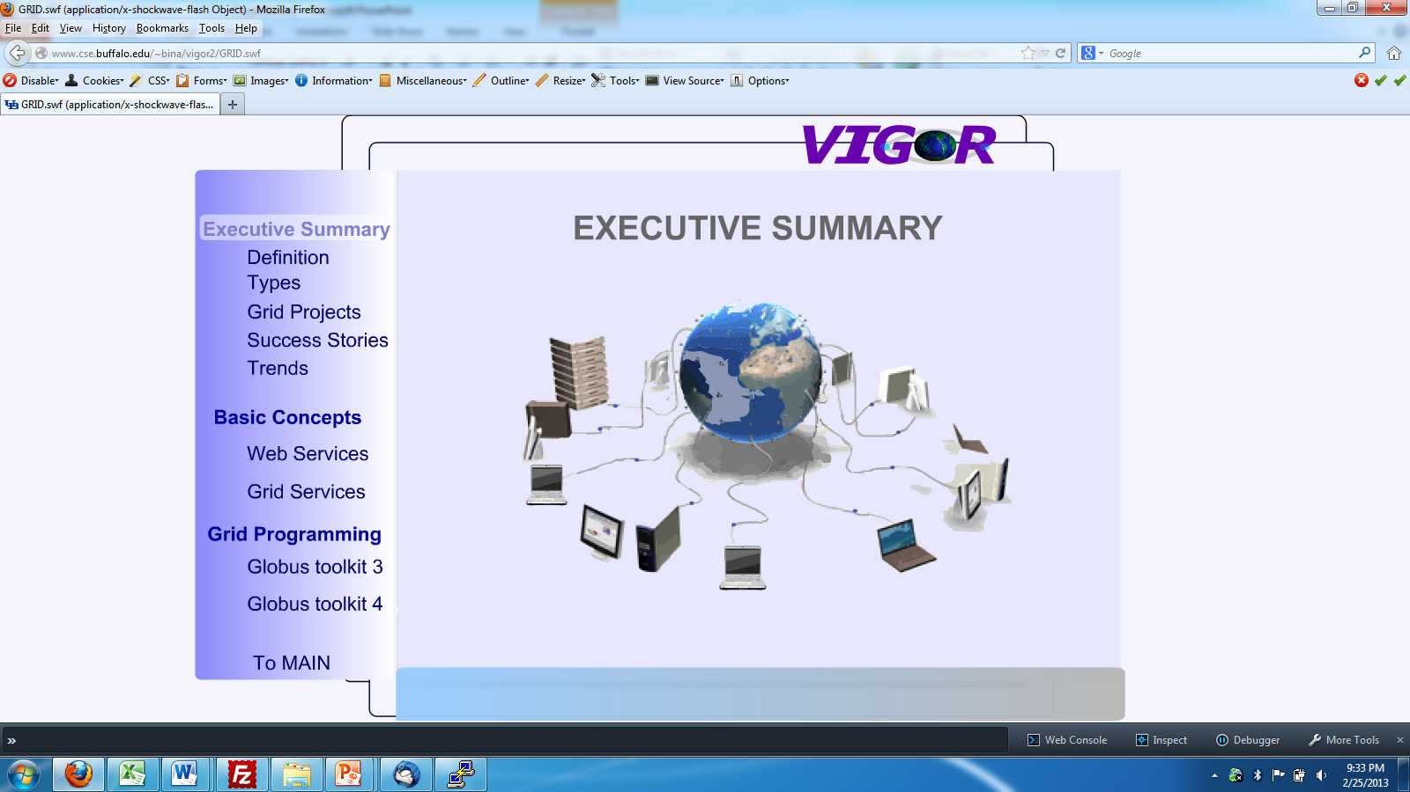
ViGOR: Visual Grid Tutorial
..2006..

Slide 4
Pop!World
Collaborative with BIO
Dr. Jessica Poulin and Dr. Katharina Dittmar of Biology
NSF supported
Used by 1000+ entry level students in Biology
Other upper level students also use it
K-12 component is also included (Pop!World Gateway)
Cloud deployed on Google App Engine
Monitoring student learning behavior
http://popworld15.appspot.com

Slide 5
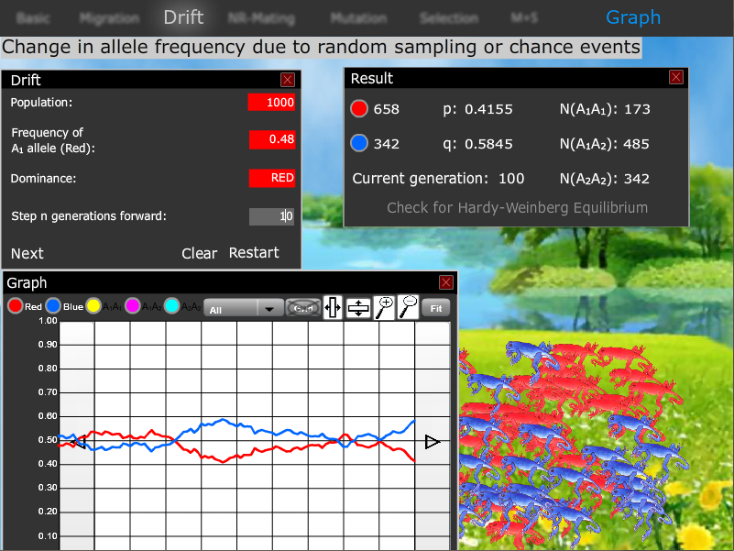
Pop!World

Slide 6
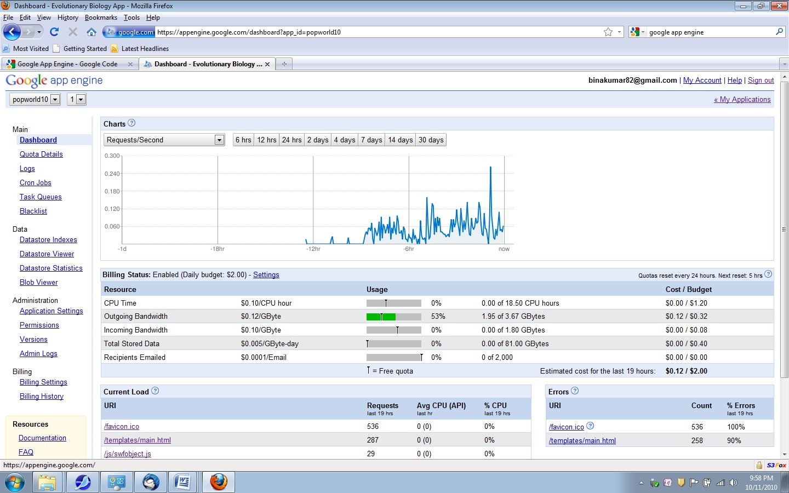
Google App Engine Load Monitoring

Slide 7
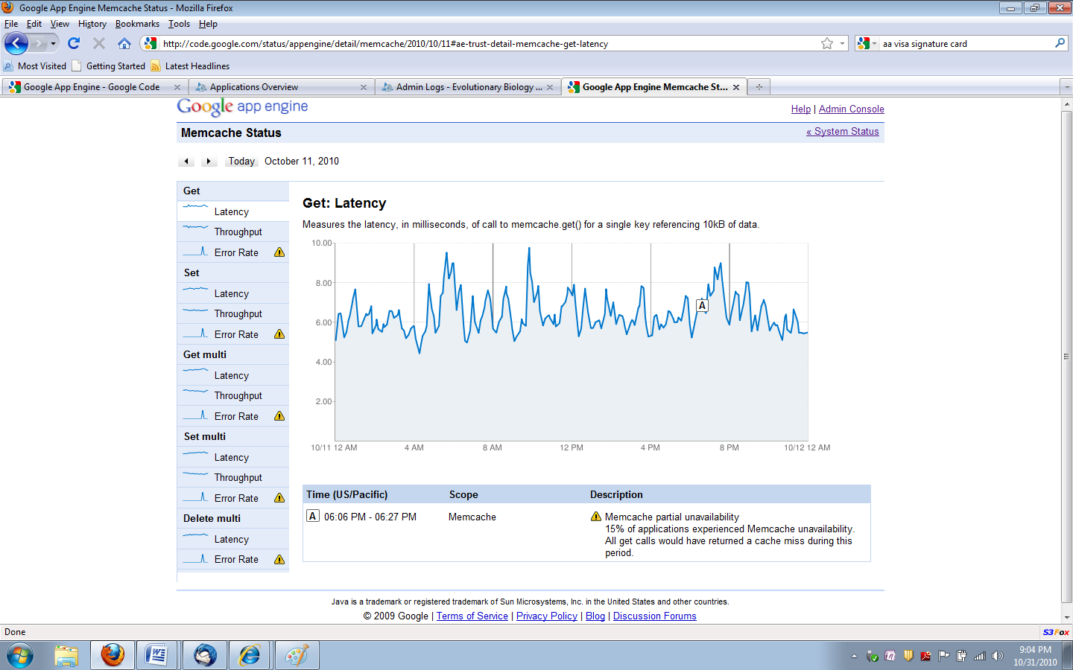
MemCache on GoogleAppEngine (2010)
Memcache partial unavailability

Slide 8
Data-intensive Computing (Big-data)
Certificate program at University at Buffalo
Lot of learning material in the traditional setting has been generated
See http://www.cse.buffalo.edu/faculty/bina/DataIntensive
We would like to create a highly interactive Massively Open Online Course format pedagogy and game-like learning environment for Big-data
Open for discussions.

