Slide 1
Graphs-at-a-time: Query Language and Access Methods for Graph Databases
Huahai He
Ambuj K. Singh
[Presented in SIGMOD’08, June9-12,2008,Vancouver,BC,Canada]

Slide 2
Contents
Introduction
Formal Languages for Graphs
Graph Query Language
Access Methods
Conclusion

Slide 3
Contents
Introduction
Formal Languages for Graphs
Graph Query Language
Access Methods
Conclusion

Slide 4
1. Introduction
Why Graph Query Language?
Data in multiple domains (for ex. Social Networks, Cheminformatics, Bioinformatics) is modeled as graph.
Need to manipulate graph
Efficiency
So, what restricts from building one?
Subgraph Isomorphism
General purpose relational model
Ex. (Continued…)

Slide 5
1. Introduction
In example , Table V(vid, label) and Table E(vid1,vid2)
Joins are costly
Why to consider A₂ and C₂ ?

Slide 6
1. Introduction
Any Solution?
Yes, this paper !
Using graph pattern as a basic operational unit
Defining formal languages for graphs
Define graph algebra
Accelerate graph pattern matching

Slide 7
Contents
Introduction
Formal Languages for Graphs
Graph Query Language
Access Methods
Results
Conclusion

Slide 8
2. Formal Languages for Graphs
A formal grammar consists of a finite set of terminals and non-terminals, and a finite set of production rules that generate strings of characters.
Ex. Grammar G consists of
Terminal – a
Non terminal – S
Rules - S -> aS | Ԑ
In graph domain, basic operational unit is a graph structure- graph motif
Can be either a simple graph or composed of other graph motifs by means of concatenation, disjunction, and repetition.
Graph grammar - a finite set of graph motifs
So, the language of a graph grammar - the set of all graphs derivable from graph motifs of that grammar.

Slide 9
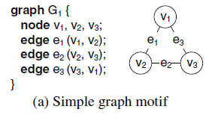
2. Formal Languages for Graphs
Simple Graph Motif - set of nodes and a set of edges.
Nodes and edges correspond to terminals, whereas graphs correspond to non-terminals

Slide 10
2. Formal Languages for Graphs
Complex Graph Motifs - composed of other graph motifs
How to compose multiple graphs?
Several operations are needed
Concatenation
Disjunction
Repetition

Slide 11
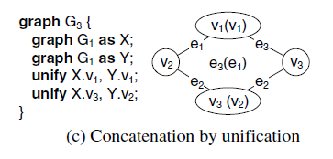
2. Formal Languages for Graphs
Concatenation
First way – connect nodes in each motif by new edges
Second way- unify nodes in each motif

Slide 12
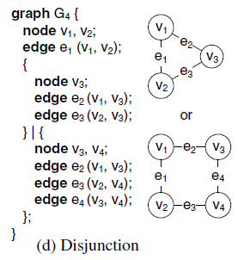
2. Formal Languages for Graphs
Disjunction- a graph motif can be defined as a disjunction of two or more graph motifs

Slide 13
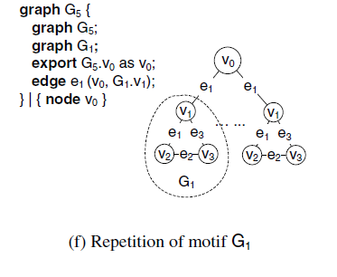
2. Formal Languages for Graphs
Repetition
In formal language: S →aS | Ԑ
In graph language:

Slide 14
Contents
Introduction
Formal Languages for Graphs
Graph Query Language
Access Methods
Conclusion

Slide 15
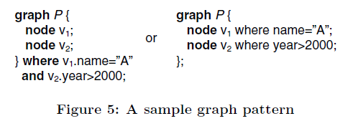
3. Graph Query Language
Each node, edge, or graph can have arbitrary attributes
Graphs are basic units of information
Each operator takes one or more collections of graphs as input and generates a collection of graph as output.
Graph Pattern- a pair P = (M,F), where M is a graph motif and F is a predicate on the attributes of the motif.

Slide 16
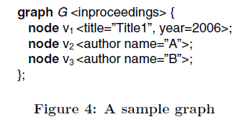
3. Graph Query Language
Graph Pattern Matching -A graph pattern P(M,F) is matched with a graph G if there exists an injective mapping (1 to 1 mapping) φ: V (M) → V (G) such that
For ∀ e(u, v) ∈ E(M), (φ(u), φ(v)) is an edge in G
predicate F_{φ}(G) holds.

Slide 17
3. Graph Query Language
Matched Graph- Given an injective mapping φ between a pattern P and a graph G, a matched graph is a triple φ,P,G and is denoted by φ_{P}(G).
A graph pattern can match a graph in multiple places.
Need some algebra to operations on graph

Slide 18
3. Graph Query Language
Selection
Generalized to graph pattern matching
σ_{P}(C) = {φ_{P}(G) | G ∈ C}
collection of graphs C
graph pattern P
σP(C)
collection of graphs

Slide 19
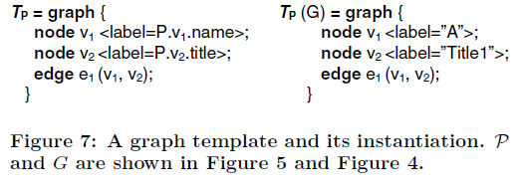
3. Graph Query Language
Cartesian Product
A Cartesian product operator takes two collections of graphs C and D and produces a collection of graphs as output.
C ×D = { graph { graph G₁, G₂;} | G₁ ∈ C, G₂ ∈ D}
The constituent graphs are unconnected
Composition
Generates new graphs by combining information from matched graphs
w : takes collection of matched graphs as input and produces a collection of graphs as output.
w_{TP}(C) ={ T_{P}(G) | G ∈ C }

Slide 20
Contents
Introduction
Formal Languages for Graphs
Graph Query Language
Access Methods
Conclusion

Slide 21
4. Access Methods
Defined for selection operator
Given a graph pattern and a collection of graphs, how to produce a collection of matched graphs.
Focuses on access methods for large graphs (protein interaction networks, social networks.)

Slide 22
4. Access Methods
Graph Pattern Matching
A graph G
Graph Pattern Matching
Algorithm
One or all feasible mappings
A graph pattern P

Slide 23
4. Access Methods
The predicate of graph pattern P is rewritten as predicates on individual nodes F_{u}’s and edges F_{e}’s.
Feasible Mates - The feasible mates Φ(u) of node u is the set of nodes in graph G that satisfies predicate F_{u}:
Φ(u) = {v|v ∈ V (G),F_{u}(v) = true}
Phase 1 of the algorithm –
retrieve the feasible mates for each node u in the pattern
Φ(u₁)×..×Φ(u_{k}) forms the search space
Phase 2 of algorithm-
Searches in depth first manner for matching between the graph pattern and graph
Complexity- O(n^{k})
NP Hard
What to do then?

Slide 24
4. Access Methods
Local Pruning
Index the attributes of the graph nodes for fast retrieval of feasible mates.
Even further, consider neighborhood subgraphs of the nodes
Neighborhood incurs large computation
Define some profile- e.g. a sequence of nodes in lexicographic order.
Pruning -> whether a profile is a subsequence of the other

Slide 25
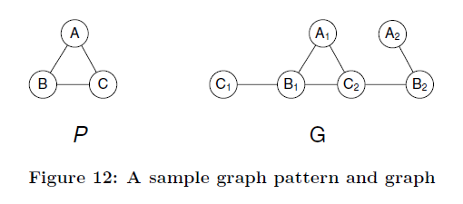
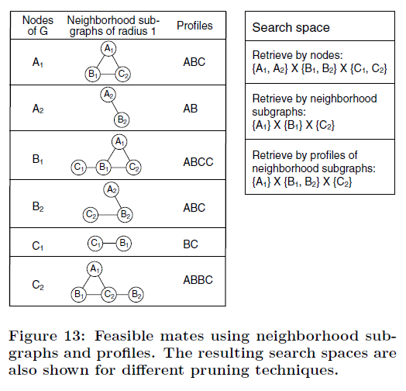
4. Access Methods

Slide 26
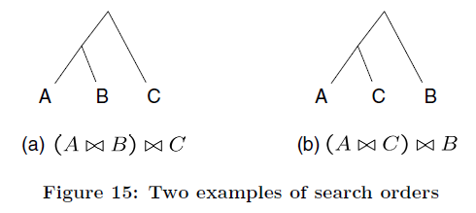
4. Access Methods
Reducing cost of joins
Size of a join i : Size(i) = Size(i.left) × Size(i.right) × γ(i)
Cost of a join i : Cost(i) = Size(i.left) × Size(i.right)
Consider input search space be {A₁}×{B₁ ,B₂}×{C₂}

Slide 27
Contents
Introduction
Formal Languages for Graphs
Graph Query Language
Access Methods
Conclusion

Slide 28
5. Conclusion
Experiments done on biological networks confirms the devised methods.
GraphQL is suitable for graphs with arbitrary attributes and sizes.
One ambiguity?

Slide 29
Questions?

Slide 30
Thank you!
Prepared by Satish Saley
Guided by Dr. Jan Chomicki

