Slide 1
YAGO: A Core of Semantic Knowledge Unifying WordNet and Wikipedia 16th international World Wide Web conference (WWW 2007)
Fabian M. Suchanek
Max-Planck-Institut
Saarbrucken / Germany ¨
suchanekaOmpii.mpg.de
Gjergji Kasneci
Max-Planck-Institut
Saarbrucken / Germany ¨
kasneciaOmpii.mpg.de
Gerhard Weikum
Max-Planck-Institut
Saarbrucken / Germany ¨
weikumaOmpii.mpg.de

Slide 2
What is YAGO?
A light-weight, extensible, high coverage and quality ontology.
1 million entities and 5 million facts.
Wikipedia uniﬁed with WordNet, design combination of rule-based methods in this paper.

Slide 3
Motivation
Which other singers were born when Elvis was born?
Google Search
I'm Feeling Lucky
Elvis Presley - Wikipedia, the free encyclopedia
Elvis Presley was born on January 8, 1935 at around 4:35 a.m. in a two-room ... Other singers had been doing this for generations, but they were black. ...
en.wikipedia.org/wiki/Elvis_Presley Cached Similar pages

Slide 4
Motivation
Many applications utilize ontological knowledge.
Existing applications use only a single source.
They could boost their performance, if a huge ontology with knowledge from several sources was available.
Such an ontology would have to be of high quality, with accuracy close to 100 percent.
Has to be extensible, easily re-usable, and application-independent.

Slide 5
Various Approaches to Problem
Assemble the ontology manually.
Example: Wordnet, SUMO, GeneOntology
Problem: Usually low coverage of result
Extract the ontology from corpora (eg.The web)
Example: KnowItAll, Espresso, Snowball, LEILA
Problem: Usually low accuracy (50%-92%)

Slide 6
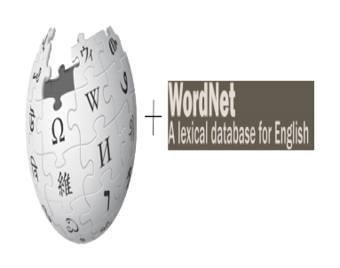
The YAGO Model
Extension of RDFS.
Unification of Wikipedia & WordNet.
Make use of rich structures and information, such as: Infoboxes, Category Pages, etc.

Slide 7
Wikipedia
Model Utilizes Wikipedia’s category pages.
Category pages are lists of articles that belong to a speciﬁc category
Zidane is in the category of French football players
These lists give us candidates for entities and candidates for relations
isCitizenOf(Zidane, France))

Slide 8
WordNet
A lexical database for the English language.
Groups English words into sets of synonyms called synsets.
thesaurus that is more intuitively usable
supports automatic text analysis and artificial intelligence applications.

Slide 9
Why Unify?
WordNet, in contrast, provides a clean and carefully assembled hierarchy of thousands of concepts.
YAGO ontology:
Vast amount of individuals known to Wikipedia
+ clean taxonomy of concepts from WordNet.

Slide 10
The YAGO Model
Knowledge represented as a set of concepts and relationships.
All objects (e.g. cities, people, even URLs) are represented as entities in the YAGO model.
Entities: AlbertEinstein, NobelPrize
Relations: hasWonPrize
Facts: AlbertEinstein hasWonPrize NobelPrize
Properties

Slide 11
The YAGO Model
How to express that a certain word refers to a certain entity ?
words are entities as well:
”Einstein” means AlbertEinstein
Similar entities are grouped into classes
AlbertEinstein type physicist

Slide 12
The YAGO Model
Classes are also entities.
physicist subClassOf scientist
How to represent properties of relations (like transitivity)?
Relations are entities as well.
subclassOf type transitiveRelation

Slide 13
The YAGO Model (n-ary) Relations
Relational database setting:
won-prize-in-year(Einstein, Nobel-Prize, 1921)
Disadvantage:
Space will be wasted if not all arguments of the n-ary facts are known.
YAGO Solution
Fact1 #1 : AlbertEinstein hasWonPrize NobelPrize
Fact2 #2 : #1 time 1921
Fact3 #1 foundIn http : //www.wikipedia.org/Einstein

Slide 14
Semantics
Any YAGO ontology must contain at least:
Minimal set of common entities:
C = entity, class, relation, acyclicTransitiveRelation
Minimal set of relation names:
R = type, subClassOf, domain, range, subRelationOf

Slide 15
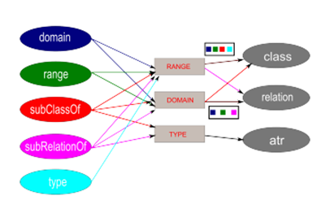
Semantics

Slide 16
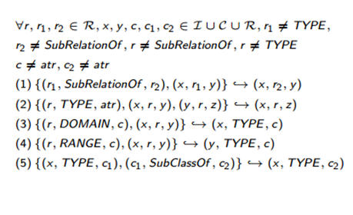
Semantics

Slide 17
Properties
Property 1:
Given a set of facts F E f, the largest set S with F->*S is unique.
A base of a YAGO ontology y is any equivalent YAGO ontology b with b ⊆ y. A canonical base of y is a base so that there exists no other base with less elements.
Property 2: [Uniqueness of the Canonical Base]
The canonical base of a consistent YAGO ontology is unique.

Slide 18
Stand Out Property
RDFS does not have a built-in transitive relation.
OWL :
The only concept that does not have an exact built-in counterpart is the acyclicTransitiveRelation.

Slide 19
THE YAGO SYSTEM

Slide 20
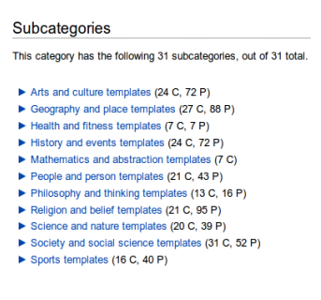
Classes and Categories
To establish for each individual its class, we exploit the category system of Wikipedia.
This well-deﬁned taxonomy of synsets is used WordNet to establish the hierarchy of classes.

Slide 21
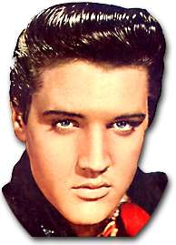
Integrating Wikipedia Categories
There are diﬀerent types of categories:
Exploit relational categories
Exploit conceptual categories
Avoid administrational categories
Disputed_article
American_singer
is a
is a
born
1935

Slide 22
Integrating Wordnet Synsets
Each synset of WordNet becomes a class of YAGO.
To be on the safe side, we always give preference to WordNet and discard the Wikipedia individual in case of a conﬂict.
hypernymy/hyponymy
the relation b/w a sub-concept and a super-concept
holonymy/meronymy :
The relation between a part and the whole

Slide 23
Establishing Relations
SubClassOf:
hyponymy relation from WordNet:
A class is a subclass of another one, if the ﬁrst synset is a hyponym of the second.
Means:
Wikipedia, WordNet both yield information on meaning. WordNet Synsets:
”urban center” and ”metropolis” both belong to the synset “city”.

Slide 24
Establishing Relations
More Relational Wikipedia categories extraction:
bornInYear, diedInYear, establishedIn, locatedIn, writtenInYear, politicianOf, and hasWonPrize.
category “1879 births” -> individual is born in 1879.
category 1980 establishments->
organization was established in 1980

Slide 25
Meta-relations
Descriptions and Witnesses:
We also store meta-relations uniformly together with usual relations.
Fact3 #1 foundIn http : //www.wikipedia.org/Einstein
Context:
We store for each individual the individuals it is linked to in the corresponding Wikipedia page.
Albert Einstein is linked to Relativity Theory.

Slide 26
Person#3
subclass
Singer#1
means
subclass
"singer"
American_singer
is a
born
1935
"Elvis Presley"
means

Slide 27
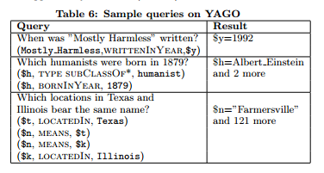
Query
An interface to query YAGO in a SPARQL like fashion

Slide 28
Evaluation and Experimentation
No computer-processable ground truth of suitable extent, we had to rely on manual evaluation.
We presented randomly selected facts of the ontology to human judges and asked them to assess whether the facts were correct.
Also, it would be pointless to evaluate the non-heuristic relations in YAGO, such as describes, means, or context.
This is why we evaluated only those facts that constitute potentially weak points in the ontology.

Slide 29
Evaluation and Experimentation

Slide 30
Conclusion
Main features of YAGO, and its contributions:
High coverage and high quality ontology.
Integration of two largest ontologies Wikipedia, and WordNet.
Usage of structured information such as Infoboxes, Wikipedia
Categories, WordNet Synsets.
Expression of acyclic transitive relations.
Type checking, ensuring that only plausible facts are contained.

Slide 31
Thank you

