Slide 1
Why not?
Adriane Chapman The MITRE Corporation McLean, VA 22102 achapman@mitre.org
H.V. Jagadish University of Michigan Ann Arbor, MI 48109 jag@umich.edu
Presented by Ying Yang
2/4/2013

Slide 2
Outline
Problem statement
Model and definition
How to compute WHY NOT? answers
Evaluation
Related work
Conclusion

Slide 3
Problem statement
A business traveler searches for flights on a popular flight booking web site, he cannot understand why there is no direct flight from DTW to LAX listed. He took that flight last week, so why is it not in the result set?
Notes:
When users are unable to sift through the data themselves, it is impossible to discover why a data item is not in the result set. Is it not in the input datasets? Is some manipulation between the input and the user discarding it?

Slide 4
Problem statement
When users are unable to sift through the data themselves, it is impossible to discover why a data item is not in the result set.
Is it not in the input datasets? Is some manipulation between the input and the user discarding it?
Notes:
When users are unable to sift through the data themselves, it is impossible to discover why a data item is not in the result set. Is it not in the input datasets? Is some manipulation between the input and the user discarding it?

Slide 5
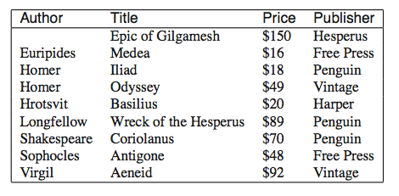
Problem statement
query: Show me all window-books.(price around $20)
Notes:
(Euripides, “Medea”). Why is (Hrotsvit, “Basilius”) not in the result set? Is it not a book in the book store? Does it cost more than $20? Is there a bug in the query-database interface such that her query was not correctly translated?

Slide 6
Model and definition
Data item: basic logical data unit
tuples in a relational table.
Attributes:
relational attributes in a tuple.
Dataset: a set of data items

Slide 7
Model and definition
MANIPULATION: M(D¹,D²,...)=Dº
MANIPULATIONM takes datasets D¹ , D² , etc as input and generate data set Dº as output.
SELECT * FROM books WHERE price≤$20
Input: book dataset.
Output:(Euripides, “Medea”), (Homer, “Iliad”), and (Hrotsvit, “Basilius”).

Slide 8
Model and definition

Slide 9
Model and definition
MANIPULATION 2. a black box function
Book’s_written_Languages(M) Return books written in English.
Input:d^{I1} is (Hrotsvit, “Basilius”, $20); d^{I2} is (吴承恩, “西游记”, $16); d^{I3} is (川端康成, “伊豆の踊り子”, $18).
Output: dº is (Hrotsvit, “Basilius”, $20);

Slide 10
Model
Model:
Dataset D
Query Q: the original query or workflow; a series of MANIPULATIONs.
The result set R
each item (in both D and R) has an associated set of attributes.
Does a result item in R have to be in D?

Slide 11
Model
Model:
“Why does R not contain any results satisfying predicate S.”
The predicate S is defined over (some subset of) the set of attributes A of D.
each atomic predicate is evaluated over a single attribute.
price<=20.
atomic predicates are combined using AND and OR, but without negation.
price <=20 AND author= Shakespeare.

Slide 12
Definition
Satisfaction-compatible:
A data item d is said to satisfy predicate S if the values of the attributes of d cause S to evaluate to TRUE.
Predicate s: price<=20. data item d(Hrotsvit, “Basilius”, $20) satisfies s.
If the root evaluates TRUE , the data item d is satisfaction-compatible with predicate S, even if it does not in itself satisfy it.
Notes:
Some is undefined because this attribute may not be in the data item d.

Slide 13
Definition
Satisfaction-compatible:
Input schema: Book(author title price publisher),data item a:(“Hrotsvit”,“Basilius”,$20,”Harper”).predicate s: author=“Hrotsvit” and price<=20 or date=“Jan1213”.
So data item a is Satisfaction-compatible with predicate s.
root
or
and
author
price
date
Notes:
Some is undefined because this attribute may not be in the data item d.

Slide 14
Definition
Lineage:
the lineage of a data item is the set of input tuples that have influenced the inclusion or appearance of that data item in the result set.

Slide 15
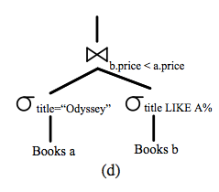
Definition
Lineage:
the lineage of (Sophocles, “Antigone”) is (Sophocles, “Antigone”) and (Homer, “Odyssey”).

Slide 16
Definition
Definition1:
Unpicked:
A data item d ∈ D is said to be unpicked, if i. There exists an attribute a ∈ A that is both associated with d and appears in the user question predicate, S, ii. d is satisfaction-compatible with S, and iii. d is not in the lineage of any result item in R.

Slide 17
Definition
Definition1:
Unpicked:
Example1:
the user had instead asked “Why are no ‘Hesperus’ books in the result set?”
we would have found books with Publisher=Hesperus, “Epic of Gilgamesh”, title=Hesperus, “Wreck of the Hesperus.”
We deduce the intended predicate based on an attribute value match. Of course it is also possible to specify a specific attribute-value pair, such as title=“Coriolanus”.

Slide 18
Definition
Definition1:
Unpicked:
Example2:
Results: (Sophocles, “Antigone”)
Question: “Why not “Free Press” and “Penguin” books?”.
only “Penguin” will be used to identify Unpicked data items from the input set, since “Free Press” is in the lineage of the result data item.

Slide 19
Definition
Definition2:
successor:
Given a manipulation m that takes in dataset I and outputs O,
d′ ∈O is a successor of d∈I,iff d^{m}∠d′.

Slide 20
Definition
Definition2:
successor:
Example1: attribute preservation is not required.
Question: “Why not $48?”,
Input: tuple (Sophocles, “Antigone”, $48).
output: using lineage, (Sophocles, “Antigone”) is directly associated with the input.

Slide 21
WHY NOT? ANSWERS
Definition3:
Picky Manipulation:
A manipulation m is “Picky” with respect to an Unpicked data item u if: i. u or a successor of u is in the input set of m, AND ii. there is no successor of u in the output set of m.
a picky manipulation is one that causes an unpicked data item to be excluded from the output set of a manipulation.

Slide 22
WHY NOT? ANSWERS
Definition3:
Picky Manipulation:
the Unpicked data item (Virgil, “Aeneid”).
Thus σ_{title}=′′Odyssey′′ is a Picky Manipulation for this data item.

Slide 23
WHY NOT? ANSWERS
Definition4:
Frontier Picky Manipulation:
A manipulation is “Frontier Picky” with respect to an Unpicked data item set U if:
i. the manipulation is Picky for at least some u ∈ U, and ii there does not exist u ∈ U for which a successor of u occcurs later in the workflow.

Slide 24
WHY NOT? ANSWERS
Definition4:
Frontier Picky Manipulation:
σ_{title}=′′Odyssey′′ is a Picky Manipulation, it is not a Frontier Picky Manipulation since an Unpicked Successor exists going into ∞b.price<a.price. Thus, ∞b.price<a.price is not just a Picky Manipulation, but since no Unpicked Successors exist later in the workflow, it is the Frontier Picky Manipulation.

Slide 25
WHY NOT? ANSWERS
Definition5:
WHY NOT? Answer:
Question: Given a user question regarding why not predicate S in a result set R, comprising manipulations M, upon an input data set D.
Answer: the answer to the user question comprises the set of frontier picky manipulations in M with respect to the items in D identified as unpicked according to S.

Slide 26
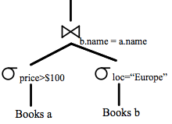
WHY NOT? ANSWERS
Definition5:
WHY NOT? Answer:
Q1:seek books priced greater than $1000, then the price selection would be the frontier picky manipulation, since there are no books costing more. The join no longer has any input and so is no longer Picky.
Q2: seek books whose authors are from Antarctica and are priced greater than $1000, then both selections are identified as Frontier Picky

Slide 27
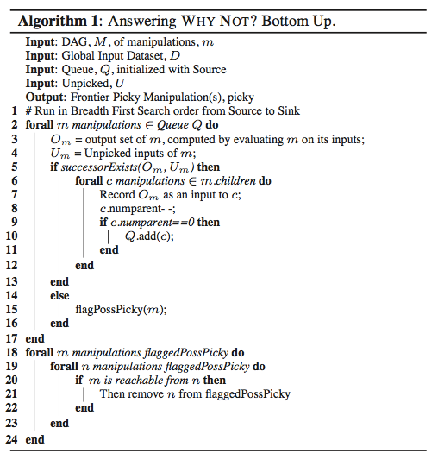
WHY NOT? ANSWERS
Bottom Up

Slide 28
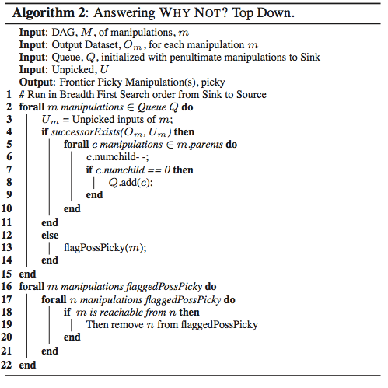
WHY NOT? ANSWERS
Top Down

Slide 29
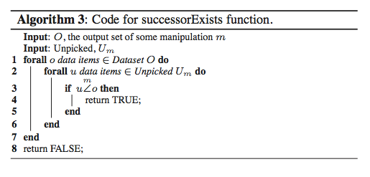
WHY NOT? ANSWERS
SuccessorExists function

Slide 30
WHY NOT? ANSWERS
Definition6: Successor Visibility:
A manipulation has Successor Visibility with respect to i_{x} if we can determine (for all values of i_{x} and o_{y} ) whether there exist o₁ , o₂ etc. such that i_{x}^{m}∠o_{y} ∀i_{x} in O(1) time.
How to achieve Successor Visibility.
Attribute preservation
Hashtable or Hashmap.

Slide 31
WHY NOT? ANSWERS
How to achieve Successor Visibility.
Attribute preservation
Question: why not the author ”Homer”.
and the author field is retained through the workflow from source dataset(s) to the result, then we say the attribute of interest has been preserved;

Slide 32
WHY NOT? ANSWERS
How to achieve Successor Visibility.
Hashtable or Hashmap.
Input: protein_id.
Output: amino acid sequence.
building a lookup hashtable of used protein_ids and sequences can permit successor determination in O(1) time, and hence give Successor Visibility.

Slide 33
Finding successors

Slide 34
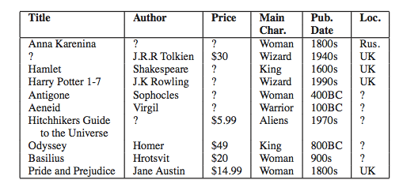
User Evaluation
Table 3: The Knowledge Table presented to the users. “?” i0ndicate values the user does not know.

Slide 35
User Evaluation
Control method: Non-answers.
Method: The result of non-answer
method (Virgil, “Aeneid”) updating the
price value to < $49 to say <$92 would
include (Virgil, “Aeneid”)
in the result set.
Answer: the set of
changes to the non-answer
tuple that would have resulted
in its inclusion in the result set;

Slide 36
Evaluation

Slide 37
Evaluation

Slide 38
Performance

Slide 39
Performance

Slide 40
Performance

Slide 41
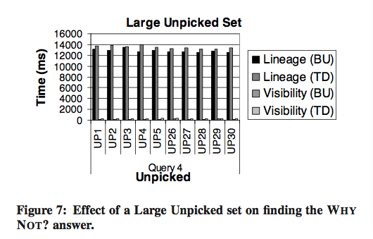
Performance
Does the size of unpicked set matter?

Slide 42
Questions?
Conclusion and future work and critique. Relate similar work.
Thank you!

