Slide 1
Identifying the Most Influential Data Objects with Reverse Top-k Queries
By
Akrivi Vlachou¹, Christos Doulkeridis¹, Kjetil Nørvag¹ and Yannis Kotidis²
¹Norwegian University of Science and Technology (NTNU), Trondheim, Norway
²Athens University of Economics and Business (AUEB), Athens, Greece
{vlachou,cdoulk,noervaag}@idi.ntnu.no, kotidis@aueb.gr
Proceedings of the VLDB Endowment, Vol. 3, No. 1
Presented by
Kalpesh Kagresha (UBIT: kkagresh Person# 5006 1160)

Slide 2
Outline
Introduction
Preliminaries
Problem Statement
Skyband Based Algorithm
Branch and Bound Algorithm
Influence Score Variants
Experimental Evaluation

Slide 3
Introduction
Top-k Queries
Retrieve k most interesting objects based on individual user preference
e.g. SELECT hotels.name
FROM hotels
ORDER BY (hotels.Dist_beach+hotels.Dist_conf)
STOP AT 3
This is a Top-3 query.
Influence of Product
Most appealing / popular product in the market
Identifying the most influential objects from given database products is important for market analysis and decision making
Optimizing Direct Marketing: Mobile Phone Company
Real Estate Market

Slide 4









Reversing the Top-k Query
From the perspective of manufacturers:
it is important that a product is returned in the highest ranked positions for as many user preferences as possible
estimate the impact of a product compared to their competitors products
advertise a product to potential customers
Which customers would be interested?
sales representative
customer
customer
customer
customer

Slide 5
Influence Score
Cardinality of reverse top-k result set
Top-m influential products
Query selects m products with highest influence score
Problem with existing techniques
Requires computing a reverse top-k query for each product in the database
Expensive for databases of moderate size

Slide 6
Preliminaries
Data space D
N dimensions {d₁, d₂,…,d_{n}}
Set of S database objects on D with cardinality |S|
Database object represented as point p ϵ S such that p = {p[1],…, p[n]} where p[i] is a value on dimension d_{i}
Assume that values p[i] are numerical non-negative scores and smaller score values are preferable.
Each d_{i} has associated query-dependent weight w[i] indicating the d_{i}'s relative importance for query.
Aggregated Score f_{w}(p) is defined as weighted sum of individual scores i.e. f_{w}(p) = ∑^{n}_{i=1} w[i] * p[i] where w[i]>=0 and Ǝj such that w[j] > 0 and ∑^{n}_{i=1} w[i]=1

Slide 7
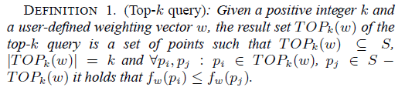
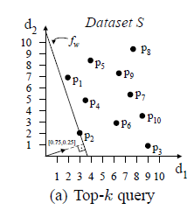
Top-k Queries
Query w = [0.75, 0.25]
Rank of point p = No. of points in half space defined by the perpendicular hyper-plane containing origin
P2 is top-1 object for given query

Slide 8
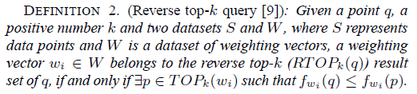
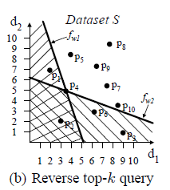
Reverse Top-k Queries
Two weight vectors w1 and w2
Reverse top-3 query is posed with query object p4
RTOP₃(p4) => w1 and not w2

Slide 9
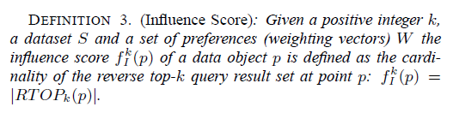
Problem Statement
Influence Score
Given a dataset S and set of weighting vectors W, the definition of influence score only requires setting a single value k that determines the scope of reverse top-k queries for identifying most influential data objects

Slide 10
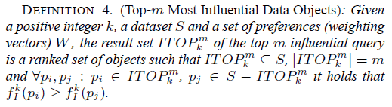
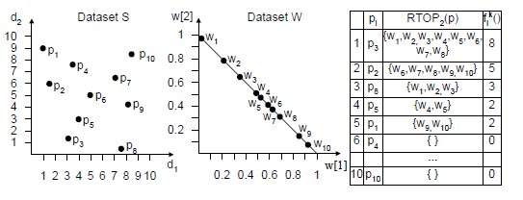
Top-m Most Influential Data Objects
Most Influential Object

Slide 11
Algorithm for Indentifying Most Influential Data Objects
We will study following three algorithms
Naive Method
Skyband-based algorithm
Branch-and-bound algorithm

Slide 12
Naive Method
Issues a reverse top-k query for each data object to find influence score f_{I}^{k}(p) and then rank the objects.
Not efficient in practice as it requires computing reverse top-k query for each database object.
Also processing of each reverse top-k query requires several top-k query evaluations.
More efficient algorithm using skyband set.

Slide 13
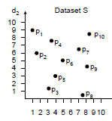
What is Skyline?
The Skyline of a set of objects (records) comprises all records that are not dominated by any other record.
A record x dominates another record y if x is as good as y in all attributes and strictly better in at least one attribute.
Domination examples:
p1 dominates p10 because 1<8 and 9=9
p2 dominates p4 because 2<3 and 6<7
p3 dominates p5 because 3<4 and 1<3
p8 dominates p9 because 7<8 and 1<4
(1,9)
(8,9)
(3,7)
(2,6)
(8,4)
(4,3)
The Skyline set: {p₁, p₂, p₃, p₈}
These objects are not dominated by any other object
(3,1)
(7,1)

Slide 14
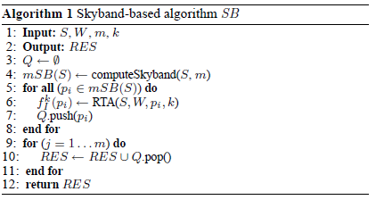
Skyband Based Algorithm
Priority Queue
Reverse Top-k Query
Queue sorted by influence score
Retrieve Top-m objects

Slide 15
Performance of Skyband Based Algorithm
For high values of m, size of skyband set increases resulting in large no. of reverse top-k queries.
SB is not incremental, it needs to process reverse top-k query for all objects in mSB(S) before reporting any result.
Cannot compute m+1 most influential data object without computing (m+1)SB(S)
Need for incremental algorithm without processing all the objects in skyband set.

Slide 16
Branch and Bound Algorithm(BB)
Computes upper bound for the influence score of candidate objects based on already processed objects.
Prioritize processing of promising objects and postpone objects that are not likely to be the next most influential objects. (minimizes reverse top-k evaluations)
BB returns influential objects incrementally when score of current object is higher than upper bound of all candidate objects.
BB employees result sharing to avoid costly re-computations and boost performance of influence score evaluations.

Slide 17
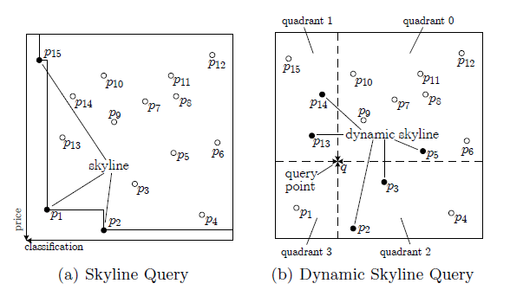
Upper Bound of Influence Scores
Dynamic Skyline set
Point p_{i} dynamically dominates p_{i}’ based on point q, if Ɐd_{j} ϵ D: |p_{i}[j]-q[j]|<=|p’_{i}[j]-q[j]| and on at least one dimension d_{j} ϵ D: |pi[j]-q[j]|<|p’_{i}[j]-q[j]|. The set of points that are not dominated based on q forms dynamic skyline set

Slide 18
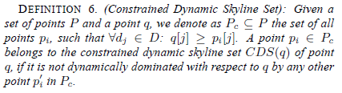
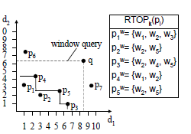
Constrained Dynamic Skyline Set
CDS(q): Applying dynamic skyline query on the objects enclosed in the window query defined by q and origin of data space
For P_{c} ={p1, p2,…p5} CDS(q)={p3, p4, p5}

Slide 19
Property for Upper Bound
Given a point q and a non-empty set of constrained dynamic skyline points of CDS(q)={p_{i}}, it holds that
RTOP_{k}(q) ⊆ ∩_{Ɐpi ϵ CDS(q)} RTOP_{k}(p_{i})
The upper bound U₁(q) of q’s influence score (f^{k}_{I}(q) <= U₁(q)
U₁(q) = | ∩_{Ɐpi ϵ CDS(q)} RTOP_{k}(p_{i})|
A point p ϵ P – CDS(q) can not refine the upper bound

Slide 20
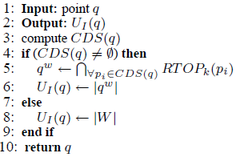
Algorithm for Upper Bound
computeBound()
CDS(q)={p3, p4, p5}
Upper Bound |q^{w}| = 1

Slide 21
BB Algorithm
Assumption
Dataset S: indexed by multidimensional indexing structure such as R-tree.
A multidimensional bounding rectangle (MBR) e_{i} in R-tree is represented by lower left corner l_{i} & upper right corner u_{i}
Influence of an MBR e_{i} is influence of lower left corner
f^{k}_{I}(e_{i}) = f^{k}_{I}(l_{i})

Slide 22
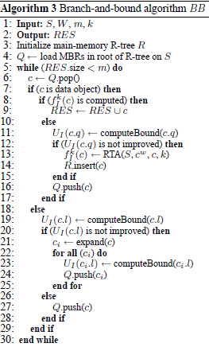
MBR is inserted in Q with influence score=|W|
Influence score is already computed
c is most influential object
Reverse top-k computation
To facilitate more accurate score for estimation
of other entries
c is a MBR

Slide 23
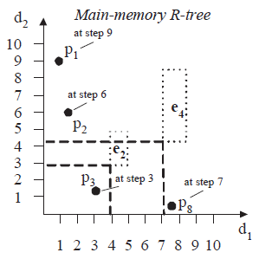
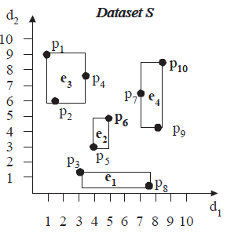
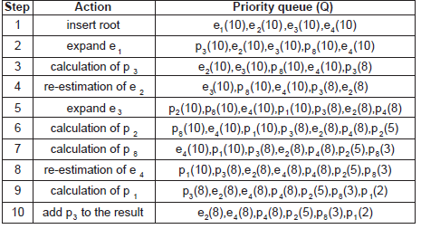
Contents of Priority
Queue

Slide 24
Analysis of BB algorithm
Correctness
BB algorithm always returns correct result set
Efficiency
BB minimizes the number of RTOP_{k} evaluations
Evaluates queries only if upper bound cannot be improved by any point in dataset

Slide 25
Influence Score Variants
Threshold-based influential objects
Retrieval of objects with influence score higher than a user specified threshold.
E.g. Product is considered important if result set of reverse top-k query includes 10% of all customers.
SB cannot support these queries while BB is easily adapted to such queries.

Slide 26

Influence Score Variants
Profit-aware influence score
Each customer(w_{i}) associated with profit pr_{i}
E.g. No. of orders or total amount of cost of orders
Influence score is defined as
SB and BB both support profit-aware influence queries.

Slide 27
Experimental Setup
SB, BB and Naive algorithms implemented in Java
3Ghz Dual Core AMD processor with 2GB RAM
R-tree with buffer size of 100 blocks with block size 4KB
Real and Synthetic datasets with uniform(UN), correlated(CO) and anti-correlated(AC) collections.
Two real datasets used
NBA dataset with 17265 5-dimensional tuples representing player’s performance per year.
HOUSE dataset with 127930 6-dimensional tuples representing percentage of an American family’s annual income spent on expenditures.
Metrics used are total execution time, No. of I/Os, No. of top-k and reverse top-k evaluations.

Slide 28
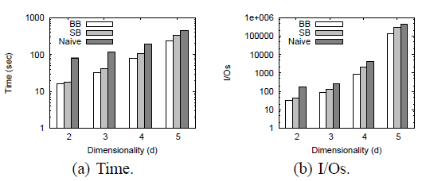
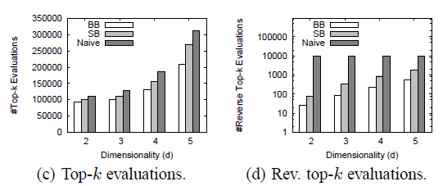
Experimental Evaluation
Comparative performance of all algorithms for UN dataset and varying dimensionality (d)

Slide 29
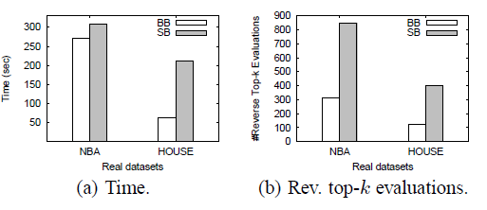
Experimental Evaluation
BB vs SB for real data
By varying dimensionality d, cardinality of S, W, k and m, it is observed that BB outperforms SB in all metrics.

Slide 30
Conclusion
Reverse top-k query returns set of customers that find product appealing i.e. top-k results.
Influence of product is cardinality of reverse top-k query result.
Two algorithms were presented
SB: Restricts candidate set of objects based on skyband set of data objects.
BB: Retrieve results incrementally with minimum no. of reverse top-k evaluations.
Variations of query for most influential objects

Slide 31
Questions?

