Slide 1
SODA: Generating SQL for Business Users
Lukas Blunschi
Claudio Jossen
Donald Kossmann
Magdalini Mori
Kurt Stockinger

Slide 2
Abstract
SODA - Search Over DAta warehouse
Enables search experience
Key idea – use graph pattern matching

Slide 3
Introduction
Problem with the modern data ware houses:
  becoming increasingly complex
  growing gap between the high-level (conceptual) view of business users and the low-level (physical) perspective of database administrators.
Thus to support a more agile usage of a data warehouse a search tool is required which automatically translates operators and business concepts into SQL queries.
Typical query asked by a business user could be:
  Show me all my wealthy customers who live in Zurich
  Who are my top ten customers in terms of revenue

Slide 4
Introduction…
SODA uses flexible way of making use of metadata that goes way beyond looking at key/foreign key relationships or lookups on column names and table names.
The metadata allows to bridge the gap between the low-level SQL implementation and the concepts typically used by business users.
SODA is generic and flexible by using patterns.

Slide 5
Contributions
How SODA can be used to generate SQL queries from a high-level query language
How patterns help to interpret and exploit a large variety of different kinds of metadata such as homonyms and synonyms
Results of the experiments using real-life data warehouse with hundreds of tables and thousands of attributes.

Slide 6
Running Example
An example of mini-bank with customers that buy and sell banking products (financial instruments)
Typical end user queries that we will analyse:
(1) Find all financial instruments of customers in Zurich.
(2) What is the total trading volume over the last months?
(3) What is the address of Sara Guttinger

Slide 7
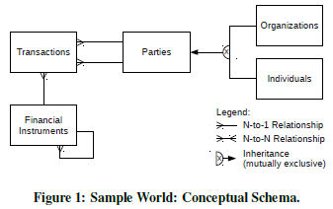
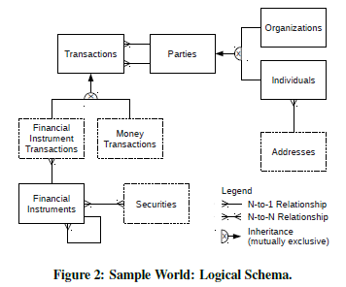
Example Schema

Slide 8
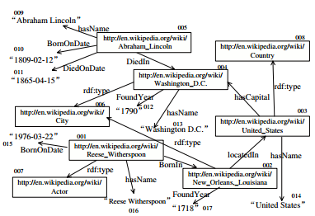
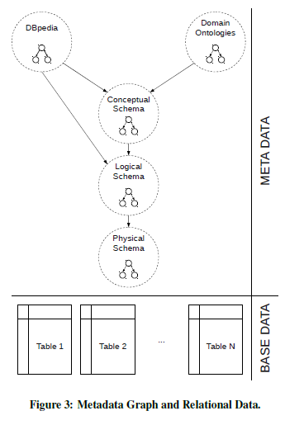
Extended metadata graph
RDF Graph
Metadata is stored in RDF Graph

Slide 9
Integrated Schema:
  To handle data from heterogeneous data sources
  Conceptual Schema
  Logical Schema
  Physical Schema
Domain Ontologies:
  Built for a data warehouse, used to classify data for a specific domain
  Ex: Classifying Instruments and Customers

Slide 10
DBPedia:
  Used to capture synonyms
  Parties Customer, Client, Political Organization
  Search on customers would result Parties as one option
Base Data:
  It is stored in relational databases
  It is connected to metadata by table and column names

Slide 11
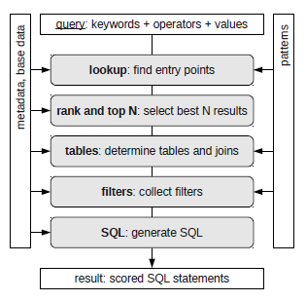
SODA Overview:

Slide 12
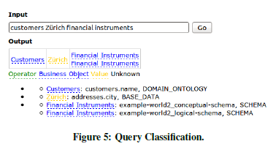
Step 1 – Lookup:
  Matches the keywords of the input query to sets of possible entry points.
  Output is the combinational product of all lookup terms, here 2 solutions are produced

Slide 13
Step 2 – Rank and top N:
  Assigns a score to every result and continues with the best N results
  Currently apply a simple heuristic which uses the location of the entry points in the metadata graph to assign a score to a result
  Keyword found in DBpedia gets a lower score than in the domain ontology
Step 3 –Tables:
  Identify tables and its relation between them
  Recursively follow all the outgoing edges in the metadata graph and test set of graph patterns to find tables and joins.

Slide 14
Step 4 – Filters:
  Filters can be found by parsing the input query or looking for filter condition while traversing the metadata graph
  Ex: connect “Zurich” to the city column within the addresses table
Step 5 – SQL:
  Combine information collected into a reasonable, executable SQL statement.

Slide 15
Generating SQL from patterns
Metadata graph patterns provide a flexible way to adapt the SODA algorithm to different data warehouses.
SODA uses patterns in 2 situations:
  Step 1 – Lookup
    Input patterns instead of natural language processing
  Step 3 – Tables and Step 4 – Filters
    SODA tests for metadata graph pattern matches while traversing the metadata graph.
    A matching pattern tells us when we arrived at a special node which could be, for instance, a table, a foreign key or an attribute with a filter condition.

Slide 16
Credit Suisse Patterns
Metadata Graph Patterns
  Each entity triple (<Subject, Property, Object>) either connects 2 nodes or a node and a text label.
  A node can be URI or variable
  In our discussion, node will be represented as italic and text label as t:
  Consider ‘x’ as current node and match each tuple in the pattern to the graph accordingly.

Slide 17


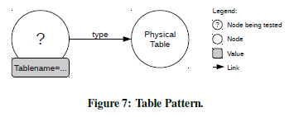
  Basic Patterns:
    Describe how tables, columns are represented in metadata graph.
    Table Pattern:
    Column Pattern:

Slide 18

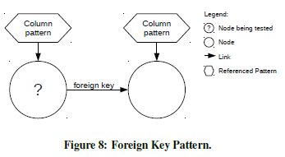
  More Complex Patterns:
    The simplest implementation of a join relationship is a direct edge between a foreign key attribute and a primary key attribute.
    Foreign Key Pattern:
      The term “matches-column” references the Column pattern

Slide 19
Application in SODA:
  Traverse the graph starting from entry points of each given query and recursively follow all outgoing edges
  We need to find out relations ship between tables(i.e., joins) : again traverse the metadata graph starting from the entry points. Instead of testing the Table, Column patterns as before, we now try to match the Foreign Key pattern

Slide 20
Input Patterns:
  Used in Step 1 – Lookup to identify meaning of query terms
  Keywords:
    look for longest word combinations.
    We first try to match all the words in the input against our classification index. If we find a match, we are done. Otherwise, we recursively try smaller word combination
    Ex: Private customers Switzerland
  Comparison Operators:
    Each comparison operator is a small binary pattern where the operator is in the middle and its operands are to the left and to the right
    >, >=, =, <=, < and like.
  Aggregation Operators:
    Currently sum and count is supported.

Slide 21
Query Language
query language for processing keywords and comparison operators can be formalized as:
  <search keywords> [ [AND|OR] <search keywords> |
  <comparison operator> <search keyword> ]
In order to express time-based range queries, the following syntax needs to be applied:
  <search keywords> [ [AND | OR] <search keywords> |
  <comparison operator> date(YYYY-MM-DD) ]
The characters Y, M, D refer to year, month and date. The formal specification for aggregate queries is as follows:
  <aggregation operator> (<aggregation attribute>)
  [<search keywords>]
  [group by (<group-by attribute1, ,attributeN>)]

Slide 22
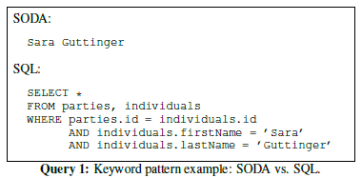
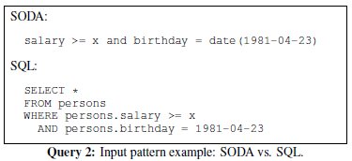
Examples
Examples with Filters

Slide 23
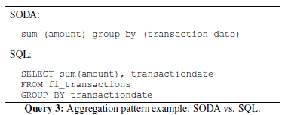
Examples with aggregation:
  The above query is ambiguous
  Advantage of SODA is that it automatically identifies join predicates.

Slide 24
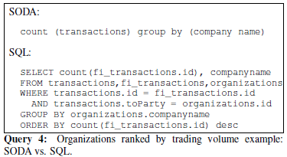

Slide 25
Experimental Results
Experiments are reported on Credit Suisse’s central data warehouse, which is most complex data warehouses in the financial industry
SODA reveals ambiguities of the query keywords
SODA also supports range queries

Slide 26
Experimental Setup:
Credit Suisse data warehouse consists of three main layers:
  Integration layer:
    take the data from the heterogeneous data sources and integrate them into a carefully modelled enterprise data warehouse with bi-temporal historization
    the data warehouse is a temporal database system with time dimensions covering the validity time and the system time

Slide 27
  Enrichment layer:
    used for storing so-called reusable measures and dimensions that are calculated based on previously integrated data
  Analysis layer:
    consists of several business specific physical data marts fed either from the integration layer or the enrichment layer.
    Ex: data marts for risk calculations, legal and compliance assessments or profitability calculations

Slide 28
Results:
  A mix of queries are taken to cover all corner cases and queries from astrophysics
  SODA produces SQL queries with precision of 1.0 but recall is either 0.2 or 1.0
  Precision 1.0 => SQL statement produced by SODA returns only tuples that also appear in Standard result.
  Recall 1.0 => SQL statement produced by SODA returns all tuples that also appear in Standard result.

Slide 29
THANK YOU

