Slide 1
(Self) Balanced Search Trees
AVL
Red-black
2-4
splay

Slide 2
BSTs are potentially good
We can perform
  Search
  Minimum, maximum
  Predecessor, successor
  Insert
  Delete
In O(h)-time, where h is the height of the tree
An n-node binary tree must have height Ω(log n)
  Why?

Slide 3
Intuitively, how to keep a tree’s height small?
For every internal node
  Number of nodes on the left should be roughly the same as the number of nodes on the right
AVL trees maintain this property by
  Keeping the heights of left and the right subtrees roughly equal
Red Black trees maintains this property by
  Keeping all the leaves to be of roughly the same depth
AVL is more rigid, faster search
Red-Black has faster insert/delete

Slide 4
AVL Trees
Named after
- ГеÓргий Макси́мович АдельсÓн-Вéльский
and
Евгéний Михáйлович Лáндис
1962
Idea: rebalance the tree after an insert/delete

Slide 5
AVL Trees
Balanced node:
  A node v is “balanced” if its left subtree and right subtree have heights differ by at most 1
An AVL tree is
  a BST in which every internal node is balanced.
Theorem: an AVL tree on n nodes has O(log n)-height

Slide 6
Proof of Theorem
Let h(n) be the max height of an AVL-tree with n nodes
Want to show (roughly) h(n) ≤ 10 log(n)
  Where 10 could be some other constant
The following two statements are equivalent
  An AVL-tree can’t have large height h (relative to n)
  An AVL-tree can’t have two few nodes n (relative to h)
Let n(h) be the minimum # of nodes of an AVL-tree with height h
Want to show (roughly) n(h) ≥ 2^{h/10}

Slide 7
Recurrence for n(h)
For convenience, heights measured to the NULLs

Slide 8
Solving for n(h)

Slide 9
Old friend Fibonacci

Slide 10
But how do we maintain AVL property?
After an insert
  One subtree might be taller than the other by 2
  Potentially affect the balance of all nodes up to the root
  Rebalance
After a delete
  One subtree might be shorter than the other by 2
  Potentially affect the balance of all nodes up to the root
  Rebalance

Slide 11
Insert
50
90
unbalanced
30
110
10
70
100
150
8
40
80
105
130
160
35
60
120
140

Slide 12
Balance
Let’s define the “balance” of a node
  balance of v = height(v->left) – height(v->right)
We want v’s balance to be in {-1, 0, 1}
  balance = -1 means v is “right heavy”
  balance = 1 means v is “left heavy”
After inserting a new node
  Let a be the first node on the path back to the root that’s not balanced, then a’s new balance is -2 or 2

Slide 13
Example: RR case
0
-2
a
b
b
-1
Single Rotation
0
a
T₁
T₃
T₁
T₂
T₂
T₃
New node

Slide 14
Example: RL case
0
b
-2
a
0
+1
c
Double Rotation
a
c
T₁
b
T₂
T₄
T₄
T₁
T₃
T₂
T₃
New node

Slide 15
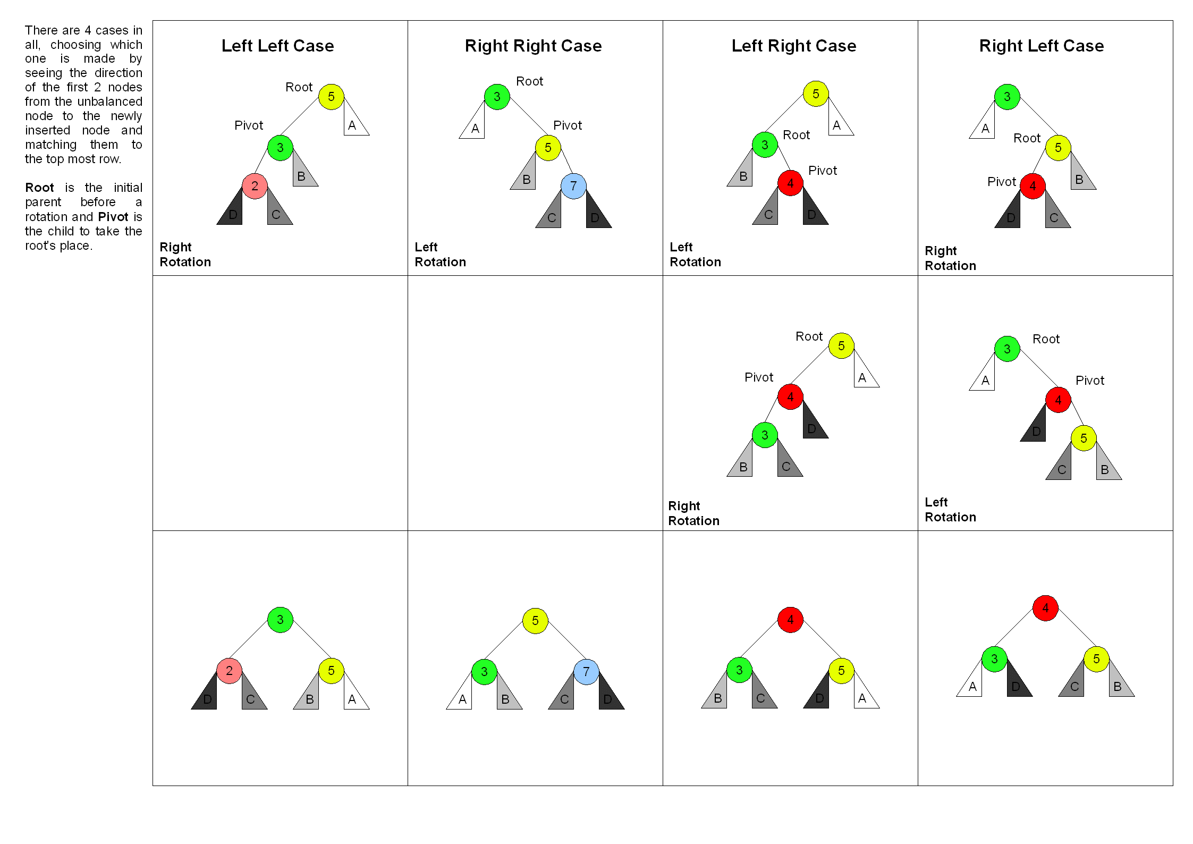
Picture from Wikipedia

Slide 16
Delete
Same as deleting a node from a BST
Nodes on path to root might become unbalanced
Fix them one by one using exactly the same strategy
Insert & delete run in time O(log n)

Slide 17
Theorems
Insertion:
  After fixing one node (with a single/double rotation) the tree becomes balanced (i.e. AVL again) – why?
Deletion:
  Fixing one node does not necessarily balance the tree
  Need more fixing up to the root
You should think of an example AVL-tree for which
Ω(log n) fixes are necessary after a deletion!

Slide 18
Red-Black Trees
Rudolf Bayer (1972)
Leonidas j. guibas and robert sedgewick (1978)
Now we understand the banner on the course’ blog
Std::map and std::set are based on red-black trees

Slide 19
Idea
In a perfectly balanced tree
  Every path from the root to the leaves have the same length
  In fact, every path from any given node to its descendent leaves have the same length
This property is way too strong to be feasible
We will relax it
  Color nodes black or red
  Black nodes form the “skeleton” of a perfectly balanced tree
  Red nodes provide some slack
  Can’t cut the tree too much slack or else it will become unbalanced

Slide 20
Red-Black Trees
Are bi-color BSTs with the following properties
  Leaves are the NULL nodes (for convenience)
  Every node is either RED or BLACK
  Root and leaves are black
  Both children of a RED node are BLACK
  (Equivalently, every RED node has a BLACK parent)
  This way, red nodes will be sparsely populated in the tree
  Every path from an internal node to any descendent leaf has the same number of black nodes
Number of black nodes from v down to a leaf (not counting v) is called black-height(v)

Slide 21
30
Black height = 3
Black height = 2
15
40
10
24
35
50
3
12
17
26
32
37
45
55
14
36
39

Slide 22
Key Results
In a RB Tree:
Its height is O(log n)
Insertion and deletion take O(log n)-time
Insertion and deletion require only O(1) rotations

Slide 23
Height of an RB-tree, Connection to 2-4
Move each red node next to its black parent
Get a 2-4 tree with height h’
  2-4 tree: every internal node has 2, 3, or 4 children
  h’ is exactly the black height of the root
We will show that
  h = height(RB-tree) ≤ 2 log₂(n+1)

Slide 24
2-3-4 Tree from a Red-Black Tree
h’ = black-height(root)
30
40
10
15
24
35
37
50
3
12
14
17
26
32
36
39
45
55

Slide 25
Insertion
Insert as in normal BST
Call new node z
Color it red
Fix the potential “double red” problem

Slide 26
Lucky case: New Node’s Parent is Black
30
15
40
10
24
35
50
3
12
17
26
32
37
45
55
z
14
36
39
Great, nothing to do!

Slide 27
Unlucky case: New Node’s Parent is Red
10
3
12
Double red problem!
z
14

Slide 28
Case 1: z’s Uncle is Red
New z
b
b
Recolor & move up
a
c
a
c
z
T₁
T₂
T₁
T₂
d
d
T₃
T₃
T₄
T₅
T₄
T₅

Slide 29
Case 2a: z’s Uncle is Black
b
c
Single rotation
a
c
b
d
z
a
T₃
T₄
T₅
T₁
T₂
d
T₃
T₁
T₂
T₄
T₅

Slide 30
Case 2b: z’s Parent is Red & Uncle is Black
b
c
Double rotation
a
d
b
d
z
a
T₃
T₄
T₅
T₁
T₂
c
T₅
T₁
T₂
T₃
T₄

Slide 31
Deletion
Delete as in normal BST
Call the child of the spliced node z
If we spliced a red node, lucky! Nothing else to do
Else, fix the potential “double black” problem

Slide 32
Lucky Case 0a: splice a red node
30
15
40
10
24
35
50
3
12
17
26
32
37
45
55
14
36
39
Great, nothing to do!

Slide 33
Lucky Case 0b: splice a red node
30
16
15
40
10
24
35
50
3
12
17
26
32
37
45
55
16
36
39
Great, nothing
else to do!

Slide 34
Unlucky → Double Black Problem
30
15
40
10
24
35
50
3
12
17
26
32
37
45
55
z
14
36
39

Slide 35
Solving the double black problem
  z’s sibling can’t be a leaf. Why?
Case 1: z’s sibling is black with a red child
Case 2: z’s sibling is black with no red child
Case 3: z’s sibling is red

Slide 36
Case 1a: z’s sibling is black with a red child
c
b
z
Single rotation
b
d
a
c
d
a
T₃
T₁
T₂
d
T₄
T₅
T₃
T₁
T₂
T₄
T₅

Slide 37
Case 1b: z’s sibling is black with a red child
c
b
z
Double rotation
a
d
a
c
d
T₁
b
T₁
T₂
d
T₄
T₅
T₃
T₂
T₃
T₄
T₅

Slide 38
Case 2a: z’s sibling is black with 2 black children
b
b
z
Recolor
a
c
a
c
d
T₂
T₁
T₂
T₁
T₃
T₄
T₃
T₄

Slide 39
Case 2b: z’s sibling is black with 2 black children
New z
b
b
d
z
Recolor & move up
a
a
c
c
d
T₂
T₁
T₂
T₁
T₃
T₄
T₃
T₄

Slide 40
Case 3: z’s sibling is red
b
a
z
Rotate
a
c
b
d
T₁
New z with a
black sibling
T₁
T₂
T₂
c
T₃
T₄
T₃
T₄

Slide 41
(2,4)-Trees
Also called 2-3-4-trees
A type of B-Trees
A type of Multi-way search trees
Invented by rudolf bayer (1972)
Red-black trees can be viewed as an implementation of (2,4)-trees and vice versa, they are “isomorphic”

Slide 42
Multi-Way Search Trees
d-node
K₁ ≤ K₂ ≤ … ≤ K_{d-1}
v₁
v₂
v_{d-1}
v_{d}
Keys ≤ K₁
K1 ≤ Keys ≤ K₂
K_{d-2} ≤ Keys ≤ K_{d-1}
K_{d-1} ≤ Keys

Slide 43
Multi-Way Search Trees
4-node
30 | 60 | 81
3-node
2-node
3 | 10
32 | 45 | 55
95
1 | 2
8
31
38
57
88
97 | 99

Slide 44
Searching in a Multiway Search Tree
47
57
30 | 60 | 81
3 | 10
32 | 45 | 55
95
1 | 2
8
31
38
57
88
97 | 99
Minimum, maximum, predecessor, successor?

Slide 45
(2, 4)-Trees
A multi-way search tree which maintain
Size Property
  Each internal node has 2, 3, or 4 children
Depth property
  All leaves (NULL nodes) have the same depth

Slide 46
(2,4)-Trees
30 | 60 | 81
3 | 10
32 | 45 | 55
70 | 78
95
1 | 2
8
11 | 15
31
38
47 | 50
57
65
72 | 77
80
88
97 | 99

Slide 47
Properties of (2, 4)-trees
On n keys
Number of leaves (NULL) is n+1
If the height of the tree is h, then
2^{h} ≤ n+1 ≤ 4^{h} ➔ h ≤ log (n+1)
Search, min, max, predecessor, successor all take logarithmic time
How about updates?

Slide 48
Insertion, the Nice Case
48
30 | 60 | 81
3 | 10
32 | 45
70 | 78
95
8
31
38
47 | 48 | 50
1 | 2
11 | 15
47 | 50
65
72 | 77
80
88
97 | 99

Slide 49
Insertion, Overflow Case → Split
25 | 101
Propagate further up if still overflow
30 | 45 | 60 | 81
25 | 45 | 101
5 children: overflow
30
60 | 81

Slide 50
Insertion, Overflow at the Root
This is the new root
45
root
30 | 45 | 60 | 81
30
60 | 81

Slide 51
Deletion, Nice Case #1
30 | 60 | 81
3 | 10
32 | 45
70 | 78
95
47 | 50
1 | 2
8
11 | 15
31
38
47 | 48 | 50
65
72 | 77
80
88
97 | 99
Delete parent of a leaf and no underflow

Slide 52
Deletion, Nice Case #2
30 | 60 | 81
3 | 10
32 | 45
70 | 78
95
8
31
38
47 | 50
62
1 | 2
11 | 15
62 | 65
72 | 77
80
88
97 | 99
Successor has no underflow

Slide 53
Deletion ➔ Underflow ➔ Transfer
25 | 101
60 | 101
transfer
15
60 | 81
25
81
Adjacent sibling is a
3-node or a 4-node
25 | 101
14 | 101
transfer
10 | 14
52
10
25

Slide 54
Deletion ➔ Underflow ➔ Fusion
25 | 101
25 | 90
15
81
15
81
95
One 2-node sibling
Two 2-node siblings
fusion
101
90
25
81
15
25
95

Slide 55
Fusion Propagation Might be Necessary
25
25
To be deleted
15
81
25
81

Slide 56
Splay Trees
Invented by
Daniel Dominic Sleator, Robert Endre Tarjan
1985
- Self balanced
Does not require additional data fields
(color, balance)
Any operation takes o(log n) amortized time

Slide 57
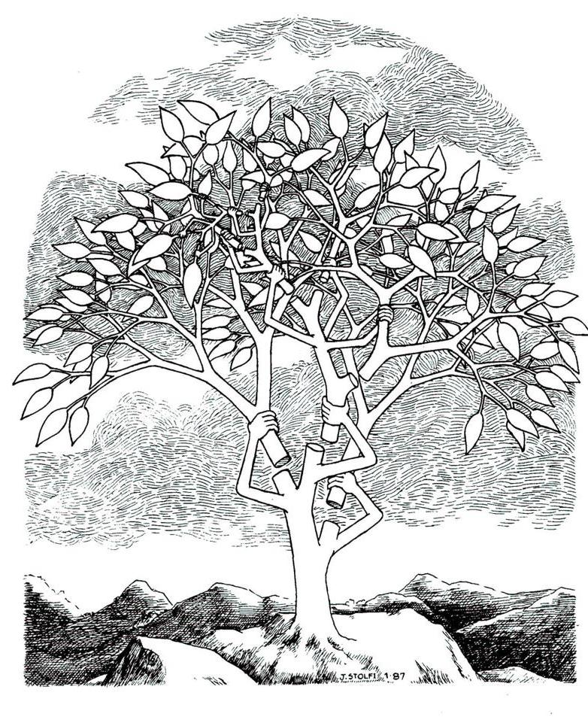

Slide 58
Differences with Blanced Trees
In RB, AVL:
  Extra space per node (color, height)
    Well, for RB there’s a way to avoid the color, but a little tricky
  Logic is slightly complicated to implement
In a splay tree
  No extra space per node
  Insert/delete are done exactly like it BST + one “splaying” step
  All operations are still O(log n)-time … in amortized term.
  One additional property: frequently accessed nodes are close to the root!

Slide 59
Splay operation
After each operation (insert, delete, search) a node c is splayed
Result of splay(c) is that c ends up in the root!
  Splay(c) consists of O(height) # of steps
  Each step is one of: zig-zig, zig-zag, or zig
We’ll talk about which node is splayed later

Slide 60
Zig-zig (depth(c) -= 2)
y
c
x
x
T₁
Zig-Zig
T₄
c
C has a grandparent
y
T₂
T₃
T₃
T₄
T₁
T₂
There’s also the symmetric case when y is on the left
and c is the left child of y

Slide 61
Zig-zag (depth(c) -= 2)
y
c
x
Zig-Zag
y
x
T₁
c
C has a grandparent
T₂
T₄
T₄
T₁
T₃
T₂
T₃
There’s also the symmetric case when y is on the left
and c is the right child of y

Slide 62
Zig (depth(c) -= 1)
y
c
c
y
x
T₁
Zig
x
C has no grandparent
T₂
T₃
T₄
T₂
T₁
T₃
T₄
There’s also the symmetric case when c & y are on the left
note that y could be NULL

Slide 63
Which node to splay?
Search:
  Successful: splay the found node
  Unsuccessful: splay the node just before falling off to NULL
Insert:
  Splay the newly inserted node
Delete:
  Splay the child of the spliced node
After splaying c, it ends up in the root!
  http://webdiis.unizar.es/asignaturas/EDA/AVLTree/avltree.html

Slide 64
44
Splay(78)
50
17
88
32
65
97
zig-zag
28
54
82
z
29
76
y
80
x
78

Slide 65
44
Splay(78)
50
17
88
32
65
97
zig-zag
28
54
82
x
29
78
z
80
y
76

Slide 66
44
Splay(78)
50
17
88
32
z
65
97
zig-zag
y
28
54
82
29
78
x
76
80

Slide 67
44
Splay(78)
50
17
88
32
x
78
97
zig-zag
28
z
65
y
82
29
54
76
80

Slide 68
44
z
Splay(78)
50
17
88
y
32
x
78
97
zig-zag
28
65
82
29
54
76
80

Slide 69
44
x
Splay(78)
78
17
z
88
y
50
82
32
97
zig-zag
65
28
80
54
76
29

Slide 70
y
44
x
Splay(78)
78
17
88
w
50
82
32
97
zig
65
28
80
54
76
29

Slide 71
78
x
y
44
Splay(78)
17
88
w
50
82
32
97
zig
65
28
80
54
76
29

Slide 72
Main Theorem
The amortized cost of each operation is O(log n)
In particular, for a sequence of m searches, inserts, deletes on a splay tree, the total time it takes is
O(m + Σ_{i=1..m} lg n_{i})
Where n_{i} = # of nodes in the tree at i’th operation

Slide 73
So Many Data Structures
What to adopt?
Need experiments

Slide 74
Here’s one set of experiments
Ben Pfaff, SIGMETRICS 2004
  http://www.stanford.edu/~blp/papers/libavl.pdf

Slide 75
Among many other conclusions, here are some
RB trees are preferred when
  When input is expected to be randomly ordered with occasional runs of sorted order
AVL trees are preferred when
  Insertions often occur in sorted order
  Later random access
Splay trees are preferred when
  Insertions often occur in sorted order
  Later sequential or clustered access

