Slide 1
Basic Searching and Sorting
Linear and binary search
Solving Recurrence with a tree
Four sorting algorithms
Function template
Callback functions

Slide 2
Agenda
Linear and binary search
Insertion sort
Selection sort
Merge sort
Solving recurrences using a recurrence tree
Quick sort and randomized quick sort
Experimenting with the 5 sorting algorithms

Slide 3
Linear and binary search
Search for a key in a given vector/array

Slide 4
Linear search
bool linear_search(vector<int> vec, int key) {
for (size_t i=0; i<vec.size(); i++) {
if (key == vec[i]) return true;
}
return false;
}

Slide 5
Binary search
bool binary_search(vector<int> sorted_vec, int key, size_t left, size_t right) {
while (left <= right) {
// the following will cause problems if you do
// mid = (left+right)/2, due to potential integer overflow
size_t mid = left + (right - left)/2;
if (key > sorted_vec[mid])
left = mid+1;
else if (key < sorted_vec[mid])
right = mid-1;
else
return true;
}
return false;
}

Slide 6
Sorting algorithms
Insertion sort
Selection sort
Merge sort
Quick sort
http://www.sorting-algorithms.com/

Slide 7
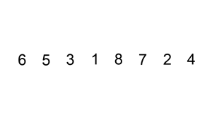

Insertion sort

Slide 8
Insertion sort
void insertion_sort(vector<int> &vec) {
int temp, j;
for (int i=1; i<vec.size(); i++) {
temp = vec[i];
j = i-1;
while (j >= 0 && vec[j] > temp) {
vec[j+1] = vec[j];
j--;
}
vec[j+1] = temp;
}
}

Slide 9
Properties
Worst case run time is
  Worst case input: inversedly sorted vector
Sorting is in-place, i.e. O(1)-extra storage needed
Number of comparisons in the worst case
Number of item moves is also in at worst
It is a stable sort algorithm

Slide 10
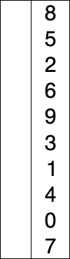
Selection sort
void selection_sort(vector<int> &vec) {
int i, j, k;
for (i=0; i<vec.size()-1; i++) {
j=i;
for (k=i+1; k<vec.size(); k++)
if (vec[k] < vec[i]) j=k;
if (j!=i) swap(vec[i], vec[j]);
}
}

Slide 11
Properties
Number of comparisons
  Even when the input is already sorted
Number of data movements is always
  Important for some applications (relational database)
We do not always have to move data!
  Sort pointers to data

Slide 12
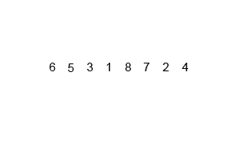

Merge sort

Slide 13
Merge sort
void merge_sort(vector<int> &vec) {
size_t n = vec.size();
if (n <= 1) return;
vector<int> left(vec.begin(), vec.begin()+n/2);
vector<int> right(vec.begin()+n/2, vec.end());
merge_sort(left);
merge_sort(right);
merge(vec, left, right);
}

Slide 14
The merge procedure
void merge(vector<int> &target,
const vector<int> &left,
const vector<int> &right)
{
size_t i=0, j=0, k=0;
while (i < left.size() && j < right.size()) {
if (left[i] < right[j])
target[k++] = left[i++];
else
target[k++] = right[j++];
}
while (i < left.size()) target[k++] = left[i++];
while (j < right.size()) target[k++] = right[j++];
}

Slide 15
Solving recurrences with recurrence tree

Slide 16
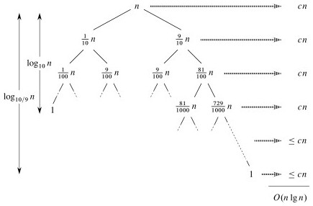
Another example

Slide 17
Properties
Worst case run time is optimal among comparison-based sorting algorithms
Space complexity
  Big problem!
Can be made in-place, but too complex
comparisons and item moves
Is stable

Slide 18
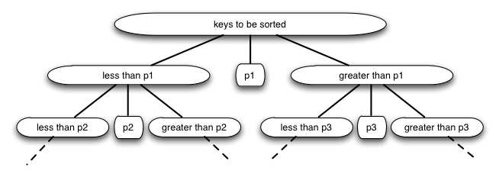
Quick sort

Slide 19
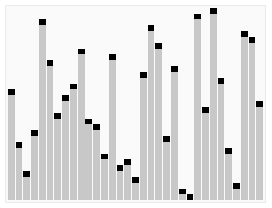

Quick sort

Slide 20
Quick sort code (slightly different from anim)
void qs_with_range(vector<int> &vec, int p, int q) {
if (p >= q) return;
// partition
int r=p-1;
for (int j=p; j<q; j++)
if (vec[j] < vec[q])
swap(vec[++r], vec[j]);
swap(vec[++r], vec[q]);
// sort the left & the right parts
qs_with_range(vec, p, r-1);
qs_with_range(vec, r+1, q);
}

Slide 21
Properties
Worst-case run time
  Which sequence of pivots lead to this?
On “average” should work well
We can make it more likely to work well by randomizing the pivot!!!
  Las Vegas algorithm

Slide 22
Randomized Quick sort
void rqs_with_range(vector<int> &vec, int p, int q) {
if (p >= q) return;
// pick a random pivot
int m = rand() % (q-p+1);
swap(vec[q], vec[p+m]);
// partition
int r=p-1;
for (int j=p; j<q; j++)
if (vec[j] < vec[q])
swap(vec[++r], vec[j]);
swap(vec[++r], vec[q]);
// sort the left & the right parts
rqs_with_range(vec, p, r-1);
rqs_with_range(vec, r+1, q);
}

Slide 23
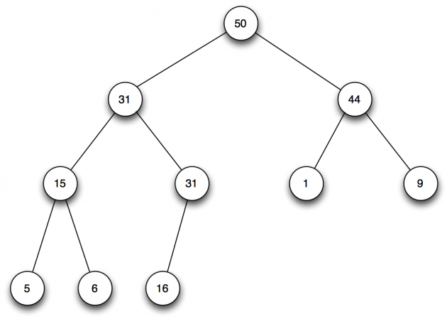
Max Heap

Slide 24
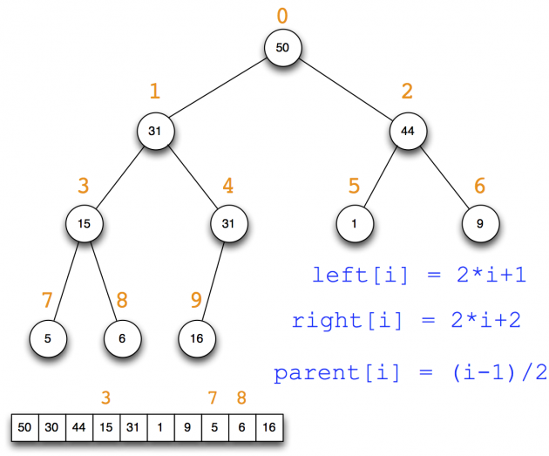
Max Heap as an Array

Slide 25
Heap sort
Heapify: turn a vector/array into a heap
Sink(i, n, array): make sub-tree rooted at i a heap
  Assumes left & right sub-trees are already max heap
  Sink node i down to the right level

Slide 26
Experiments with sorting
Random input
Sorted input
Inversedly sorted input

Slide 28
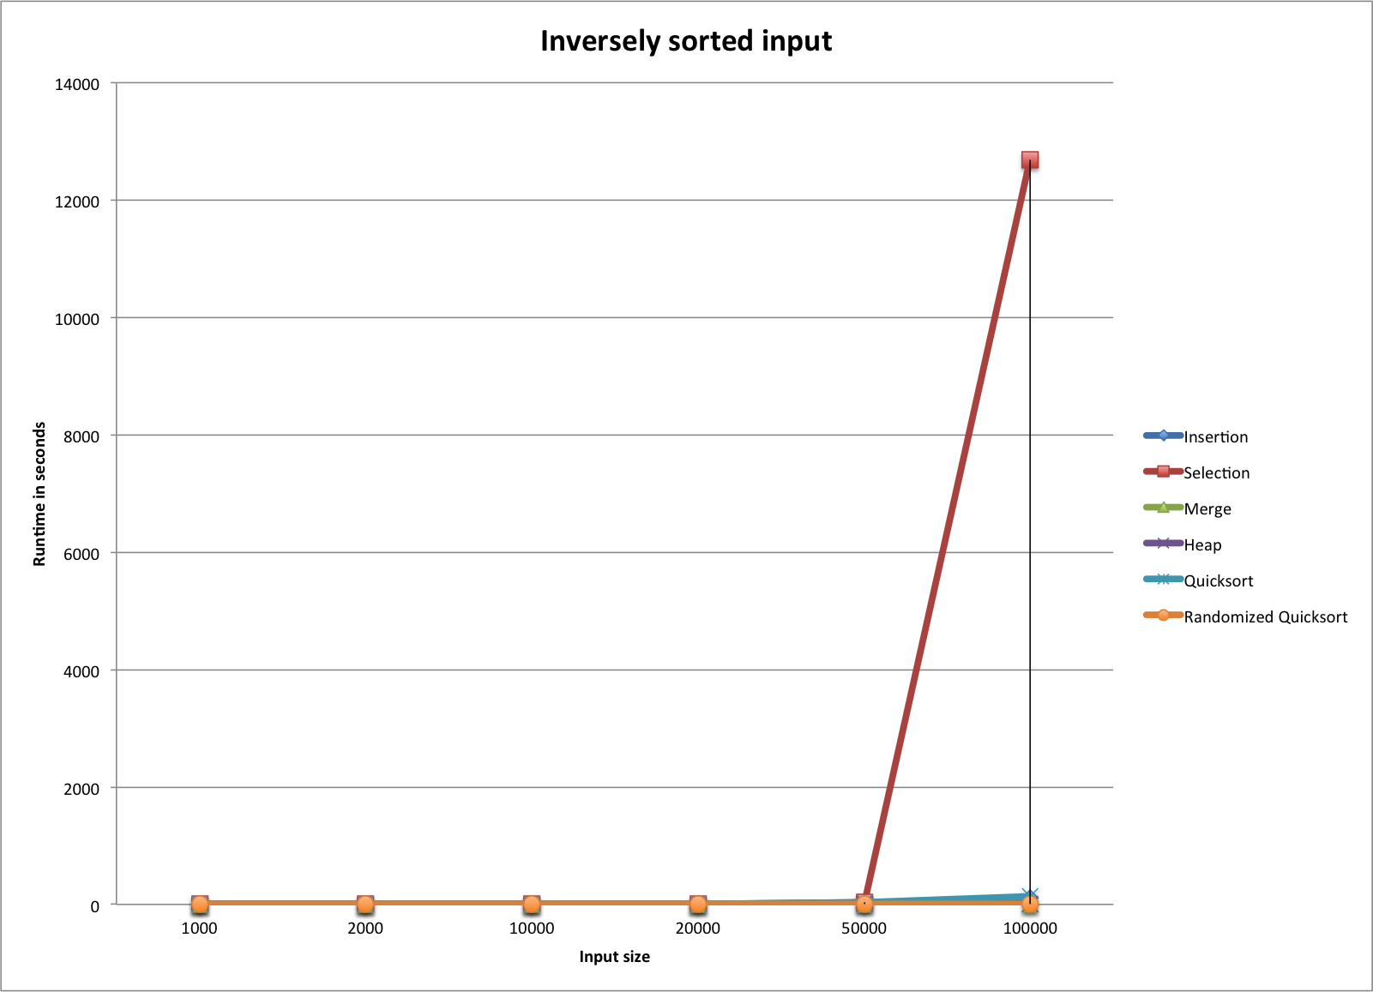

Slide 32
Generic sorting routines
Function templates
Call back functions

Slide 33
Function templates
template <typename Item_Type>
void insertion_sort(std::vector<Item_Type> &vec) {
Item_Type temp, j;
for (int i=1; i<vec.size(); i++) {
temp = vec[i];
j = i-1;
// assumes '>' with Item_Type is meaningful
while (j >= 0 && vec[j] > temp) {
vec[j+1] = vec[j];
j--;
}
vec[j+1] = temp;
}
}

Slide 34
Problems
With the above templates
  Sorting doubles, long, etc. are OK
  Since <, >, == are built-in with them
Can’t sort strings (say, sort by last name)
Can’t sort in some other order (say, reverse order)

Slide 35
Callback functions
template <typename Item_Type>
void insertion_sort(std::vector<Item_Type> &vec,
int (*cmp)(Item_Type, Item_Type))
{
Item_Type temp;
int j;
for (int i=1; i<vec.size(); i++) {
temp = vec[i];
j = i-1;
while (j >= 0 && cmp(vec[j],temp) > 0) {
vec[j+1] = vec[j];
j--;
}
vec[j+1] = temp;
}
}

Slide 36
Problems, Still
Users always have to specify a callback function, even for primitive types

Slide 37
Solution: default function
template <typename Item_Type>
void insertion_sort(
std::vector<Item_Type> &vec,
int (*cmp)(Item_Type, Item_Type) = default_cmp)
{
Item_Type temp;
int j;
for (int i=1; i<vec.size(); i++) {
temp = vec[i];
j = i-1;
// uses 'cmp' to compare instead of '>'
while (j >= 0 && cmp(vec[j],temp) > 0) {
vec[j+1] = vec[j];
j--;
}
vec[j+1] = temp;
}
}

