Slide 1
CSE 489/589 Modern Networking Concepts
Lu Su
Department of Computer Science and Engineering
State University of New York at Buffalo
http://www.cse.buffalo.edu/~lusu/

Slide 2
Today’s Agenda
A brief overview of the course
Basic Information
Prerequisites
Grading Policies
Administrative aspects

Slide 3
Course format
Lectures
Pre-recorded videos.
Accessible on Ublearns.
Uploaded on Mo We Fr.
Recitations
Only for undergraduates taking CSE 489.
Online live.
Recitation Session 1: Wednesdays 11:30am – 12:20pm, led by Michael Frank
Recitation Session 2: Fridays 11:30am – 12:20pm, led by Matthew Wiewiorski

Slide 4
Course Staff: Instructor
Instructor: Lu Su
Associate Professor, Computer Science and Engineering
PhD in Computer Science, December 2013, UIUC
Research interests: Wireless Networks, Mobile Computing, Internet of Things, Cyber-Physical System
Office: 321 Davis Hall
Online Office hours: Friday 3:00-5:00 PM, or by appointment (use email)
Zoom room: https://buffalo.zoom.us/my/lusuzoom
Email: lusu@buffalo.edu
Website: www.cse.buffalo.edu/~lusu/

Slide 5
Course Staff: TA and Friends
Shiyang Wang (Grad TA)
Email: shiyangw@buffalo.edu
Office hours: TBD
Moinak Ghoshal (Grad TA)
Email: moinakgh@buffalo.edu
Office hours: TBD
Zhe Zhang (Friend)
Email: zzhang64@buffalo.edu
Office hours: TBD
Michael Frank (Under TA)
Email: mafrank@buffalo.edu
Office hours: TBD
Matthew Wiewiorski (Under TA)
Email: mwiewior@buffalo.edu
Office hours: TBD
The office hours will be held online using Zoom

Slide 6

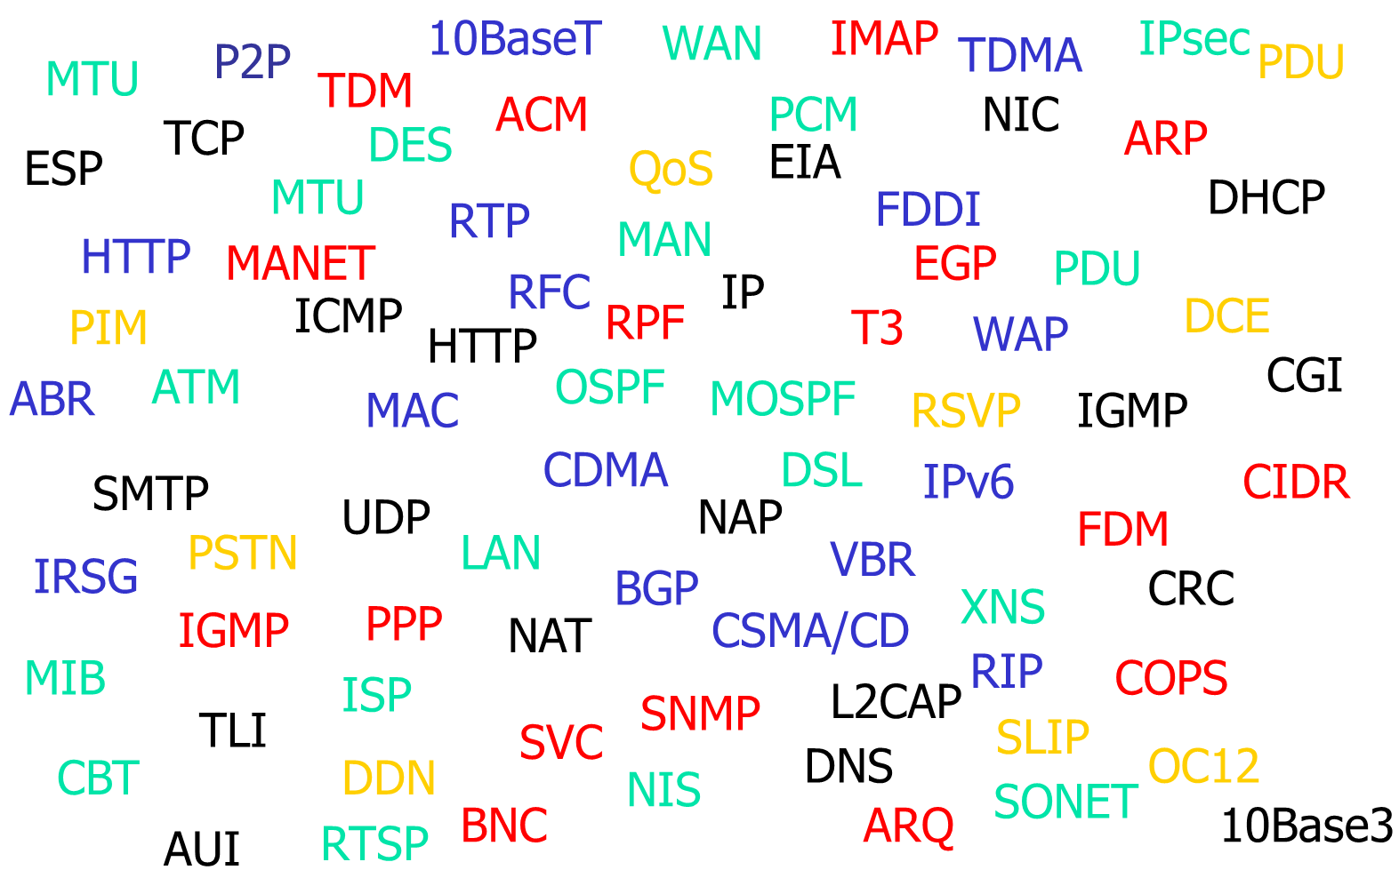
What is the course about?

Slide 7









What is the course about?

Slide 8

What is the course about?

Slide 9
What you’d achieve from this course
Learn the fundamentals of Internet and general computer networking concepts
The technologies that make networking possible.
Software architectures integrating the technologies to build a computer network, the Internet in particular.
Network programming.
Shortcomings and challenges of current Internet architecture (technologically, politically).
Have fun!

Slide 10
What you will not learn from this course
A lot!!!
Why?
There are many things I don’t know
The field is enormous
Technologies evolve super-fast

Slide 11
Prerequisites
Elementary calculus and probability
Elementary computer architecture, operating system, data structures and algorithms
Basic Communication Theory (helpful)
C / C++ programming in Unix/Linux
No other programming language will be allowed!
No other OS will be allowed!

Slide 12


Course Material
Textbook
James F. F. Kurose and Keith W. Ross, "Computer Networking: A Top-Down Approach", 7th edition.
Recommended reference
Andrew S. Tanenbaum and David J. Wetherall, "Computer Networks“,
W. Richard Stevens, "UNIX Network Programming : Networking APIs : Sockets and XTI : Volume 1, Second Edition", Prentice Hall.
Other references (including slides)
Course website
Piazza

Slide 13
Important URLs
Course Website (announcements, assignments, projects, notes, readings)
https://www.cse.buffalo.edu/~lusu/cse4589/
Piazza (questions, discussions)
piazza.com/buffalo/fall2020/cse489589/home
Make sure you receive email notifications for every new post/comment
Post in the right category
Mark a questions as “Resolved” when it is resolved

Slide 14
Lectures
Will follow the textbook
Watch the lecture videos.
Read the lecture notes.
Read relevant chapters if needed.

Slide 15
Grading Policy (Tentative)
4 Homework
Only two homework with highest scores will be counted in the final grade.
5 Wireshark Labs
Only three labs with highest scores will be counted in the final grade.
Done individually or in team of up to 2 students.
All team members get the same grade.
Counts 15% towards the final grade.
Each homework/wireshark counts 3%.
Submitted electronically, no late submissions are accepted.

Slide 16
More on Grading Policy (Tentative)
Two Programming Projects (each for 20%):
(1) Text Chat Application (mid Sep. to late Oct.)
(2) Reliable Transport Protocols (early Nov. to early Dec.)
Projects can be done either individually or in team of up to 2 students.
Late submissions will receive penalties.

Slide 17
More on Grading Policy (Tentative)
Mid-term Exam (20%)
Near the end of October
Final Exam (25%)
12/14/2020, Monday, 11:45AM - 2:45PM
Both exams are online exams
No make up exam will be given without a valid excuse

Slide 18

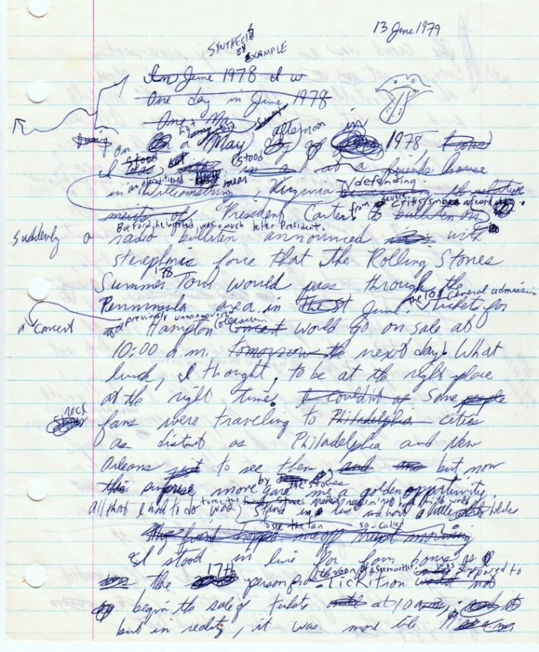
No handwritten work
All assignments and exams must be typed.
Handwritten work is not allowed.

Slide 19
Grade Expectation
On the curve
Just for reference:
A: top 15-20%
A-: next 10-15%
B+, B, B-: next 25-40%
C+,C,C-: next 10-20%
D and below: you don’t want to know
I reserve the right to assign grades based on the overall performance.

Slide 20
No lame excuses, please!!!
I have to go home early, can I take the exam on December 1st? (no long valid)
I had a fight with my girlfriend/boyfriend.
I’ve studied very hard, I understood the stuff very well, but I got a C- please consider giving an A-.
I will graduate this semester and won’t be able to graduate unless I get at least a B+

Slide 21
Academic Honesty
Zero tolerance on cheating/plagiarism:
Fail the course on any homework assignment/lab, project, or exam even for first attempt, & report to the department
Consult the University Code of Conduct for details on other consequences of academic misconduct
Group study/discussion is encouraged, but the submission must be your own work.
Team members are equally responsible!
Students who share the work with others are as responsible for academic dishonesty as those receiving the material.

Slide 22
More on Academic Honesty
Homeworks
No collaboration across teams!
Use of reference material is allowed as long as you explicitly state the reference
Exception: hw/lab solutions from past years or Internet
Course Projects:
Discussion of ideas is welcome but no sharing of code!
Use of code found online is allowed as long as you explicitly state the reference
Exception: code from past years
We will use MOSS to detect cheating.
No lame excuses!
I did not know/I was not sure/I forgot

Slide 23
How to do well?
Start early on homeworks/labs/programming assignments
Make use of the TAs/Friends (and me) during office hours
Feel free to ask questions and share ideas on piazza.

Slide 24
Where Do I Ask Questions About
Lectures
Piazza
Instructor (office hours, email)
Homeworks
Piazza
Instructor (office hours, email)
TAs (office hours, email)
Programming Assignments
Piazza
TAs (office hours, email)
Friend (office hours, email)

Slide 25
Questions?

