Slide 1
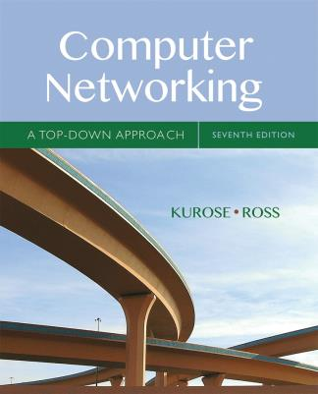
Chapter 6 The Link Layer
and LANs
Lu Su
Associate Professor
Department of Computer Science and Engineering
State University of New York at Buffalo
Computer Networking: A Top Down Approach
7th edition Jim Kurose, Keith Ross Pearson/Addison Wesley April 2016
Adapted from the slides of the book’s authors

Slide 2
Link layer, LANs: outline
6.1 introduction, services
6.2 error detection, correction
6.3 multiple access protocols
6.4 LANs
addressing, ARP
Ethernet
switches
VLANS
6.5 link virtualization: MPLS
6.6 data center networking
6.7 a day in the life of a web request

Slide 3





Multiple access links, protocols
two types of “links”:
point-to-point
PPP for dial-up access
point-to-point link between Ethernet switch, host
broadcast (shared wire or medium)
old-fashioned Ethernet
upstream HFC
802.11 wireless LAN
shared wire (e.g.,
cabled Ethernet)
shared RF
(e.g., 802.11 WiFi)
shared RF
(satellite)
humans at a
cocktail party
(shared air, acoustical)

Slide 4
Multiple access protocols
single shared broadcast channel
two or more simultaneous transmissions by nodes: interference
collision if node receives two or more signals at the same time
multiple access protocol
distributed algorithm that determines how nodes share channel, i.e., determine when node can transmit
communication about channel sharing must use channel itself!
no out-of-band channel for coordination

Slide 5
An ideal multiple access protocol
given: broadcast channel of rate R bps
desiderata:
1. when one node wants to transmit, it can send at rate R.
2. when M nodes want to transmit, each can send at average rate R/M
3. fully decentralized:
no special node to coordinate transmissions
no synchronization of clocks, slots
4. simple

Slide 6
MAC protocols: taxonomy
three broad classes:
channel partitioning
divide channel into smaller “pieces” (time slots, frequency, code)
allocate piece to node for exclusive use
random access
channel not divided, allow collisions
“recover” from collisions
“taking turns”
nodes take turns, but nodes with more to send can take longer turns

Slide 7
Channel partitioning MAC protocols: TDMA
TDMA: time division multiple access
access to channel in "rounds"
each station gets fixed length slot (length = packet transmission time) in each round
unused slots go idle
example: 6-station LAN, 1,3,4 have packets to send, slots 2,5,6 idle
6-slot
frame
6-slot
frame
1
3
4
1
3
4

Slide 8
Channel partitioning MAC protocols: FDMA
FDMA: frequency division multiple access
channel spectrum divided into frequency bands
each station assigned fixed frequency band
unused transmission time in frequency bands go idle
example: 6-station LAN, 1,3,4 have packet to send, frequency bands 2,5,6 idle
time
frequency bands
FDM cable

Slide 9
Random access protocols
when node has packet to send
transmit at full channel data rate R.
no a priori coordination among nodes
two or more transmitting nodes ➜ “collision”,
random access MAC protocol specifies:
how to detect collisions
how to recover from collisions (e.g., via delayed retransmissions)
examples of random access MAC protocols:
slotted ALOHA
ALOHA
CSMA, CSMA/CD, CSMA/CA

Slide 10
Slotted ALOHA
assumptions:
all frames same size
time divided into equal size slots (time to transmit 1 frame)
nodes start to transmit only slot beginning
nodes are synchronized
if 2 or more nodes transmit in slot, all nodes detect collision
operation:
when node obtains fresh frame, transmits in next slot
if no collision: node can send new frame in next slot
if collision: node retransmits frame in each subsequent slot with prob. p until success

Slide 11
Slotted ALOHA
node 1
1
1
1
1
node 2
2
2
2
node 3
3
3
3
C
E
C
S
E
C
E
S
S
Pros:
single active node can continuously transmit at full rate of channel
highly decentralized: only slots in nodes need to be in sync
simple
Cons:
collisions, wasting slots
idle slots
nodes may be able to detect collision in less than time to transmit packet
clock synchronization

Slide 12
Slotted ALOHA: efficiency
efficiency: long-run fraction of successful slots (many nodes, all with many frames to send)
max efficiency: find p* that maximizes Np(1-p)^{N-1}
for many nodes, take limit of Np*(1-p*)^{N-1} as N goes to infinity, gives:
max efficiency = 1/e = .37
suppose: N nodes with many frames to send, each transmits in slot with probability p
prob that given node has success in a slot = p(1-p)^{N-1}
prob that any node has a success = Np(1-p)^{N-1}
at best: channel
used for useful
transmissions 37%
of time!
!

Slide 13
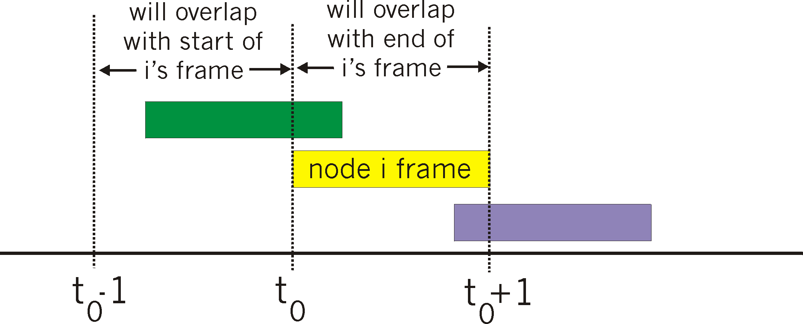
Pure (unslotted) ALOHA
unslotted Aloha: simpler, no synchronization
when frame first arrives
transmit immediately
collision probability increases:
frame sent at t₀ collides with other frames sent in [t₀-1,t₀+1]

Slide 14
Pure ALOHA efficiency
P(success by given node) = P(node transmits) .
P(no other node transmits in [t₀-1,t₀] .
P(no other node transmits in [t₀,t₀+1]
= p . (1-p)^{N-1 .} (1-p)^{N-1}
= p . (1-p)^{2(N-1)}
… choosing optimum p and then letting n
= 1/(2e) = .18
even worse than slotted Aloha!

Slide 15
CSMA (carrier sense multiple access)
CSMA: listen before transmit:
if channel sensed idle: transmit entire frame
if channel sensed busy, defer transmission
human analogy: don’t interrupt others!

Slide 16
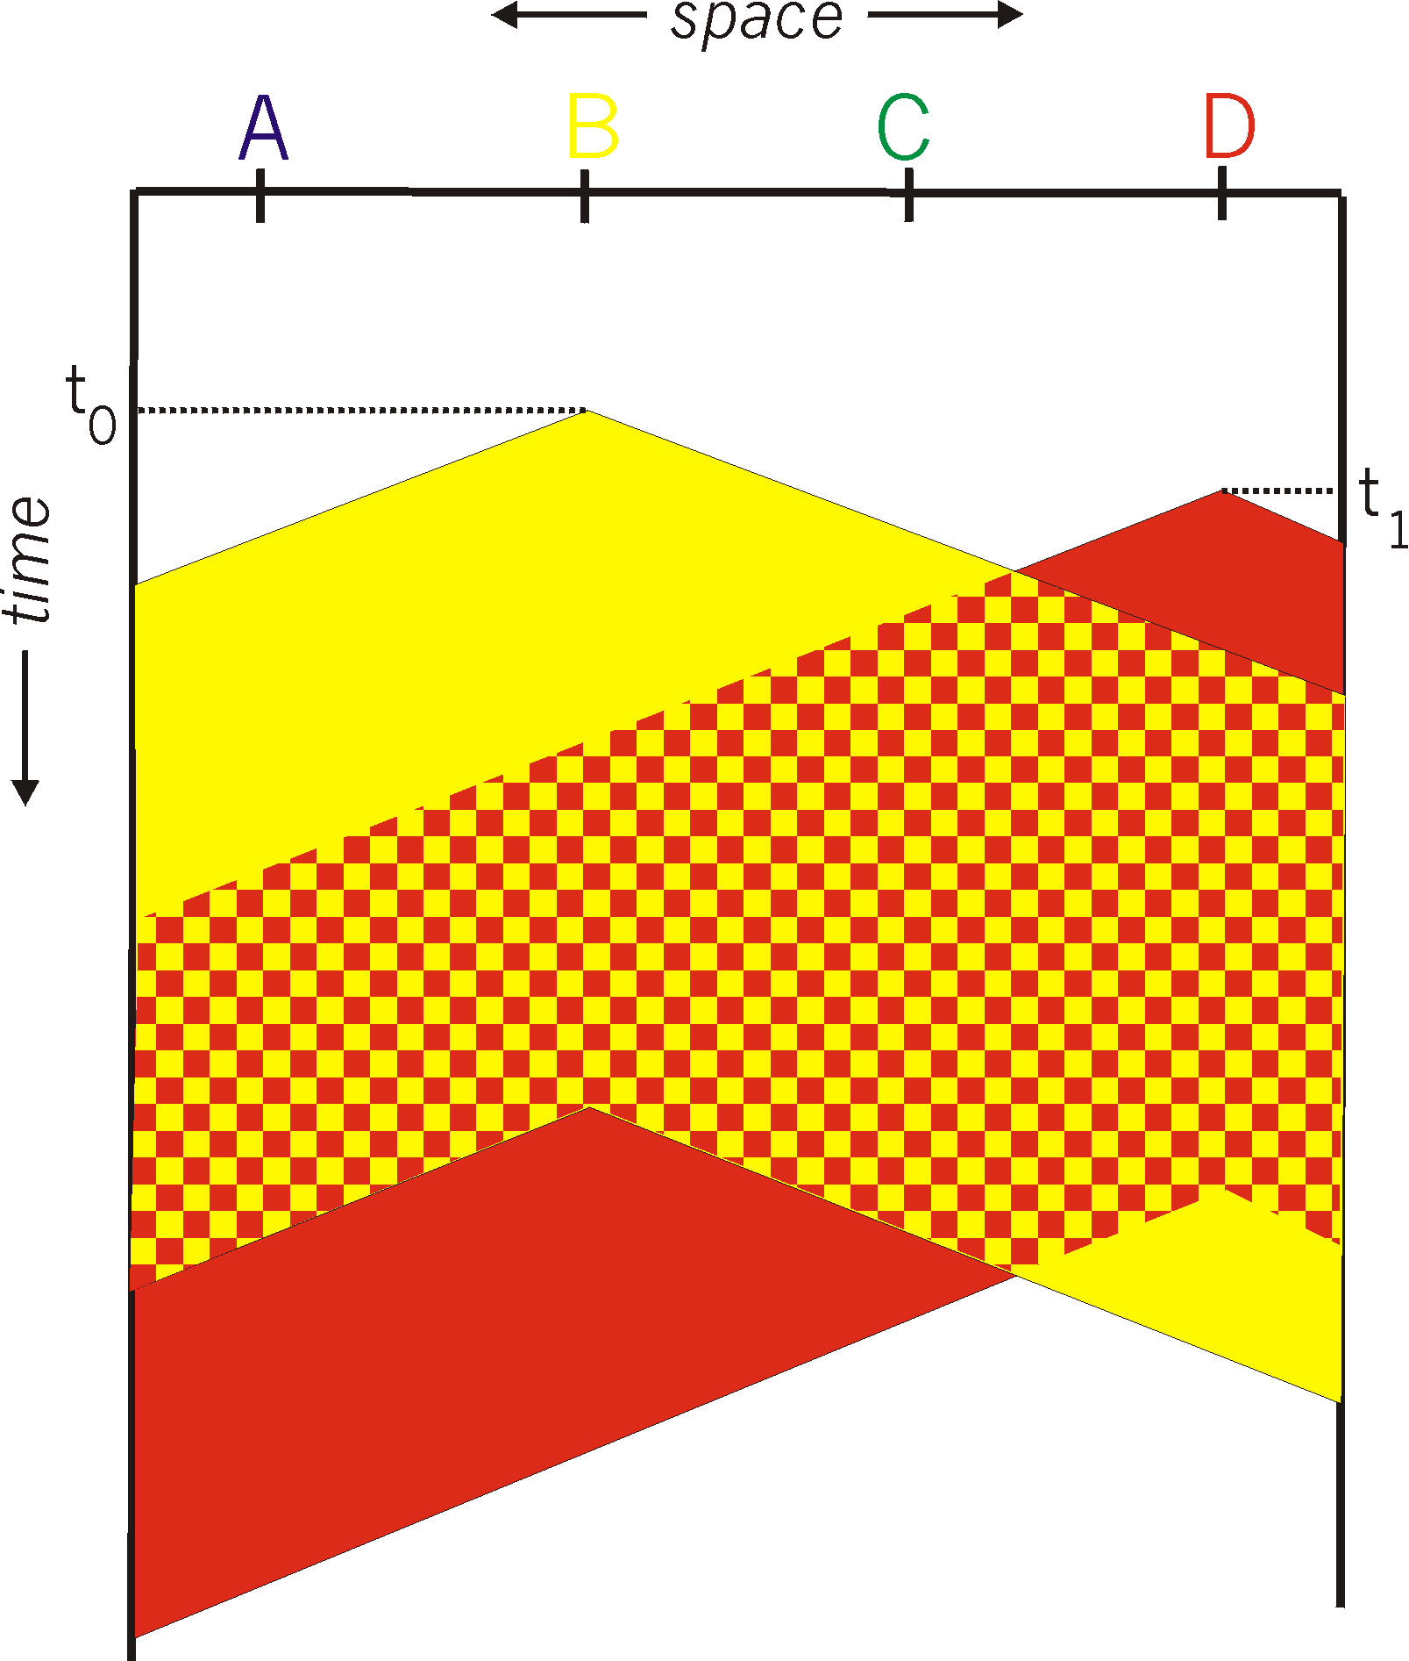
CSMA collisions
spatial layout of nodes
collisions can still occur: propagation delay means two nodes may not hear each other’s transmission
collision: entire packet transmission time wasted
distance & propagation delay play role in determining collision probability

Slide 17
CSMA/CD (collision detection)
CSMA/CD: carrier sensing, deferral as in CSMA
collisions detected within short time
colliding transmissions aborted, reducing channel wastage
collision detection:
easy in wired LANs: measure signal strengths, compare transmitted, received signals
difficult in wireless LANs: received signal strength overwhelmed by local transmission strength
human analogy: the polite conversationalist

Slide 18
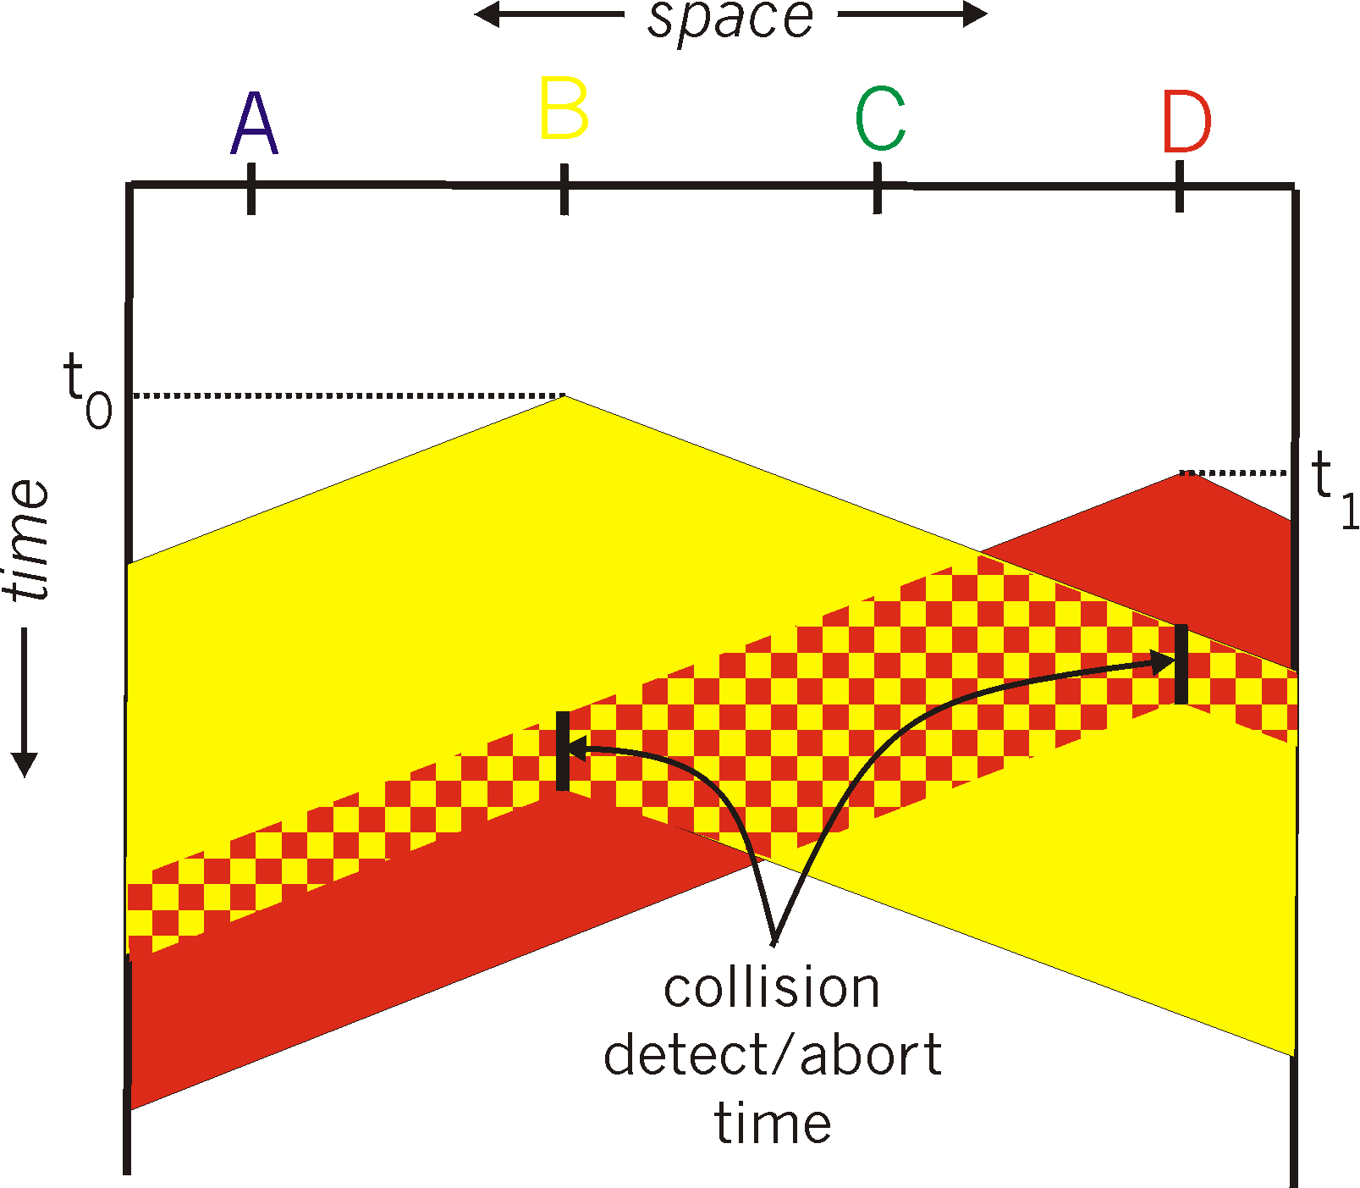
CSMA/CD (collision detection)
spatial layout of nodes

Slide 19
Ethernet CSMA/CD algorithm
1. NIC receives datagram from network layer, creates frame
2. If NIC senses channel idle, starts frame transmission. If NIC senses channel busy, waits until channel idle, then transmits.
3. If NIC transmits entire frame without detecting another transmission, NIC is done with frame !
4. If NIC detects another transmission while transmitting, aborts and sends jam signal
5. After aborting, NIC enters binary (exponential) backoff:
after mth collision, NIC chooses K at random from {0,1,2, …, 2^{m}-1}. NIC waits K·512 bit times, returns to Step 2
longer backoff interval with more collisions

Slide 20
CSMA/CD efficiency
T_{prop} = max prop delay between 2 nodes in LAN
t_{trans} = time to transmit max-size frame
efficiency goes to 1
as t_{prop} goes to 0
as t_{trans} goes to infinity
better performance than ALOHA: and simple, cheap, decentralized!

Slide 21
“Taking turns” MAC protocols
channel partitioning MAC protocols:
share channel efficiently and fairly at high load
inefficient at low load: delay in channel access, 1/N bandwidth allocated even if only 1 active node!
random access MAC protocols
efficient at low load: single node can fully utilize channel
high load: collision overhead
“taking turns” protocols
look for best of both worlds!

Slide 22

“Taking turns” MAC protocols
polling:
master node “invites” slave nodes to transmit in turn
typically used with “dumb” slave devices
concerns:
polling overhead
latency
single point of failure (master)
data
poll
master
data
slaves

Slide 23
“Taking turns” MAC protocols
token passing:
control token passed from one node to next sequentially.
token message
concerns:
token overhead
latency
single point of failure (token)
T
(nothing
to send)
T
data

Slide 24
Summary of MAC protocols
channel partitioning, by time, frequency or code
Time Division, Frequency Division
random access (dynamic),
ALOHA, S-ALOHA, CSMA, CSMA/CD
carrier sensing: easy in some technologies (wire), hard in others (wireless)
CSMA/CD used in Ethernet
CSMA/CA used in 802.11
taking turns
polling from central site, token passing
Bluetooth, FDDI, token ring

