Slide 1
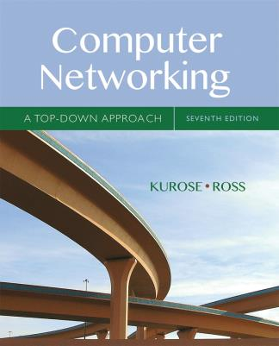
Chapter 7
Wireless and
Mobile Networks
Lu Su
Associate Professor
Department of Computer Science and Engineering
State University of New York at Buffalo
Computer Networking: A Top Down Approach
7th edition
Jim Kurose, Keith Ross
Pearson/Addison Wesley
April 2016
Adapted from the slides of the book’s authors

Slide 2
Chapter 7 outline
7.1 Introduction
Wireless
7.2 Wireless links, characteristics
  CDMA
7.3 IEEE 802.11 wireless LANs (“Wi-Fi”)
7.4 Cellular Internet Access
  architecture
  standards (e.g., 3G, LTE)
Mobility
7.5 Principles: addressing and routing to mobile users
7.6 Mobile IP
7.7 Handling mobility in cellular networks
7.8 Mobility and higher-layer protocols

Slide 3
What is mobility?
spectrum of mobility, from the network perspective:
no mobility
high mobility
mobile wireless user,
using same access
point
mobile user, connecting/ disconnecting from network using DHCP.
mobile user, passing through multiple access point while maintaining ongoing connections (like cell phone)

Slide 4



Mobility: vocabulary
home network: permanent “home” of mobile
(e.g., 128.119.40/24)
home agent: entity that will perform mobility functions on behalf of mobile, when mobile is remote
wide area network
permanent address: address in home network, can always be used to reach mobile
e.g., 128.119.40.186

Slide 5
Mobility: more vocabulary
permanent address: remains constant (e.g., 128.119.40.186)
visited network: network in which mobile currently resides (e.g., 79.129.13/24)
care-of-address: address in visited network.
(e.g., 79,129.13.2)
wide area network
foreign agent: entity in visited network that performs mobility functions on behalf of mobile.
correspondent: wants to communicate with mobile

Slide 6

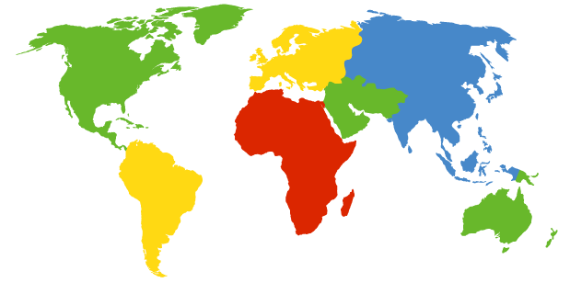

How do you contact a mobile friend:
Consider friend frequently changing addresses, how do you find her?
I wonder where Alice moved to?
search all phone books?
call her parents?
expect her to let you know where he/she is?
Facebook!

Slide 7
Mobility: approaches
let routing handle it: routers advertise permanent address of mobile-nodes-in-residence via usual routing table exchange.
  routing tables indicate where each mobile located
  no changes to end-systems
let end-systems handle it:
  indirect routing: communication from correspondent to mobile goes through home agent, then forwarded to remote
  direct routing: correspondent gets foreign address of mobile, sends directly to mobile

Slide 8
Mobility: approaches
let routing handle it: routers advertise permanent address of mobile-nodes-in-residence via usual routing table exchange.
  routing tables indicate where each mobile located
  no changes to end-systems
let end-systems handle it:
  indirect routing: communication from correspondent to mobile goes through home agent, then forwarded to remote
  direct routing: correspondent gets foreign address of mobile, sends directly to mobile
not
scalable
to millions of
mobiles

Slide 9
Mobility: registration
visited network
home network
1
2
wide area network
mobile contacts foreign agent on entering visited network
foreign agent contacts home agent home: “this mobile is resident in my network”
end result:
foreign agent knows about mobile
home agent knows location of mobile

Slide 10

Mobility via indirect routing
foreign agent receives packets, forwards to mobile
home agent intercepts packets, forwards to foreign agent
visited
network
home
network
3
wide area network
2
1
correspondent addresses packets using home address of mobile
4
mobile replies directly to correspondent

Slide 11
Indirect Routing: comments
mobile uses two addresses:
  permanent address: used by correspondent (hence mobile location is transparent to correspondent)
  care-of-address: used by home agent to forward datagrams to mobile
foreign agent functions may be done by mobile itself
triangle routing: correspondent-home-network-mobile
  inefficient when
  correspondent, mobile
  are in same network

Slide 12
Indirect routing: moving between networks
suppose mobile user moves to another network
  registers with new foreign agent
  new foreign agent registers with home agent
  home agent update care-of-address for mobile
  packets continue to be forwarded to mobile (but with new care-of-address)
mobility, changing foreign networks transparent: on going connections can be maintained!

Slide 13



Mobility via direct routing
foreign agent receives packets, forwards to mobile
correspondent forwards to foreign agent
visited
network
home
network
3
1
2
4
correspondent requests, receives foreign address of mobile
mobile replies directly to correspondent

Slide 14

Mobility via direct routing: comments
overcome triangle routing problem
non-transparent to correspondent: correspondent must get care-of-address from home agent
  what if mobile changes visited network?
3
1
2
4

Slide 15

Accommodating mobility with direct routing
anchor foreign agent: FA in first visited network
data always routed first to anchor FA
when mobile moves: new FA arranges to have data forwarded from old FA (chaining)
foreign net visited
at session start
anchor
foreign
agent
wide area network
2
1
4
5
3
new
foreign
network
correspondent
agent
new foreign
agent
correspondent

Slide 16
Chapter 7 outline
7.1 Introduction
Wireless
7.2 Wireless links, characteristics
  CDMA
7.3 IEEE 802.11 wireless LANs (“Wi-Fi”)
7.4 Cellular Internet Access
  architecture
  standards (e.g., 3G, LTE)
Mobility
7.5 Principles: addressing and routing to mobile users
7.6 Mobile IP
7.7 Handling mobility in cellular networks
7.8 Mobility and higher-layer protocols

Slide 17
Mobile IP
RFC 3344
has many features we’ve seen:
  home agents, foreign agents, foreign-agent registration, care-of-addresses, encapsulation (packet-within-a-packet)
three components to standard:
  indirect routing of datagrams
  agent discovery
  registration with home agent

Slide 18

Mobile IP: indirect routing
foreign-agent-to-mobile packet
packet sent by home agent to foreign agent: a packet within a packet
dest: 128.119.40.186
dest: 79.129.13.2
dest: 128.119.40.186
Permanent address: 128.119.40.186
Care-of address: 79.129.13.2
dest: 128.119.40.186
packet sent by correspondent

Slide 19
Mobile IP: agent discovery
agent advertisement: foreign/home agents advertise service by broadcasting ICMP messages (typefield = 9)
H,F bits: home and/or foreign agent
R bit: registration required

Slide 20


Mobile IP: registration example
visited network: 79.129.13/24
home agent
HA: 128.119.40.7
foreign agent
COA: 79.129.13.2
mobile agent
MA: 128.119.40.186
ICMP agent adv.
COA: 79.129.13.2
….
registration req.
registration req.
COA: 79.129.13.2
HA: 128.119.40.7
MA: 128.119.40.186
Lifetime: 9999
identification: 714
encapsulation format
….
COA: 79.129.13.2
HA: 128.119.40.7
MA: 128.119.40.186
Lifetime: 9999
identification:714
….
registration reply
HA: 128.119.40.7
MA: 128.119.40.186
Lifetime: 4999
Identification: 714
encapsulation format
….
registration reply
HA: 128.119.40.7
MA: 128.119.40.186
Lifetime: 4999
Identification: 714
….
time

Slide 21
Chapter 7 summary
Wireless
wireless links:
  capacity, distance
  channel impairments
  CDMA
IEEE 802.11 (“Wi-Fi”)
  CSMA/CA reflects wireless channel characteristics
cellular access
  architecture
  standards (e.g., 3G, 4G LTE)
Mobility
principles: addressing, routing to mobile users
  home, visited networks
  direct, indirect routing
  care-of-addresses
case studies
  mobile IP
  mobility in GSM, LTE
impact on higher-layer protocols

