Slide 1
PIQL: Success- Tolerant Query Processing in the Cloud
Michael Armbrust, Kristal Curtis, Tim Kraska
Armando Fox, Michael J. Franklin, David A. Patterson
AMP Lab, EECS, UC Berkeley

Slide 2
Introduction
Large-scale websites are increasingly moving from relational databases to distributed key-value stores.
Why?
High request rate
Low latency workloads
Scalability

Slide 3
Key-value stores at a cost of ?
Writing complex imperative functions
Index management
Intra query parallelization
And LOSS of DATA INDEPENCE

Slide 4
A blend of both: PIQL
Performance predictable subset of SQL
Benefits of RDBMS such as ability to express queries declaratively
Physical data independence
Automatic index selection and maintenance
Real time guarantees on PERFORMANCE that come from underlying key-value store

Slide 5
Features:
Run on the top of key/value stores
Bounds on the number of operations that will be performed on key-value store
Compile time feedback on worst-case performance for all queries
Automatic selection and maintenance of indexes

Slide 6
Alternative approach
Complex developer written imperative programs
Example:
Data model of Cassandra
For a query: search for messages that contain certain word
Values inserted of the form:
row -> userid, supercolumn ->word, column ->
messageTimestamp, value->messageId

Slide 7
Equivalent PIQL query:
FETCH message
OF user BY recipient
WHERE user = [this] AND
message.text CONTAINS [1: word]
ORDER BY timestamp

Slide 8
Query Scaling classes
Class 1: (Constant)- Amount of data required to process the query is constant
Class 2: (Bounded)- Amount of data required to process the query is naturally bounded
Class 3: (Sub-linear or Linear)- Amount of data required to process the query grows sub-linearly eventually
Class 4: (Super-linear)-

Slide 9
PIQL Query Syntax
name
Parameters
[ordinal:name]
General syntax:
QUERY name
FETCH entity
[OF joined-entity alias BY relationship] ...
WHERE predicates
[{PAGINATE perpage | LIMIT count}]

Slide 10
Example Class 1
To return profile of a user given a user name
QUERY userByName
FETCH user
WHERE user.name = [1:name]
Calculating bound:
Simple: 1 or zero results

Slide 11
Example Class 2
To return users by their hometown
QUERY userByHometown
FETCH user
WHERE user.hometown = [1:hometown]
LIMIT [1:count] MAX 100
Calculating bound:
LIMIT clause returns at most 100 items

Slide 12
Example Class 3
To return a list of the most recent thoughts owned by a particular user
QUERY userThoughts
FETCH thought of
user by owner
WHERE user.name = [1:username]
ORDER BY timestamp
LIMIT [2:count] MAX 100
Bound: 100

Slide 13
Example Class 4
To return a paginated list, 10 at a time, of the most recent thoughts of all the approved subscriptions owned by the current user.
QUERY thoughtstream
FETCH thought
OF user friend BY owner
OF subscription BY target
OF user me BY owner
WHERE me.username=[1:username] AND approved = true
ORDER BY timestamp
PAGINATE 10

Slide 14
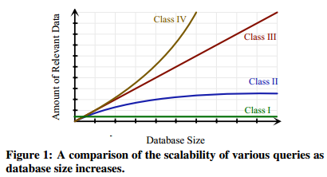
Comparison
Graph

Slide 15
Queries in PIQL
Entities analogous to Relations
Queries are specified as templates ahead of time
No of operations required in worst case are provided to developer as feedback at compile time

Slide 16
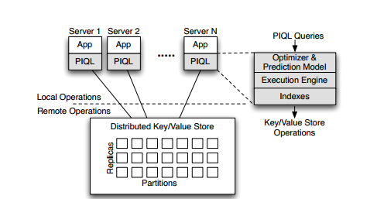
Architecture Overview

Slide 17
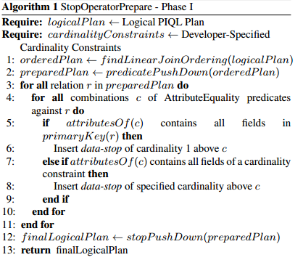
Optimization in PIQL
Phase 1-(Stop Operator Insertion)

Slide 18
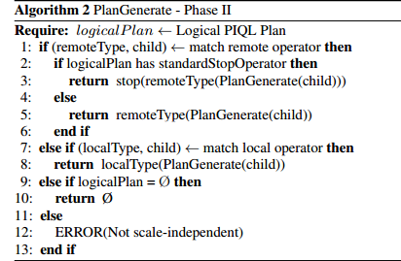
Optimization in PIQL
Phase 2

Slide 19
Prediction Framework
Performance Insight Assistant
Provides feedback to developer to fix ‘unsafe’ queries
Guidance on how to set a ‘Cardinality limit’ compatible with SLO Compliance
Provides a chart of latency distribution for each setting of the cardinality

Slide 20
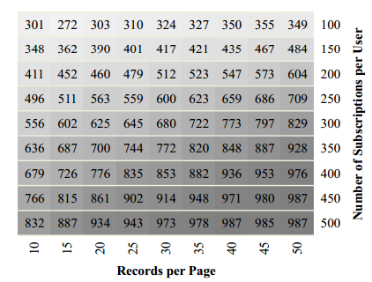
Performance Insight assistant
Predicted Heat Map for Thoughtstream query

Slide 21
Execution Engine
Leverages key-value store to achieve scalability and high performance
Requests to a key-value store are done in parallel
Limit hint information is used to prefetch all required data in single request

Slide 22
Performance overview
Fig: System scaling in number of users/machines with constant query latency

Slide 23
Conclusion
Performance predictability and scalability of Key-value stores + Scale independence of Relational Model= PIQL
GQL, HIVE, PIG, VoltDB are also on similar grounds but they are focused on Batch Analytics rather than Interactive applications

