Slide 1
Putting Lipstick on Pig:
Enabling Database-styleWorkflow
Provenance
YaelAmsterdamer,Susan B.Davidson,Daniel Deutch
Tova Milo,Julia Stoyanovich,ValTannen
Using slides by Guozhang Wang

Slide 2
Provenance in context of Workflows
Data-Intensive complex computational processes often generate many ﬁnal and intermediate data products
Scientists and engineers need to expend substantial effort managing data and recording provenance information so that basic questions can be answered.

Slide 3
Provenance in context of Workflows
Who created this data product and when?
When was it modiﬁed and by whom?
What was the process used to create the
data product?
Were two data products derived from the same raw data?

Slide 4
Provenance in context of Workflows
an essential component to allow for
result reproducibility
verifiability
sharing and knowledge re-use in the scientiﬁc community

Slide 5
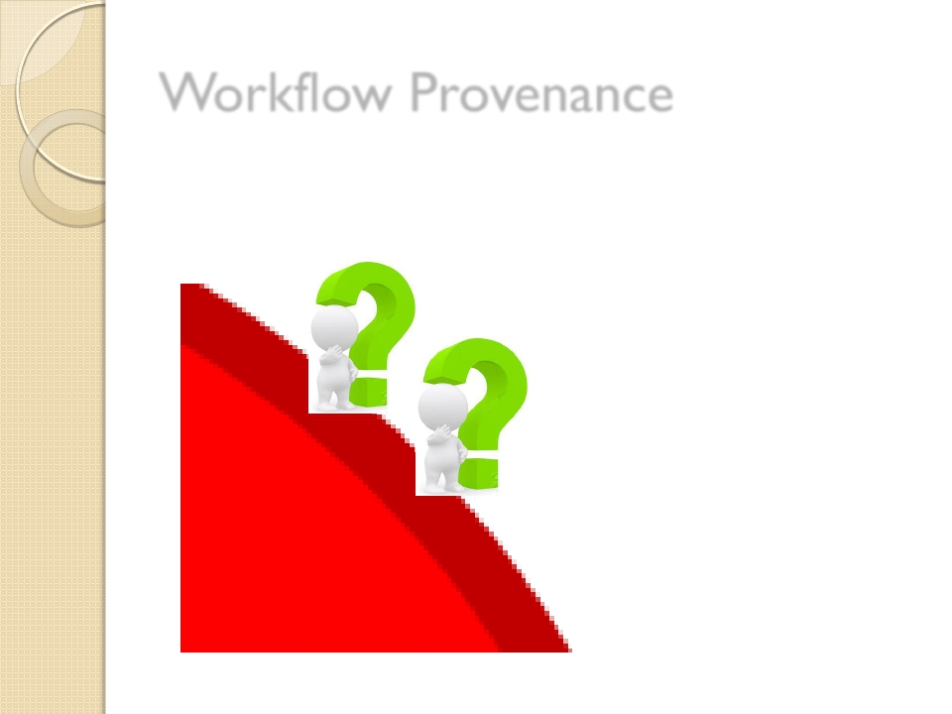
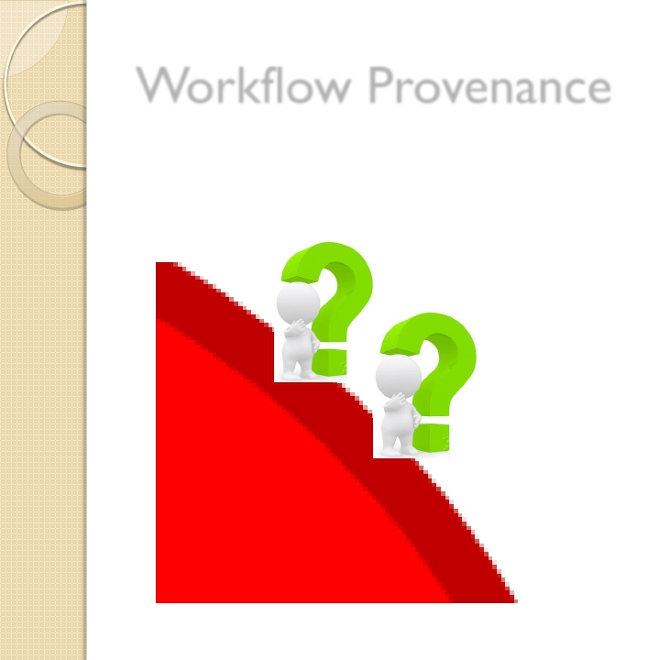
Workflow Provenance

Motivated by ScientificWorkflows
◦ Community :IPAW
◦ Interests:process
documentation,data
derivation and
annotation,etc
◦ Model :OPM

Slide 6
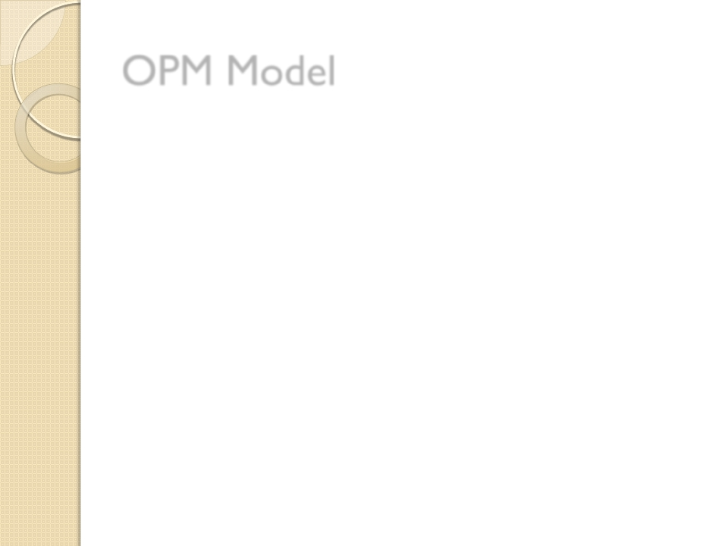
OPM Model



Annotated directed acyclic graph
◦ Artifact:immutable piece of state
◦ Process:actions performed on artifacts,result
in new artifacts
◦ Agents:execute and control processes
Aims to capture causal dependencies
between agents/processes
Each process is treated as a“black-box”

Slide 7
Example:Car Dealership

Slide 8
Data Provenance
(for Relational DB and XML)

Motivated by Prob.DB,data warehousing ..
◦ Community:
SIGMOD/PODS
◦ Interests:data
auditing,data sharing,
etc
◦ Model:Semiring (etc)

Slide 9
Semiring


K-relations
◦ Each tuple is uniquely labeled with a
provenance“token”
Operations:
◦ • :join
◦ + :projection
◦ 0 and 1:selection predicates

Slide 10
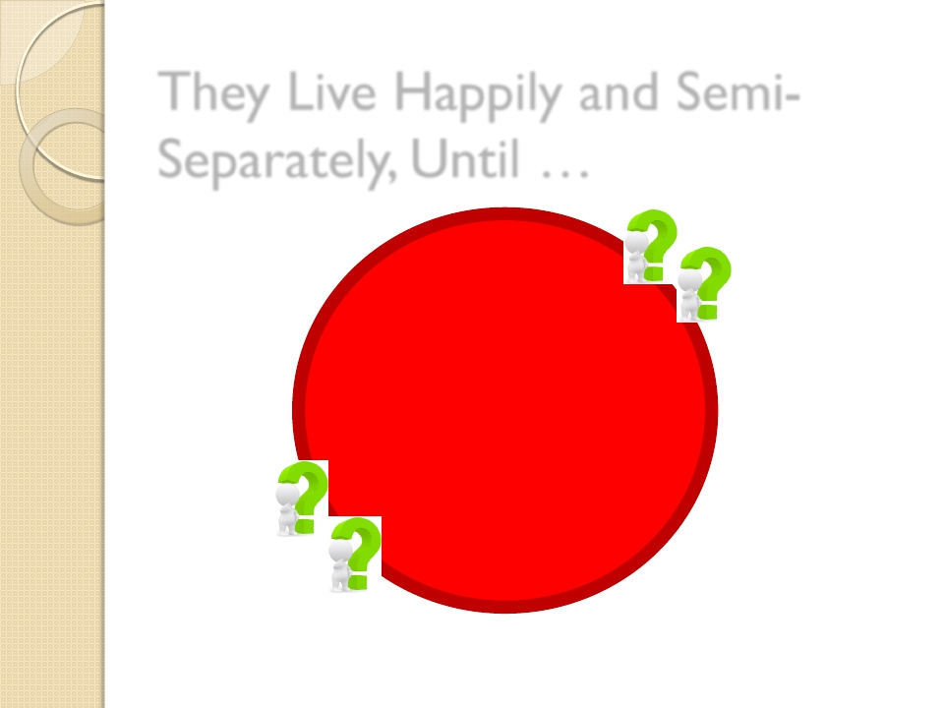
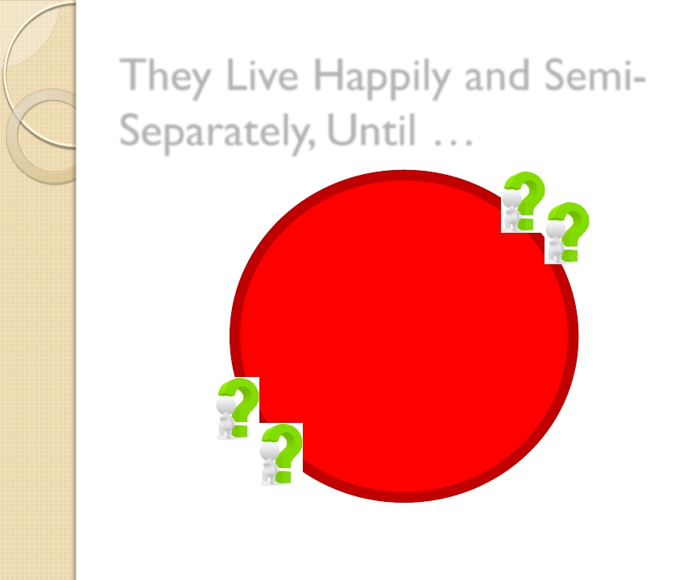
Workflow
Provenance
Researchers
Data Provenance
Researchers

Slide 11
Semiring Comes to Meet OPM

Slide 12
OPM’s Drawbacks in Semiring
People’s Eyes


The black-box assumption:each output of
the module depends solely on all its
inputs
◦ Cannot leverage the common fact that some
output only depends on small subset of inputs
◦ Does not capture internal state of a module
So:replace it with Semirings!

Slide 13
The Idea


General workflow modules are
complicated,and thus hard to capture its
internal logic by annotations
However,modules written in Pig Latin is
very similar to Nested Relational Calculus
(NRC),thus are much more feasible

Slide 14
Pig Latin


Data:unordered (nested) bag of tuples
Operators:
◦ FOREACH t GENERATE f1, f2, … OP(f0)
◦ FILTER BY condition
◦ GROUP/COGROUP
◦ UNION, JOIN, FLATTEN, DISTINCT …

Slide 15
Example:Car Dealership

Slide 16
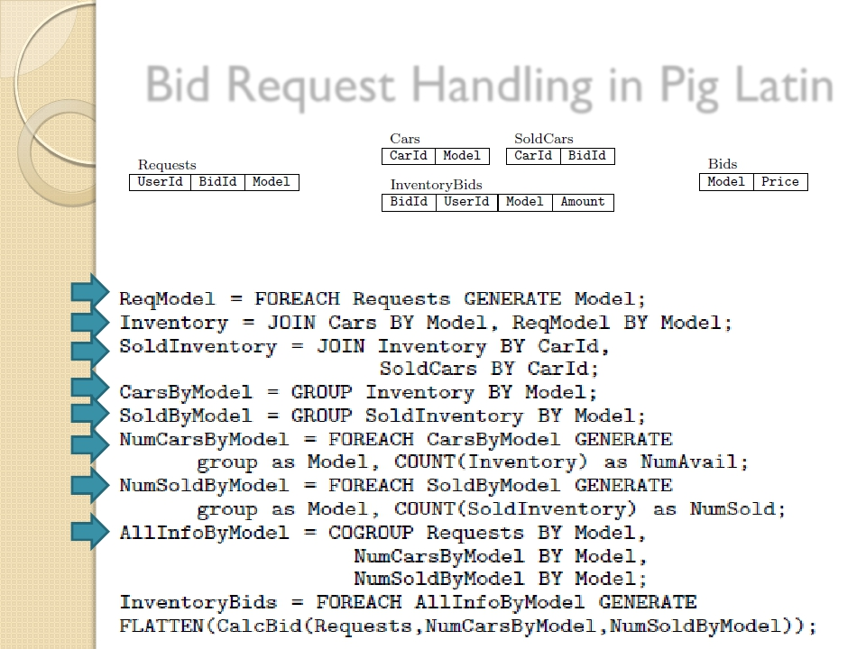
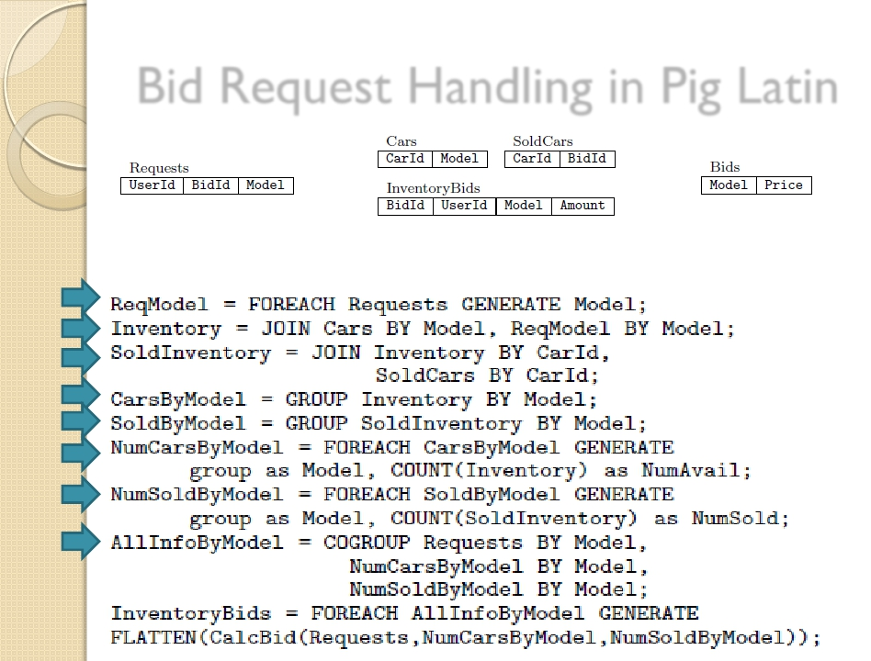
Bid Request Handling in Pig Latin

Slide 17
ProvenanceAnnotation

Slide 18
ProvenanceAnnotation 1.1

Provenance node and value nodes
◦ Workflow input nodes
◦ Module invocation nodes
◦ Module input/output nodes

Slide 19
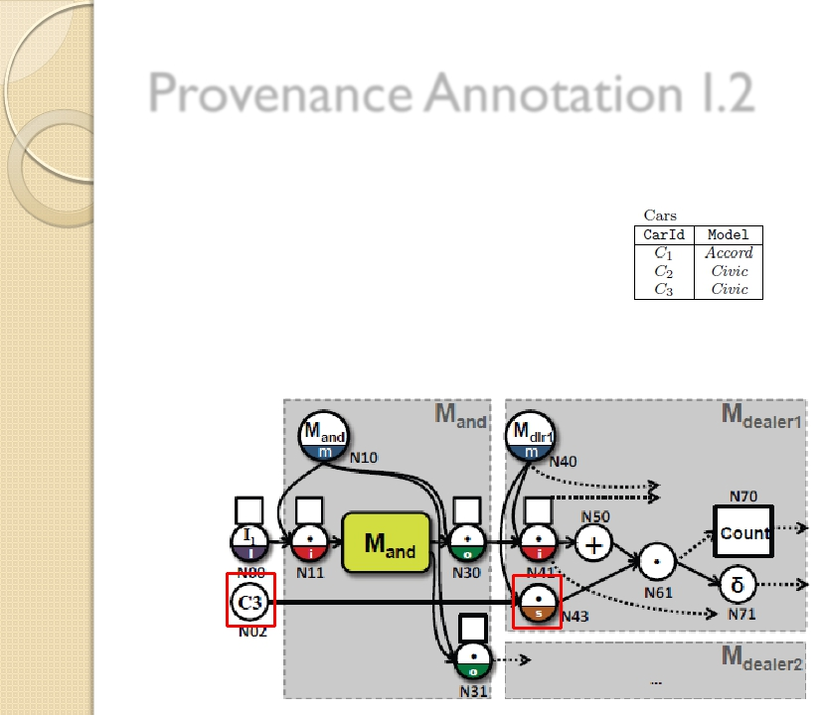
ProvenanceAnnotation I.2

State nodes
◦ P-node for the tuple
◦ P-node for the state

Slide 20
ProvenanceAnnotation 2.1

FOREACH (projection,no OP)
◦ P-node with“+”

Slide 21
ProvenanceAnnotation 2.2

JOIN
◦ P-node with“*”

Slide 22
ProvenanceAnnotation 2.3

GROUP
◦ P-node with“∂”

Slide 23
ProvenanceAnnotation 2.4

FOREACH (aggregation,OP)
◦ V-node with the OP name

Slide 24
ProvenanceAnnotation 2.5

COGROUP
◦ P-node with“∂”

Slide 25
ProvenanceAnnotation 2.6

FOREACH (UDF Black Box)
◦ P-node/V-node with the UDF name

Slide 26
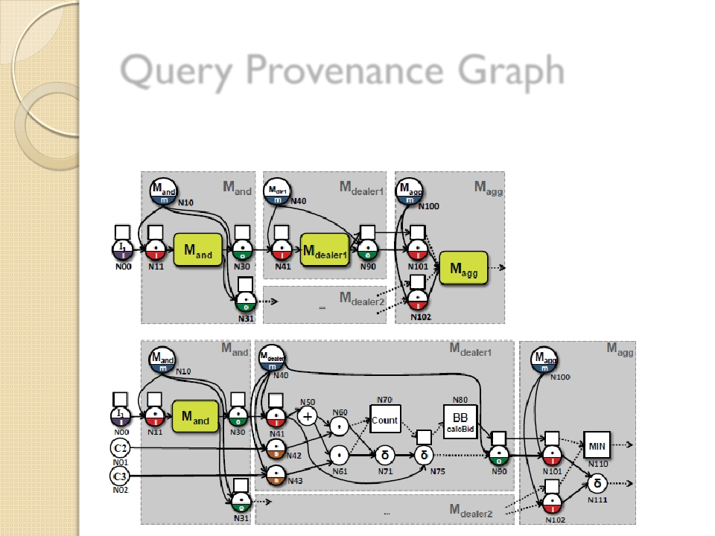
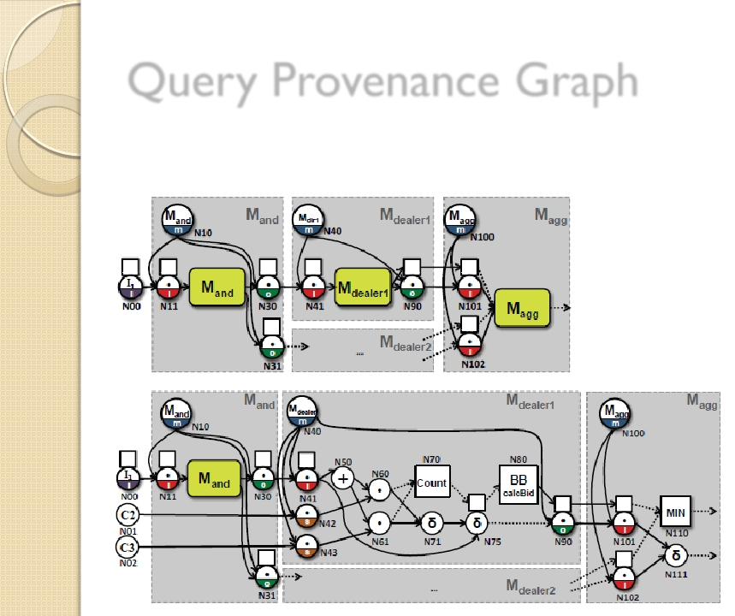
Query Provenance Graph

Zoom-In v.s.Zoom-Out
Coarse-grained
Fine-grained

Slide 27
Query Provenance Graph

Deletion Propagation
◦ Delete the tuple P-node and its out-edges
◦ Repeated delete P-nodes if
 All its in-edges are deleted
 It has label • and one of its in-edges is deleted

Slide 28
Implementation and Experiments


Lipstick prototype
◦ Provenance annotation coded in Pig Latin,
with the graph written to files
◦ Query processing coded in Java and runs in
memory.
Benchmark data
◦ Car dealership:fixed workflow and # dealers
◦ Arctic Station:Varied workflow structure and
size

Slide 29
Annotation Overhead

Overhead increases with execution time

Slide 30
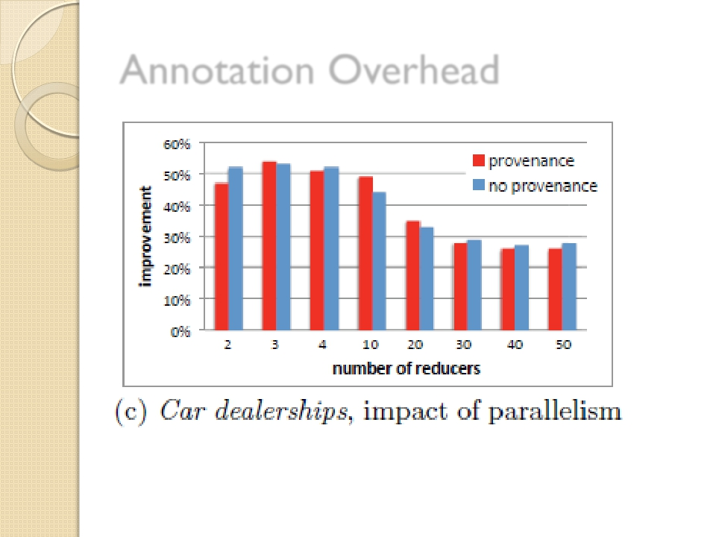
Annotation Overhead

Parallelism helps with up to # modules

Slide 31
Loading Graph Overhead

Increase with graph size
(comp.time < 8 sec)

Slide 32
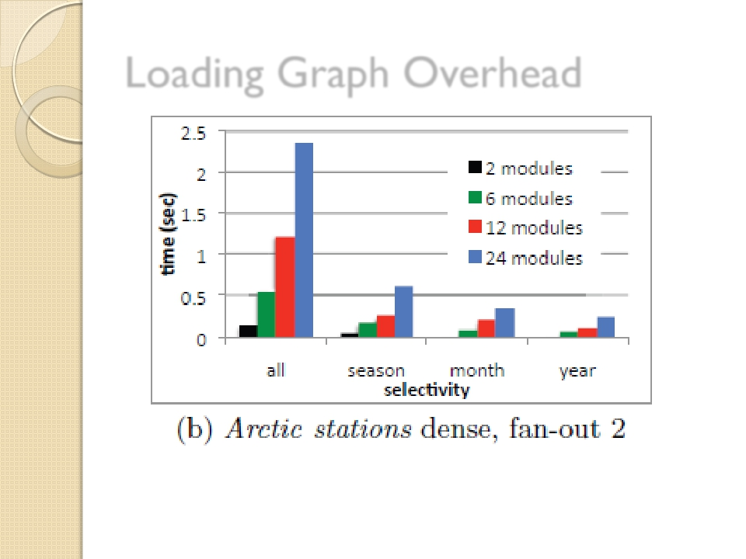
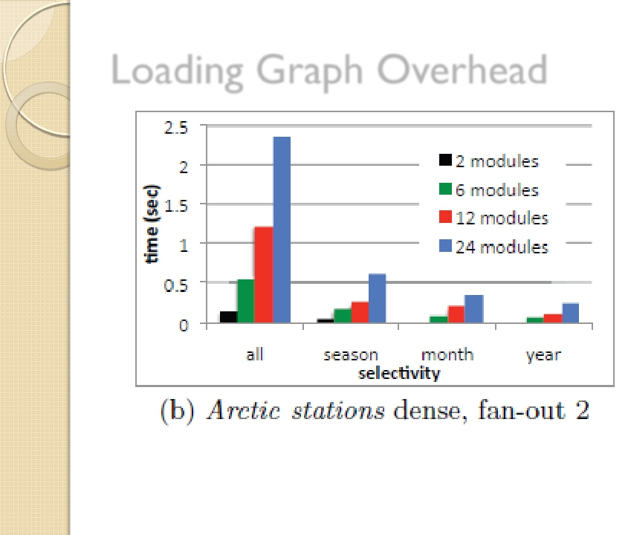
Loading Graph Overhead

Feasible with various sizes
(comp.time < 3 sec)

Slide 33
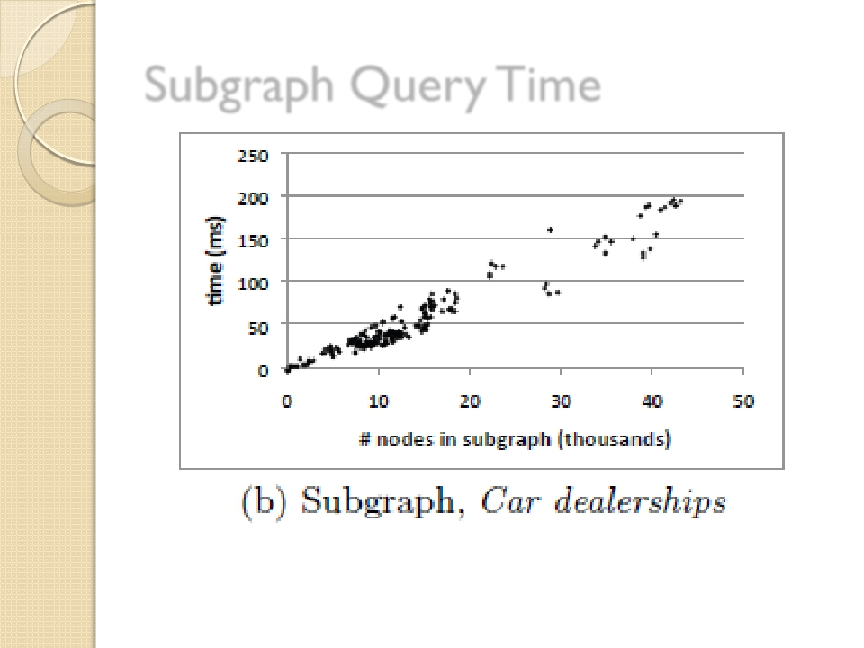
Subgraph QueryTime

Query efficiently with sub-second time

Slide 34
Conclusions
Thank You!
Studied fine-grained provenance for workflows
Individual modules implemented in Pig Latin
Provenance model for Pig Latin queries
Data provenance ideas such as Semirings
can be brought to workflow provenance

