Slide 1
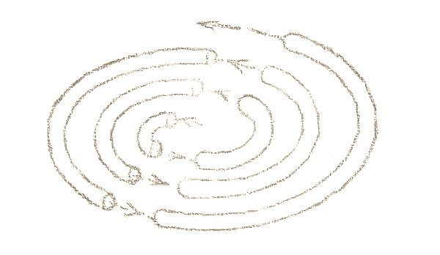
The Data Cyclotron
The Data Cyclotron Query Processing Scheme
Romulo Goncalves
Martin Kersten
ACM Trans. Database Syst. (TODS) 36(4):27 (2011)

Slide 2
Outline
Introduction
Motivations
Design Goals
Interaction Protocols
Experimental Results
Conclusions
Notes:
The traditional approach for parallelizing db is to partition the data over the nodes, and use this partitioning for load balancing decisions. (each sub-query is evaluated where the data is stored). Static allocation -> predictable workload. Sometimes advances in computer hardware suggests/leads to different/alternative architectural choices.

Slide 3
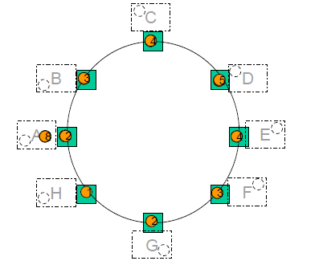
System Overview
Notes:
Logical ring
Data partition
Hot set and responsibility

Slide 4
Motivations
High-performance local networks can be faster than disks
Load balancing based on data allocation doesn't perform well with skewed workloads

Slide 5
Design Goals
Exploit high-performance local networks
Load balancing using data movements (handle skewed work-loads)
Minimize query response time
Maximize query throughput
No single point of failure
Notes:
The DataCyclotron is a brand new approach for implementing a parallel DB.
The main design goal of the DataCyclotron architecture is to provide a distributed system that can take advantage of modern high-perfomance local networks, in order to minimize the average query response time,

Slide 6
System Overview
Notes:
Queries can attach at any node …
A data chunk is loaded by a node into the ring…
It continuously hops from node to node...
Construct a large main-memory ring buffer…
Hot-sed: data continously flowing around

Slide 7
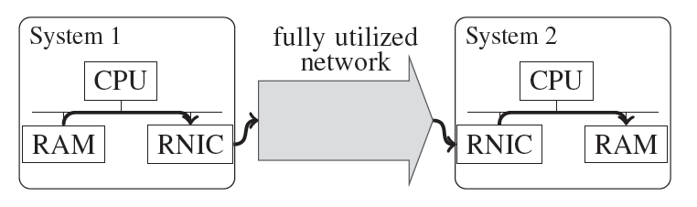
Motivations: RDMA

Slide 8
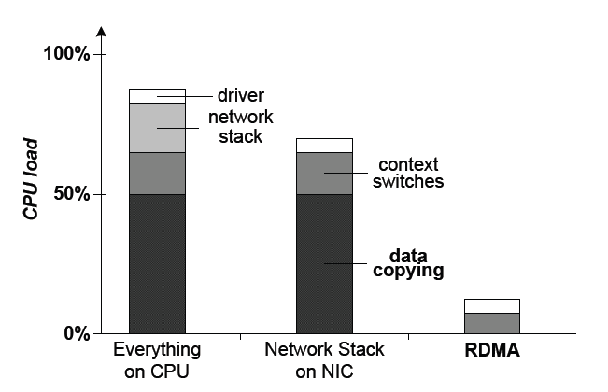
Motivations: RDMA

Slide 9
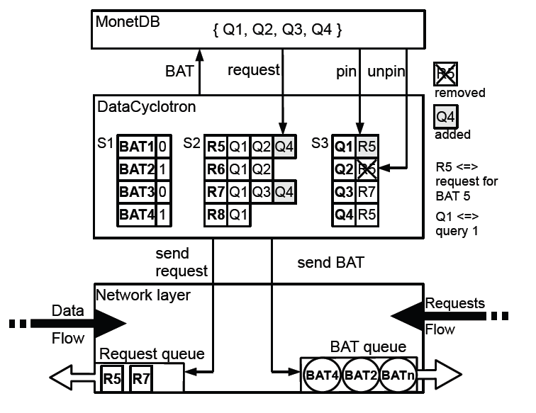
Architecture

Slide 10
The DBMS Layer
Notes:
Bat, req, pin, unpin
Why request and pin?

Slide 11
Data Cyclotron Layer

Slide 12
The Network Layer

Slide 13
DC Layer: Request Propagation
Request_msg = (SenderID, ChunkID)
If (SenderID ==me) : raise exception (data is missing!)
If ChunkID is stored here :
  It was already loaded to the ring? Ignore the request msg
  Is the ring is full ?
    YES : add the request to the pending queue
    NO : load the data to the ring
If I need the very same ChunkID : absorb the request
Else: forward the request to the next node in the ring

Slide 14
DC Layer: Pending Requests
Check for available space at regular intervals
Handle the older request that fits the actual available space in the ring

Slide 15
DC Layer: handling data-chunks
Data-chunk header:
  Data-chunk-uid
  Owner
  LOI (Level Of Interest)
  Copies
  Hops
  Cycles

Slide 16
DC Layer: handling foreign chunks
Hops++
If I was waiting for this Data-chunk-uid :
    Wake-up pinned queries
    Copies ++
Forward the chunk

Slide 17


DC Layer: handling local chunks
Fragments are loaded/unload into the ring depending on their LOI
How to set the LOI threshold?
Notes:
Solution: make it proportional to the load of the local pending-request queue
Low threshold -> slow swapping strategy (unfair to big chunks)
High threshold -> aggressive chunk replacement strategy

Slide 18
Some questions
How does it scale?
No single point of failure?
How does it manage local bandwidth?
Resource allocation is fair?

Slide 19
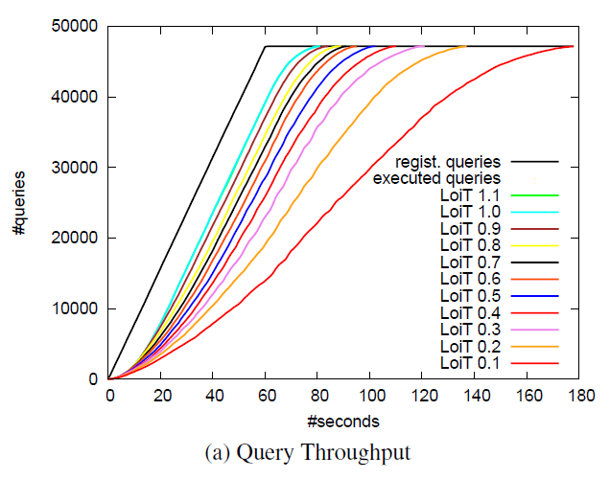
Experiments: limited ring capacity

Slide 20
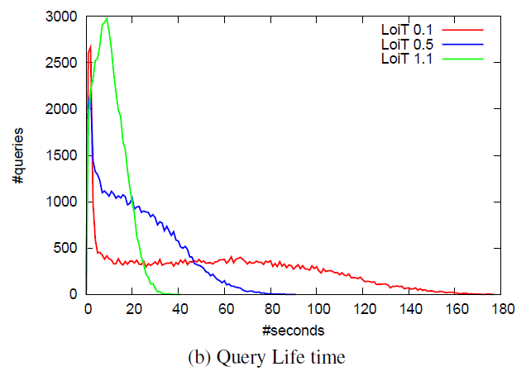
Experiments: limited ring capacity

Slide 21
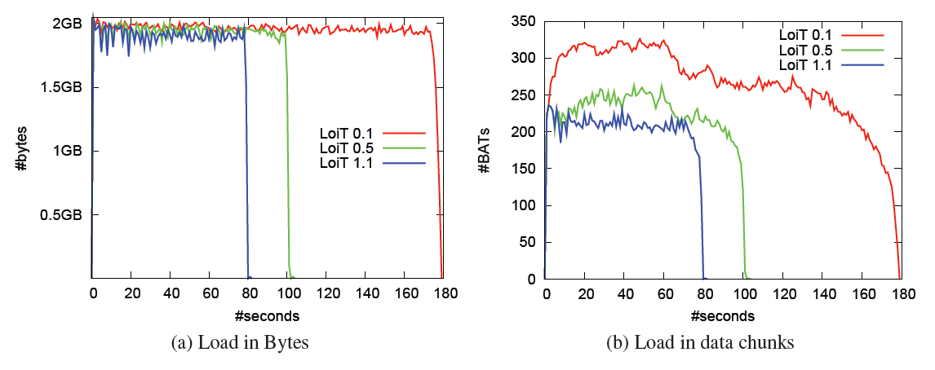
Experiments: limited ring capacity
Notes:
Low Loit penalizes big chunks

Slide 22
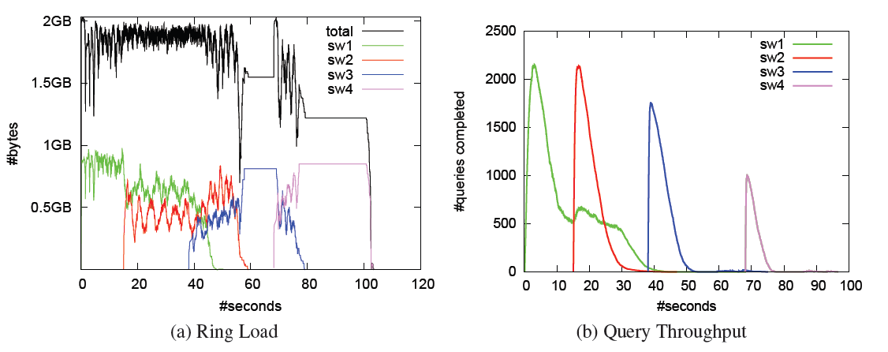
Experiments: skewed workloads
Notes:
Disjointed datasets

Slide 23
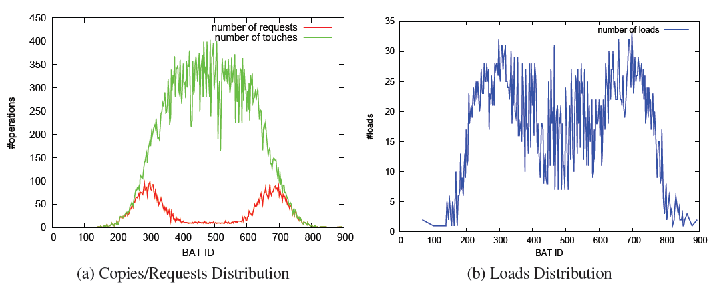
Experiments: non uniform workloads
Notes:
Many queries needing the same data.
The more a Bat is touched, the less number of loads.

Slide 24
Possible extensions
UPDATE queries
Pulsating rings
Nomadic queries

Slide 25
Thank you!
Q&A time!

