Slide 1
PNUTS
PNUTS: Yahoo!’s Hosted Data Serving Platform
Brian F. Cooper, Raghu Ramakrishnan, Utkarsh Srivastava, Adam Silberstein,
Philip Bohannon, HansArno
Jacobsen, Nick Puz, Daniel Weaver and Ramana Yerneni
Yahoo! Research

Slide 2
Motivation And Goals
Web applications:
  Simple query needs
  Relaxed consistency guarantees
  Example: Flickr.com
Widely Distributed Systems
  Earth’s round trip time: 133.7 ms
Goals
  Response time guarantees
  Load balancing
  Scalability, high-availability, fault tolerance
Notes:
PNUTS is a hosted, centrally-managed data-managements service, offering a simplified relational model for web-scale applications. PNUTS offers to web developers a framework for managing the state of their applications, that is stored and replicated over a wide distributed system. PNUTS is designed for application that are made available globally…

Slide 3
Data Model and Query Language
Relational model of data
  Tuples with attributes
  BLOBs
  Flexible schema (JSON)
Simplified query language
  Point access (hash tables)
  Range access (ordered tables)
  Relaxed consistency
Notes:
99.9%

Slide 4
System Overview
Notes:
Regions -> replicas

Slide 5
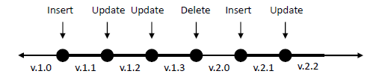
Consistency Model
Per-record serializability
  Record-level mastering
  Events: insert, update, delete
  Master is chooses by locality
Notes:
Every record has a seq number. All replicas apply updates in the same order.
EXAMPLE
(How to serialize instert-ops? See later)

Slide 6
Query Language
Read-any
Read-critical (version)
Read-latest
Write [blind write]
Test-and-set (version) [optimistic transactions]

Slide 7
System Overview
Yahoo Message Broker
  Topic based publish-subscribe
  Guaranteed delivery
Used for
  Distributing updates
  Notification service
Notes:
Regions -> replicas

Slide 8
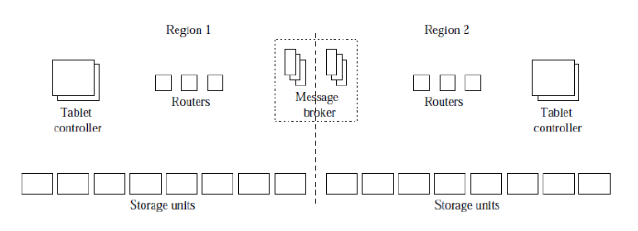
System Architecture
Notes:
Tablets -> partitions (ordered-> MySQL, hashed->Yahoo system)
Routers -> maps tablets (partitions) to storage units (soft state)
Tablet controller -> keep track of the mapping, and make local load balancing decisions

Slide 9
Query Processing
Scatter-gather engine
  Receives multi-record requests
  Splits it and execute in parallel
  Collects the results
  Better usage of TCP stack

Slide 10
Failure Tolerance
Three step recovery
  Request for a remote copy
  Checkpoint-message
  Actual tablet delivery

Slide 11
Experiments
Setup
  Three regions (east, west1, west2)
  128 tablets per region
  1 Kb records
  100 client-threads per region
  Locality: 0.8

Slide 12
Experiment 1 : INSERTs
1 million records insertion
Hash tables (100 clients):
  West 1 : 75.6 ms (per request)
  West 2 : 131.5 ms
  East : 315.5 ms
Ordered tables (60 clients):
  West 1 : 33 ms
  West 2 : 105.8 ms
  East : 324.5 ms
Adding clients -> contention
Notes:
Tablet-master!

Slide 13
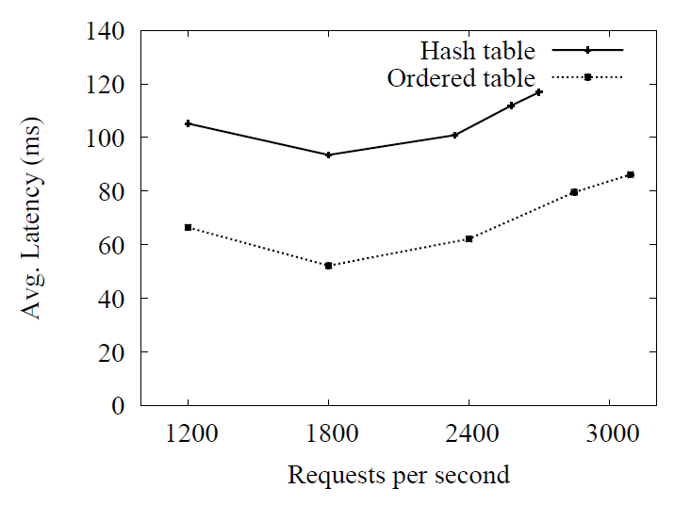
Experiment 2: varying request rate
Notes:
TCP contention

Slide 14
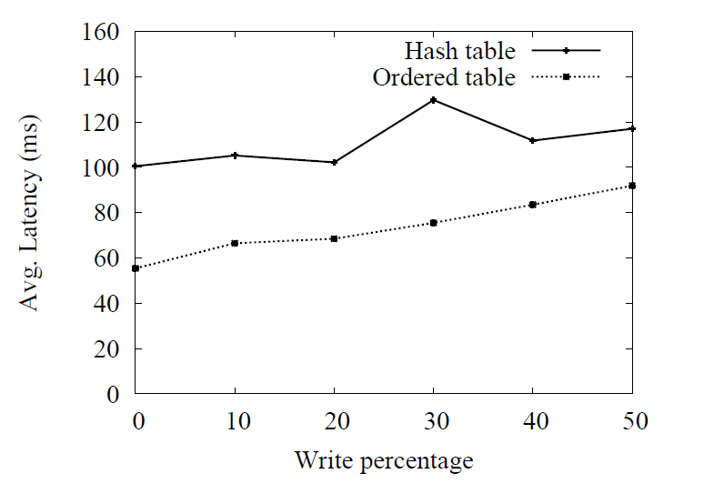
Experiment 3: varying w/r ratio

Slide 15
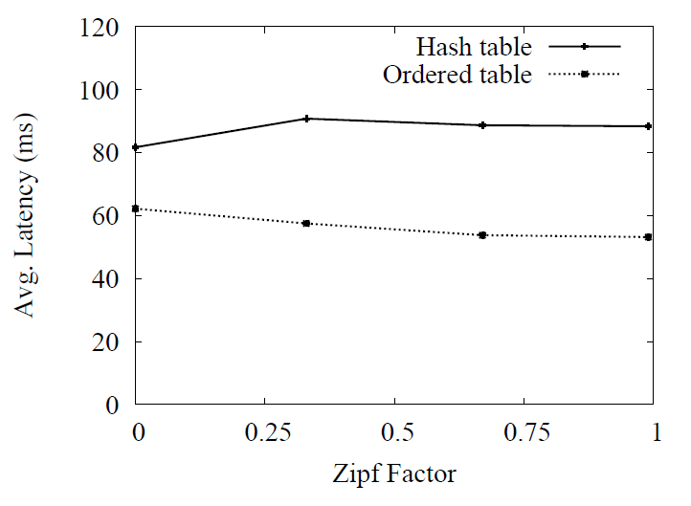
Experiment 4: Zipfian workload

Slide 16
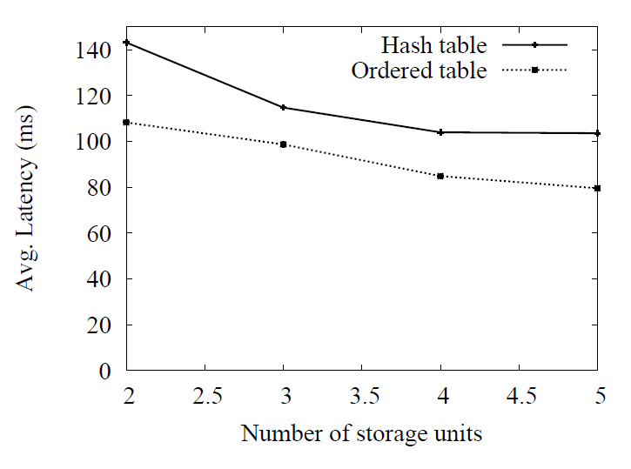
Experiment 5: adding storage units

Slide 17
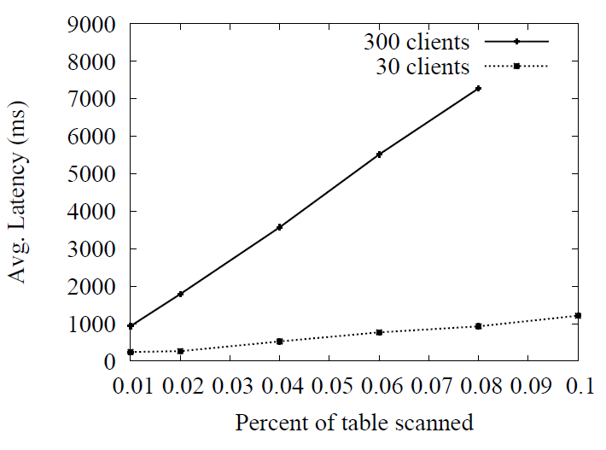
Experiment 6: range queries

Slide 18
Thank you!
Q&A time!

